Slide 1

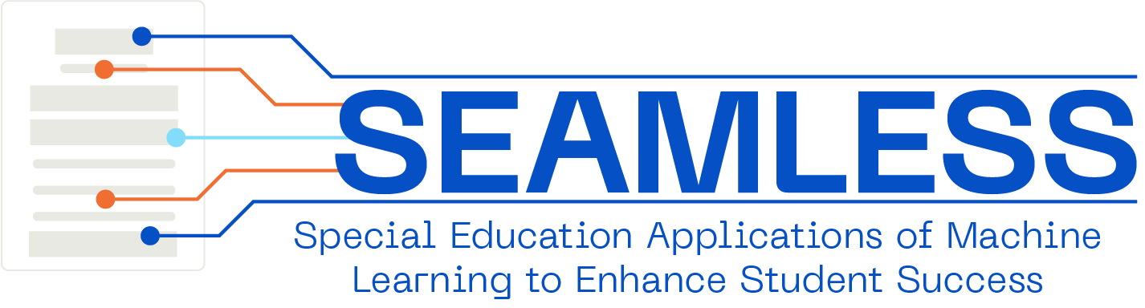
October 1, 2026
Go Beyond Compliance:
Use IEPs to Answer Strategic Questions and Improve Programs
Adrienne D. Woods, PhD
SPDG Directors Webinar Presentation

Slide 2

Ice Breaker
Drop in the chat –
What’s one kind of data you use in your everyday life?
Notes:
Drop an example in the chat. It could be your grocery list, the weather forecast, your calendar, step count, bank balance, commute time, sports statistics—anything!
My example – Oura ring sleep score!

Slide 3

Goals for Session
…through use-case examples from
SRI’s IEP data access and analysis project.
1
Think about how we currently use IEP data at scale
Understand barriers to wider use of IEP data at scale, and how technology advances might fix
2
3
Think about how we can use IEP data at scale if those barriers are removed
Notes:
While you do that, I am going to share our goals for today…
Transition with: “We’re surrounded by data, but what makes data valuable is how we use it to understand something or make a decision—which is what we’ll be exploring today.”

Slide 4


Adrienne D. Woods, PhD
Michigan native, now in Boston.
Younger brother received special education services.
Inspired me to pursue my PhD in Education and Psychology at the University of Michigan.
Quickly realized that we need better special education data to understand how to improve special education for all.
Notes:
Grew up in southeastern MI but now in Boston
(bit of a preview for why I started developing SEAMLESS) I got into special education research because my brother went through the special ed. system, and his experiences really sparked a passion in me for this work. I generally try to understand questions like, “is special ed working? For whom is it working? How can it be improved?” When I started in grad school, one of the first things I noticed was the richest source of data you might need to dig really deeply into those Qs are locked into these very sensitive, text-based IEPs that can vary in their structure, format, and quality from district to district. So I started building SEAMLESS to be the key that unlocks those IEPs, under the assumption that having better access to IEP data at scale could enable data-informed decisions that benefit kids with disabilities.

Slide 5



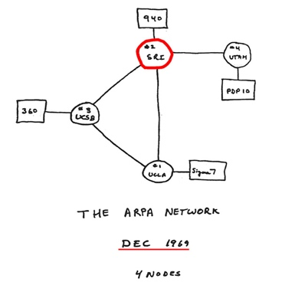
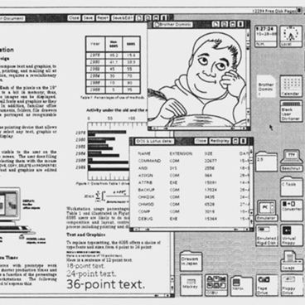







SRI: A legacy of innovation
LIQUID
CRYSTAL
DISPLAY
FIRST
AUTONOMOUS ROBOT
We create and deliver world-changing solutions for a safer, healthier, and more sustainable future.
FIRST
COMPUTER
MOUSE
ARPANET
GRAPHICAL USER INTERFACE
ELECTRONIC BANKING
ETHERNET NETWORKING
ROBOTIC SURGERY
CYBERSECURITY
HDTV
AUTOMATED
DRUG DISCOVERY
SIRI
Notes:
I work at a non-profit research company called SRI International. Founded in 1946 by Stanford University (as Stanford Research Institute), became independent in 1970. HQ in Silicon Valley, CA but >80% of Edu division works remotely.
Our mission across SRI boils down to "how do we make the world a better place?”
We have a long history of being on the frontlines of technological innovation (e.g., we created early versions of the internet and the computer mouse, we developed SIRI, etc.).
Important to note that at SRI, our innovations are typically funded and developed with government $ and research grants. We're not trying to sell a product or make money, but rather to develop ethical and effective solutions that meet real-world challenges. IF they get sold down the line, that’s a bonus, but that’s not our end goal and we’re not funded commercially.

Slide 6

SRI Education Mission
SRI Education works to reduce barriers, optimize outcomes, and ensure educational equity for all children, youth, and families.
We do this by conducting high-quality research, supporting use of data and evidence, and developing tools that improve teaching and accelerate and deepen learning.
Notes:
Alongside our more technology-heavy divisions, SRI also has an education division, where I am. We focus on 3 things: research and evaluation projects; technical assistance to fed, state, local clients; and we develop new tools for teaching and learning. We have a long track record of making the world a better place through our work in disability and inclusion, digital learning and technology, student behavior and well-being, teaching quality, and more.
Now the world is pushing into the AI space, and our priorities are to continue being at the forefront of this innovation. However, regarding kids and especially vulnerable kids, our role is to make sure AI innovations are not only helpful but also ethical – maintain student privacy while they help folks do their job better to improve outcomes for kids and families.

Slide 7
The SEAMLESS project uses artificial intelligence (AI) to make Individualized Education Program (IEP) data easier to access, understand, and use for decision-making through two proprietary tools.
Together, these tools turn IEPs into actionable information, with the goal to help districts:
  Save significant time on manual paperwork and review.
  Identify trends in services, goals, and student progress.
  Strengthen compliance and IEP quality.
  Support data-informed decision-making and program improvement.
Zone Redactor
Automatically removes identifying information from IEPs and converts PDFs into structured datasets that
can be further analyzed.
ClassifyED
Uses AI to organize IEP content (e.g., goals, services, accommodations)
into coded data that can be summarized, compared, and visualized.
Notes:
In service to our strong interest in the responsible use of AI in edu, SRI has been internally funding the R&D of my project, SEAMLESS.
This project has been exploring how we can use AI to make IEPs easier to (SAFELY) access, understand, and use at scale, so to derive insights from across students – for example, by disability group or grade level, or across schools, districts, or states. Also – note that while I’ve been describing IEPs, these questions and this presentation are equally applicable to IFSPs/Part C data!
Under the SEAMLESS project, we created 2 complementary/modular tools – first is ZR, which takes a set of PDFs and does 2 things: (1) redacts user-specified sensitive info, and (2) converts those PDFs into a structured dataset that can support both student-level profiles and aggregate district analytics. ZR is flexible/customizable so it works on any IEP from any software system.
Then, once we have converted a corpus of documents into a single, de-identified dataset, we use ClassifyED to help make sense of the open-ended narrative text within IEPs.

Slide 8


What words come to mind when you think about your state’s IEP data today?
menti.com
9958 6670

Slide 9

We kept hearing…
“We are currently sitting on a mountain of IEP data, but we don’t have a good system in place to make use of that information.”
Notes:
IEPs are the primary source of information on the special education services and accommodations that a child with a disability is scheduled to receive.
But they’re difficult to access and use at scale, meaning beyond serving as a reference document for an individual student

Slide 10
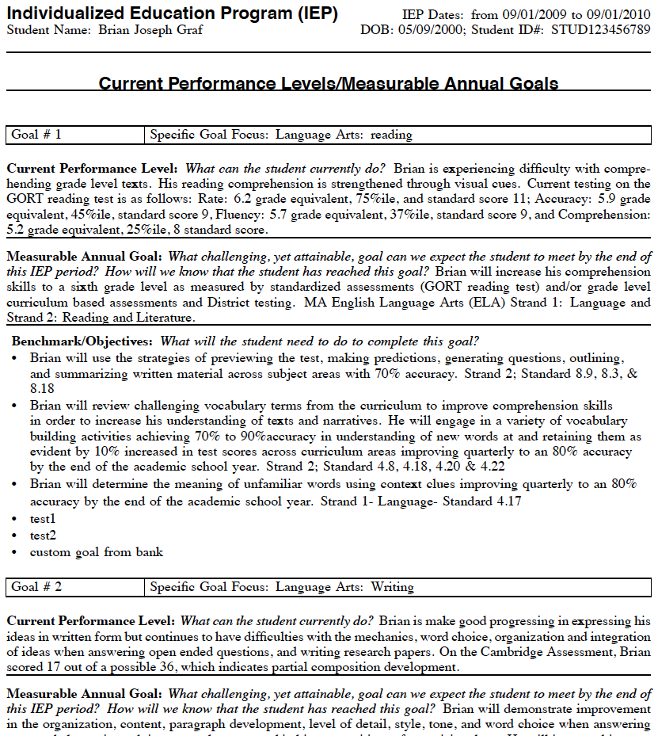
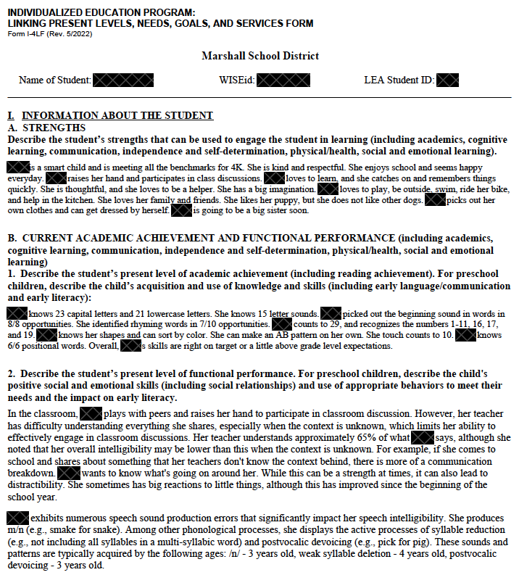
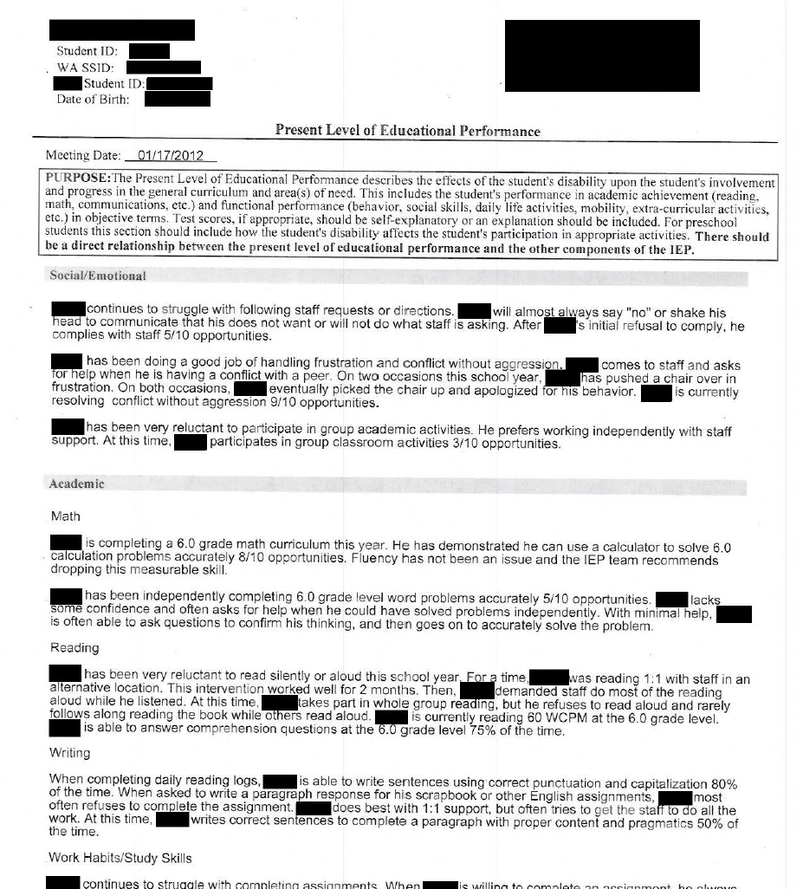
Why are IEP data inaccessible at scale?
Individualized education programs (IEPs) represent the primary source of information on the educational experiences (e.g., goals, services, and accommodations) of students with disabilities.
But IEPs are largely unusable to education leaders at scale because they are mostly text-based, non-standard, and full of sensitive information.
Notes:
…because they are:
(1) mostly narrative text-based – if you wanted to combine info across IEPs, you’d have to come up with a way to code that
(2) full of sensitive personally identifiable information, which has been redacted in this example and makes it hard to share IEPs with folks who might have the capabilities to combine IEPs and analyze what’s in them
(3) Another complication is that while IEPs are all legally required to contain certain information, their format can vary across districts depending on the specific IEP software that a district may use.

Slide 11


What do we mean by “sensitive” information?
When analyzing IEP data, users must maintain compliance with:
FERPA (Family Educational Rights and Privacy Act)
HIPAA (Health Insurance Portability & Accountability Act)
University Ethics Institutional Review Board (IRB) or Ethics Boards
AND EITHER
Ensure de-identification of data if sharing outside of LEA or SEA
OR
Obtain parental consent to share IEP data outside of the LEA or SEA
IRB
Institutional Review Board
AND
OR
Ensure de-identification of data if sharing outside of LEA or SEA.
Obtain parental consent to share IEP data outside of LEA or SEA.
Notes:
A quick note on confidentiality, student privacy, and the ethics of obtaining IEP data –
We have been thinking deeply about how to maintain student privacy while enabling folks to share their IEP data with us so we can help them evaluate their systems and practices.
This means that ANY technology used to access or analyze IEPs needs to maintain compliance with FERPA, HIPAA, and – if you’re working with a research firm or academic institution – IRB
Typically need to either obtain parent consent to share an IEP with an evaluator, or you need to de-identify the documents if sharing outside of LEA or SEA (and that can include for FOIA public records requests).
Data sharing or use agreements should be in place – FERPA also has an exception to its protections if an entity is acting as an evaluator for a district
You should NOT just be uploading IEPs into LLMs and asking them to redact – EVEN if you have a corporate license or workspace!!

Slide 12
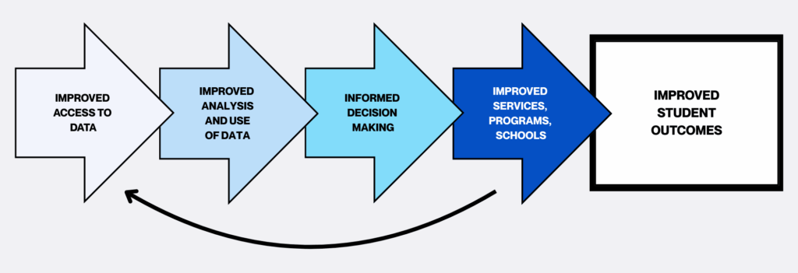
Why improve access to and use of IEP data?
Notes:
But, why do we care about this? What is important about being able to improve access to and use of IEP data
Better access to data improves folks’ ability to use data, which itself leads to improved data systems.
And as that self-improving cycle repeats, key players are better able to make data-informed decisions that will ultimately and eventually lead to improved student outcomes

Slide 13



What do we mean by “scale?”
TYPE
PURPOSE
EXAMPLES
SATELLITE DATA
Large grain size
Point us in a general direction for further investigation
Patterns of achievement, equity, teacher quality, teacher retention
MAP DATA
Medium grain size
Identify student skill gaps (e.g., decoding, fractions) or instructional skill gaps for teachers
Point us in a slightly more focused direction
Inform and shape our next moves; Require focused listening and observation
Understand experiences, misconceptions, mindsets of students, parents, staff; monitor student’s internalization of skills
STREET DATA
Small grain size
Adapted from Shafir, S. & Dugan, J. (2021) Street Data: A Next-Generation Model for Equity, Pedagogy, and School Transformation.
Notes:
Most of us are accustomed to using IEP information as street data: looking closely at one student’s strengths, needs, goals, services, and experiences.
That small grain size is essential because the IEP is fundamentally an individualized document—but it makes it difficult to see patterns across hundreds or thousands of students.
When I talk about analyzing IEP data at scale, I’m talking about moving up to the map or satellite level: looking across students, schools, districts or other LEAs, and potentially an entire state.
At the map level (with current district partners), we might ask: What needs appear most frequently? How well do goals align with those needs? Where might there be gaps in services or supports?
At the satellite level, we can examine broader patterns—such as whether students’ experiences differ across grade levels, disability categories, schools, or LEAs.
The goal is not to replace the street-level view or lose the individual student’s story. Map and satellite data help us identify where to look more closely; street data help us understand what is happening and decide what to do.

Slide 14
Two quick polls:
Digital IEP Software Platforms
We have a required state-adopted digital IEP software platform.
We have a recommended state-adopted digital IEP software platform.
We do not have any requirements or recommendations; districts are free to choose their own IEP software platforms.
I’m not sure.
IEP Forms or Templates
We have a mandated statewide IEP form or template.
We have an optional or recommended statewide IEP form or template.
We do not have any mandates or recommendations; districts are free to create their own IEP form or template.
I’m not sure.
As of December 2024 –
20 states had state-adopted IEP platform:
Mandated use in 8 states
Optional use in 12 states
As of December 2024 –
44 states had state-adopted IEP forms:
Mandated use in 18 states
Optional use in 26 states
Prater, S. et al (2024, December). Individualized Education Program (IEP) Form and Digital Platform Landscape Analysis.
American Institutes of Research.

Slide 15
You may experience issues harmonizing data across LEAs within your state…
District A
District B
District C
Extracting Insights
Common State Template
…If you don’t have a required digital platform or common IEP template and want to review current data.
…If you switch to a new digital platform or adopt a common IEP template and want to review historical data.
Notes:
Let’s say you don’t have a mandated platform and many or all of your districts use different platforms… if you want to extract insights, you’ll need to do a LOT of data harmonization
- Might fall on individual districts to do, which could be harder for smaller districts who lack an IT/data management dept
If you wanted to switch to a new IEP platform…
Districts are going to stress about this harmonization, AND
If you ever wanted to “look back” at historical data, you’d need to harmonize that as well

Slide 16
What do we mean by “harmonize?”
Example 1: Free-text entry of services provided in state database of IEPs.
Service Category Examples in IEPs | # Unique Descriptors
Direct speech language services | 54
Direct speech services
Group speech and language
Group speech and language therapy
Related service: speech/language therapy (1%)
Related speech/language therapy (1%)
RELATED – speech/language
Speech
Speech language
Speech/language
Speech/Language Therapy.
Speech language therapy
Speech+ add. support & mtgs not to exceed 4 hrs/mo
Many IEP systems allow for the use of free-text entry fields.
These free-text entry fields will produce variations in terminology across a data set even within a district.
This problem expands as the number of authors increases.
Notes:
What do I mean by “cleaned” and “coded?” Here’s an example from one state ED database. Because the fields for the child’s proposed services were free text entry-based, folks were writing in different variations of essentially the same service. E.g., 54 different ways that folks indicated the child was receiving speech and language services.
This is a common problem that you encounter with text-based data, and it exacerbates as the number of IEPs increases (and the number of authors of IEPs, who all have a slightly different way of describing the same thing)

Slide 17
What do we mean by “harmonize?”
Example 2: Free-text entry of annual goal area or topic within one ISD’s IEPs
SEAMLESS coding taxonomy
Executive Functioning Skills | Social-Emotional Skills | Behavioral Regulation Skills
Task Monitoring Organization of Materials Plan/Organize Initiation Working Memory | Relationship Skills Social Awareness Self-Management Self-Awareness Responsible Decision-making Self-Advocacy | Inhibition Externalizing Self-Monitoring Attention/On-Task Emotional Regulation
Annual goal areas listed in one ISD’s IEPs
Goal area | Number | Percent
Socio-Emotional/Behavioral | 204 | 10%
Executive Functioning | 8 | <0.5%
Executive Functioning Skills | 3 | <0.2%
Executive Functioning, Work completion/handing in assignments, Working independently | 1 | <0.1%
Attention | 3 | <0.2%
Study Skills | 3 | <0.2%
Study Skills/Organization | 1 | <0.1%
Study/Organizational Skills | 1 | <0.1%
Organization | 1 | <0.1%
Following Directions | 1 | <0.1%
Self-monitoring | 1 | <0.1%
Perception/Motor/Mobility, Visual Motor Skills, Self- help, Self-regulation | 1 | <0.1%
Cognitive | 1 | <0.1%
Academics | 1 | <0.1%
Perseverance with Challenging Academic Tasks | 1 | <0.1%
Independent Functioning | 1 | <0.1%
Independent work | 1 | <0.1%
School Readiness Skills | 1 | <0.1%
Functional Academics | 1 | <0.1%
All Social-Emotional/Behavioral/EF Statements | 235 | 12%
Total Number of Annual Goal Statements | 2,037 | 100%
Comparison of manual vs. SEAMLESS Coding
Rather than manually code the variation in executive functioning skills listed in IEPs, our AI-based system allows us to capture those skills regardless of the overall title of the goal.
Since these three skill categories may frequently overlap, our taxonomy allows us to capture skills that might appear across multiple goal areas.
Notes:
Here’s another example, and I’ll also show how we addressed this with SEAMLESS – to the left, we created an expert coding taxonomy of skill domains and subskills listed in IEPs. Three of those domains are EF, SEL, BR
To the right is a list of all the annual goal areas that were written into this district’s IEPs that our AI-based system coded as having an EF, SEL, BR goal.
You can see again that a lot of these are very similar in name, some more descriptive than others.
Sometimes, these skill domains overlap – so a goal could be both about
executive functioning (organizing materials) and behavioral regulation (paying attention); OR
Social-emotional skills (Responsible decision-making) and behavioral regulation (emotional regulation)
Allows for flexibility with the messiness inherent in really individualized data without forcing categories onto folks.
But if you didn’t have our system, you’d probably have to do all of this by hand – and you can see that in this one district there were over 2000 goal statements alone.

Slide 18


What insights can you CURRENTLY extract from your state’s IEP data?
SILENT IDEATION IN PADLET
Notes:
3 minutes?
https://padlet.com/adriennewoods/what-insights-can-you-currently-extract-from-your-iep-data-a-s0242ny0gqa1rfqn83s0

Slide 19



transforms IEPs into policy-ready insights
93% of principals¹ and 98% of superintendents² have said they would feel “more confident making decisions with better access to data.”
¹Data Quality Campaign (2021).
²Data Quality Campaign (2022).
Notes:
I’d love to take a few moments to share more about how the SEAMLESS tools work before we start thinking about what we can do with our IEPs.
This project and these tools arose because we were approached by a district who had questions about their student population and special ed programming, and they were overwhelmed by the number of IEPs they’d need to go through. Right now, leaders who want to better understand these systems-level questions would need to spend hours/days combing through individual documents to manually compile information or fighting with their IEP software provider to produce custom ad hoc reports that were still often limited in scope. (CLICK) They wanted to know if our research could help turn this paperwork into actionable insights.
This is where we realized that before we were able to analyze any information across students or schools or programs, we needed to figure out how to actually gain access to those IEPs in a safe and ethical way and convert them into a more usable set of data…

Slide 20
reduces the burden of accessing de-identified IEPs
LEA staff manually redacting IEPs
Researchers/
evaluators training staff to code IEP
data
Researchers/
evaluators obtaining parental consent or access to administrative data
Heaviest burden
Burden of
time/effort to access data
Zone Redactor
De-identifying IEPs
Lightest burden
<10
50
100
>500
# of IEPs required
Notes:
The only way that district would share the IEPs with us as researchers was to either have staff manually redact them (and they had tens of thousands) or try to obtain parental consent. This initial partnership actually fell apart because they knew it was going to be too time-consuming to do either option. (CLICK) So we have created Zone Redactor to reduce that difficulty access.
Whereas one of our district partners estimated that manually redacting 6 IEPs took her ~1.5 hr, ZR redacts 6 IEPs in about 30 seconds. The burden of using Zone Redactor is roughly the same whether you feed it a handful of IEPs or hundreds of IEPs.
ZR is also a system that our partners could choose to operate entirely on their end so they have full control over all student data and only ever share the de-identified versions with us.

Slide 21
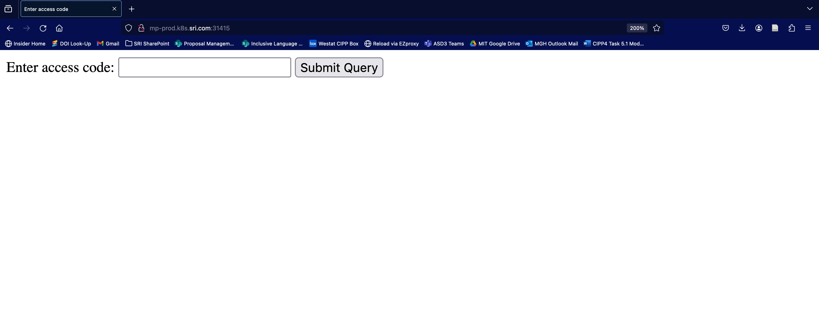
client de-identification interface view, process
Notes:
If you were our partner, here’s what you’d see with Zone Redactor.
First, you will put all of the IEPs you want to redact in a folder somewhere on your computer.
BY THE WAY – this also works with spreadsheets that you could download from an IEP platform – this example uses PDFs
Then, you navigate to a website that is hosted in a protected environment inside SRI.
Each participating organization has a different access code (PLAY) that tells the software which IEP platform or template you use.
When you’re in, you select the folder of data and then confirm redaction.
This folder contains only two files for demonstration, but Zone Redactor can handle as many files as needed.
Any files that you upload here are only stored temporarily inside this protected environment and deleted as soon as redaction is complete. Nobody can retrieve these files on the back end.
As you can see, redaction takes about ten seconds or less per file.
Once it’s complete, you have the option to download a zip file with the redacted documents included.

Slide 22
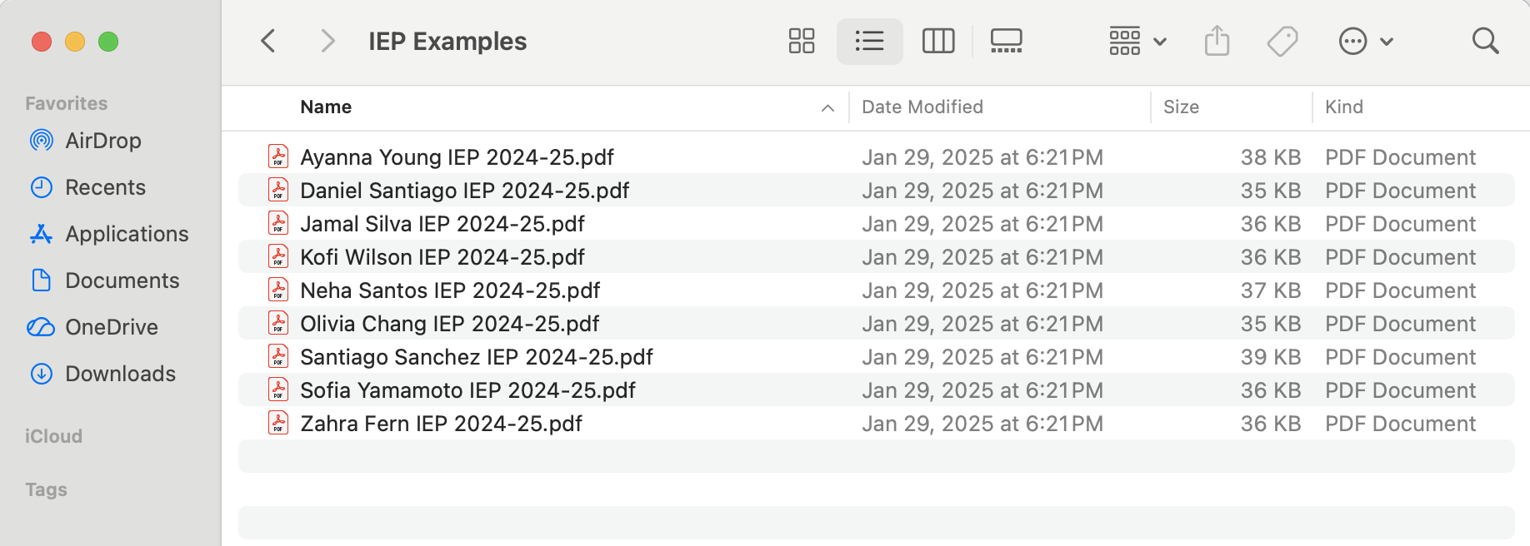
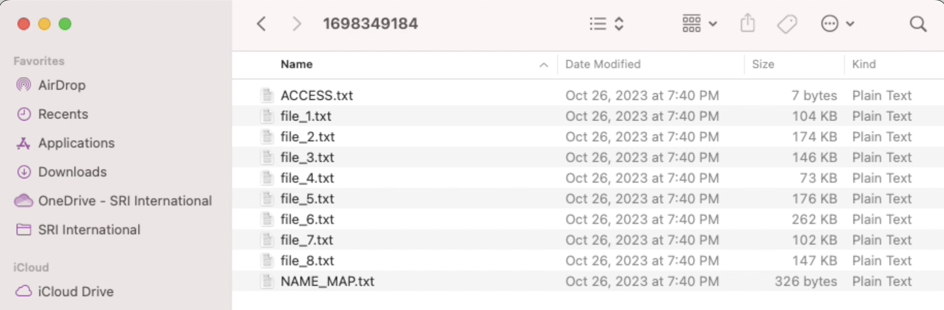
De-identified files are also automatically renamed during download to further preserve privacy
Original Folder and Files
The download includes a cross-walk to map the renamed files to the original file names
Downloaded Folder with Redacted Files
Notes:
Most IEPs also contain sensitive info in the file names. So ZR renames each redacted file to prevent this and creates a crosswalk to link back to the original file. Clients can then review the redaction for each file to confirm it worked as expected and share these files outside of their organization.

Slide 23
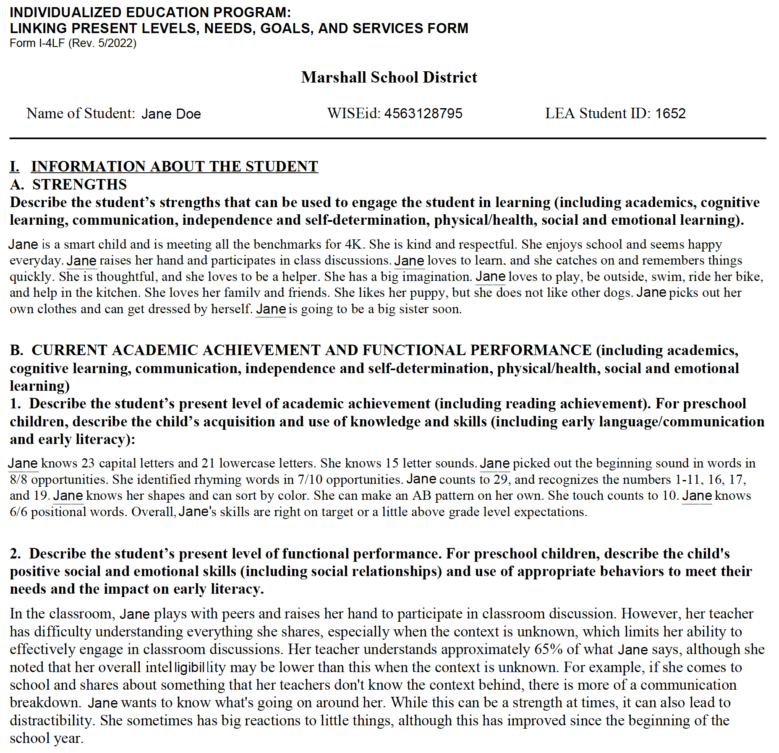
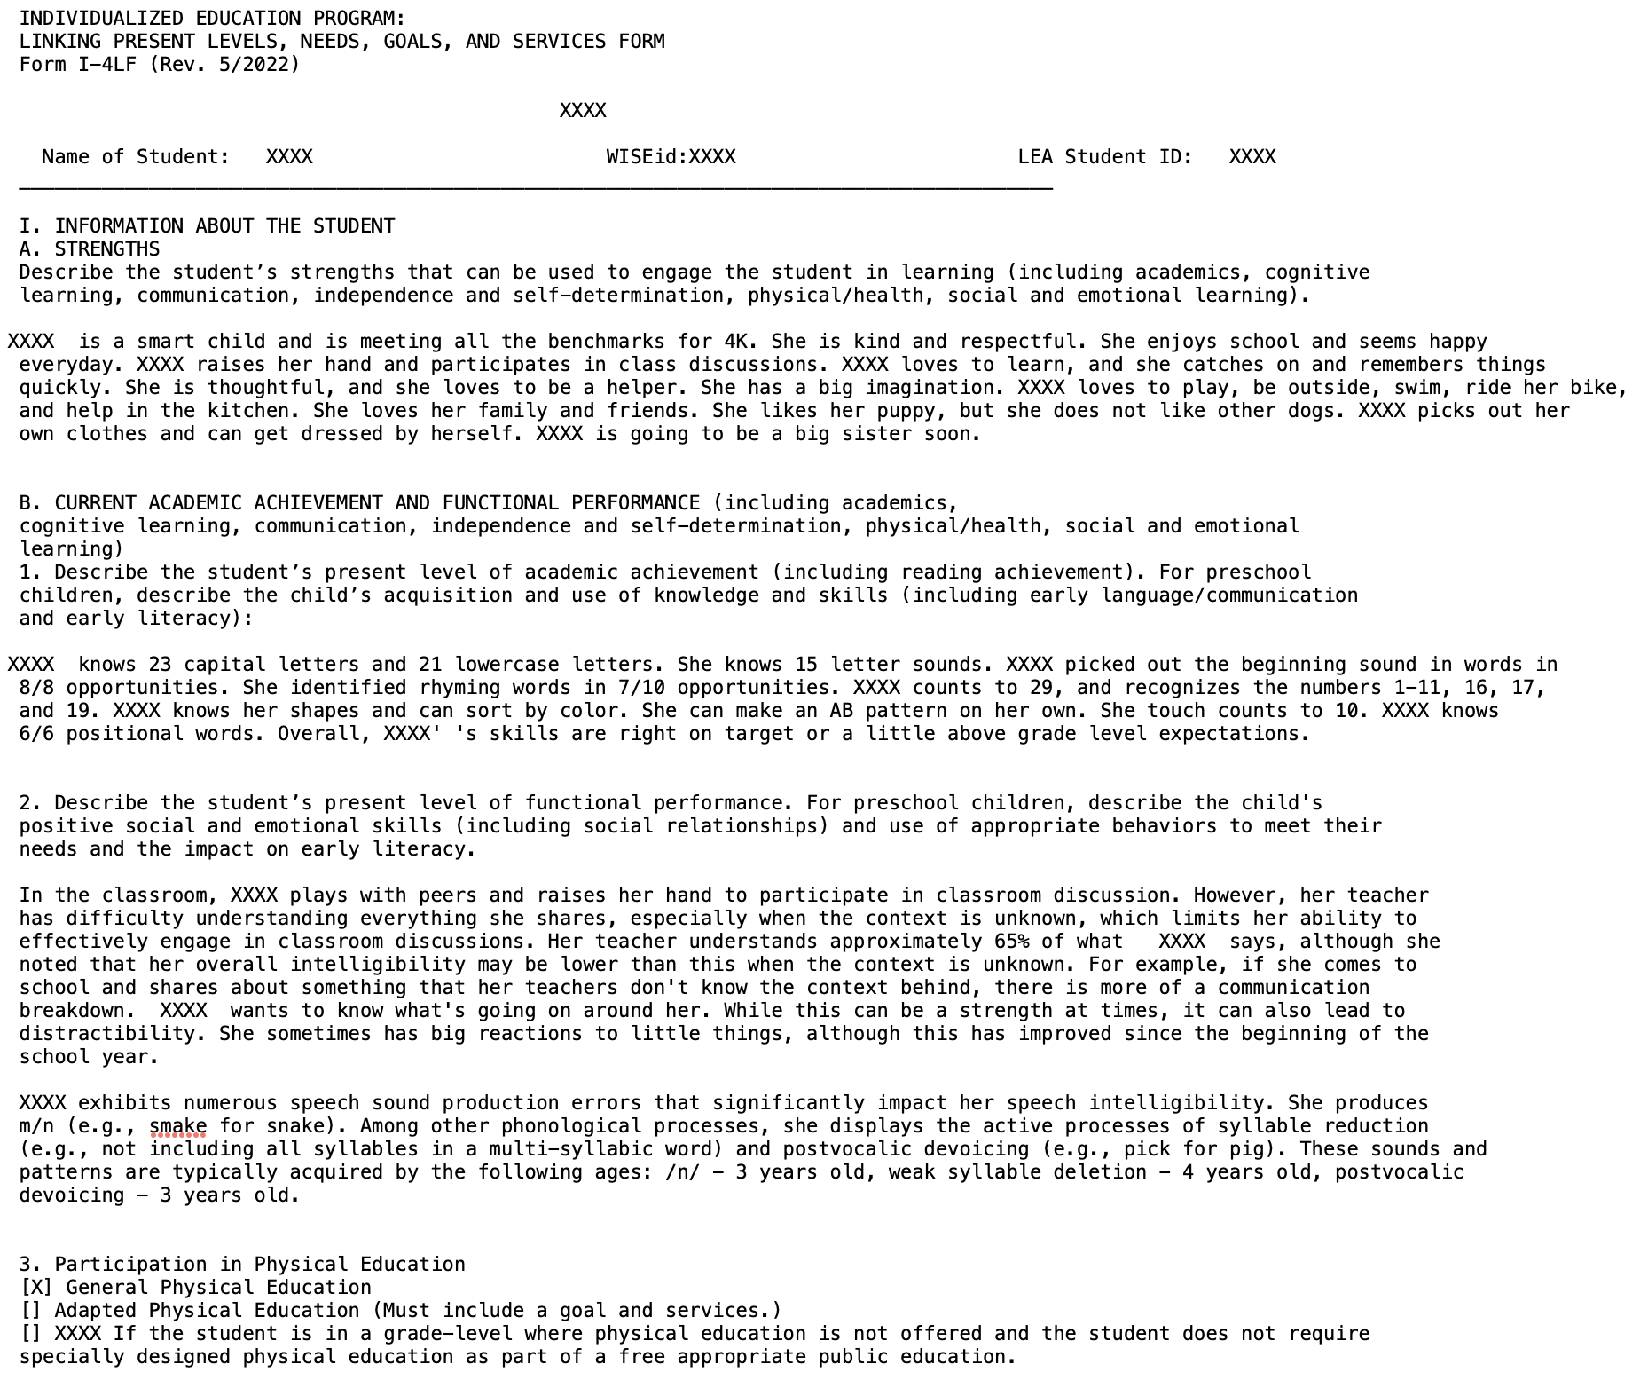
De-identification – before and after
Notes:
Here’s the before and after – you can see that all sensitive info including names & IDs are replaced with a series of XXXX’s

Slide 24
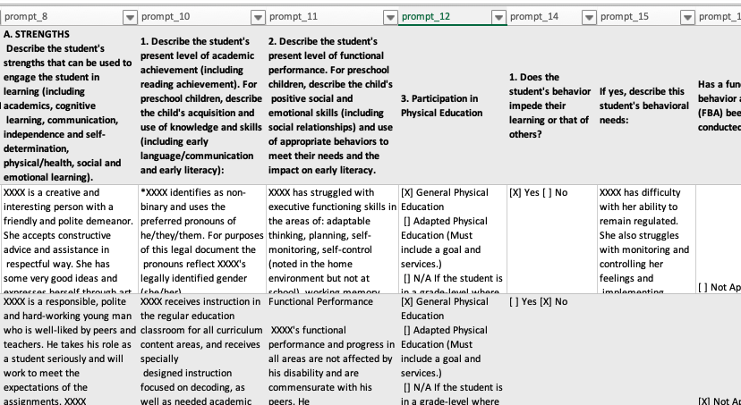
also converts PDFs into spreadsheets
Notes:
Take those PDFs and turn them into de-identified spreadsheets…
If you had hundreds of IEPs, you could set up ZR to run, go get a coffee or go to a meeting, and when you come back – not only do you have de-identified data, but you also have a dataset of information instead of individual documents. The idea from there as researchers was once we had access to IEPs, we could analyze them and help districts make data-informed decisions.
I also point this out to show you – Let’s say you already have a state dataset of your IEPs. Odds are, even if your data are already in some sort of downloadable spreadsheet or report, they’re still full of PII because so much of the IEP is free text entry and full of names (see XXX’s), and they may be minimally cleaned or organized or coded, if at all.

Slide 25
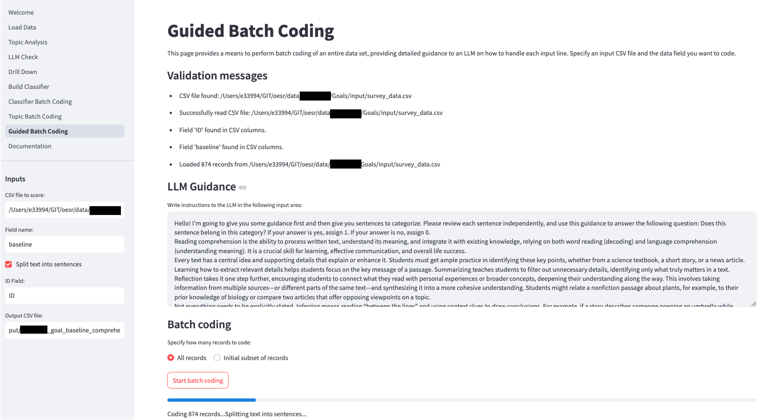
then codes the de-identified data according to user specifications
User can code whole paragraphs or individual sentences
User specifies coding guidance and requested output
Progress is displayed as each IEP is coded
Notes:
Once you have those spreadsheets de-identified, you upload them into our second tool, ClassifyED, which allows the user to specify their own coding schemas and how they want the coded data to appear; users can code whole sections of an IEP or go sentence-by-sentence.

Slide 26
creates cleaned, analysis-ready datasets
Unstructured IEPs
Example Cleaned Data, post SEAMLESS tools:
 | Primary IDEA Disability Category | Primary LRE Setting | English Learner | Second Language Included in IEP | % of Time in Regular Education Classroom | Evidence of Family Engage-ment | Transition Plan Included
IEP_1 | SLI | Gen Ed | Yes | Yes | 82 | Yes | N/A
IEP_2 | OHI | Gen Ed | No | N/A | 98 | No | Yes
IEP_3 | ASD | Specialized Setting | No | N/A | 45 | Yes | No
IEP_4 | SLD | Gen Ed | Yes | No | 72 | Yes | N/A
… | … | … | … | … | … | … | …
Vendor agnostic – built for research across multiple systems, so designed to be flexible to different file formats & redaction capacities.
Designed for IEPs, but can work with any set of structured documents
Notes:
And at the end of it all, you have moved from unstructured, messy files to cleaned, coded, analysis-ready datasets.
This system is vendor-agnostic, meaning it works with IEPs from any IEP software platform, AND it’s document-agnostic – could work with any set of documents that follow the same layout beside just IEPs

Slide 27
solves practical issues
District Leadership
SEA Leadership
Monitor for substantive + procedural compliance with the IDEA.
Inform professional development.
Forecast staffing needs.
Efficiently monitor individual progress toward goals given types or amounts of IEP services.
Improved state required reporting capabilities.
Develop more efficient partnerships with researchers and program evaluators.
More easily link relevant IEP data to other data sources, like cumulative education files, state information and longitudinal data systems.
Quicker assessment of state and federal funding and compliance.
Improved required federal reporting.
Identify model programs and areas for additional development.
Evaluate and improve policy and guidance.
Notes:
I’m not going to spend too much time here, suffice to say that we’ve built and tested this system with about a dozen district partners, so we’ve been focused on the column to the left – but we think there could be just as if not more value in the insights we’re derived from IEPs at the state level, including to help
Link data across systems
Speed up funding & compliance reporting, including SPP/APR
Identify which LEAs within your state are doing really well and which ones need support
Evaluate and improve policy/guidance
I also say this because for every single district we’ve delivered insights to, their first question is always “How are we doing relative to other districts in our state that you’ve worked with?” And frankly, we don’t have the answer yet – because we’d need more data points across/within states!
If the following slides or ideas resonate with you, please reach out – we’d love to connect to see how we can better support you.

Slide 28

What could you do with your IEPs at scale?
Zoom poll
I have never thought about my state’s IEP data beyond required reporting
I have wished we could dig into our IEP data more (beyond required reporting), but don’t know how
We have done some analyses of our state IEP data beyond required reporting, but want to do more
We regularly analyze our state’s IEP data beyond required reporting
Notes:
So with that – let’s talk more about how YOU would want to work with your IEPs at scale!
…poll…
Next, let’s talk about some ideas for using your IEP data at scale, meaning across districts within states.

Slide 29


Evaluate critical questions to inform policy and practice
What could you do with your IEPs at scale? You could…
Combining data from IEPs with state information systems (SIS) and longitudinal data systems (LDS) may answer questions like:
  How well do local education agencies (LEAs) within a state adhere to procedural and substantive compliance?
  Are there patterns in service delivery for certain groups of students, or across different LEAs/SEAs?
  How effective are special education programs? Where are they most effective?
  What professional development may be needed? For which LEAs?
“A high-quality statewide data system provides the information needed to address important questions about early intervention and early childhood special education.”
https://dasycenter.org/resources/critical-questions/
Notes:
But what are those questions? What should data users, such as program directors, advocates, and policymakers, be asking?
SRI has led the DaSy Center for almost 15 years
Developed a list of critical questions that leaders can ask with regard to Part C EARLY CHILDHOOD special ed., but these are also useful for brainstorming parallel questions about Part B K-12 special ed
<put link in the chat>

Slide 30
Examples of DaSy Critical Questions
What could you do with your IEPs at scale?
1.B.1.) What are the characteristics of the services and supports provided to children/families receiving special education services?
1.B.1.a.) What percentage of children receiving special education services were planned to have each type of service (e.g., occupational therapist, physical therapist) according to their IEP within a given time period (e.g., the past month or year)? 1.B.1.b.) What percentage of children received each type of service within a given time period (e.g., the past month or year)? 1.B.1.c.) What amount of each type of service (e.g., frequency, intensity, total hours) do children receiving special education services receive? 1.B.1.d.) What is the relationship between the amount of services planned and the amount of services received?
Notes:
Here’s one set of questions to peruse – in a nutshell: how many children are planned to receive difference types of services, vs. how many children actually received those services? Did the planned frequency/intensity, total service hours map onto the actual amount of services received?

Slide 31
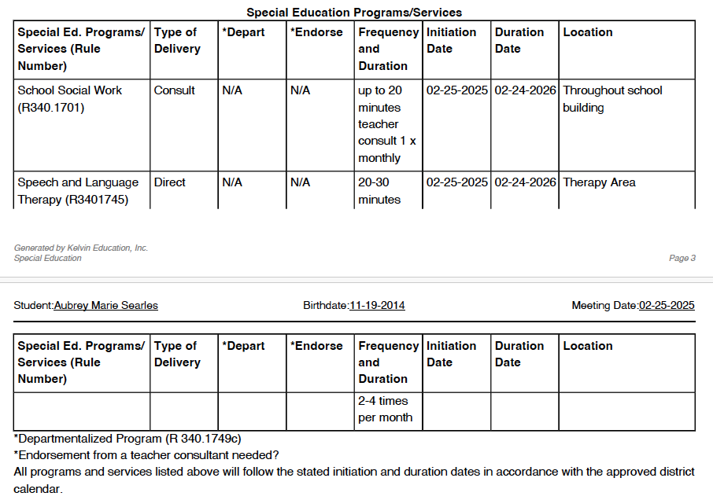
Real Example – Calculating Service Minutes
What could you do with your IEPs at scale?
Minimum = 1 minute, 1 time per month
Maximum = 20 minutes, 1 time per month
0.25–5 minutes per week
Most IEPs contain a range of service minutes per program, as in the example at right.
We identified the minimum and maximum frequency and duration of each service, then converted these into average range of minutes or hours per week.
Minimum = 20 minutes, 2 times per month
Maximum = 30 minutes, 4 times per month
10–30 minutes per week
Program | Delivery | # IEPs | Average Weekly Duration per IEP | Total Weekly Duration Across IEPs
Speech and Language Therapy (R3401745) | Consult | 10 | 2–5 minutes/week | 20–45 minutes/week
Speech and Language Therapy (R3401745) | Direct | 210 | 12–35 minutes/week | 43–123 hours/week
Notes:
In that vein, here’s an example of an initial analysis we did to start identifying types and amounts of services. Every district partner we’ve had has wanted to know how much service time they have written into IEPs for different kinds of special ed. programs/services to make sure they are staffing the appropriate number of providers.
Total weekly duration per IEP & across IEPs – can then start to link that back to other types of data to answer those critical questions

Slide 32
Evaluate the quality or content of IEPs
What could you do with your IEPs at scale? You could…
States are increasingly making substantial investments to promote the development of high-quality IEPs. National survey data from the 2019-2020 school year tells us: ¹
22 states provided a rubric describing features of quality IEPs, including appropriately ambitious IEP goals.
15 states provided IEP coach, mentor, or facilitator to assist with writing the IEP.
23 states provided other resources to promote the quality of IEPs.
Nearly all (97%) districts conduct periodic review of completed IEPs and most (78%) monitor the services and supports specified in the IEP. ²
These tasks are primarily accomplished by reviewing IEPs. Nationally: ³
55% districts conducted formal assessment of IEP quality based on a checklist or rubric.
61% districts formally assessed IEP goals to ensure they were appropriately ambitious.
88% districts reviewed records of IEP meeting attendees to ensure there was appropriate representation of all key parties.
Source: Potamites, E., Lai, I., Coopersmith, J., Larson, A., Lipscomb, S., and Johnson, A. (2023). ¹ 2019-2020 state survey on IDEA programs for school-age children (question E3). ² 2019-2020 district survey focused on IDEA programs for school-age children (question D7). ³ 2019-2020 school survey focused on IDEA programs for preschool-and school-age children (question B2).
Notes:
You could also evaluate the quality or content of your IEPs, which is something many states are already taking on (drop a thumbs up in the chat if you’re one of them!)
Even though states are increasingly investing in the development of high-quality IEPs (e.g., through rubrics, coaches, or other resources), it seems like they’re mostly relying on districts to provide this information
– and, almost all districts are conducting these periodic reviews by assessing IEPs one at a time including against a rubric or checklist. I’ll show you an example.

Slide 33
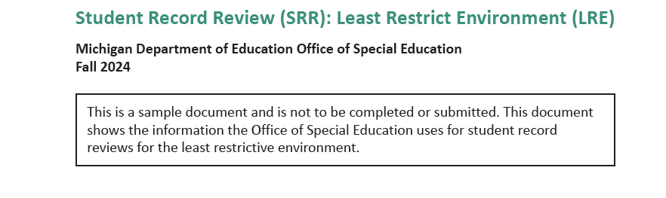
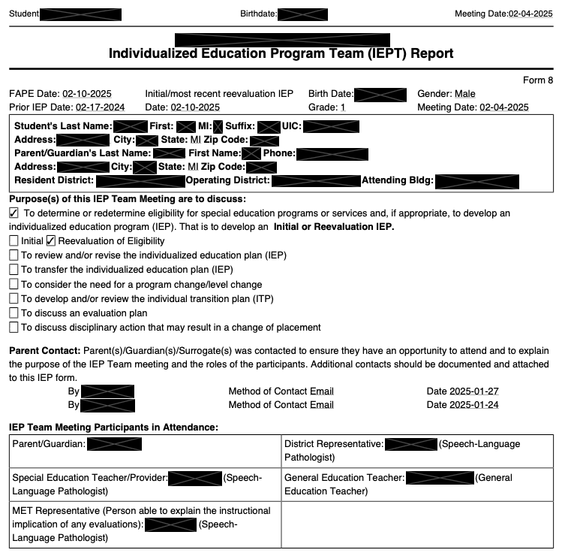
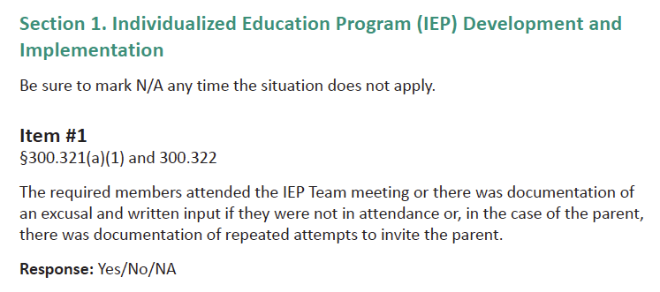
Example Record Review Checklist from Michigan
What could you do with your IEPs at scale?
Notes:
States must have a reasonably designed general supervision system where LEA ISD is monitored at least one time within a six-year cycle. Michigan’s OSE is monitoring their ISDs in cohorts of 10 participants each year. The first cohort was initiated in the fall of 2024.
This checklist has ~25 questions about the IEP setting and LRE, and was created to review student records for one student at a time.
One district estimated that it took a team of folks a full hour to go through this checklist with something like 2 IEPs. If you could automate this process, you would save tremendous amount of time and money, and it would allow states and districts to make better use of their own data to prepare for these kinds of audits.

Slide 34
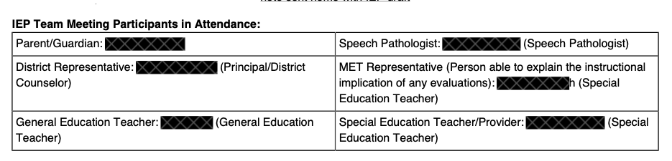
Item 1) Did parents and students attend the IEP meeting?
What could you do with your IEPs at scale? (Example Records Review)
§300.321(a)(1) and 300.322 – The required members attended the IEP Team meeting or there was documentation of an excusal and written input if they were not in attendance or, in the case of the parent, there was documentation of repeated attempts to invite the parent.
  SEAMLESS Findings
Parents and students were coded as present (1) or absent (0) from a Participants field, such as below.
Parents were absent from:
  MI ISD 1: 14% IEP team meetings.
  MI ISD 2: 27% IEP team meetings.
  MI ISD 3: 21% IEP team meetings.
Age-appropriate students were absent from:
  MI ISD 1: 2% IEP team meetings.
  MI ISD 2: 1% IEP team meetings.
  MI ISD 3: 12% IEP team meetings.
Parent = 1
(present)
Student = 0
(absent)
Notes:
I’m going to show you 2 examples of questions from this LRE checklist that we helped review for our MI district partners

Slide 35
Item 1C) If parents did not attend IEP meeting, were they invited early enough to reasonably attend?
What could you do with your IEPs at scale? (Example Records Review)
§300.322(a)(1),(2) – If the parent(s) were not in attendance, is there evidence they were invited early enough to ensure they would have an opportunity to attend…? How early was the parent invited?
SEAMLESS Findings | MI ISD #1 | MI ISD #3
Average first invite to parents | 21 days before the IEP meeting. | 17 days before the IEP meeting.
Did the timing of the first invite differ for parents who did or did not attend? | No significant differences in timing of first meeting invite. | No significant differences in timing of first meeting invite.
Average last invite to parents | 7 days before the IEP meeting. 25% contained last invitation dates that fell on or after the IEP meeting date listed. | 6 days before the IEP meeting. <1% contained last invitation dates that fell on or after the IEP meeting date listed.
Did the timing of the last invite differ for parents who did or did not attend? | Last invitations for non-attenders were sent significantly closer to the IEP meeting date than IEPs where parent attended. | No significant differences in timing of last meeting invite.
*This information was not available in IEPs from MI ISD #2
Notes:
Avg Date of first invite about 2.5-3 weeks before IEP meeting, avg date of last invite was about 1 week before.
Comparing the IEPs of parents who did or did not attend, we did not observe significant differences in how early the ISD FIRST invited parents – but we DID observe that in district 1, the final invitations were sent significantly closer to the IEP meeting date – and about a quarter of IEPs strangely contained a date of last invite that occurred after the IEP meeting, suggesting maybe their staff were using this field as a general documentation of parent contact that didn’t make much sense.
So our advice to ISD #1 was to review IEP documentation guidance and to review policies for inviting parents to make sure they’re getting reminders earlier

Slide 36
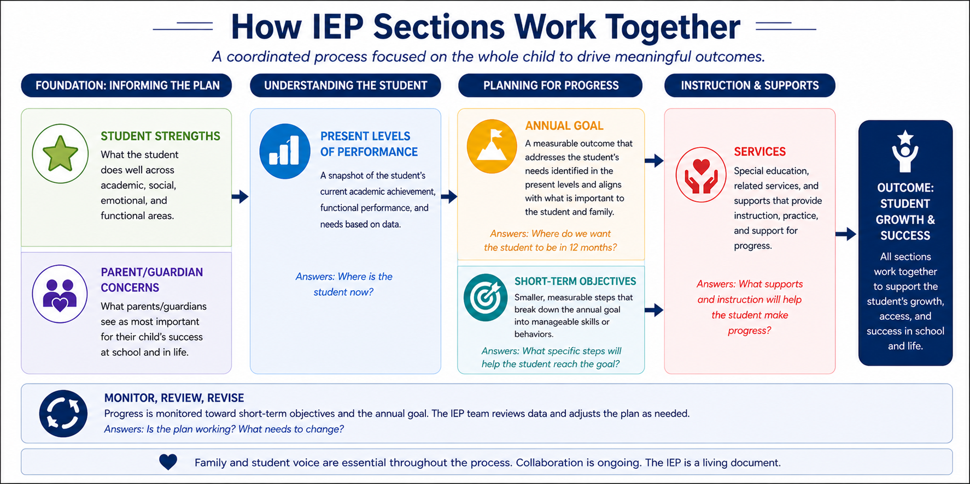


Evaluate whether and how IEP sections work together as intended
What could you do with your IEPs at scale? You could…
STUDENT NEEDS
What the student needs
support with to access,
participate in, and make
progress in school.
Notes:
Quick primer/review of IEP sections & how they work together as we move into our next section… these are the sections that typically appear in IEPs.
How do different sections of the IEP map together to explain a student’s needs, goals, and the services she requires to be successful?
Next, I’m going to have you think like a data scientist!

Slide 37
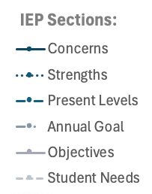
What similarities or differences do you notice about each ISD’s IEPs?
ISD #1
Overall, prevalence trends look similar across both ISDs
62% of IEPs mention social-emotional skills in the statement of student strengths. Otherwise, skills are mentioned less frequently in strengths section than ISD #2.
ISD #2
Largest gaps between Needs/Present Levels and Goals tend to appear for executive function, behavioral regulation
All skill categories are referenced least often in parent concerns
Strengths more frequently overlap with needs and goals in ISD #2, suggesting teams may be framing areas for growth within students’ broader skill profiles.
Needs section only present in ISD #2’s IEPs! Needs parallels ISD #1’s Present Levels
Gap between needs & other sections re: functional skills
Notes:
(~5 mins) Legend @ right = sections from last slide
X-axis = skill domains we coded for (functional skills = adaptive, self-help, life skills, independent living, etc.)
Y-axis = percent of all IEPs in that ISD that mentioned the skill somewhere in that section.
e.g., ~65% of ISD #1’s IEPs mention reading skills somewhere in the student’s present levels section.
Feel free to come off mute or drop observations in the chat!
Some similarities:
Similar prevalence trends across both ISDs: e.g., about 50-60% of IEPs mention reading skills in PLAAFP, A Goal, ST Objectives
Parent concerns reference these skill categories least often – why? Do they just not have concerns, or are they describing something else about their child than their skills?
Largest gaps: EF, Beh showing up far more often in needs/present levels and not in goals – could that present an issue with substantive compliance?
Some differences:
ISD #2’s IEP software contains a section for student needs, whereas ISD #1’s software does not! And, while clearly related, Needs seem to more closely parallel ISD #1’s present levels than ISD #2’s present levels.
ISD #1 Strengths: maybe they’re overly focusing on student strengths re: social-emotional skills but underfocusing on other skill strengths (e.g., math skills that are strengths)
ISD #2 strengths: they may be better at creating person-centered IEPs than ISD #1
ISD #2: functional skills: identified as need, but not being addressed? Showing up in transition plans instead of goals sections?

Slide 38
Identify professional development (PD) opportunities or case studies
What could you do with your IEPs at scale?
IEP Sections:
Behavioral skills are documented most often in student needs or present levels sections across grades (especially early on) but less consistently appear in goals and objectives.
Notes:
Another thing you could do is to identify case studies or opportunities for PD – OR districts doing it well and districts that need help
Digging back into behavior on IEPs, here’s another way to visualize this gap between behavioral skills and other IEP sections – this time, x-axis is across grade level
Most often appear in earlier grades
Gap between needs & goal/objectives is consistent from 3rd grade on
Now that we see this ”map data” (remember?), let’s move to more fine-grained “street data” –

Slide 39
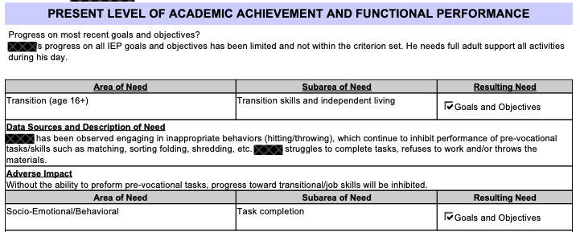
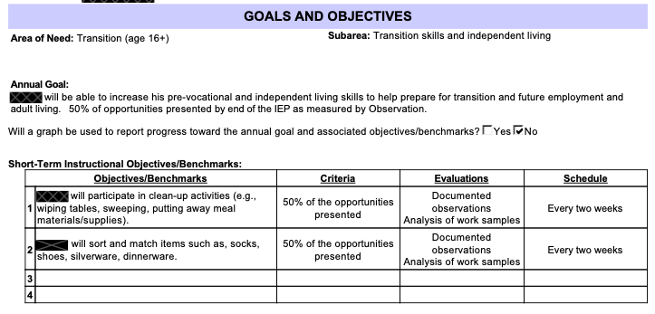
Identify professional development (PD) opportunities or case studies
What could you do with your IEPs at scale?
Present Levels:
Coded Yes for behavioral skills
Annual Goal:
Coded No for behavioral skills
Short-Term Objectives:
Coded No for behavioral skills
Notes:
We pulled some example IEPs that had behavior listed in needs but not in goals to identify what’s going on. This is an example where the student has a clear behavioral need that is inhibiting performance on task completion objectives in their transition need/goal, but the behavior is not being addressed in either the goal/objectives. The team could use this as an example of an IEP that might be more appropriately targeting the behavior that’s interfering with his ability to perform the pre-vocational tasks, rather than targeting the prevocational tasks themselves.
Our system allows them to (a) find these examples much quicker, and (b) create redacted versions of the IEPs that they could then share or work from in PD environments to improve their practices and policies.

Slide 40



Planned future directions and upcoming work
What could you do with your IEPs at scale?
Structured Data
Aim 1: Validate Coding Framework
Specific focus on mental illness needs, goals, and services
Understand and improve mental health supports embedded in IEPs
Recently submitted grant to NIH that scored well
Evaluate state-level IFSP data for young children with autism
NIH Autism Data Science Initiative
NEEDS (Present Levels)
Social-Emotional: Self-Management, Relationships, Social Awareness
Behavioral: Externalizing, Inhibition, Emotional Regulation
Aim 2: Quantify Prevalence and Variation
What is identified and provided? To whom? Where?
GOAL (Example)
By May 2026, the student will use 2 coping strategies to manage emotions in 4 out of 5 opportunities across settings, as measured by teacher and counselor data.
SERVICES (Example)
Aim 3: Analyze Alignment
To what extent do goals and services align to support identified mental illness needs?
Service | Provider | Frequency | Setting
Individual counseling | School counselor | 1x/week 30 min | Pull-out room
Evidence on service gaps, coordination, and opportunities for improvement.
Notes:
This isn’t everything you could do, but wanted to share a few of our future directions and upcoming work before turning the floor back over to you all

Slide 41
Planned future directions and upcoming work
What could you do with your IEPs at scale?
Evaluate “person-centered” IEPs
  e.g., evaluate content of student vision statements and student strengths; degree of integration into other IEP sections
Score transition plan quality to improve transition programming and employability skills
  e.g., explore misalignment between functional skills named in transition goals
Student’s Vision | Example Responses
This year, I want to learn: | more math and to read more out loud | to read more fluently, write in neat cursive | know the meanings of prefixes and suffixes in words
By the time I finish elementary/ middle school, I want to: | be better at basketball | have better handwriting | get better at self-advocating and gain more confidence
While I am in high school, I want to: | pass classes with good grades | improve my reading and writing skills | receive my driver’s license
Notes:
One of our district partners in MA is interested in better understanding their student vision statements and student strengths sections, understanding how those show up in other parts of the IEP including goals

Slide 42
Planned future directions and upcoming work
What could you do with your IEPs at scale?
Score IEP quality, identify opportunities for continuous improvement
  e.g., how often are IEP goals S.M.A.R.T.?
Connect IEP services to student outcomes, other data sources to enable whole-child decision-making
  e.g., literacy achievement, STEM/math achievement, discipline, attendance, graduation
  e.g., MTSS data, behavior intervention plans, restraint/seclusion
S
SPECIFIC – Clearly names the exact skill or behavior the student will learn.
MEASURABLE – Uses numbers, percentages, or frequencies so anyone can objectively count/observe progress.
M
ATTAINABLE – Sets a realistic challenge based on the student's current baseline and abilities.
A
RELEVANT – Directly addresses the unique needs caused by the student's disability.
R
TIME-BOUND – States a precise deadline or timeframe (e.g., "by the end of the semester" or "in 36 weeks").
T
Notes:
More long-term plans include scoring IEPs for quality, specifically looking at how often IEP goals are SMART
Connecting IEPs to student outcomes and other data sources like MTSS data that enable whole-child decision-making

Slide 43

What insights do you WISH you could extract from your IEP data?
Breakout Room Discussion
Whoever is wearing GREEN, please take notes on your group’s discussion in the Padlet!
Notes:
I’ve given you a very broad swath of ideas that have mostly been ideated and explored at the district level, so now I want to hear more from you all at the state level –
If you could wave a magic wand and all of the issues we discussed with accessing/analyzing IEP data were not a factor, what do you wish you could do? What would you want to learn?
Put link to padlet in chat, then put into breakout rooms
Come back together to share out? Or just come back together to sign off?

Slide 44


Are you interested in learning more or working together to evaluate your state’s IEP data?
Join our Team!
View our open positions at sri.com/careers
Get the latest news from SRI Education:
We are committed to a diverse and inclusive workplace and to creating equitable learning opportunities for all students.
SRIEducationNews.org
https://tinyurl.com/seamless-spdg
Adrienne D. Woods, PhD
SRI International
adrienne.woods@sri.com
Thank You!
Notes:
If you are interested in learning more or potentially working together to evaluate your state’s IEP data, please scan the QR code or follow this link to leave your name, affiliation, and email, and I will follow up with you. You can also head to this page to leave questions/suggestions including anonymously if you don’t want to enter any contact information.

