Slide 1
Diving Beneath The Surface: Building LEA Capacity in Arkansas
Fred Edora and Tammy Williams – IDC
Jeff Adams and Laura Goadrich – Arkansas DOE

Slide 2
Agenda
Welcome/Introductions
Setting the Context: Why Building Data Capacity at the LEA Level Matters
Arkansas LEA Capacity Building Strategy and Approach
Arkansas LEA Data Summits: What happened?
Outcomes, Lessons Learned, and Impact
Application and Discussion
Conclusions

Slide 3
Why Building Data Capacity at the LEA Matters
Notes:
Tammy
“You’ve just seen where we’re headed in this session, and now we want to zoom in on this big idea: why LEA data capacity really matters. As state teams, we invest a lot of time improving our systems, our collections, and our reports. But if local teams aren’t confident in working with those data, we won’t get the outcomes we’re hoping for. In this next section, I’m going to walk you through a story that may feel uncomfortably familiar and use it to highlight the kinds of capacity we have to build at the LEA level.”practices.”

Slide 4
Scenario
A mid-sized district in your state has just received its annual determination. Some of the data which contributed to this show the following:
  Dropout rates increased on Indicator 2
  Declining performance on both the reading and math assessments on Indicator 3 across multiple grade levels
  Increased discipline rates as shown in their 618
  There were issues with timeliness and accuracy of their data
Notes:
Tammy
“Let me introduce a district that might look a lot like some in your state. It’s mid-sized, not your largest district but not the smallest either, and they’ve just received their annual determination. When we look at the data, we see several red flags: dropout rates are up on Indicator 2, performance in reading and math on Indicator 3 is slipping across multiple grade levels, discipline rates have climbed in their 618 data, and on top of that there have been problems with timeliness and accuracy in their submissions. From our vantage point at the state, this is a district that clearly needs attention. The question is: will the district see what we see?”

Slide 5

The State Perspective
There is clearly a concern with this district!
The state decides to reach out to the district to discuss their data, their determination, and a plan for moving forward.
Notes:
Tammy
“If we stay in the state role for a moment, our reaction is probably something like, ‘We have to talk with this district.’ We see a pattern that suggests students with disabilities are not being well served, and accountability is pushing us to respond. So we call the district, we schedule a meeting, and we go in ready to talk about their data, their determination, and what needs to happen going forward. In our minds, the story the data are telling is obvious, and we’re expecting the local team to nod along and say, ‘Yes, we know, and here’s what we’re doing about it.’”
https://tse3.mm.bing.net/th/id/OIP.S6NK6qM-Q3TTw5dsPaBOFgHaEA?r=0&cb=thfc1falcon4&rs=1&pid=ImgDetMain&o=7&rm=3

Slide 6

The District’s Response
We are not seeing this!
They share their local data
  Kids are still graduating
  Their internal reports show stable performance across other indicators
  Their discipline referrals haven’t ‘increased’
Notes:
Tammy
“But when we sit down with the district, the conversation doesn’t go quite the way we imagined. Instead of confirming our concerns, they say, ‘We’re not seeing this.’ They pull up their own local reports and show that students are still graduating at about the same rate. Their internal dashboards show fairly stable performance across other indicators. Their discipline referrals don’t look like they’ve increased. From their point of view, things are challenging but not alarming. So now we have this moment where the state and the district are looking at what they believe is good data, but they’re drawing very different conclusions.”
https://img.freepik.com/premium-vector/one-continuous-line-drawing-happy-positive-people-with-hands-fingers-love-support-solidarity-ok-expressions-concept-doodle-vector-illustration-simple-linear-style_660848-1952.jpg?w=2000

Slide 7
Two Different Stories with the Exact Same Data!
Notes:
Tammy
“That’s how we end up with two very different stories built on what, in theory, is the exact same data. We’re not talking about one side fabricating numbers and the other side being naïve. We’re talking about honest professionals, working hard, who are still not aligned in how they understand the situation. And if you’ve ever been in a meeting like this, you know how quickly it can turn from collaboration to tension. The question we want to explore is: how do we get here, and what would it take to prevent it?”

Slide 8
Two Different Stories with the Same Data
At the state level
  We see patterns but not the context
  We identify concerns but can’t always pinpoint the root cause
  We assume districts understand the data the same way we do
At the local level
  Data might live in silos across departments
  Different teams using different definitions or sources
  A limited understanding of how local data connects with federal requirements
  Assumptions based on experience instead of evidence
Notes:
Tammy
“One way to unpack this is to look at what’s happening at each level. At the state level, we see patterns, trends, and outliers across all districts, but we usually don’t have the on-the-ground context that explains why those patterns exist. We can identify concerns, but we can’t always pinpoint root causes. We also sometimes assume that districts are looking at the data exactly the way we are. At the local level, the reality can be very different. Data might be scattered across departments, or different teams might be using different definitions or systems. Folks may not fully understand how their local data connect to federal requirements or the determination process. And when there are gaps, people naturally fall back on assumptions and prior experience instead of evidence. So it’s not surprising that the stories don’t match.”
Content from slide 8: Or save for the end table discussion
Where is the breakdown?
Is this a data quality issue, or is this a data use issue?
Are the data wrong—or is the interpretation different?
What data sources are they using locally versus what the state is using?
Who in the district is responsible for understanding these data?
Most importantly, how confident are you that this scenario is not happening in your state?

Slide 9
The Importance of the LEA Level
This isn’t just a data issue, it’s a capacity issue
If an LEA team
  Doesn’t have a shared understanding of the data
  Doesn’t have structured processes for reviewing the data
  Doesn’t have cross-role teams to interpret the data together
The state and the district will continue to see two different realities from the same data
Notes:
Tammy
“That’s why the LEA level is so critical. Think about what happens when a district team doesn’t share a common understanding of key indicators. Different people are using different mental models of what the numbers mean. If the team doesn’t have a regular, structured process for reviewing and discussing data, then issues only surface in crisis moments—like the determination conversation we just described. And if they don’t have cross-role teams—special education, general education, administrators, and data staff all at the same table—then no one is seeing the full picture. Under those conditions, the state and the district will continue to live in two different realities, even when they’re technically working from the same data set.”

Slide 10

Why does all of this matter?
High-quality state data depends on high-quality local practices
Interpretation starts at the local level
Decisions impact students directly at the local level
Are we just collecting better data, or are we building the capacity of local districts and teams to see clearly, think collectively, and act consistently on that data?
Notes:
Tammy
“So why does this matter beyond this one hypothetical district? First, high-quality state data are built on high-quality local practices. If LEAs don’t have strong processes for collecting, checking, and interpreting data, state-level quality will always be fragile. Second, interpretation almost always starts locally. Long before data show up in an APR or a public report, local staff are making meaning from those numbers—or choosing not to. And third, the decisions that most directly affect students—scheduling, placement, supports, interventions—are made in districts and schools. If those decisions are not informed by a shared, accurate understanding of the data, then we’re missing a huge opportunity to improve outcomes for children with disabilities.”

Slide 11
Building LEA Capacity in Arkansas

Slide 12



Arkansas LEA Capacity Building Strategy and Approach
Notes:
Jeff- bill came forth in 2023- student promotion impacted
From 43rd to 36th in education, it’s clear that LEARNS and ADE’s implementation is working, and it takes all of you. It takes you to improve literacy scores by providing necessary resources, coaching, and tutoring to make sure every student is reading at or above grade level.
“The L in LEARNS stands for Literacy. We recognized if we don’t address this crisis we will not improve our public schools,” said Governor Sanders. “So through LEARNS we funded and deployed 120 full time literacy coaches and provided literacy tutoring grants for families. And now, in the most recent year for which we have data, 2,700 additional kids are at or above reading proficiency.”

Slide 13
Arkansas LEA Capacity Building Strategy and Approach
LEARNS Act prioritizes data-driven decision-making to improve student outcomes.
Moving from compliance to active student growth and school improvement.
Mandates a more collaborative, deep-dive approach to analyzing special education data.
Arkansas moved from 43rd to 36th in education rankings, a direct result of the collective effort and the LEARNS framework.
A Call to Action: "It takes all of you." Success is driven by translating state-level policy into local-level improvement.
Shifting from "what" the law is to "how" districts implement it. Data retreats embody the LEARNS ideas by shifting from high-level summaries to focused work sessions.
Notes:
Jeff- bill came forth in 2023- student promotion impacted
From 43rd to 36th in education, it’s clear that LEARNS and ADE’s implementation is working, and it takes all of you. It takes you to improve literacy scores by providing necessary resources, coaching, and tutoring to make sure every student is reading at or above grade level.
“The L in LEARNS stands for Literacy. We recognized if we don’t address this crisis we will not improve our public schools,” said Governor Sanders. “So through LEARNS we funded and deployed 120 full time literacy coaches and provided literacy tutoring grants for families. And now, in the most recent year for which we have data, 2,700 additional kids are at or above reading proficiency.”

Slide 14
Arkansas LEA Capacity Building Strategy and Approach
R.I.S.E. Arkansas: Transforming Literacy Outcomes
The "L" in LEARNS: As Governor Sanders noted, literacy is the foundation of the public school crisis; if we don’t address this, we won't improve schools.
The Science of Reading focusing on evidence-based literacy instruction.
120 literacy coaches in districts and grant resources directly to their students who are currently below grade level.
Direct-to-family literacy tutoring grants.
2,700 additional students reached or exceeded reading proficiency.
Notes:
Jeff
From 43rd to 36th in education, it’s clear that LEARNS and ADE’s implementation is working, and it takes all of you. It takes you to improve literacy scores by providing necessary resources, coaching, and tutoring to make sure every student is reading at or above grade level.
“The L in LEARNS stands for Literacy. We recognized if we don’t address this crisis we will not improve our public schools,” said Governor Sanders. “So through LEARNS we funded and deployed 120 full time literacy coaches and provided literacy tutoring grants for families. And now, in the most recent year for which we have data, 2,700 additional kids are at or above reading proficiency.”

Slide 15
State Systemic Improvement Plan (SSIP)
The State-identified Measurable Result (SiMR) for Arkansas is the percent of students with disabilities in grades 3-5, from targeted schools, whose value-added score in reading is moderate or high for the same subject and grade level in the state.
Notes:
Jeff

Slide 16



Do not edit
How to change the design
In one word, what is the biggest challenge your district/state faces when using IDEA Part B data for decision-making?
Presenting with animations, GIFs or speaker notes? Enable our Chrome extension
Notes:
📣 This is Slido interaction slide, please don't delete it.
✅ Click on 'Present with Slido' and the poll will launch automatically when you get to this slide.

Slide 17
Arkansas LEA Capacity Building Strategy and Approach
ATLAS (Arkansas Teaching & Learning Assessment System) for statewide testing.
The portal provides immediate, transparent access to student performance metrics.
  View scores
  Identify specific areas for intervention
During the data retreats, participants logged into ATLAS to
research trends for indicator 3 district APR
connect site-specific improvements and individualized education programs.
Notes:
Jeff

Slide 18

Arkansas LEA Capacity Building Strategy and Approach
Spring 2025 data summits:
Day after Sig Dispro conference
All day session
Morning was Kahoot of eSchool
Afternoon was data visualization
Notes:
Laura
Benefit- timing with Sig Dispro allowed more districts to come and stay the night in the area if needed
Groups were already ready to work
Morning- IDEA data
At the time I was co-director of the IDEA Data and Research unit in the Special education unit
- Afternoon focused on “where” to get your data, looking at online systems “MySchoolInfo” Dashboards
Transition in summer with the retirement of our current Part B Data Manager and I was hired
2025 Data Summit post-survey results:
What to Change or Add
Tiered sessions (beginner vs. advanced)
More hands‑on, LEA‑specific work time
Deeper dives into fewer topics
Expanded Q&A and participant‑submitted questions
Clearer pacing and scaffolding for new data users
What Participants Want to Change or Improve Next Year
1. More Differentiation by Experience Level
Requests for:
Introductory sessions for new administrators and data staff
Clearer explanations for those who “struggle with data”
Concern that some presentations moved too fast or assumed prior expertise
2. More Time for Hands‑On, Applied Work
Participants asked for:
More time to:
Explore their own district or LEA‑specific data
Practice using eSchool, MySPED, LEA Insights
Step‑by‑step walkthroughs (especially for required reports and submissions)
Smaller group discussions focused on how to analyze and use data
3. Deeper Dives into Specific Topics
Requested future topics include:
Disaggregating and using Indicator 3 (Assessment) data
RDA data
Early Childhood data presented separately
Educational environments and inclusion data
Special education‑specific tools (e.g., self‑contained settings)
4. Improved Pacing & Session Design
Some felt sessions moved too quickly
Requests included:
Fewer rapid slide transitions
Less time on games (e.g., Kahoot)
More audience interaction and discussion
Positive feedback for:
Interactive activities
“Hot topics” or Q&A‑based formats (with suggestions to expand this model)
5. Better System Integration Focus
Participants expressed frustration with:
Multiple, non‑integrated data systems
Desire for clearer guidance on:
How systems connect
How to streamline data sharing and reporting

Slide 19

Arkansas LEA Capacity Building Strategy and Approach
Feedback from the 2025 Data Summit
Requests for format change:
  Introductory sessions for new administrators and data staff
  More hands‑on, LEA‑specific work time
  Deeper dives into fewer topics
  Less time on games (e.g., Kahoot)
Requested future topics include:
  Explore their own district or LEA‑specific data
  Practice using eSchool, MySPED, LEA Insights
  Disaggregating and using Indicator 3 (Assessment) data
Participants expressed frustration with:
Multiple, non‑integrated data systems
Desire for clearer guidance on:
  How systems connect
  How to streamline data sharing and reporting
Notes:
Laura
2025 Data Summit post-survey results:
What to Change or Add
Tiered sessions (beginner vs. advanced)
More hands‑on, LEA‑specific work time
Deeper dives into fewer topics
Expanded Q&A and participant‑submitted questions
Clearer pacing and scaffolding for new data users
What Participants Want to Change or Improve Next Year
1. More Differentiation by Experience Level
Requests for:
Introductory sessions for new administrators and data staff
Clearer explanations for those who “struggle with data”
Concern that some presentations moved too fast or assumed prior expertise
2. More Time for Hands‑On, Applied Work
Participants asked for:
More time to:
Explore their own district or LEA‑specific data
Practice using eSchool, MySPED, LEA Insights
Step‑by‑step walkthroughs (especially for required reports and submissions)
Smaller group discussions focused on how to analyze and use data
3. Deeper Dives into Specific Topics
Requested future topics include:
Disaggregating and using Indicator 3 (Assessment) data
RDA data
Early Childhood data presented separately
Educational environments and inclusion data
Special education‑specific tools (e.g., self‑contained settings)
4. Improved Pacing & Session Design
Some felt sessions moved too quickly
Requests included:
Fewer rapid slide transitions
Less time on games (e.g., Kahoot)
More audience interaction and discussion
Positive feedback for:
Interactive activities
“Hot topics” or Q&A‑based formats (with suggestions to expand this model)
5. Better System Integration Focus
Participants expressed frustration with:
Multiple, non‑integrated data systems
Desire for clearer guidance on:
How systems connect
How to streamline data sharing and reporting

Slide 20
Arkansas LEA Data Summits:
What happened?
Spring 2026 presurvey:
Attendee challenges/concerns:
  New to IDEA data reports or their roles.
  Lack confidence in using published reports effectively.
  Want guidance on translating data into actionable steps and goals.
How to use State SPED Reports:
  School Board presentations
  District annual reports
  District administrative reviews
  Prepare for SPED monitoring, audits, and corrective action requirements.
Notes:
LDG

Slide 21
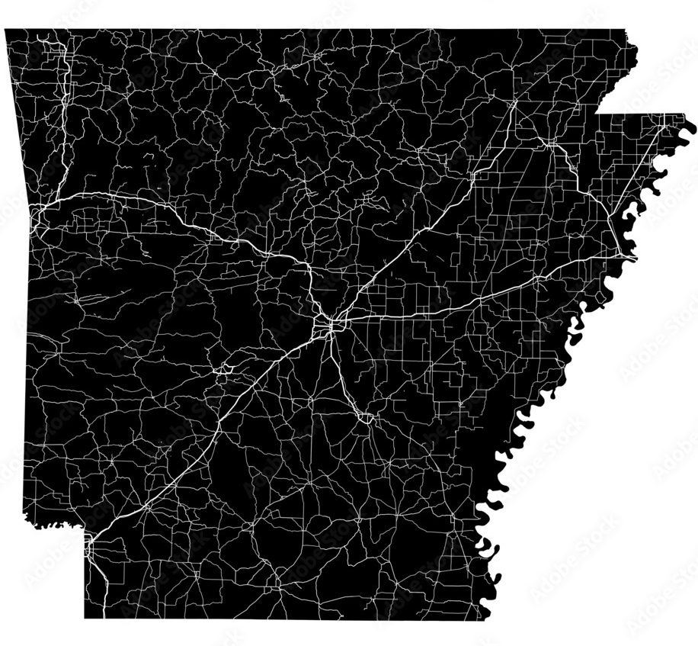

Arkansas LEA Data Summits:
What happened?
Five Regional Summits
February - March 2026
Each District was allowed to bring up to 5 team members
  LEA SPED Supervisors
  Data entry personnel
  EC providers
https://tinyurl.com/IDEA-2026slides
Notes:
LDG

Slide 22
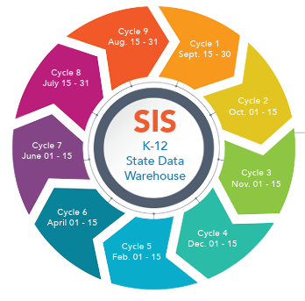
Arkansas LEA Capacity Building Strategy and Approach
Plan for 2026 Data Retreat
Worked with IDC to redesign
Location, Location, Location
Starting with purpose- an overview of Indicators
Data accuracy- eSchool/MySPED
Elephant in the Room
Regional LEA Rockstars presented
I do - We do - You do
Data Viz
  Presenting your data- know your audience
  Continued learning

Slide 23

Arkansas LEA Data Summits:
What happened?
Morning Session:
Norms Setting and Overview
  Review THEIR district data
  Reflecting on multiple lenses and
  data entry requirements
Review Presurvey Results
  Familiar with Indicators
  11 (Child Find)
  8 (Parental Involvement)
  9 &10 (Disp. Representation)
  Not familiar with Indicators
  6 (Preschool Environment)
  7 (Preschool Outcomes)
  17 (State Systemic Improvement Plan- SSIP)
Notes:
LDG
E-School section covered their students
The You do section covered their district’s Indicator 3 data

Slide 24

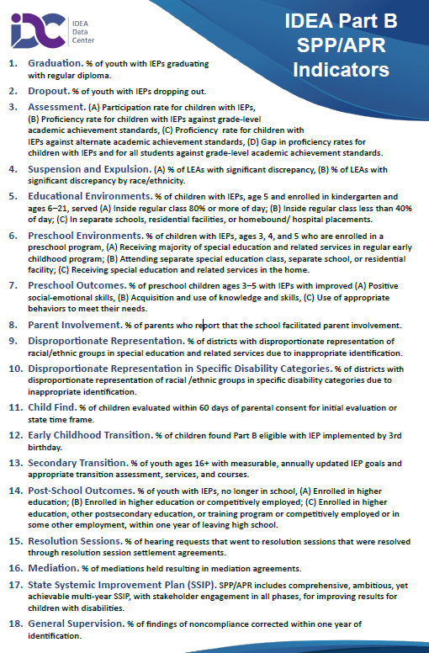
Arkansas LEA Data Summits:
What happened?
Morning Session continued,
Why districts are required to submit.
  Federal requirements
    SPP/APR
    IDEA requirements
  State requirements
    eSchool (SIS cycles deadlines)
    MySPED cycle review period
Notes:
LDG

Slide 25
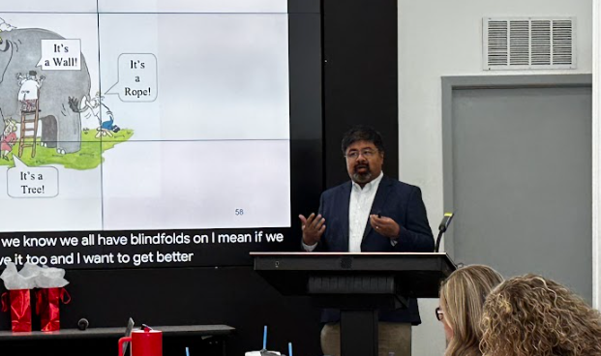
Arkansas LEA Data Summits:
What happened?
Morning Session continued,
Elephant in the Room
Data Blindfold
Mistaken Certainty
Focus on the whole,
not the part
Overcoming the blindfold
“This retreat helped take my blindfolds off.”
Notes:
LDG

Slide 26
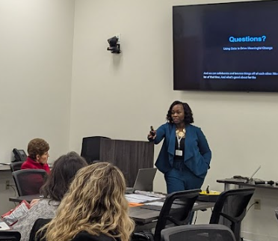
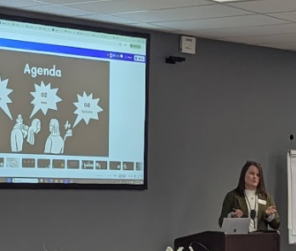
Arkansas LEA Data Summits:
What happened?
Morning Session continued,
LEA regional presenters
  Rockstars and boots-on-the-ground.
  Focus on how they use the reports.
  Walked through the reports State publishes and how they use them.
  Shared guides and resources.
Notes:
LDG

Slide 27
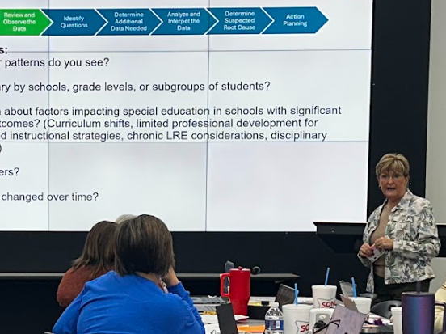
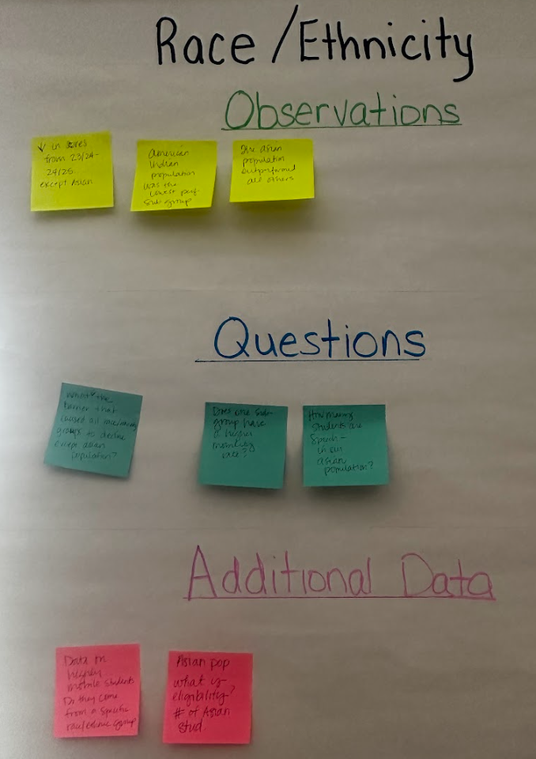
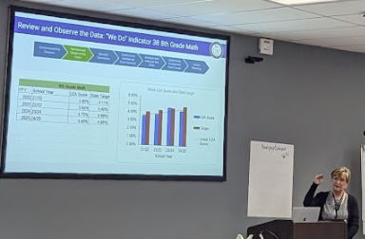
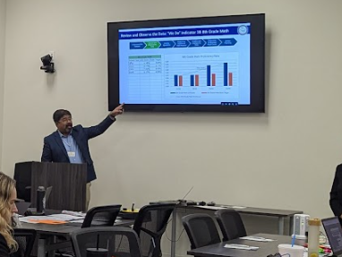
Arkansas LEA Capacity Building Strategy and Approach
Afternoon activity:
  I do (state data modeled)
  We do (mock district data- guided practice)
  You do (their district data- independent application)

Slide 28

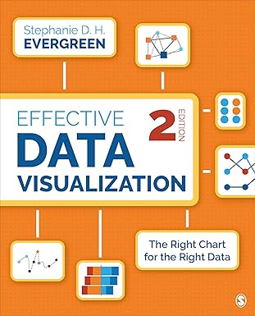
Arkansas LEA Data Summits:
What happened?
Wrap up:
Data Visualization resources
Knowing your audience
Simplify and Focus
AI Chat Prompt guides
& Data viz resources to take home
We gave our LEA’s the tools for their spring school board presentations.
Placing LEA data in a common format and using common data visualizations.
Notes:
We Got LEA’s excited about data.
Empowered thee LEA’s at the local level
Participants left trainings with the tools for common board report
Expanding this idea for SPDG, by creating a common, aligned format LEAs can use increase engagement with the project schools.

Slide 29

Arkansas LEA Capacity Building Strategy and Approach
Feedback from our February 2026 Data Retreats
Post-survey results- Most valuable components:
  LEA Supervisor Presentations
  Understanding IDEA Indicators
  Walking through data resources
  (eSchool/MySPED)
  Collaboration with peers
Planning for next year:
New area LEA Supervisors
More breakout time after live eSchool/MySPED
& “you” do section
Notes:
LDG
To quantify the results based on the break downs
Most Valuable Components: Participants consistently highlighted Understanding IDEA Indicators, Walking through data resources (eSchool/MySPED), and Collaboration with peers as the most beneficial parts of the retreat.
Success Stories: The inclusion of District presentations (LEA Supervisors) was a standout success. Multiple respondents noted that hearing from colleagues was "the best part" and provided essential real-world context.
https://www.google.com/imgres?q=image%20%20peers%20graphic&imgurl=https%3A%2F%2Fimg.freepik.com%2Ffree-vector%2Fgroup-therapy-illustration-concept_52683-45727.jpg%3Fsemt%3Dais_hybrid%26w%3D740%26q%3D80&imgrefurl=https%3A%2F%2Fwww.freepik.com%2Ffree-photos-vectors%2Fpeer-group&docid=_1CVEwymfZgafM&tbnid=uBfVtnJhqxy13M&vet=12ahUKEwjC2Zjvq4KUAxUAnCYFHVtLPWMQnPAOegQIYxAB..i&w=740&h=493&hcb=2&ved=2ahUKEwjC2Zjvq4KUAxUAnCYFHVtLPWMQnPAOegQIYxAB

Slide 30

Do not edit
How to change the design
What is the biggest operational hurdle preventing your district from maximizing the value of IDEA Part B data?
Presenting with animations, GIFs or speaker notes? Enable our Chrome extension
Notes:
📣 This is Slido interaction slide, please don't delete it.
✅ Click on 'Present with Slido' and the poll will launch automatically when you get to this slide.

Slide 31

Arkansas LEA Capacity Building Strategy and Approach
Feedback from our February 2026 Data Retreats
Post-survey results: Who to bring:
  Majority said they would bring different
  colleagues next year,
    Data assistants/clerical staff
    Building Administrators and principals
    General education teachers, content coaches,
    and related service providers
Planning for next year:
  Reframing and providing detailed agendas earlier so the district targeted team members can attend
Notes:
LDG!!
Attendance Awareness: About 43% of respondents indicated they would have brought different team members if they had known the specific focus. Suggested additions included:
Building administrators (Principals/APs)
Data/clerical staff (eSchool/Reporting)
Curriculum coaches
https://www.flaticon.com/free-icon/car_3731420

Slide 32

Arkansas LEA Capacity Building Strategy and Approach
Feedback from our February 2026 Data Retreats
Post-survey results: Structure and format preferences
  Structure: combination of statewide and targeted sessions
  Format: in-person regional sessions
  & mixed virtual/in-person models
  Timing/Duration: 8:30-11:30 am or Full-day
  Approach:
    Guided practice (I do, we do, you do)
    Deep dive with hands-on analysis
Notes:
LDG!!
Structure & Format
Desired Structure: A combination of statewide sessions and targeted sessions for identified districts (e.g., determination levels).
Preferred Format: A strong preference for In-person regional sessions and Mixed virtual/in-person models.
Timing/Duration: Preferences were split between Full-day sessions and Morning sessions (8:30–11:30).
Approach: Learners prefer Combination approaches, specifically pairing "Guided Practice (I do, we do, you do)" with Deep-dive hands-on analysis.
https://t4.ftcdn.net/jpg/14/68/00/07/360_F_1468000771_HCq4q1NvzxS2kXCQvbhr01j98cn1G3GN.jpg
Add slide on this is a form of stakeholder engagement- personal feedback that we wouldn’t get from a survey

Slide 33
Arkansas LEA Capacity Building Strategy and Approach
Feedback from our February 2026 Data Retreats
Post-survey results: Reporting Cycle Support:
  December (Cycle 4) & June (Cycle 7):
    1st: Resource guides and recorded trainings.
    2nd: Virtual, cycle-focused training sessions.
    3rd: In-person regional training & district-specific
    "Office Hours."
Planning for next year:
  Add more recorded training sessions online (Colossyan)
  Timely and targeted online training
  Travel to districts for in-person regional training
Notes:
LDG!!
4. Reporting Cycle Support (Cycles 4 & 7)
For both the December and June reporting cycles, districts requested the following support hierarchy:
Primary: Resource guides and recorded trainings.
Secondary: Virtual, cycle-focused training sessions.
Tertiary: In-person regional training and district-specific "Office Hours."
The retreat was well-received, but there is a clear appetite for shifting from "high-level theory" to "hands-on technical mastery" in regional, collaborative settings.

Slide 34
Outcomes, Lessons Learned, & Impact
Impacts from our spring 2026 Data Retreats (anonymous surveys):
“Data is not a ‘gotcha’ but a helpful tool.”
“Data can be shown in a better way- graphs instead of just percentages.”
“After many years in the position, I understood more than I ever had with each of your presentations.”
“I’m not just doing paperwork anymore- I understand the purpose.”
“It changed how I think about telling our district’s story with data.”
“I finally understand why accuracy in data entry matters so much.”
“The environment was warm, collaborative, and well worth my day away from the office.”
Notes:
LDG
There were repeated asks for us to return to their district for team training. We are working on identifying how that looks and are working with our regional presenters to make a high impact solution for interested districts. Audience focus of data entry and administration support
Quotes from our attendees

Slide 35
Outcomes, Lessons Learned, & Impact
Planning for next year (anonymous surveys):
“Everyone needs to know how to retrieve and analyze data for planning.”
“Understanding data is needed for all new supervisors.”
“Superintendents, principals, content coaches, and teachers should attend.”
“More people need to see the ‘why’ behind the decisions being made.”
“The team we brought helps collect and enter data—this helped us all speak the same language.”
“Using multiple sources of data helps us find meaningful goals and solutions.”
Notes:
LDG
There were repeated asks for us to return to their district for team training. We are working on identifying how that looks and are working with our regional presenters to make a high impact solution for interested districts. Audience focus of data entry and administration support
Quotes from our attendees

Slide 36
Application and Discussion
Notes:
Tammy
“Up to this point, we’ve been making the case for why LEA data capacity matters and why misalignment between state and local interpretation can happen so easily. Now we want to shift from the example into application. This is the point where we’d like you to think about your own context, your own districts, and your own state systems. As you move into this activity, the goal is not just to identify problems, but to start naming the specific barriers that make LEA data use hard in real settings. We want to ground the conversation in what you are seeing on the ground and what that means for technical assistance and capacity-building.”

Slide 37
Common Challenges to Building LEA Capacity for Data Use
Limited data literacy at the LEA level
Compliance vs. improvement mindset
Inconsistent data entry practices across an LEA
Staff turnover
Lack of data processes at the local level
Divisions or departments within an LEA working in data silos
Lack of communication across departments
Notes:
Tammy
“To help frame the discussion, here are some common challenges we often see when states are trying to strengthen LEA capacity for data use. Sometimes the issue is basic data literacy—local teams may not feel confident interpreting reports, asking questions of the data, or connecting indicators to action. Sometimes the mindset is still centered on compliance rather than improvement, so data are treated as something to submit rather than something to use. In other cases, the barriers are operational: inconsistent data entry practices, staff turnover, weak local review processes, departments working in silos, or just not enough communication across teams. As you look at this list, think about which of these challenges show up most often in your state and which ones are the biggest obstacles to meaningful local data use.”

Slide 38

Do not edit
How to change the design
What elements of Arkansas’s approach could work in your state?
Presenting with animations, GIFs or speaker notes? Enable our Chrome extension
Notes:
Tammy
📣 This is Slido interaction slide, please don't delete it.
✅ Click on 'Present with Slido' and the poll will launch automatically when you get to this slide.

Slide 39
Table Discussion
Where do you see the biggest gaps in data literacy and use?
What elements of Arkansas’s approach could work in your state?
What would need to be adapted to your state context?
What barriers might prevent you from implementing a similar initiative?
Notes:
Tammy:
“Now that we’ve named some of the common challenges to building LEA capacity for data use, we’re going to switch into an interactive mode. The goal of this activity is to connect those challenges to your real work with districts and to start identifying concrete leverage points for building capacity.
At your tables, I’d like you to focus on your own state experience—not on hypothetical states. Think about the districts you worry about, the recurring issues you see, and the patterns that show up year after year in your data conversations.”
Using the Question (copy on the table), take about _15_____ minutes and each state team capture your thoughts and discuss with your table mates what your SEA wrote.
Use these prompts to guide your conversation:
Start with a quick round: each person shares one LEA-level challenge they see most often.
As a group, identify where those challenges come from. Are they about structures, skills, mindsets, or something else?
Then discuss: What has your state already tried to address these challenges? What seems to help, and what hasn’t moved the needle?
As you talk, try to notice any common themes at your table.
Each SEA team will leave their responses on the table for the IDEA Data Center to use as feedback for potential support.
Liaison will touch base on

Slide 40
Contact Us
Jeff Adams, Arkansas Department of Education
Laura Goadrich, Arkansas Department of Education
Fred Edora, IDEA Data Center
Tammy Williams, IDEA Data Center

Slide 41
Keep Up With IDC!
Visit our website
www.ideadata.org
Follow us on LinkedIn
www.linkedin.com/company/idea-data-center
Email us
ideadata@westat.com

Slide 42
Disclaimer
The contents of this presentation were developed under a grant from the U.S. Department of Education, #H373Y240002, and administered by Westat. However, the contents do not necessarily represent the policy of the U.S. Department of Education, and you should not assume endorsement by the federal government.
Project Officers: Amy Bae and Alexis Lessans

