Slide 1

SPDG Directors’ Webinar
EB-PD Lit Review
PA SPDG Family Partnerships
May 7, 2026

Slide 2

Agenda
Question for you & Colorado example
New & Noteworthy
Capping off our Family Partnerships Series
The dissemination workbook & engaging critical perspectives framework
MTSS & Conference + ongoing professional learning

Slide 3
What do you want to know about AI & Dissemination?
July’s CIDDL Presentation

Slide 4

New & Noteworthy

Slide 5
OSEP Conference & SPDG National Meeting

Slide 6
OSEP Conference
Meet-ups
  Evaluators
  New to SPDG
  Sustainability Conversations
  GrantWISE: Internal Processes & Budgeting
Program Area Meeting
  Design Labs
SPDG Bowling Night

Slide 7
SPDG National Meeting
Theme: “Doing What We Do, Even Better
Dates: October 14 & 15
Location: Friends Meeting in Dupont Circle, DC
Hotel: Reserve your own hotel room
Who should come: All Y’all!

Slide 8

Dissemination & Complex Change

Slide 9
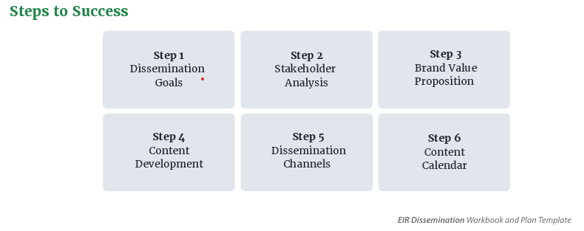
Dissemination Workbook
Who do you consider to be your primary audience?
Which dissemination channels are you using?
How will you know if you are reaching your primary audience?

Slide 10
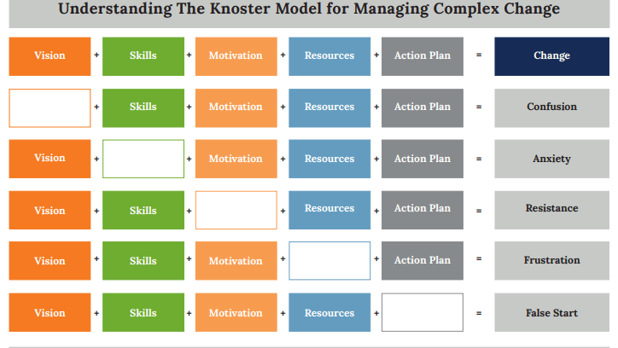

Slide 11
Your SPDG Partnership
1. How have you built relationship over time?
2. How do you measure success in your partnership?
3. How do you support each other’s dissemination?
4. Which areas of the Model for Complex Change are strengths for the partnership? Which areas are tougher?

Slide 12
Our Speakers
Indiana SPDG: Dissemination Workbook and Engaging Critical Perspectives: A Comparative Analysis
Oklahoma SPDG: MTSS & connecting conference to ongoing professional learning

Slide 13

Questions?
Email John & Jennifer (signetwork@uoregon.edu; Jennifer.coffey@ed.gov)

