Slide 1
Loops that Link
In this session, Oklahoma SPDG will discuss how their feedback loops link to ongoing professional training and coaching plans.
Additionally, Oklahoma SPDG has facilitated a state-agency feedback loop to support district efforts and resource allocation. This statewide effort has identified districts with significant need and gaps in resources from the agency.
Join us to hear how all these loops link together to support a unified effort under MTSS.

Slide 2
Professional Learning Loops
Feedback loops linking to ongoing professional training and coaching plans.

Slide 3
Integrating Training and Coaching
Training
OKMTSS Conferences
  Winter and Summer
Modules
Communities of Practice Monthly
System Data Retreat
Student Data Retreat
Coaching
District system coaching
  Twice a month
Early career coaching
  Once a week

Slide 4
Coached Districts Timeline
Winter
Conference
Summer
Conference
August
November
February
May
August
COP
COP
COP
COP
COP
COP
COP
Modules
Modules
Modules
Modules
Modules
Modules
Modules
Modules
LEA system coaching
LEA system coaching
LEA system coaching
LEA system coaching
LEA system coaching
LEA system coaching
LEA system coaching
LEA system coaching
LEA system coaching
LEA system coaching
LEA Onboarding
LEA system coaching
LEA system coaching
LEA system coaching
LEA system coaching
LEA system coaching
LEA system coaching
LEA system coaching
LEA system coaching
LEA system coaching
LEA system coaching
System Data Retreat
Student Data Retreat

Slide 5
Non-Coached Districts Timeline
Winter
Conference
Summer
Conference
August
November
February
May
August
COP
COP
COP
COP
COP
COP
COP
Modules
Modules
Modules
Modules
Modules
Modules
Modules
Modules
System Data Retreat
Student Data Retreat

Slide 6
Connection Between Each Element
LEA system coaching
Virtual session supports integration with modules
Modules
Supports initial understanding
LEA Onboarding
Needs Assessment
Module Connection
Scheduling
COP
Expert in the field supports connections
LEA system coaching
In person session supports specific needs
Winter
Conference
Summer
Conference
System Data Retreat
Annual Tier 1 data analysis
Support for ongoing data plans
Needs Assessment
State MTSS Feedback
Phased implementation
Student Data Retreat
DBI training for Tier 2 and Tier 3

Slide 7
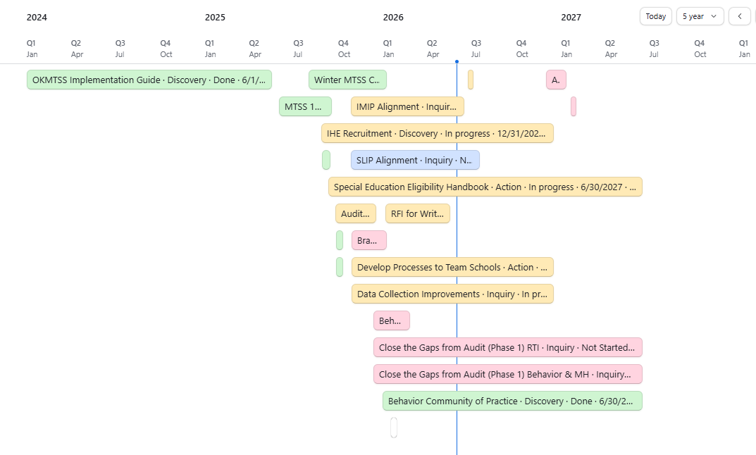
OKMTSS Phased Timeline
Using a long-term planning guide supports our statewide efforts to improve MTSS and RTI understanding by 2032.
The phased plan provides context for the next steps and what must be accomplished at each element.

Slide 8
Data Integration
Activity | Data Collected | Purpose
LEA Onboarding | Needs Assessment | Baseline implementation Audit of agency-wide areas of improvement Direction for conference programming
Modules | Completion Proficiency | Proficiency of understanding
Community of Practice | Attendance | Access to MTSS
LEA system Coaching | Completion Proficiency | Proficiency of Implementation
Conferences | Attendance Feedback | Engagement to MTSS Programming Engagement
System Data Retreat | Action Plans Content Assessment | Implementation Understanding
Student Data Retreat | Content Assessment | Understanding

Slide 9
6 minute
Breakout Group!
How do you integrate your training and coaching opportunities to make the largest impact?
What data informs the alignment between the two elements?

Slide 10
Agency Feedback Loop
Oklahoma SPDG has facilitated a state-agency feedback loop to support district efforts and resource allocation. This statewide effort has identified districts with significant need and gaps in resources from the agency.

Slide 11
Teaming Process
Agency Directors and Program Managers attend a monthly meeting to address SSFI (conducted in April) improvements.
Field employees who work directly with districts can submit concerns which may indicate a compliance or TA need greater than their scope (approximately 50 employees).
The team reviews the submissions and determines what interventions and supports are available to direct towards that need.
Audits of the specific interventions are conducted quarterly.

Slide 12
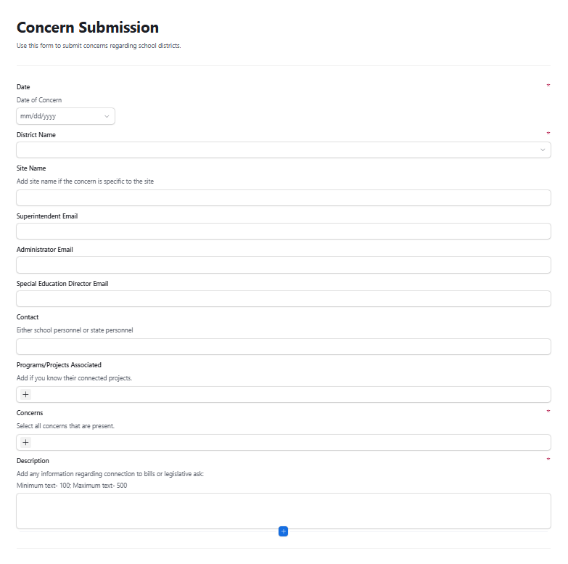
Concern Submission
Date of concern
District name
Site name
Emails
Submitter contact
Programs or projects the school is associated
Concerns
Description
Documents or evidence

Slide 13
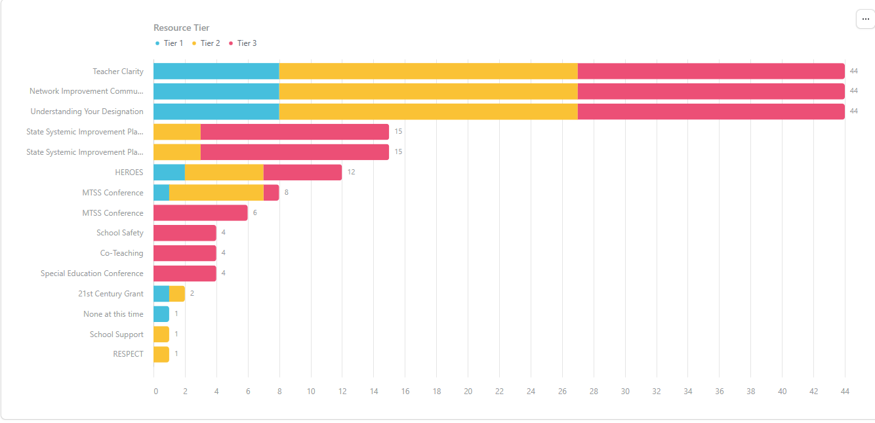
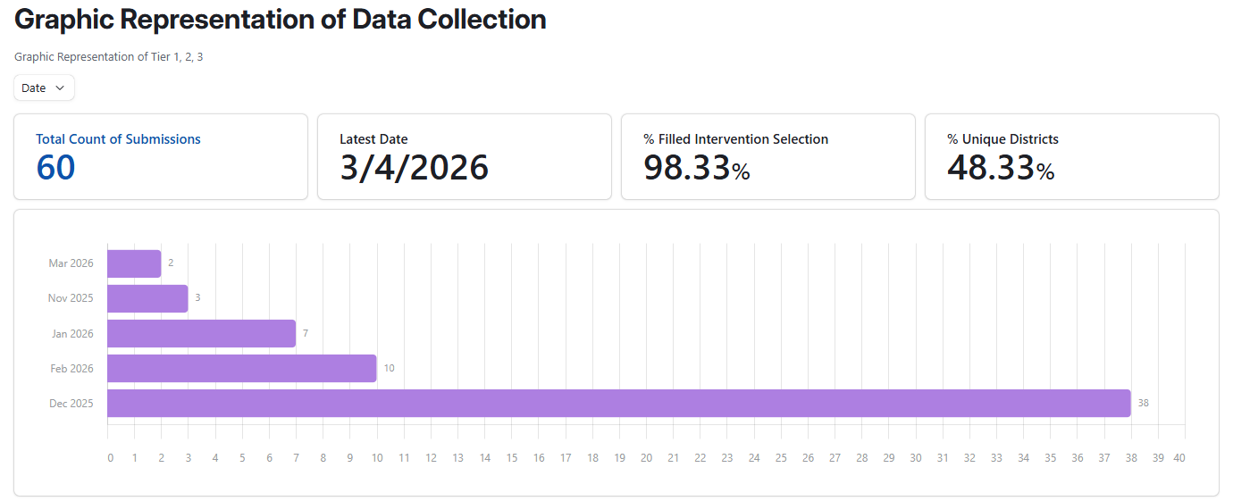
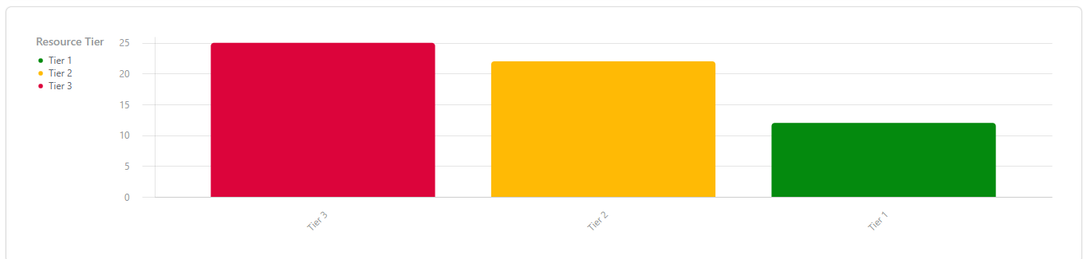
Concern Data

Slide 14
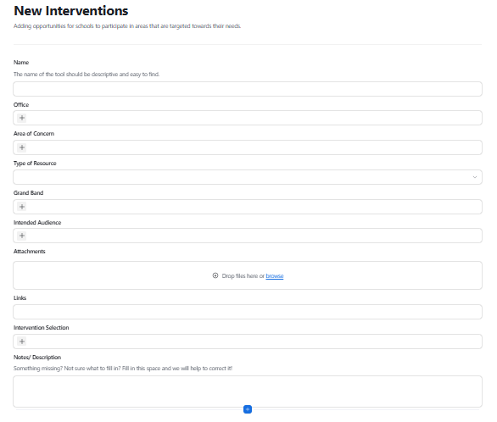
New Interventions
Name of tool
Office
Area of concern
Type of resource
Grade band
Intended audience
Attachments
Links
Intervention selection
Notes

Slide 15
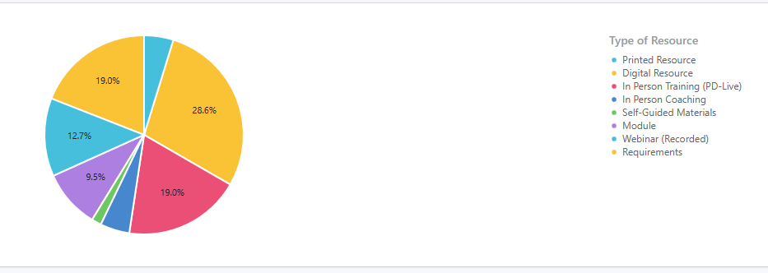
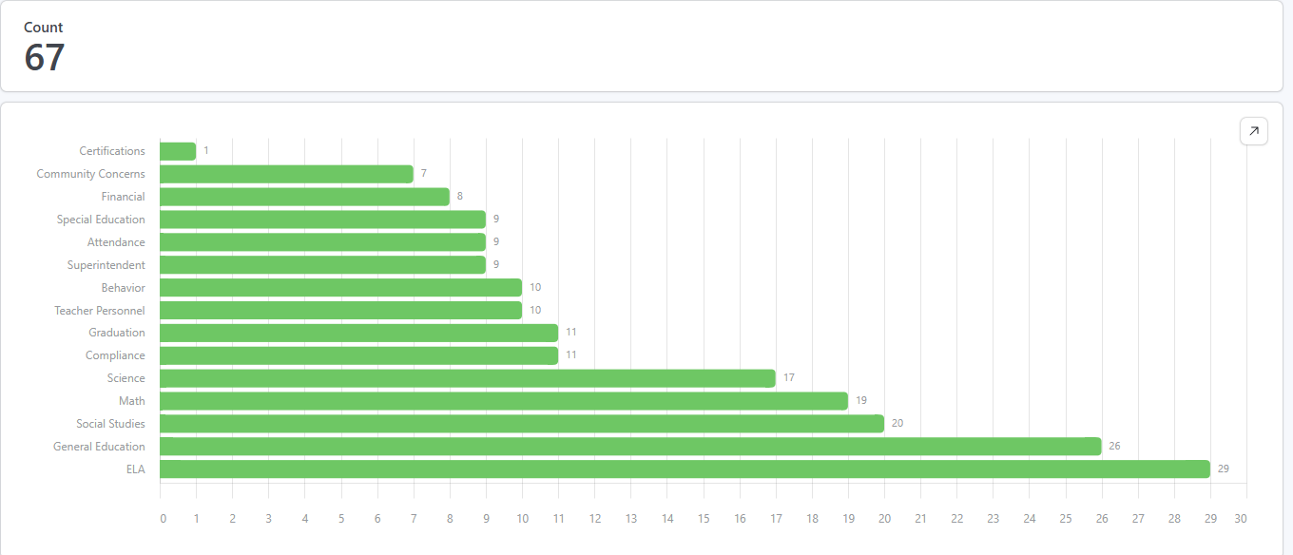
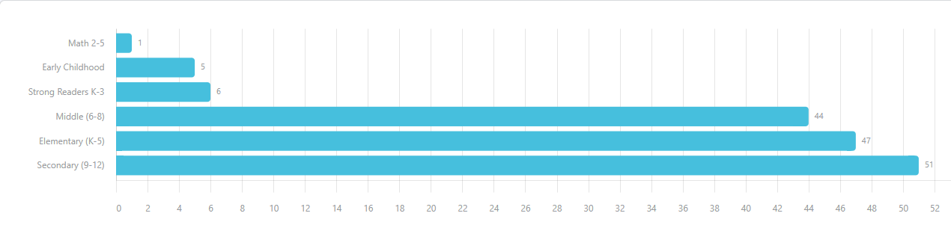
Intervention Data

Slide 16
Outcomes
Because of this data, the OKMTSS team has been able to:
  Submit letters of concern to the Superintendent's cabinet.
  Begin a plan of phased implementation for training and professional support for districts not making adequate progress.
  Target specific coaching and opportunities to those who are in need.
  Recommend additional compliance measures for those who are at risk of non-compliance.
  Align MTSS program planning to real-time, state-wide implementation.

Slide 17
External Partnerships
Using this data also allows for our teams to engage with external partners (IHEs, community partnerships, etc.) to build capacity in areas we are unable to address head on.
This data has validated and continued the state funding of several field initiatives.
Provides insight into new grant activities and areas for collaboration.

Slide 18
6 minute
Breakout Group!
How does agency alignment look in your context?
What efforts would improve the alignment and feedback loops?

