Slide 1

Dissemination Workbook and
Engaging Critical Perspectives
A Comparative analysis
Center on Education and Lifelong Learning

Slide 2
Let’s Connect!
Rose, Thorn, Bud – Summer Edition
Rose – The highlight of your week
Thorn – A challenge you’re facing
Bud – What is something you’re looking forward to this summer?
Notes:
People may share in the chat, or raise their hand and come off of mute to share
3-4 minutes

Slide 3
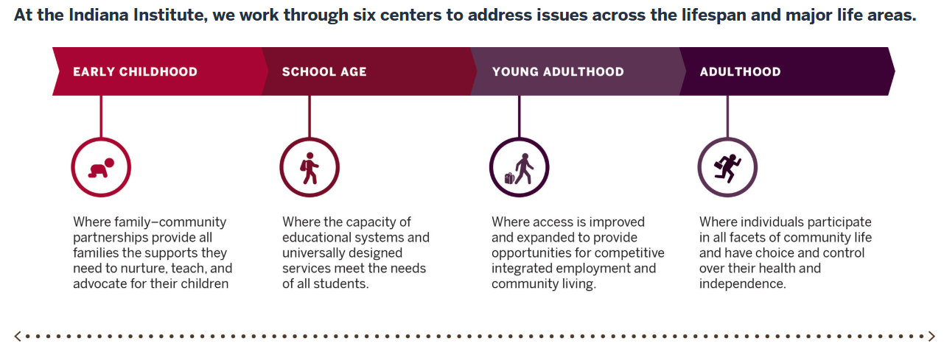
Indiana Institute on Disability and Community
Notes:
Slide for IIDC and CELL – who we are

Slide 4
Indiana SPDG
Grant Activities
CELL School Leadership Initiative – two-year program for school building administrators
ASELI Team – one-year program for teacher+principal partners
Director of Exceptional Needs – building capacity in the state with tuition-free coursework to qualify for director license exam
Family Engagement Resources – person-centered IEPs and support to develop SEPACs
Dr. Lucy Fischman
fischman@iu.edu
Dr. Pennie Gregory
pmgregor@iu.edu
Dr. Nancy Holsapple
nholsapple@doe.in.us
Notes:
Highlight my work and experiences

Slide 5

Agenda
01
Tool Purpose and Process
02
Similarities & Differences
03
Strategic Integration
04
Benefits of Using Both Tools
05
Questions and Comments?

Slide 6

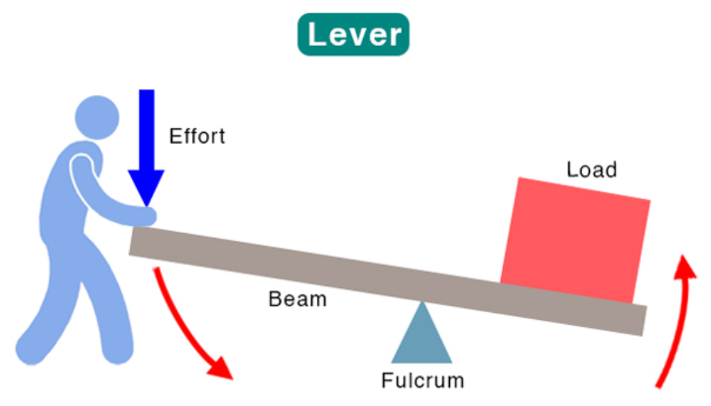
Tool Purpose
EIR Dissemination Workbook (DW)
SISEP Guidance for
Engaging Critical Perspectives (ECP)
Purpose:
To scale up and sustain what works by establishing a clear brand value to move from awareness to advocacy
Purpose:
To cultivate deep learning and ongoing improvement by leveraging diverse expertise collaboratively
Notes:
Please have access to both of these tools for deeper engagement in the presentation.

Slide 7
Tool Process
DW: Technical Dissemination Progression | ECP: Equity-Centered Engagement Progression
Step 1: Dissemination Goals | Step 1: Identify (What perspectives are needed?)
Step 2: Stakeholder Analysis | Step 2: Map Level of Engagement
Step 3: Brand Value Proposition | Step 3: Analyze (Barriers and facilitators)
Step 4: Content Development | Step 4: Plan (Action items and responsibility)
Step 5: Dissemination Channels
Step 6: Content Calendar

Slide 8
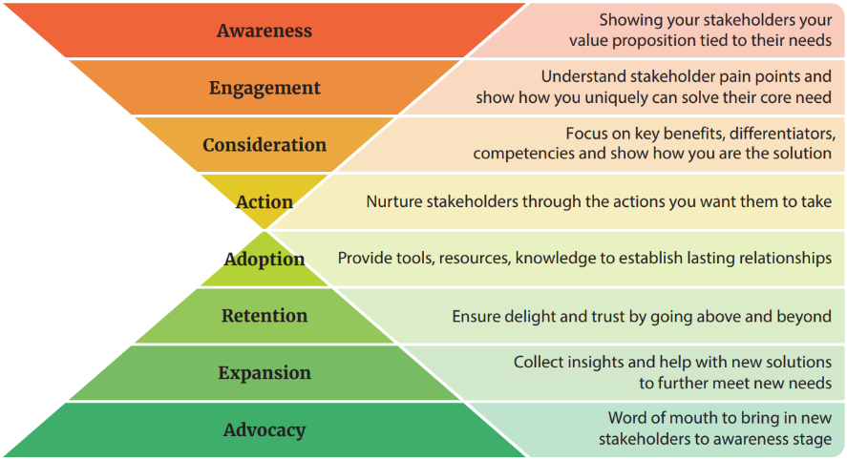
Breakout!
Dissemination Workbook – Hourglass Engagement Framework (p. 22)
Notes:
This framework helps you engage stakeholders at different stages, ensuring sustained interaction.
BUT FIRST – who are these stakeholders? Do this in Step 2 – Stakeholder Analysis
Breakout Prompts to put in the chat:
Map out some of your current project: Who would you slot in – who has been responsible for each part, and how has it worked? (2 minutes)
Come back together and share identified gaps in the hourglass (3 minutes)

Slide 9
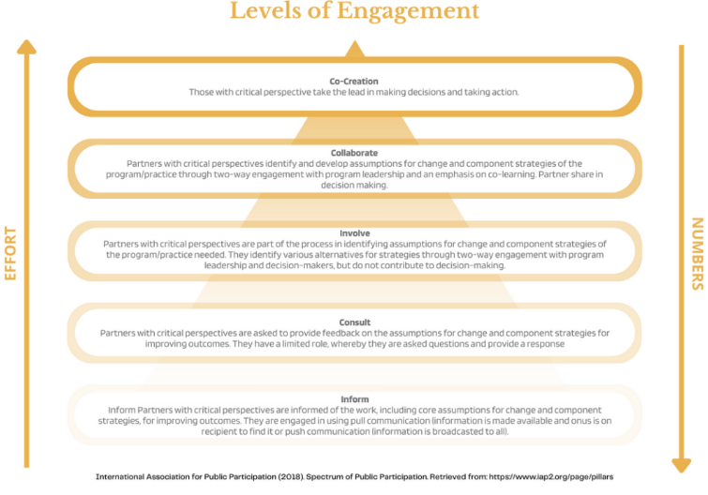
Breakout!
Engaging Critical Perspectives – Levels of Engagement (p. 3)
Takes most effort
Takes fewest people
Notes:
What is the needed level of engagement from each collaborator?
BUT FIRST – identifying those collaborators takes time, and is equity-focused…whose voice is being heard or amplified at each level of engagement? That’s Step 1.
Breakout Prompts to put in the chat:
Again, map your project onto these levels. What collaborators have each of these roles? Who is responsible for maintaining or growing engagement and how is it working? (2 minutes)
Come back together and share a story about one of these levels in your SPDG.

Slide 10
Strategic Integration
For Holistic Engagement
DW: Technical Dissemination Progression | ECP: Equity-Centered Engagement Progression
Step 1: Develop Dissemination Goals | Step 1: Identify (What perspectives are needed?)
Step 2: Stakeholder Analysis | Step 2: Map Level of Engagement
Step 3: Brand Value Proposition | Step 3: Analyze (Barriers and facilitators)
Step 4: Content Development | Step 4: Plan (Action items and responsibility)
Step 5: Dissemination Channels
Step 6: Content Calendar
Context for Implementation
Deep Engagement for Program Fidelity
Do ECP Steps 1 & 2 to find gaps in demographic and issue-based expert voices
Ensures intervention-context fit before scaling or dissemination begins
Then go through DW Step 1
ECP Step 3 - invite critical perspectives of your core assumptions
Ensures intervention is viable in your community context
Notes:
To create holistic engagement, we want to strategically integrate these tools.
We’re going to zig zag between steps to get the biggest bang for our buck.

Slide 11
Strategic Integration
For Holistic Engagement
DW: Technical Dissemination Progression | ECP: Equity-Centered Engagement Progression
Step 1: Develop Dissemination Goals | Step 1: Identify (What perspectives are needed?)
Step 2: Stakeholder Analysis | Step 2: Map Level of Engagement
Step 3: Brand Value Proposition | Step 3: Analyze (Barriers and facilitators)
Step 4: Content Development | Step 4: Plan (Action items and responsibility)
Step 5: Dissemination Channels
Step 6: Content Calendar
Align and Frame Our Values
Systematic Scaling
Do DW Step 3 (brand value proposition)
Translate their “pains” and “gains” into the core message of the project
Ensures community-validated equity
Do DW Step 4, 5 & 6
Once message and dissemination goals are developed, move to content calendar and various channels
Complete the ECP Step 4 (engagement plan)
Notes:
Using these two tools allows us to align and frame our values
Because we have identified and amplified representative and expert voices in our context, we can see where our SPDG work meets participants’ needs.

Slide 12
Engagement and Dissemination Progression
ECP Step 1: Identify (What perspectives are needed?)
ECP Step 2: Map Level of Engagement
DW Step 2: Stakeholder Analysis
DW Step 1: Develop Dissemination Goals
ECP Step 3: Analyze (Barriers and facilitators)
DW Step 3: Brand Value Proposition
DW Step 4: Content Development
DW Step 5: Dissemination Channels
DW Step 6: Content Calendar
ECP Step 4: Plan (Action items and responsibility)

Slide 13
Primary Benefits to Tandem Use
Stronger Intervention-Context Fit
Operationalized Equity
Sustained Success
Access deep community perspectives before scaling
Responsive to local needs
Increases fidelity
Structured engagement OVER symbolic participation prevents tokenism
Recommend Equity Literacy Frameworks as well
High-reach dissemination (guided by DW)
Deep-rooted community advocacy (ECP)
Can protect intervention during leadership or funding shifts

Slide 14
Questions?
Dr. Lucy Fischman
fischman@iu.edu
Dr. Pennie Gregory
pmgregor@iu.edu
Dr. Nancy Holsapple
nholsapple@doe.in.us

Slide 15
References
Equity Literacy Institute. (28 May, 2026). https://www.equityliteracy.org/
Farmer, S., & Perkins, Y. (2023). Engaging Critical Perspectives. State Implementation and Scaling-up of Evidence-based Practices Center. https://implementation.fpg.unc.edu/resource/guidance-for-engaging-critical-perspectives/
US Dept of Education. (20__). EIR Dissemination Workbook and Plan Template.

Slide 16
