Slide 1
FISCAL Resources for SPDG
Note: This slide deck was prepared by project officers for the purposes of organizing a discussion and sharing resources with grantees and is not an official publication of Department of Education. Grantees should refer to their GAN and EDGAR for official policies and requirements.

Slide 2
Agenda
Welcome and Introductions
Key Personnel, Partners, & Communication
G-5 & GANs
Project Overview & Plans
Budget Management
Project Evaluation & Reporting Requirements
Project Management & Timelines
Training & Technical Assistance Resources
Questions & Next Steps
Note: Grantees are not permitted to make changes in project scope or objectives during the conference discussion (except as recommended by reviewers and with approval of PO).

Slide 3
Department-specified Roles and Responsibilities
Project Officer (PO) Add Name
Primary Contact for OSEP / ED; accountable for the work and funds
Project Director (PD) Add Name and FTE
Confirm % FTE that PD will work on this grant.
Prior experience and current work on other discretionary grants funded by OSEP ED, and/or other federal agencies?
Authorized Representative (aka Certifying Representative) Add Name
Enters legally binding agreements on behalf of fiscal agent
Supports PD in administration of grant
Verify on GAN / G5

Slide 4
G5 & GANs
ED’s Grant Management System

Slide 5
G5 supports grantees to…
Identify and make requests for administrative actions (which will be completed, if approved, by the project officer)
Request payments and access to their grant funds
Account was established at the financial institution designated in the application (DUNS number).
Drawdowns are made by the grantee through G5. Payment procedures are outlined in 2 CFR § 200.305.
Monitor your federal funds (do not delegate that authority to others!)

Slide 6
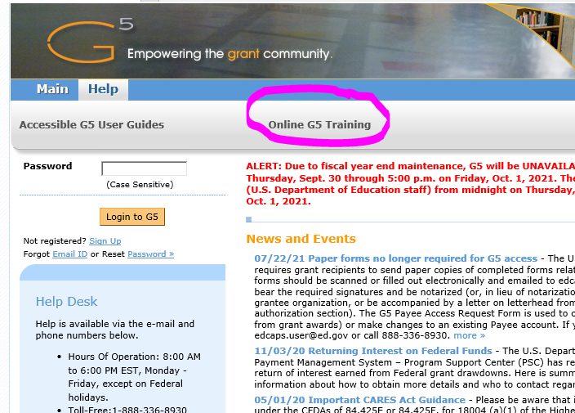
G5 Tutorials
Recommend using Internet Explorer browser (if possible)
If the online training is not cooperating, you can access the text-only version using the “Accessible G5 User Guides” link (works in most browsers)
Monitor G5 homepage for notices of scheduled down time as well as operating hours and contact information for the Help Desk

Slide 7
Project Officers use G5 for monitoring…
Excessive drawdowns
Exceeding the amount of money necessary to meet the immediate cash needs of your grant
Large Available Balances (LABs)
If you are identified as having a potential LAB, your project officer will ask for additional information including your anticipated carry-over and how you expect to spend-down the carry-over funds.
G5 is the system through which Annual Performance Reports (APRs) are submitted by Project Directors.
Get access to G5 for those who need it; access is based on role(s)
Help desk is available, and grantees can also contact PO for technical issues

Slide 8
Information found in each section (box) of the GAN
Box 1-4: Basic award information, verify that this is correct
Box 5: Key Personnel, verify that this is correct
Box 6: Award Periods (Budget, Performance Periods)
Box 7: Authorized Funding (future budget period amounts are proposed but not authorized)
Box 8: Administrative Information
Box 9: Legislative and Fiscal Data
Box 10: Terms and Conditions, including applicable regulations and special conditions

Slide 9
Information found in Box 10
The “rules” that govern your grant, including your application, applicable regulations, and the terms and conditions of the GAN
Subaward rules
Adarand v. Pena Supreme Court decision – must not use race/ethnicity/national origin in selection of personnel or scholars
Indirect cost rate maximum
Regulations regarding awards/subawards to faith-based organizations
Indirect cost rate agreements
Service obligation requirements (pre-scholarship agreements and exit agreements)
Risk mitigation plan: Due 30 days from receipt of award
Please note in your GAN special condition 8: “Projected carryover funds greater than 30 percent of the annual award at the end of the budget period … is one of the factors that may trigger an additional review of the grantee s expenditures and performance. Such review could impact the grant continuation award, including a possible reduction of continuation funds for the subsequent budget period.”

Slide 10
Information found in attachments
Performance report requirements (Annual and Final)
Single audit requirements
Program Income requirements
Federal requirements for all federal grantees (not trafficking in persons, Stevens Amendment statutory requirements for disclosing federal funding, prohibition of text messaging and emailing while driving)
Reporting subawards and executive compensation
UEI and TIN / SAM registration
Review of financial management requirements, memos on drawdowns and cash management
Use of grant funds for conferences and meetings
Dear Colleague Letter on PDP Pre-Scholarship Agreements and Exit Certification Forms (PDPD CS)
(Attachments are usually only included with Initial GAN and Continuation GANs; other GANs created during the year due to updates like administrative actions will not include the attachments)
Notes:
Stevens Amendment statutory requirements, GAN attachment #11- required to disclose for their grant project the percent of the costs financed with Federal funds, the Federal dollar amount, and the percentage and dollar amount financed by nongovernmental funds when issuing statements, press releases, bid solicitations, and other documents describing their grant project. Also, remind grantee that they must document the equation used to determine the Federal and nongovernmental dollar amounts and percentages, and maintain this documentation with their grant file in the event ED requests to review their documentation.

Slide 11
Accessing Federal Regulations – ecfr.gov
2 CFR 200 - Uniform Administrative Requirements, Cost Principles, and Audit Requirements for Federal Awards
34 CFR 75 – Direct Grant Programs (Education)

Slide 12
Official Grant Documents
OSEP will maintain an official file and grant records in G5.
Grantees should retain official file and grant records for 3 years following closeout of your grant.

Slide 13
Budget Management

Slide 14
Budget Management Reminders
The project director (and other key personnel) are responsible for oversight and management of the federal funds awarded and non-federal matching funds proposed as in the funded application
90% of budget over five years must be designated for professional development.
In addition, in all years of your grant (including a no-cost extension year) you must contract or subgrant with (a) an IHE, (b) a PTI or CPRC, and (c) an LEA.
Budget transfers: Transfers for allowable purposes can be made up to 10% of the total (5-year) award without prior approval.
If cumulative transfers exceed 10% of the award, project officer must provide approval.
Communicate with your project officer about budget changes.
Always consider if costs are “allowable,” “reasonable,” and “allocable.”

Slide 15
All project costs must meet the following criteria:
Allowable
Either permitted or not specifically prohibited by program statute or 2 CFR Part 200
Necessary for project success
Allocable
Expended for a particular purpose or time period that benefits the grant
Reasonable
Costs that would be incurred by any prudent person
Necessary
Needed to implement the grant
Notes:
It’s useful to keep in mind this general rule for budget expenditures. All costs must be allowable, allocable, reasonable and necessary:
Costs are “allowable” if they are either permitted or not specifically prohibited by program statute and any specific program regulations or the code of federal regulations, and if they are necessary for project success.
Costs are allocable if they are expended for a particular purpose or time period that benefits the grant.
Costs are reasonable if they might be incurred by any prudent person.
And lastly, costs are necessary to implement the grant.
If an expenditure fails any of these four tests, do not use these grant funds to pay for the cost.
As mentioned previously, during your post-award call with your assigned program officer, needed budget revisions may be discussed.

Slide 16
Budget Review
 | Planning Year / Year 1 | Year 2 | Year 3 | Year 4 | Year 5
Personnel (salary and fringe)
Travel
Supplies
Other
Indirect
Line items of budget; clarify and itemize costs, as needed.

Slide 17
Budget Review
Expanded Authorities
Time extensions (one-time no cost extension) Please don’t plan for this.
Carry over—first in, first out—use carryover funds before continuation funds.
Pre-award costs—pre-award costs incurred 90 days prior to budget period can be reimbursed
Risks to continuation funding associated with carrying large available balances.

Slide 18
Project Evaluation & Reporting Requirements

Slide 19
Grant Management & Budget Oversight Training
Welcome to ED Grants
Discretionary Grants Administration
Allowable Costs and Activities
Internal Controls
Cash Management
Subrecipient Monitoring
Federal Funding Accountability and Transparency Act (FFATA)
Managing the Procurement Process

