Slide 1

Innovating Together: Leveraging Flite Stem Coaching and CIDDL to Advance Learning Outcomes
The FLITE STEM Coaching project is funded through a cooperative agreement with the U.S. Department of Education, Office of Special Education Programs (OSEP) Grant #H3275210005. The products under development do not necessarily represent the policy of the U.S. Department of Education, and you should not assume endorsement by the Federal Government. Project Officer, Jennifer Coffey
Disclaimer: The contents of this presentation for CIDDL were developed by the presenters under award #H327F200008, #H327F250003. They do not represent the policy of the Department of Education. Do not assume endorsement by the Federal Government.

Slide 2

Agenda
Collaborative Question
In the chat, please share when you were MOST stressed as an educator or leader
Menu of FREE Items
FLITE STEM Coaching
Center for Innovation, Design, and Digital Learning (CIDDL)
Podcast (tables aligned with content)
Closing Question
What is one way you could use the resources shared?

Slide 3

Flexible Learning through Innovation in Teaching & Education

Slide 4

FLITE STEM: COACHING
A partnership between the University of Kansas, the University of Central Florida, and Auburn University, funded by the U.S. Department of Education, Office of Special Education Programs H327S230012
Lisa Dieker
PI: University of Kansas
Charles Hughes and Olivia Coleman
Co-PI: University of Central Florida
https://flitestemcoaching.org/
Notes:
Lisa 2-11

Slide 5
Project Goals
Improve the instructional skills of special education teachers during STEM content delivery.
Improve the use of evidence-based practices in STEM instruction.
Improve the STEM content knowledge of students with disabilities.
Notes:
Lisa slides 5-11

Slide 6
FLITE STEM Coaching Suite
Coaching Cycle
Teacher Resources
DebriefScape Observation Dashboard
https://flitestemcoaching.org/

Slide 7
FLITE STEM Coaching Suite
Coaching Cycle
https://flitestemcoaching.org/

Slide 8
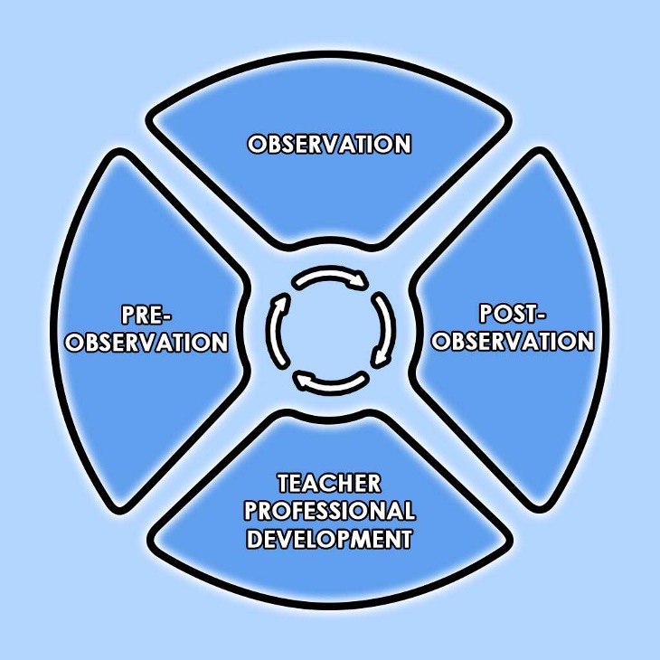
Coaching Cycle

Slide 9
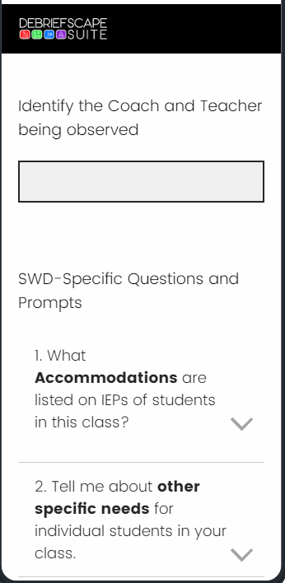
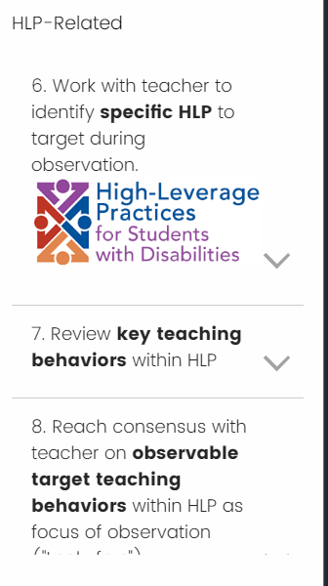
Pre-observation Checklists
To guide the conversation
Emphasis on best practices in Special Ed and STEM

Slide 10
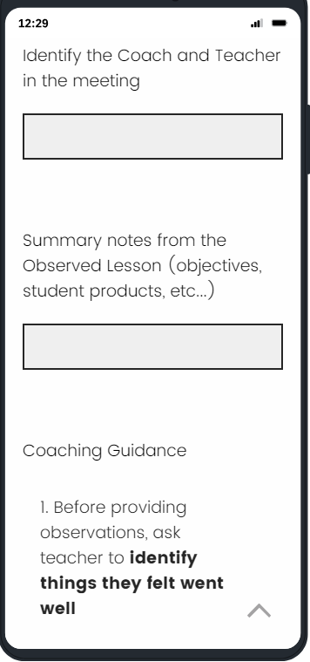
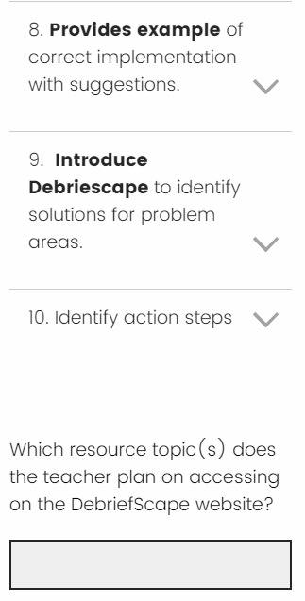
Post-observation Checklists
To focus the conversation
To lead the teacher to support

Slide 11
FLITE STEM Coaching Suite
Teacher Resources
https://flitestemcoaching.org/

Slide 12
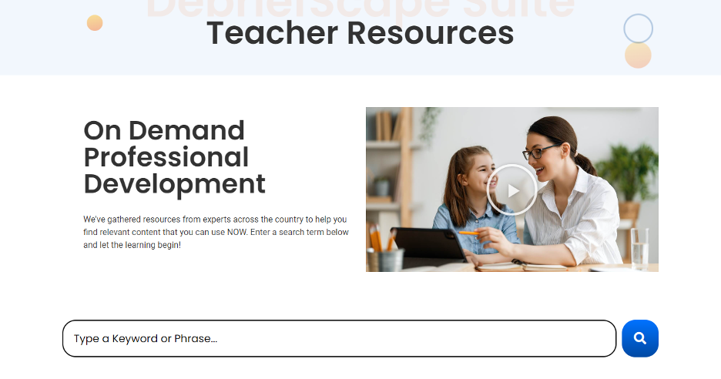

Slide 13
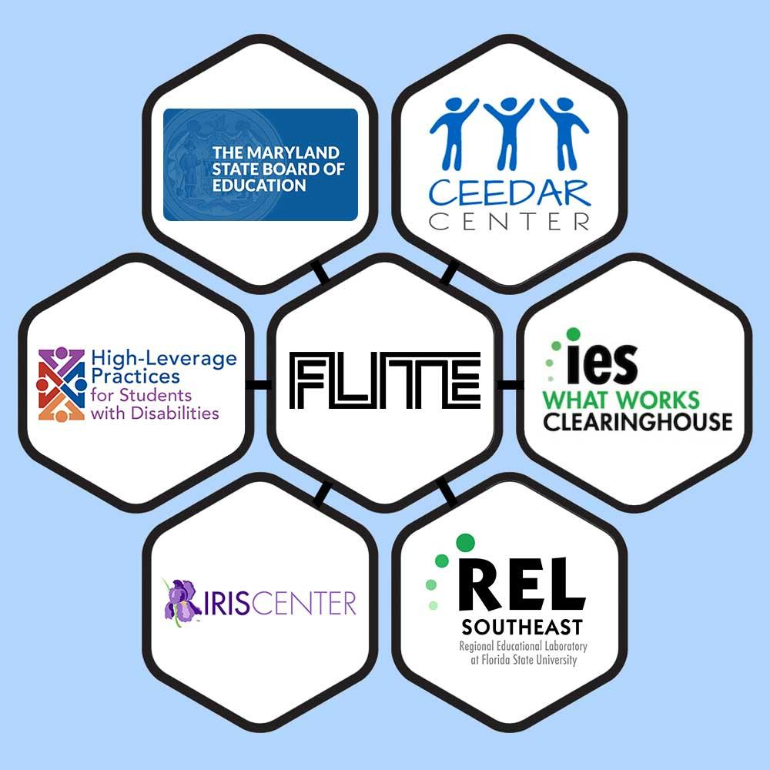
Project Formal Partners

Slide 14
FLITE STEM Coaching Suite
Debriefscape™
Observation
Tool
https://flitestemcoaching.org/

Slide 15
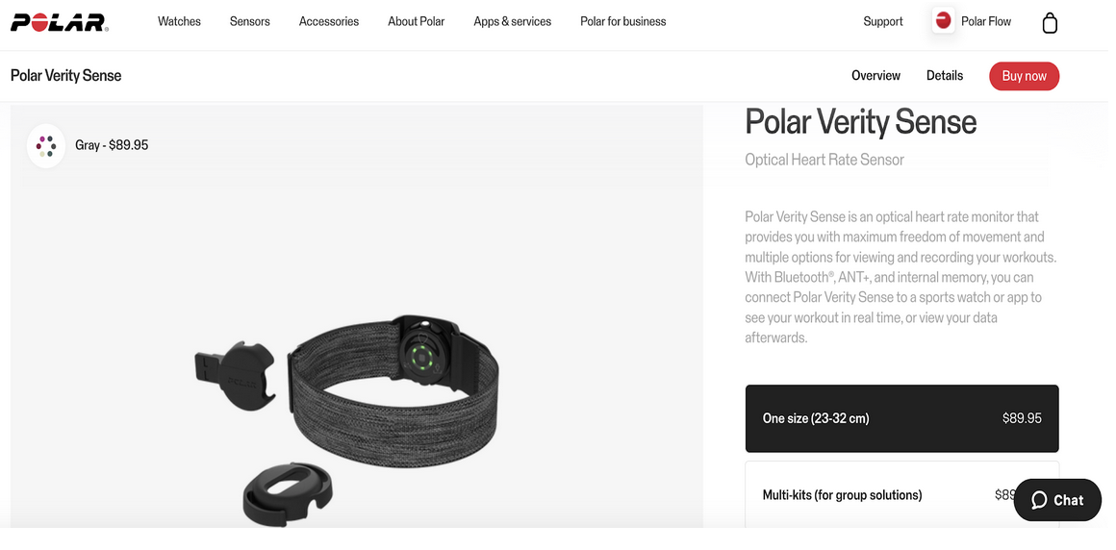
Biometrics

Slide 16
Observation Dashboard: DebriefScape™
Customizable video tagging
Tagging templates aligned with HLPs
Biometric data integration using an NSF grant-developed tool (Vision-based)
Newly integrated facial analysis
Coming Soon: automated suggestions to assist tagging and save time; multi-session analyses
FREE, extendible, and customizable

Slide 17
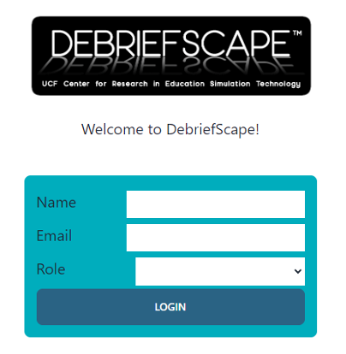
Logging In: Simple one time only

Slide 18
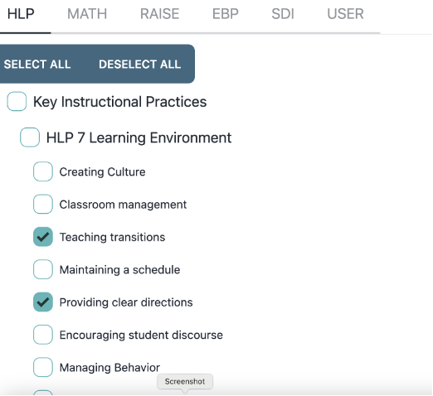
Categories and Specific Tags

Slide 19
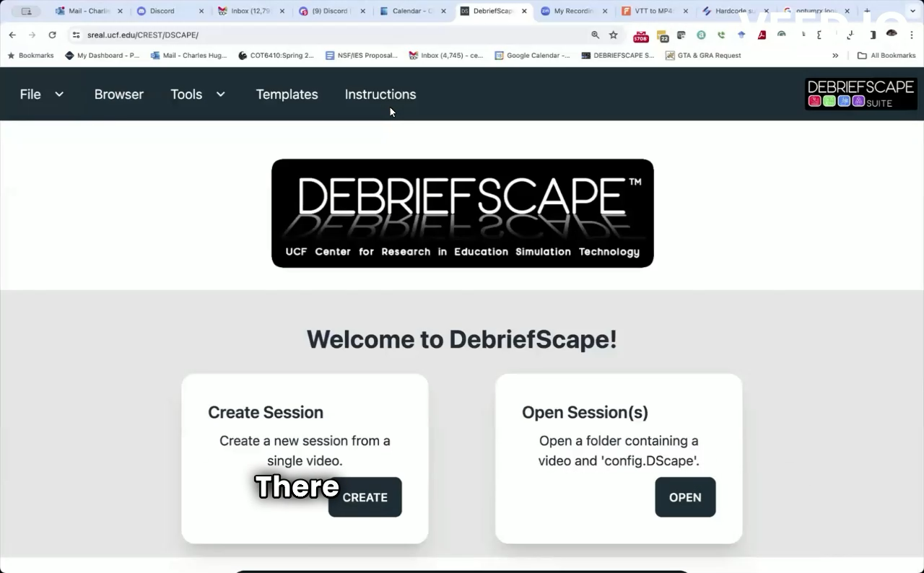

Slide 20
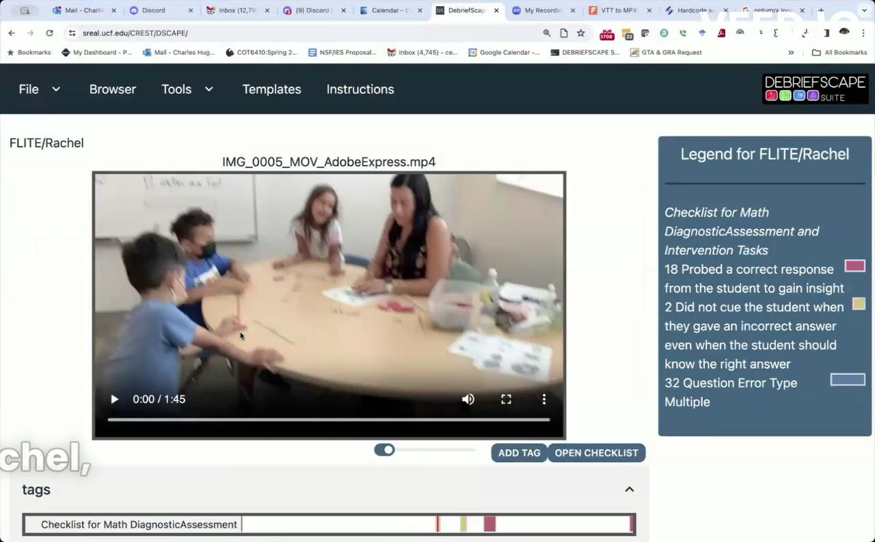
Tagging Interface

Slide 21
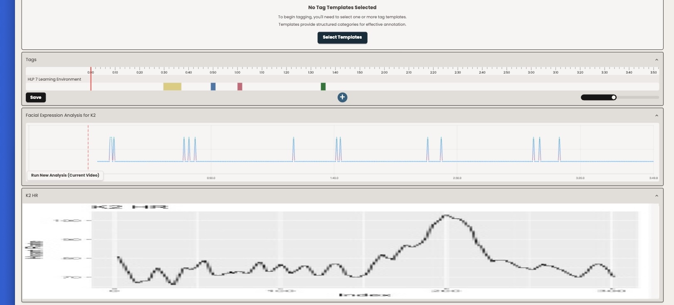

Slide 22
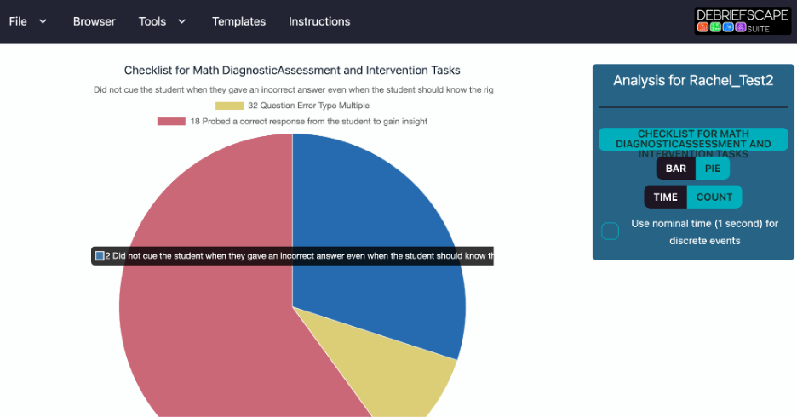
Analysis Interface

Slide 23
Future Extensions
Capture video aligned with other data, e.g., heart and respiration rate, vocalization
Press one button to start all data capture
Acquire indicators of emotional response via remote sensing (no worn devices)
Apply to videos for which a coach/teacher wants to add biosignal data
Use deep learning algorithms to suggest annotations and areas of interest within videos
This is designed to make suggestions, similar to how AI helps a radiologist
Improve user interfaces to all tools, considering usability and accessibility
Make choices easier to make and support those with visual challenges

Slide 24

Center for Innovation, Design, and Digital Learning (CIDDL)
National Center to Improve Faculty Capacity to use Educational Technology in Special Education Personnel and Leadership Preparation Programs

Slide 25
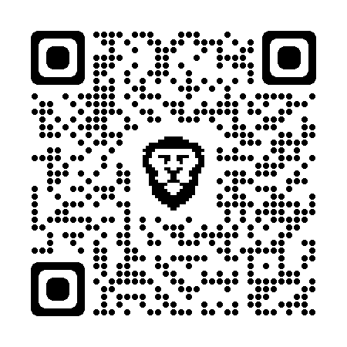
The Center for Innovation, Design, and Digital Learning (CIDDL) serves as the National Center to Improve Faculty Capacity to use Educational Technology in Special Education Personnel and Leadership Preparation Programs.
Learn more at https://ciddl.org/
Disclaimer: The contents of this presentation were developed by the presenters under award #H327F200008, #H327F250003. They do not represent the policy of the Department of Education. Do not assume endorsement by the Federal Government.
Learn more at CIDDL.org

Slide 26
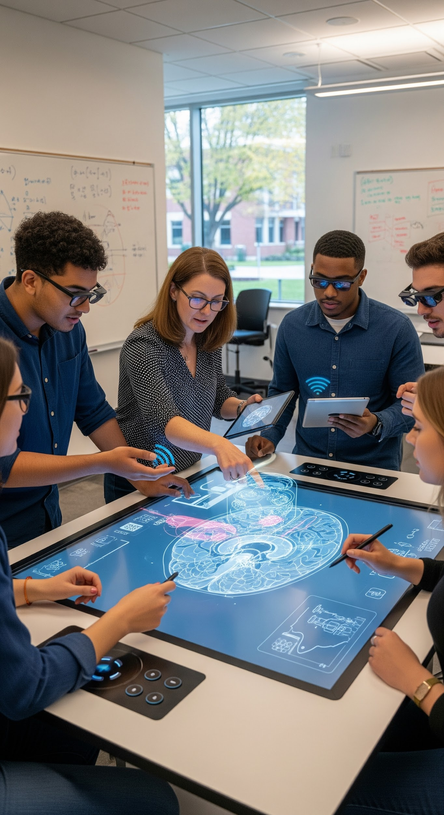
CIDDL is Focused on…
Increasing knowledge, capacity, adoption, and integration of innovative technologies (including educational, assistive, and artificial intelligence) within special education personnel and leadership preparation programs;
Increasing the number of faculty who keep up with technological innovations and research;
Increasing the number of special education and leadership personnel graduates well-prepared to integrate technologies and innovative technology practices.
Learn more at CIDDL.org

Slide 27
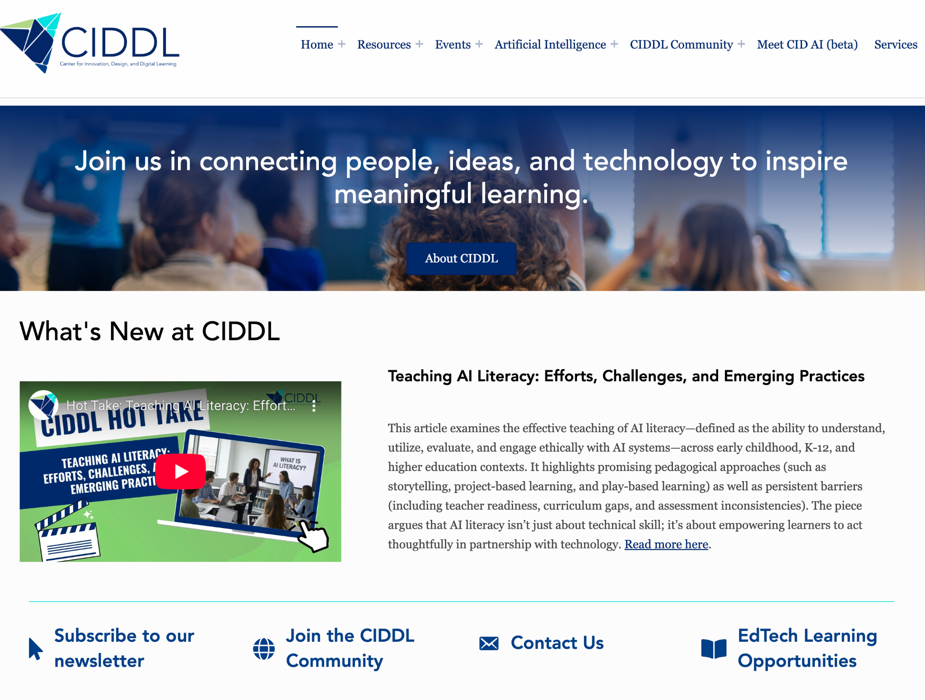
Learn more at CIDDL.org

Slide 28
Some CIDDL Resources…
Learn more at CIDDL.org

Slide 29
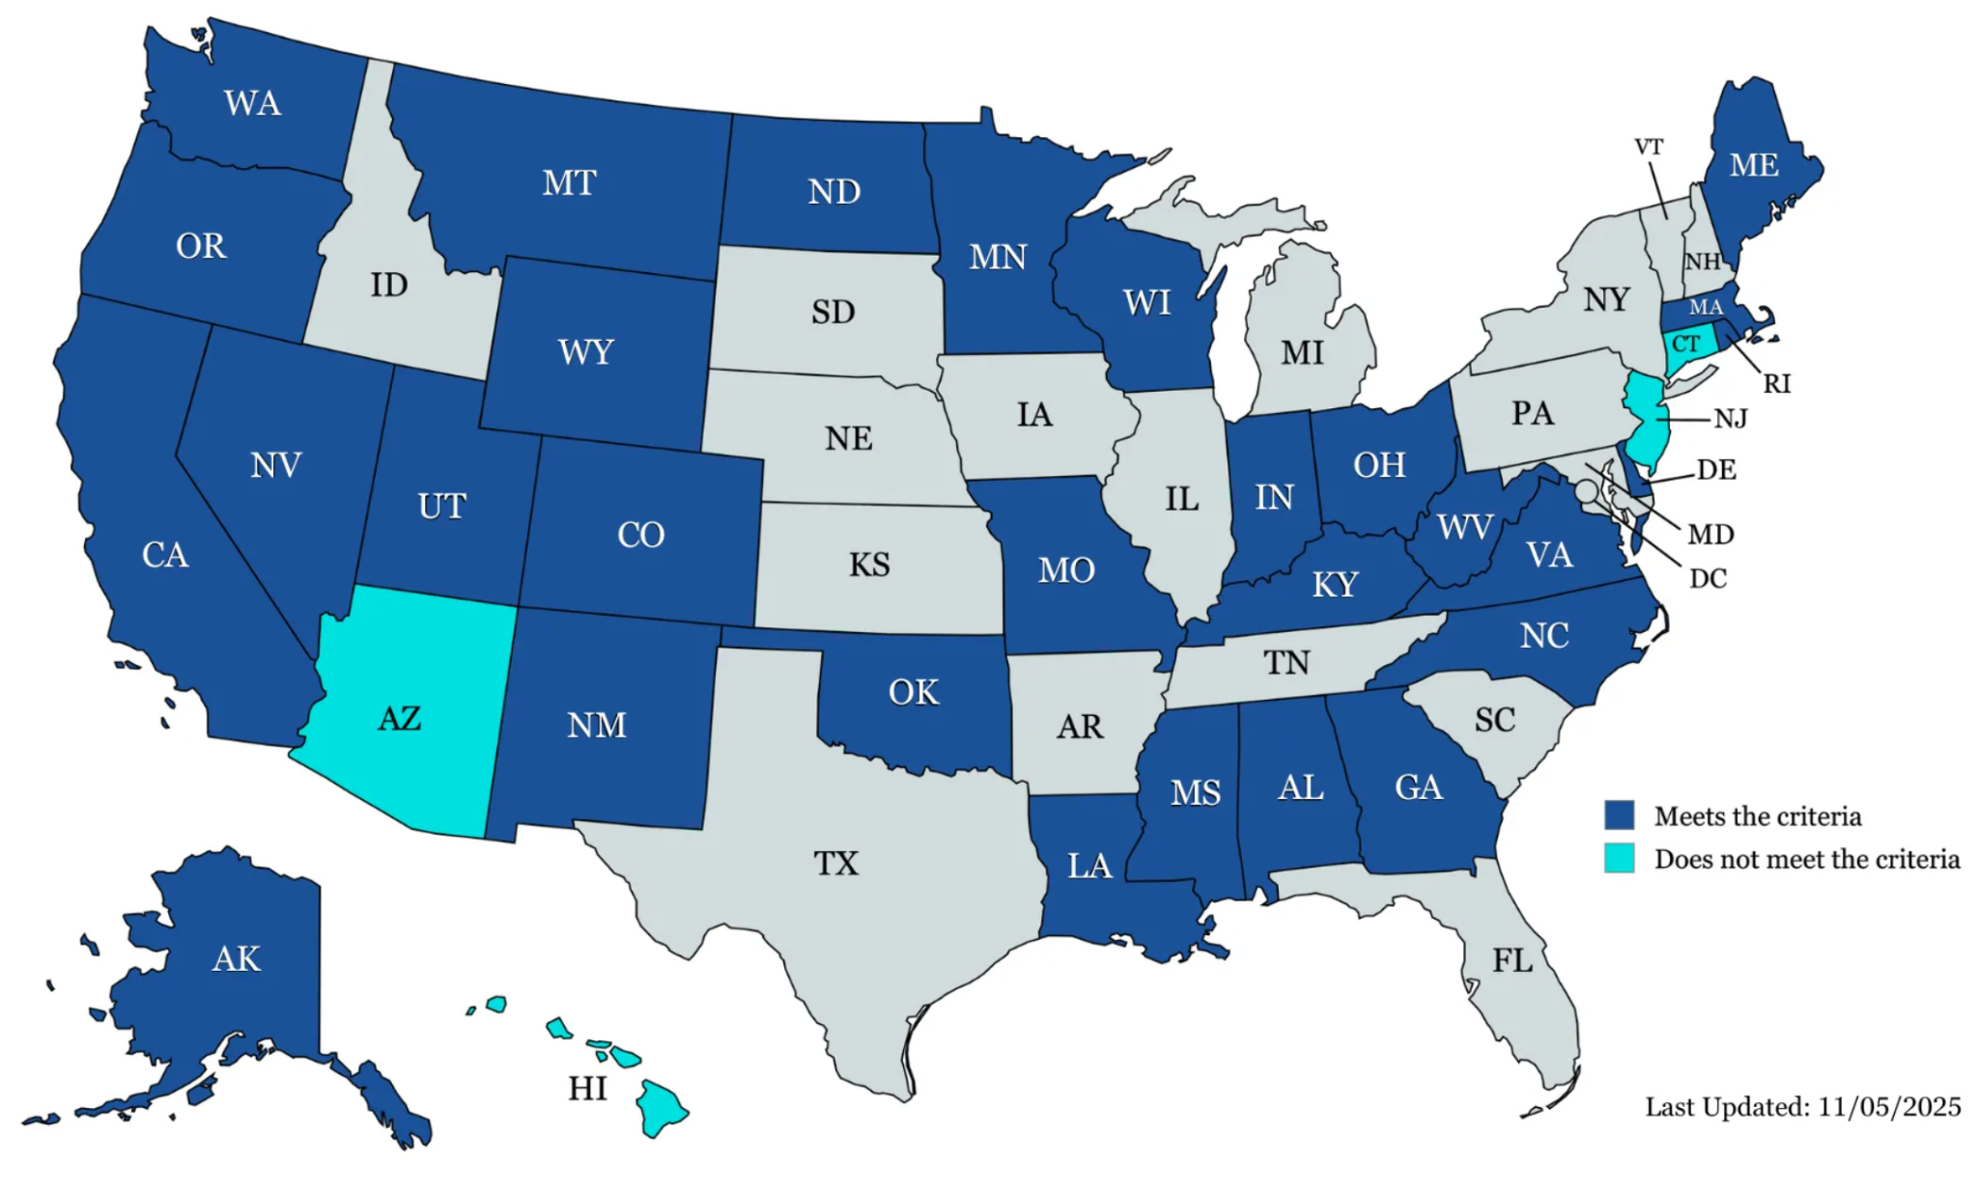
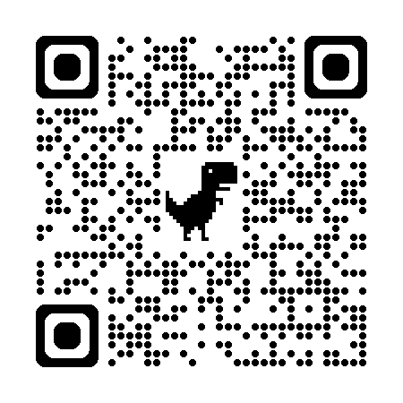
AI State Guidance for K-12 Education
Monitoring of “official” K-12 state AI guidance.
Twenty-nine state guidance documents met our criteria: AK, AL, CA, CO, DE, GA, IN, KY, LA, MA, ME, MN, MO, MS, MT, NC, ND, NM, NV, OH, OK, OR, RI, UT, VA, WA, WI, WV, and WY.
Only include students with disabilities (20 of 29 states).
A single state, Maryland has actual policy on AI use and procurement
Dark Blue= Meets criteria
Light Blue= Does not meet criteria

Slide 30

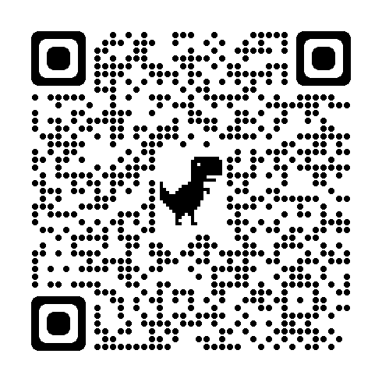

Artificial Intelligence:
The Impact of AI on Education for All Learners
Introduction
Chapter 1: Considering Artificial Intelligence in Higher Education
Chapter 2: Teacher Practices and AI Assessment
Chapter 3: Using AI in the Classroom: Considerations for Educators
Chapter 4: Envisioning AI's Impact on Special Education Research
Chapter 5: Enhancing the School-Home Connection: Empowering Parents with AI
Chapter 6: Policy and Guidance Considerations for AI in Supporting SWDs
Chapter 7: Industry Collaboration for Educators and AI
Chapter 8: Ethical Considerations for Educators Leveraging AI
CIDDL.org
Notes:
Matt

Slide 31
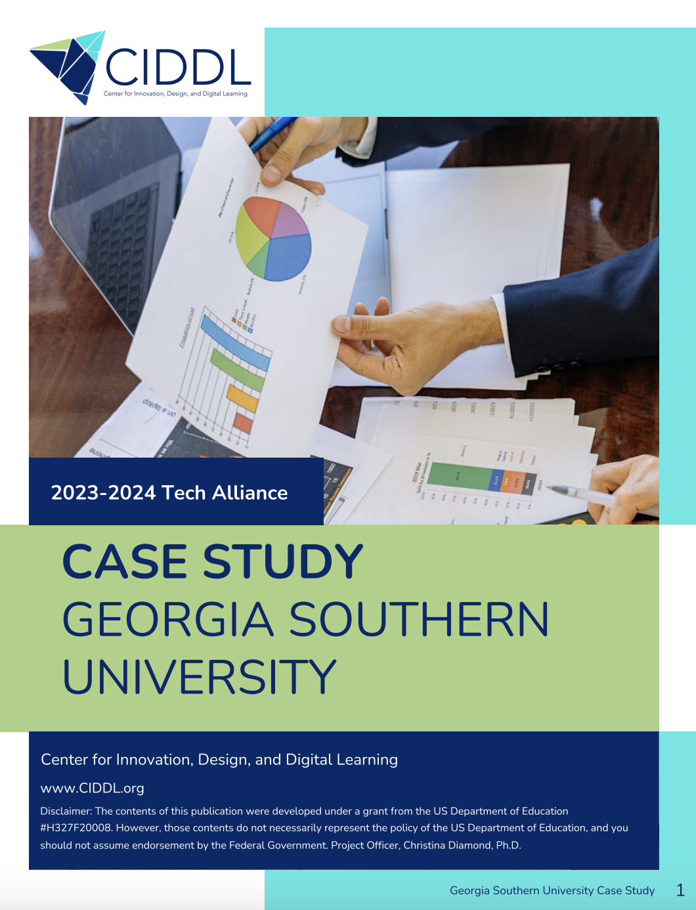
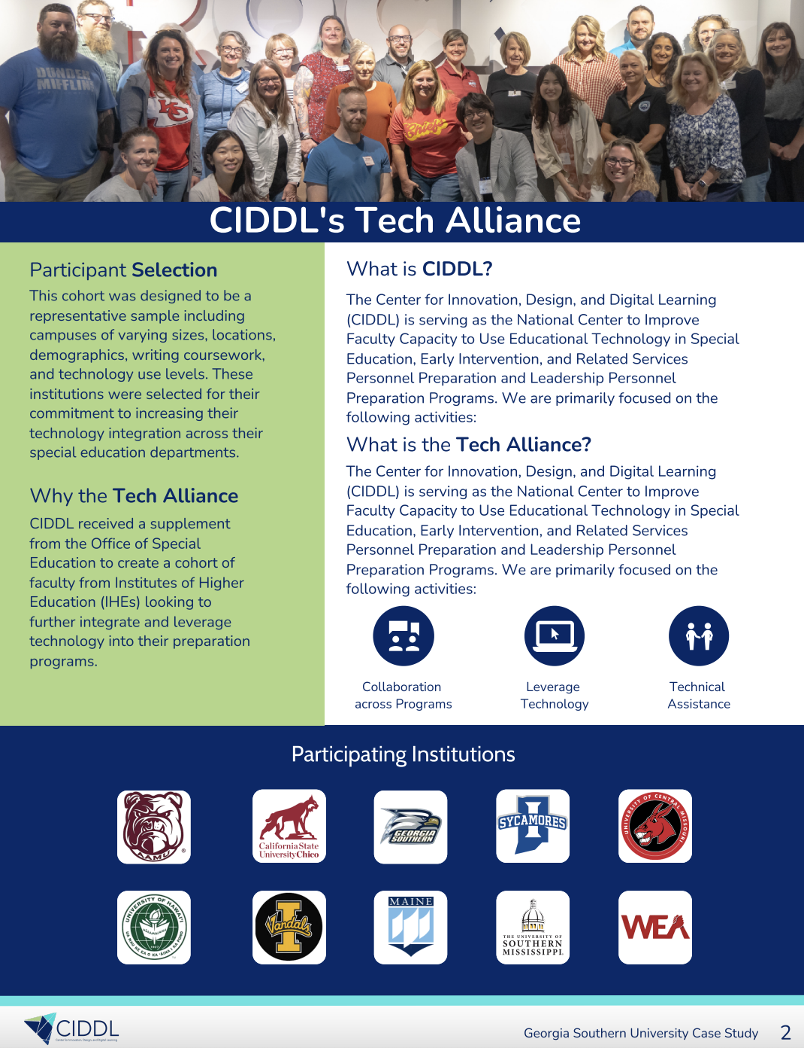
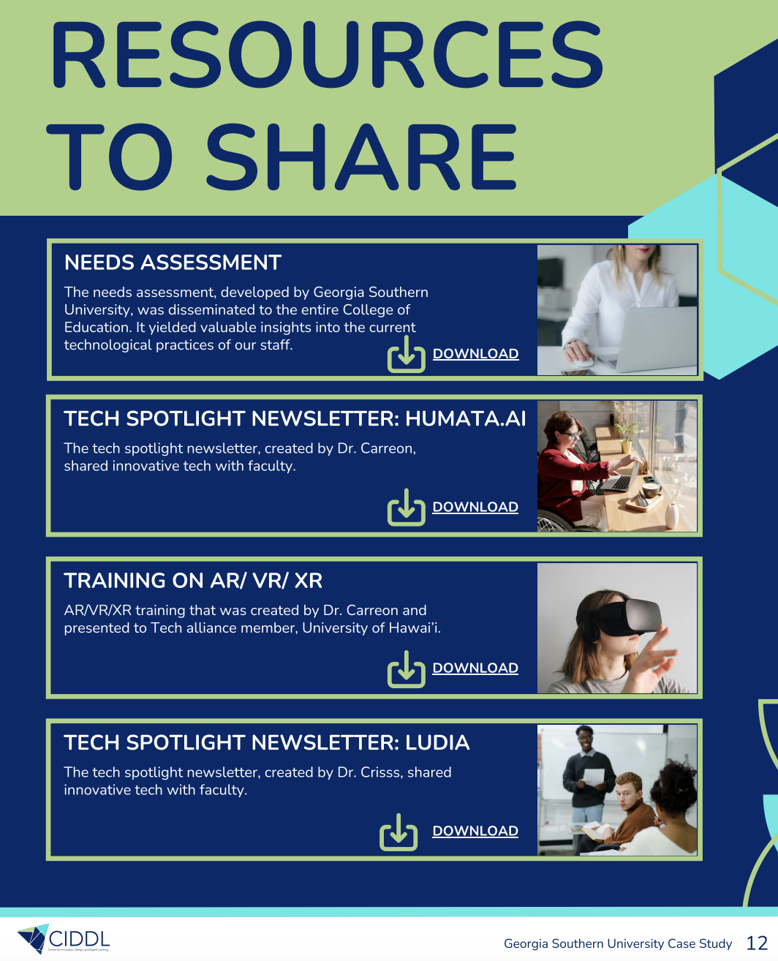
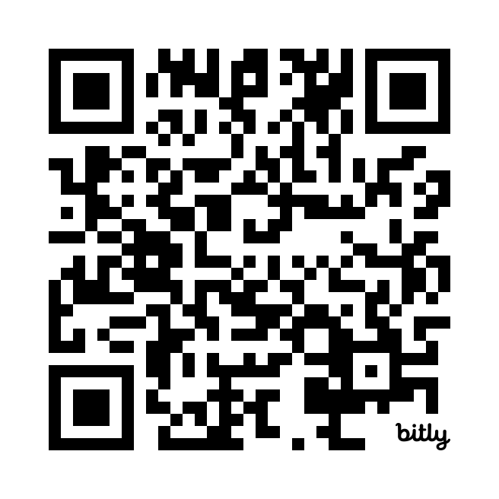
CIDDL Tech Alliance Case Studies and Resources
Notes:
Matt

Slide 32
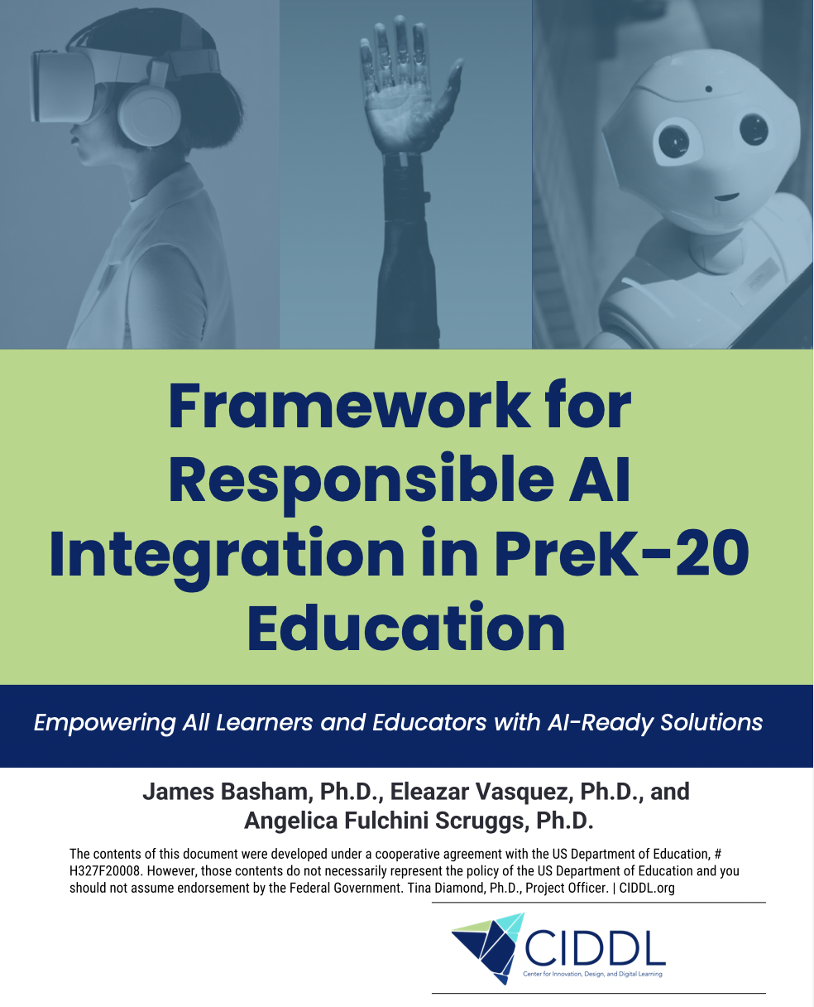
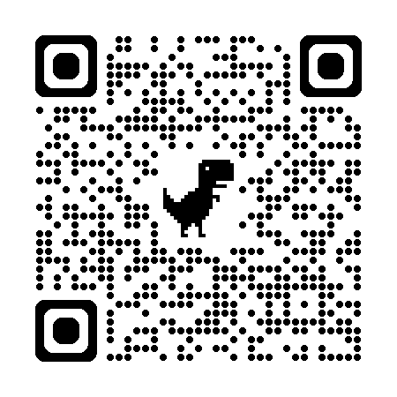
Strategic AI Use: AI in education requires careful planning to avoid risks and maximize benefits.
CIDDL Framework: Provides practical guidance for AI integration in PreK–20 settings.
Supports All Learners: Designed to meet the needs of students, including those with disabilities.
Future-Focused: Prepares students for postsecondary, career, and lifelong learning.
Evolving Resource: Framework will adapt with new technologies and insights.

Slide 33
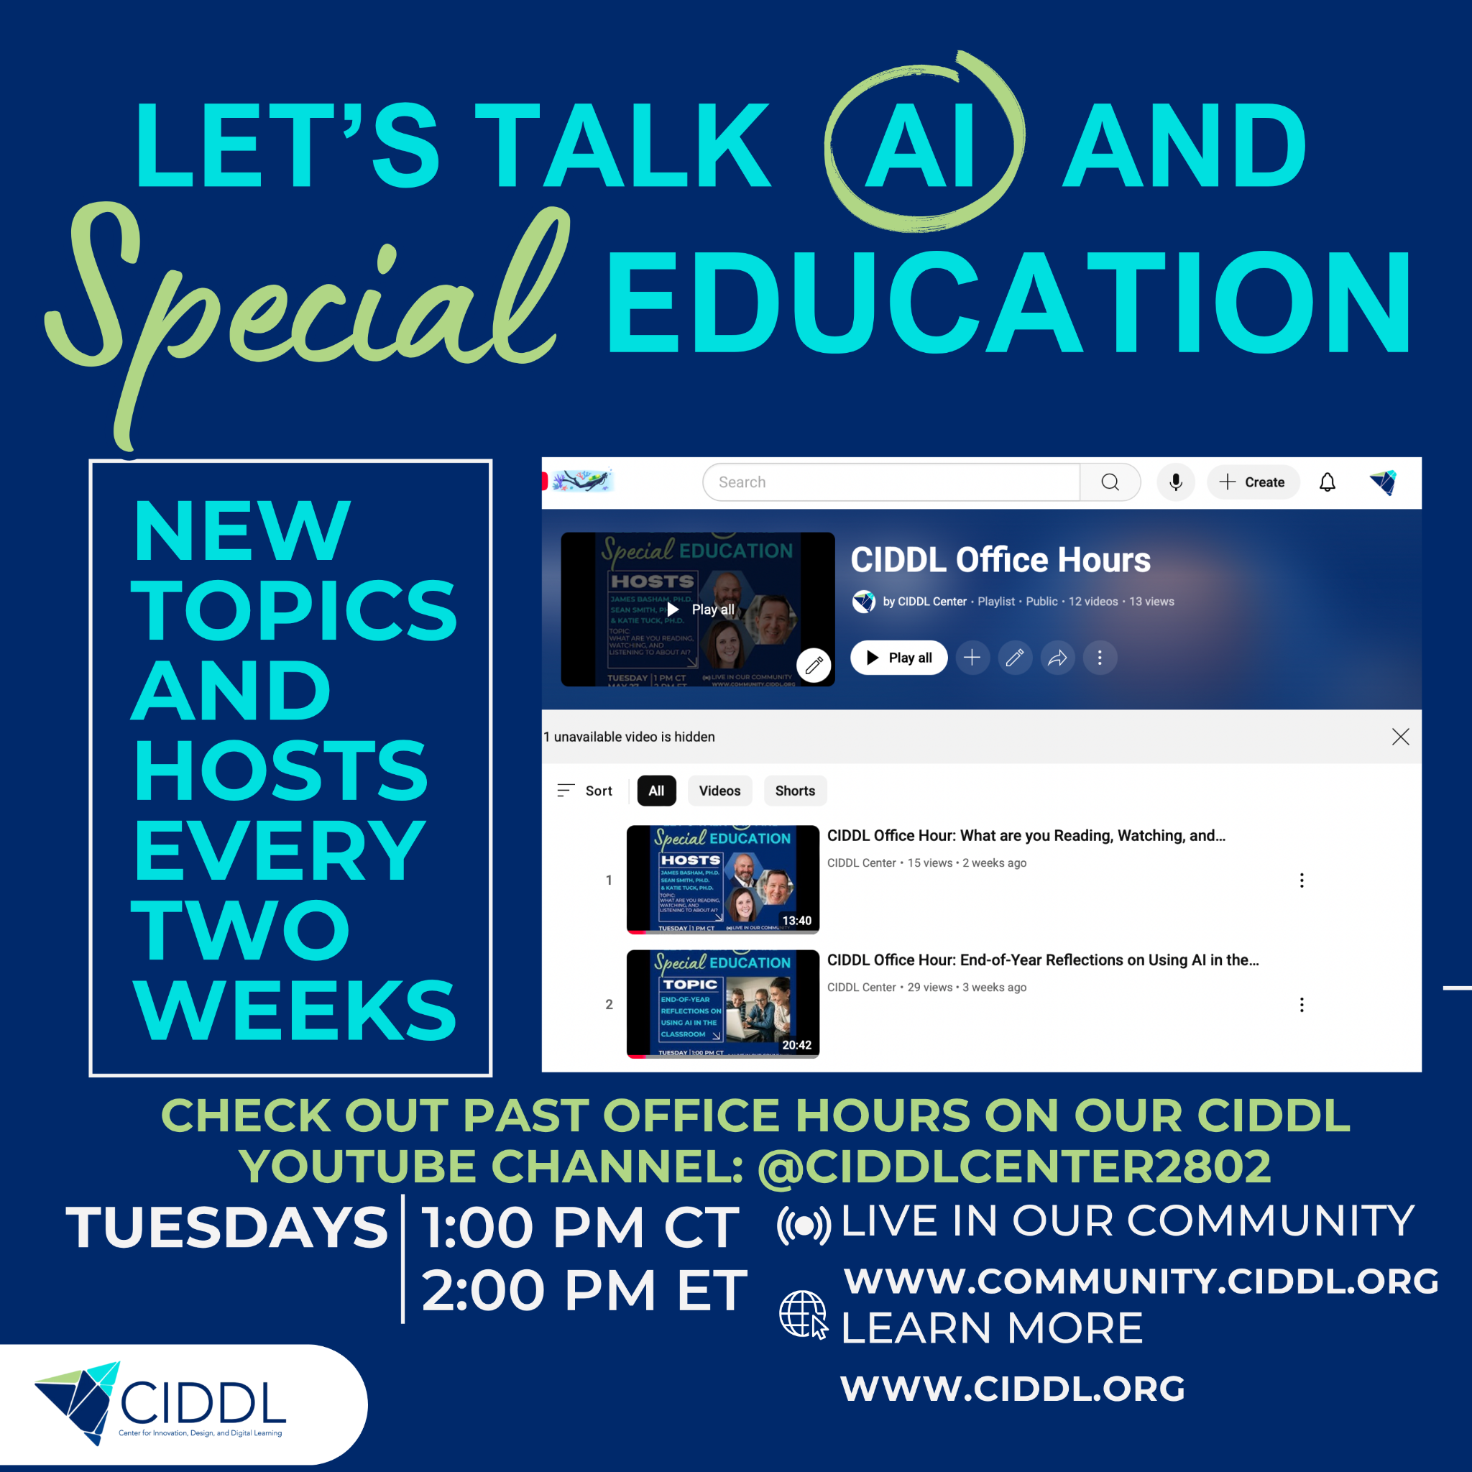
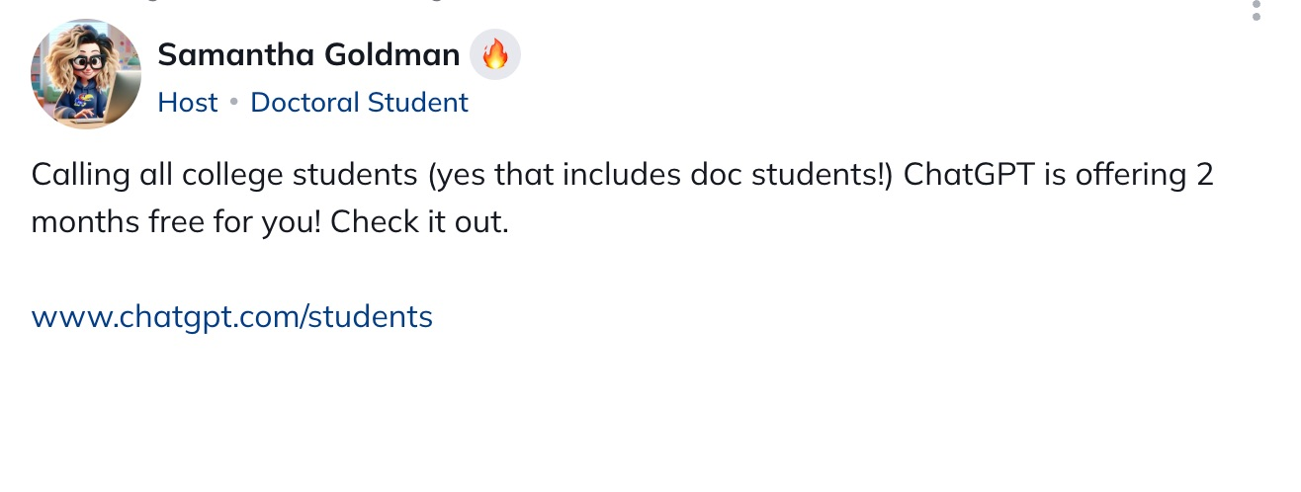
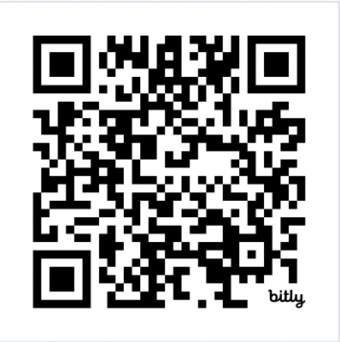
CIDDL Community and AI Office Hours

Slide 34

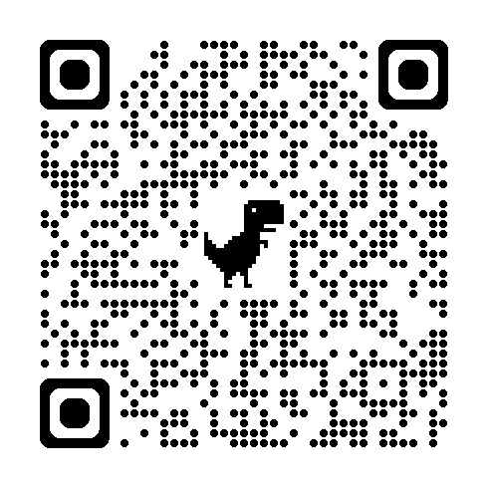
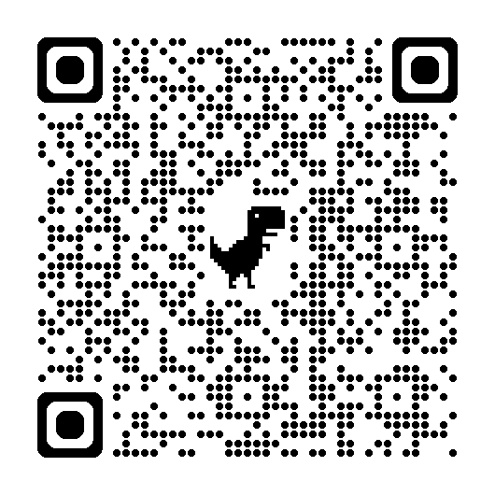
CEC Collaboration Monthly “AI Quick Takes” (30 minutes)
AI 101 for Educators: Implementing AI to Support Student Learning (November 20, 2025)
Applying AI Tools in Special Education: Strategies for Implementation and Impact (December 18, 2025)
Responsible AI Use in Education: Implementing Safe, Ethical, and Informed Practices (February 19, 2026)
AI Strategy Summit (One Day Online Summit)
(January 28, 2026)
Collaboration with Council for Exceptional Children (CEC)

Slide 35

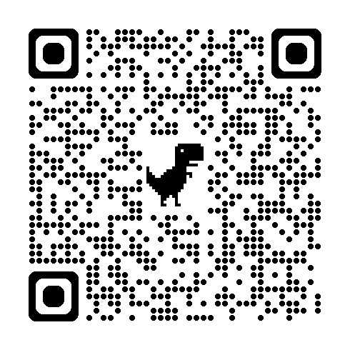
Questions?
Ask questions and share your thoughts
Connect with us via email at info@CIDDL.org
If interested in learning more about CIDDL or requesting products and services…

Slide 36
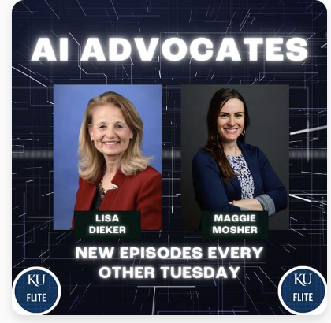
AI Advocates - 2 Seasons
https://aiadvocates.buzzsprout.com/

Slide 37
All Podcast in a Table to Use in your Districts
•AI Advocates: (2 Seasons) https://docs.google.com/document/d/1Oj4knVJpvQmp7lR9KhP_OOdJ0436U_1zpGl2XAi4gCY/edit?usp=sharing
•Practical Access: (12 Seasons)
•https://docs.google.com/spreadsheets/d/1bN6kRCzz3tF74dMdfE99uuNQOComWlb0Ww_OWs6jJi4/edit?usp=sharing

