Slide 1
Empathetic Interviewing: Why, What, & How
Caryn Ward, PhD
October 13th, 2021

Slide 2
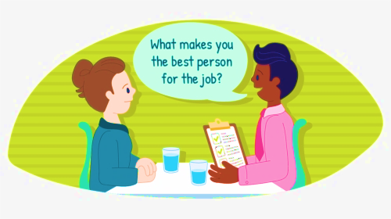
Being Interviewed.. Would you Rather

Slide 3
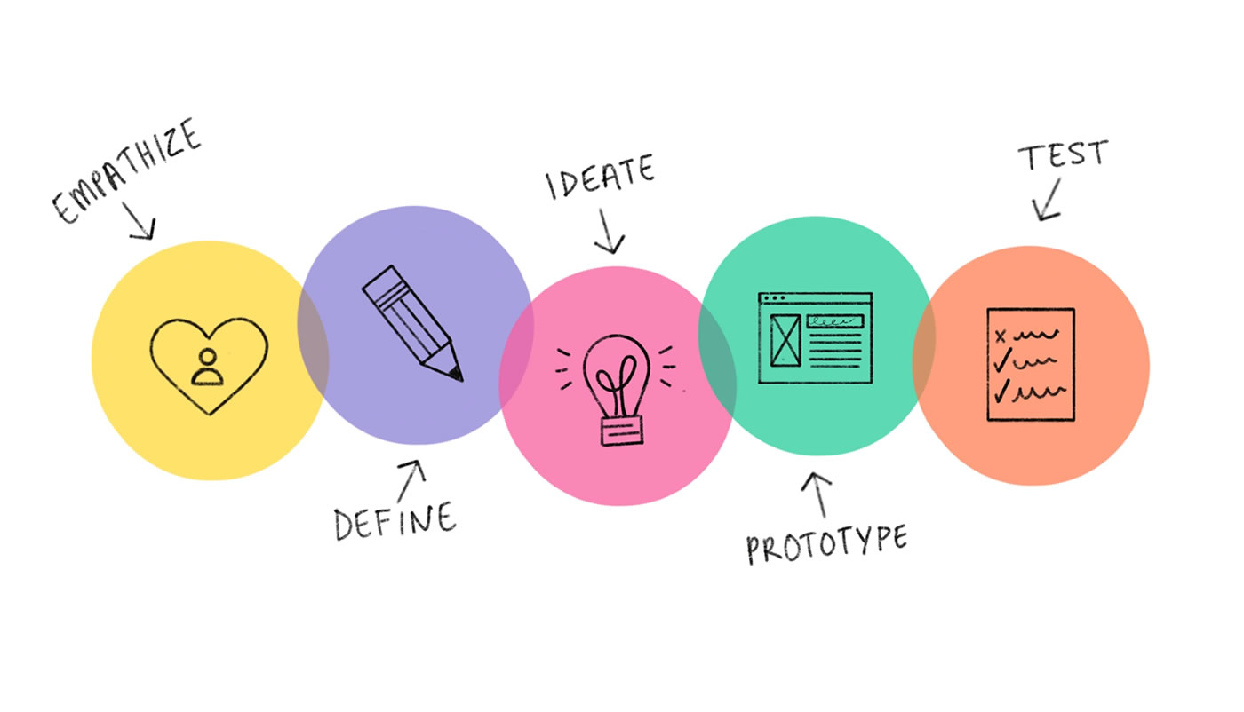
Empathy Interviewing: Why
With greater understanding another person’s thoughts, feelings, and motivations, we can understand the choices that person makes, we can understand their behavioral traits, and we are able identify their needs.
This helps us innovate, and create products or services for that person.
Design Thinking Process

Slide 4
Empathy Interview: What
To feel heard is to feel valued.
It uses active listening and active hearing
Allow users to speak about what is important to them.
Focus on the emotional and subconscious aspects of the user.
Gain insights on how users behave in given environments and situations.
Reveal solutions or unmet needs and challenges you might be overlooking.
About getting deeper and going beyond your run of the mill questions.
Make the subject feel at ease so they can shed the mask and speak from the heart.
Observe body language and reactions of the subjects to guide questions

Slide 5
Empathy Interview: How
Conducted in pairs
Use open ended questions versus leading questions
Ask follow up questions
Ask “why”; never assume know answer
Ask neutral questions
Incorrect: What frustrations do you have about the new policy?
Correct: What do you think about the new policy?
Encourage story telling
Tell me about a time..
Seek clarity on generic answers
Be an active listener
Follow up on energy and emotion
Restate or reframe
Observe body language
Embrace silence – let participant break it
Document what you learn

Slide 6
Discussion Questions
How could you use this resource or something similar for your work?
When in the implementation process?
Have you tried something similar before?
If yes, what worked and what didn’t work?

Slide 7
Visit our AI HUB
https://nirn.fpg.unc.edu/ai-hub

Slide 8
Copyright

Slide 9
UNC FPG Logo

