Slide 1
SPDG APR Webinar
January 24, 2024
Jennifer Coffey, PhD

Slide 2
Purpose of Today’s Webinar
Provide
SPDG Program’s GPRA results from last year’s APRs.
Remind
Program Measure reporting strengths & challenges.
Prepare
APR deadlines and guidance.
Gather
Fidelity Fridays

Slide 3
Learning Targets
Participants will be able to describe the type of fidelity measures now required for Program Measure 2 (for FY 20, 21, 22, & 23 grantees)
Participants will be able to navigate to the Program Measures page to review the APR resources.

Slide 4
My Intention
You will have a better sense of APR expectations and the resources that will help you meet those expectations.

Slide 5
Your APR Calendar (not for new grantees)
January
Receive your continuation package with APR directions in January.
January
APR How-to Webinar.
April 15
Provide a draft of your Program Measures to your Project Officer.
May 3
APRs due in G5.

Slide 6
Your APR Calendar (new grantees)
New grantees provide all draft measures to your Project Officer prior to the April 15th program measure submission.
Receive your continuation package with APR directions in January.
Provide a draft of your Program Measures to your Project Officer.
January
January
15 Apr.
3 May
APR How-to Webinar.
APRs due in G5.

Slide 7
GPRA Review Progression
Implementation
Year 2
Contractor reviews EB-PD Worksheet for the first time (Program Measure 1).
Implementation
Year 3 & 4
Contractor reviews worksheet, fidelity measure, and cost measure (Program Measure 1, 2, & 3).
Implementation Year 5
Contractor reviews worksheet, fidelity measure, cost measure, and child outcome measure (Program Measure 1, 2, 3, & 4).

Slide 8
Program Measure 1
Evidence-based Professional Development

Slide 9
Year | Target | Actual (or date expected) | Status
2012 | Not available. | 50 | Historical Actual
2013 | Not available. | 45 | Historical Actual
2014 | Not available. | 3 | Historical Actual
2015 | Not available. | 72.4 | Historical Actual
2016 | 70.0 | 75 | Target Exceeded
2017 | 70.0 | 92 | Target Exceeded
2018 | 77.0 | 82.8 | Target Exceeded
2019 | 82.0 | 68.7 | Did Not Meet Target
2020 | 85.0 | 81.3 | Target Not Met, but Improved
2021 | 85.0 | 81.5 | Target Not Met, but Slightly Improved
2022 | 82.0 | 88.5 | Target Exceeded
2023 | 82.0 | 88.0 | Target Exceeded

Slide 10
Initiative | Met Target
 | Yes | No
Implementation Year 2 (8 initiatives) | 8 | 0
Implementation Year 3 (2 initiatives) | 2 | 0
Implementation Year 4 (1 initiative) | 1 | 0
Implementation Year 5 (3 initiatives) | 3 | 0
Implementation Year 6 (6 initiatives) | 5 | 1
Implementation Year 7 (5 initiatives) | 3 | 2
Total (25 initiatives) | 22 | 3
% | 88.0% | 12.0%

Slide 11
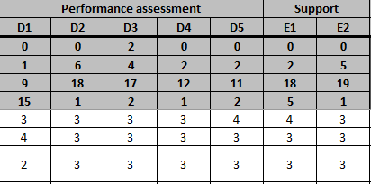

Slide 12
Areas of Strength
A(1): Expectations for PD participants
A(2): Expectations for trainers & coaches
B(1): Accountability for the delivery & quality of training
B(2): Research-based adult learning strategies are used
B(3): Training is skill-based
B(4): Trainers are trained, coached, & observed
C(1): Accountability for the development, evaluation, quality & timeliness of coaching services
C(3): Coaching outcome data collected and analyzed.
E(1): Technical & adaptive leadership at the State level.
E(2): Leadership to build state-level capacity & sustainability

Slide 13
Components to Watch
(B5) Administrators are trained and coached on the SPDG-supported practices and have knowledge of how to support its implementation, including how to develop and support implementation teams and how to support coaches.
Required elements:
Description of expectations for the role of building, district, and regional administrators in project implementation, including how coaches will be supported.
Description of how administrators are trained and coached to support implementers and coaches.
Description of supports for creating implementation teams at the building and district or local program levels.
(C2) Coaches use effective coaching practices to increase innovation fidelity.
Required elements:
Description of coaching process, including coaching strategies, frequency, how feedback is provided, use of data within the coaching process, and how coaching effectiveness is measured.
Note: This description may take the form of a coaching service delivery plan.
Description of how coaching process is captured and connected to impact on fidelity of the innovation.
Note: These data may be collected in a coaching log.

Slide 14
Components to Watch
(D2) Coherent data systems are in place at all education levels (SEA, regional, LEA, school).
Description of key data sources are analyzed to connect training and coaching to fidelity of the innovation and then child outcomes:
Description of how targets/benchmarks are set for the various types of data.
Description of how data collection guidance (e.g., procedures, timelines) is provided to professional development sites and participants.
Description of how teams are trained and coached to use training/coaching, fidelity of the innovation, and child outcomes data
(D3) Fidelity and student outcome data are used to inform the continuous improvement of the project in collaboration with stakeholders at multiple levels (SEA, regional, schools, community, other agencies).
Description of how data are compiled and communicated in usable format(s) with various audiences/stakeholders (e.g., communication protocol).
Description of how feedback loops function to inform improvement across multiple levels (State, regional, local, community, and other agencies).
Description of how fidelity and child outcome data inform modifications to project plans and processes.

Slide 15
B(5) Administrators are trained and coached on the SPDG-supported practices and have knowledge of how to support its implementation, including how to develop and support implementation teams and how to support coaches.
Feedback from CIPP:
Element B5 was scored a 2 because some of the activities described occurred in prior years and not the reporting year; the descriptions of training to trainers, coaching to trainers, and identification of a training fidelity instrument were all missing or insufficient.
B(5) was scored a 2 because the description of expectations for administrators (not project administrators) was missing, the description of how administrators are supported was insufficient, and the description of supports for creating implementation teams was missing.

Slide 16
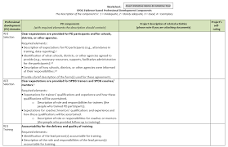
Program Measure 1
Revised Worksheet & Rubric (Required for FY 20, 21, & 22 SPDGs)

Slide 17
Completing your EB-PD Worksheet
Review
Review exemplar worksheets
Use
Use the appropriate EB-PD Worksheet
2015, 2016, and 2017 SPDG grantees use this worksheet: EB-PD Worksheet with Bullets
2020, 2021, 2022, & 2023 SPDG grantees use this worksheet: Revised EB-PD Worksheet
Perspective
Have a SPDG “novice” review your worksheet (good use of interns/doc students)
Or have another State review!

Slide 18
Questions about Program Measure 1?

Slide 19
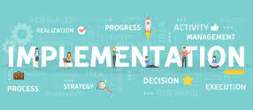
Program Measure 2: Improving Implementation
The percentage of Special Education State Personnel Grant funded Initiatives that meet benchmarks for improvement in implementation of SPDG-supported practices over time.

Slide 20
Year | Target | Actual (or date expected) | Status
2012 | Not available. | 18 | Target Not In Place
2013 | Not available. | 50 | Historical Actual
2014 | Not available. | 37 | Historical Actual
2015 | Not available. | 58 | Historical Actual
2016 | 60.0 | 74 | Target Exceeded
2017 | 60.0 | 72 | Target Exceeded
2018 | 65.0 | 54.5 | Target Not Met
2019 | 65.0 | 48.0 | Target Not Met
2020 | 70.0 | 60.0 | Target Not Met, but Improved
2021 | 70.0 | 59.3 | Target Not Met
2022 | 60.0 | 48.0 | Target Not Met
2023 | 60.0 | 70.6 | Target Exceeded

Slide 21
Celebrating You!

Slide 22
Initiative | Met Target
 | Yes | No
Implementation Year 3 (2 initiatives) | 1 | 1
Implementation Year 4 (1 initiative) | 1 | 0
Implementation Year 5 (3 initiatives) | 2 | 1
Implementation Year 6 (6 initiatives) | 6 | 0
Implementation Year 7 (5 initiatives) | 2 | 3
Total (17 initiatives) | 12 | 5
% | 70.6% | 29.4%

Slide 23
Considerations
Be clear about the fidelity measure you used.
How will the reviewers know it’s a fidelity measure?
If your fidelity measure is a self-assessment, describe 20% external observation reliability check, if possible.
If it’s not a self-assessment make that clear in your description.
Setting next year’s targets… are your targets appropriate?

Slide 24
FY 20, 21, 22, & 23 Grantees: Intervention Fidelity
For Program Measure 2, fidelity measures an intervention, practice, or program experienced by the child/student.
For instance, a SPDG is using a multi-tiered system of support (MTSS) that is focused on reading. LETRS is the intervention being used to teach reading. The SPDG should use a fidelity measure that captures personnel use of LETRS
A measure of MTSS implementation fidelity (i.e., district and school level process support) is still critical for the project and should be reported as a project measure.

Slide 25
Fidelity Requirements & Strategies
Program/GPRA measure has changed to “intervention fidelity.” The means the intervention that is expected to improve outcomes for children with disabilities.
Strategies for data collection:
Sampling
Determining common essential features across different interventions
Determining benchmarks across different types of measures and reporting the percentage of sites that met their benchmarks?
What other strategies can you think of?

Slide 26
Another Program Measure 2 Example
A SPDG is implementing PBIS with a focus on intensive intervention. The grant could assess fidelity to plans derived from the functional behavior assessment (FBA).
They also need to think about the processes that are supporting this adult behavior (implementing the plan that resulted from the FBA). Is it a student study team that creates the FBA and implementation plan? The team processes may be the implementation fidelity measure reported as a Project Measure.
Systems vs. Interventions
Do you have another way of thinking about it?

Slide 27
Setting Targets
Challenging but achievable
Analyzing your history and the outcomes other initiatives are experiencing.
Set the target for your out-years
Work with your Project Officer
Targets can be changed

Slide 28
Reliability Check
Only for fidelity measures that are “self-assessments”
20% reliability check conducted by someone not involved in the day-to-day of the work
Be clear regarding:
Is it a self-assessment?
If yes, who did the reliability check and what are they considered and “outside observer”

Slide 29
Conversation Café on Fidelity
Goal Attainment Scaling – How to do it and how to use the data collected (I have some names to recommend of people who know it well and who can share examples from their grant work)
Use of procedural checklists for self-assessment and monitoring of fidelity by observer(s)
Go-MTSS – a statewide data system developed in GA (Laura Brown) That might not be exactly the name but Laura will know. She talked about building the system, using the data, and expanding it to include fidelity data.
Identifying the essentials (and not everything) as you monitor fidelity. More pd or data may be added if you need to figure out what is not working
What to target (implementation at the student level, professional development, team, or state level)? How to prioritize if they cannot do it all?
How to monitor fidelity efficiently at the student level to be sure teachers are implementing the evidence-based practices as intended and getting student-level results.
Sharing toolkits for teaching people about fidelity, how to collect and report data, and so on

Slide 30
Deeper Dive
Question: What to target (implementation at the student level, professional development, team, or state level)? How to prioritize if they cannot do it all?
Answer: Implementation at the student level
Consideration: Are there measures that could be taken off your plate?
Idea: Sharing toolkits for teaching people about fidelity, how to collect and report data, and so on
Question: What would a fidelity toolkit include?
Question: Do we already have pieces of this toolkit?
Question: Who would like to form a subgroup to put this toolkit together?

Slide 31
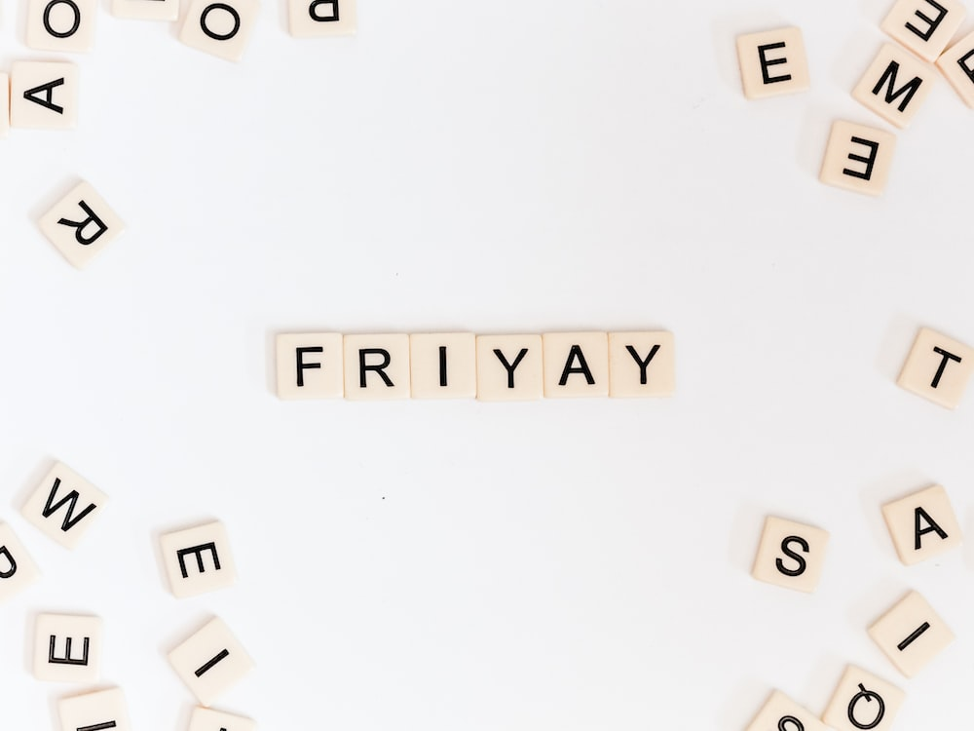
Fidelity Fridays TGIFF: Thank Goodness It’s Fidelity Friday
What should the next topic be?
Pop it in the chat, please.
Notes:
Notes from Fideilty Friday: Fidelity Friday - Google Docs

Slide 32
Questions about Program Measure 2?

Slide 33
Program Measure 3
The percentage of Special Education State Personnel Grant-funded initiatives that meet targets for the use of funds to sustain SPDG-supported practices.

Slide 34
Year | Target | Actual (or date expected) | Status
2012 | Not available. | 32 | Target Not In Place
2013 | Not available. | 88 | Historical Actual
2014 | Not available. | 63 | Historical Actual
2015 | Not available. | 90 | Historical Actual
2016 | 85.0 | 78 | Target Not Met
2017 | 85.0 | 83 | Target Not Met
2018 | 85.0 | 89.7 | Target Exceeded
2019 | 85.0 | 100.0 | Target Exceeded
2020 | 85.0 | 93.8 | Target Exceeded
2021 | 85.0 | 81.5 | Target Not Met
2022 | 85.0 | 88.5 | Target Exceeded
2023 | 85.0 | 84.0 | Target Not Met

Slide 35
Initiative | Met Target
 | Yes | No
Implementation Year 2 (8 initiatives) | 6 | 2
Implementation Year 3 (2 initiatives) | 2 | 0
Implementation Year 4 (1 initiative) | 1 | 0
Implementation Year 5 (3 initiatives) | 3 | 0
Implementation Year 6 (6 initiatives) | 4 | 2
Implementation Year 7 (5 initiatives) | 5 | 0
Total (25 initiatives) | 21 | 4
% | 84.0% | 16.0%

Slide 36
Program Measure 4
The percentage of State Personnel Development Grant-funded initiatives that meet their child outcome targets.

Slide 37
Steps for Program Measure 4
If you have not already, determine a child outcome measure that is a direct result of your intervention.
Collect baseline/ongoing data.
Set initial targets for each year.
Each year, determine if the targets still seem reasonable.
CIPP, our GPRA contractor, will collect your Program Measure 4 data in Year 5 of your initiative.
Questions or ideas?

Slide 38
(simplified) SPDG Theory of Action
Good Professional Development
Increases Intervention Implementation
Improves Child Outcomes

Slide 39
Considerations, Resources, & Your Questions

Slide 40
Rubric B & APR Fillable Form
https://signetwork.org/program-measures/
Rubric B (DOC)
APR Fillable Form (PDF)

Slide 41
Subgroup to build out a fidelity toolkit

Slide 42
Overall APR Considerations

Slide 43
Submitting your Program Measures
Please submit your draft Program Measures to your Project Officer by April 15th, 2024 for review. You do not need to submit your Project Measures, only your Program Measures.
Reminder: If it is your first year please give a draft of all of your measures to your Project Officer.

Slide 44
Large Available Balances (LAB)
You will receive an email if you have a large available balance (LAB = >70% of your annual budget)
You will need to complete the SF-424 financial form and attach it to your APR in G5.
Note that the financial form is shown for every grantee, but only those who are notified must include it with their APR.
In APR Section B, please provide a strong description of reasons you have not been able to spend down your funds and your plans to do so going forward.

Slide 45
GRANTEE REPORTING REQUIREMENTS
Annual Performance Report
Final Performance Report

Slide 46
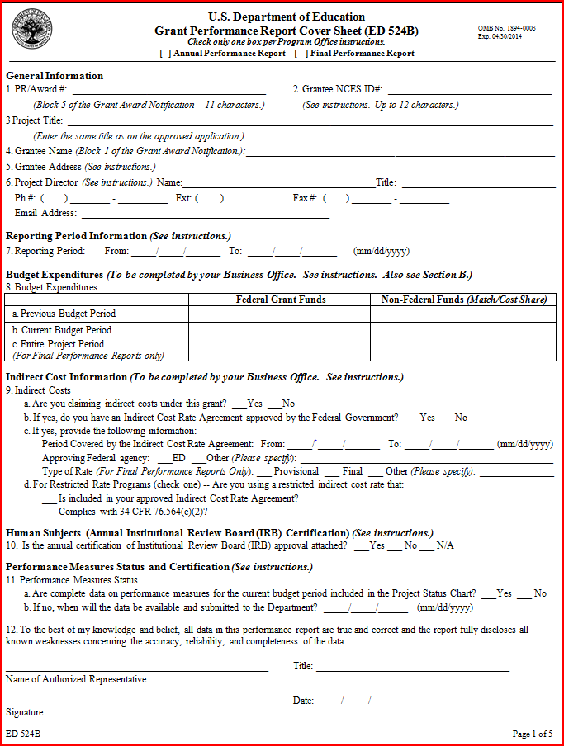

Slide 47
ANNUAL PERFORMANCE REPORTS
Reporting Period: For first year grants, the date is the beginning (i.e., start date) of the project though February 28th. For grants in years 2-5, it is the date from the end of the previous reporting period (March 1st, 20--) through February 28th, 20--.

Slide 48
ANNUAL PERFORMANCE REPORTS
Budget Expenditures:
Must be data or information from the business or grants office.
Report expenditures through the end of the “Reporting Period”.

Slide 49
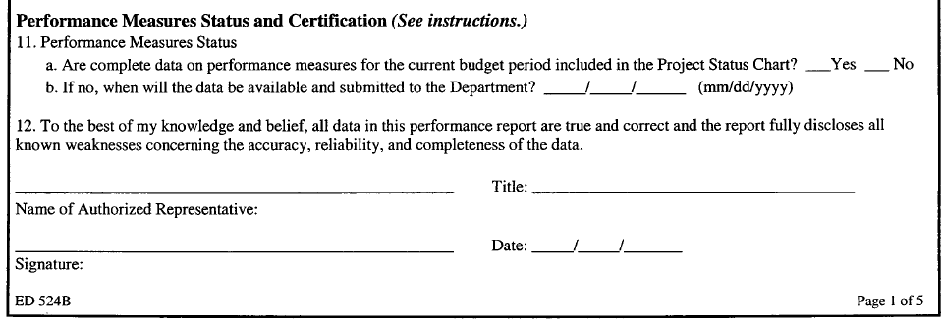
ANNUAL PERFORMANCE REPORTS
Performance Measure Status:
This will be checked “No” for all performance reports. The APR contains data for the reporting period.
The date entered here will be the due date for your Final Performance Report, which is 90 days after the end of the grant.
Signatory must have authority to sign on behalf of the institution since the grant is from the Department to the institution and not to an individual. (This person is typically not the Project Director).

Slide 50
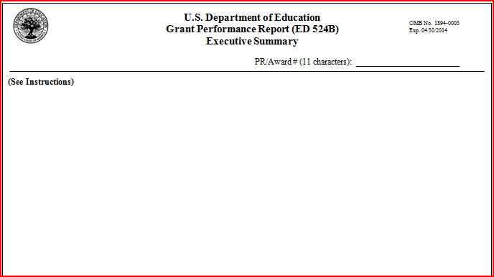
EXECUTIVE SUMMARY SHEET
H325 - - - - -
*** Provide highlights of the project's activities and the extent to which the expected outcomes and performance measures were achieved during the reporting period. Do NOT include the project abstract.

Slide 51
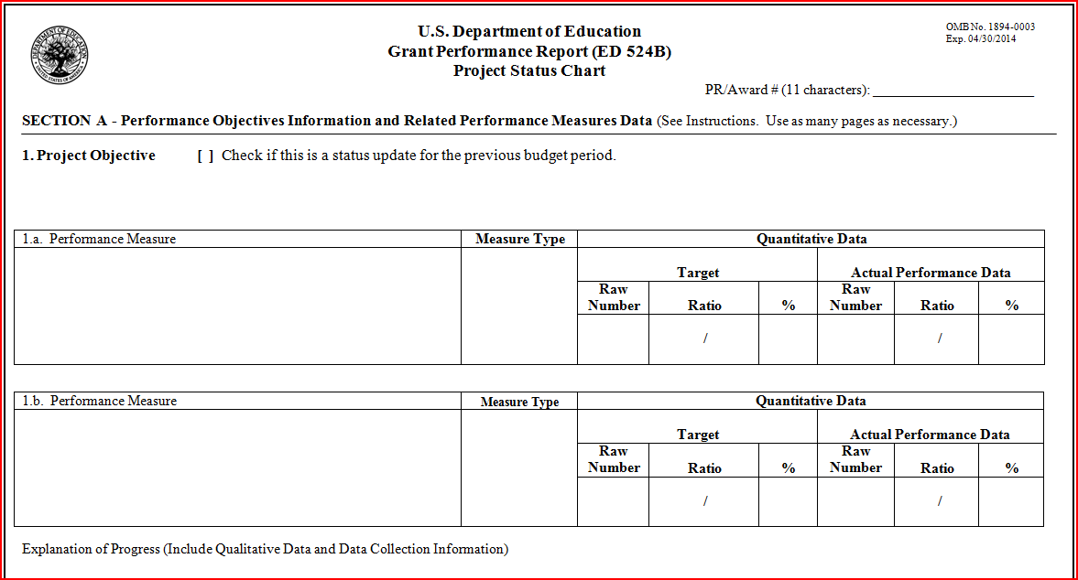
PROJECT STATUS CHART
H325 - - - - -

Slide 52
PROJECT STATUS CHART
H325 - - - - -
Enter one of the project’s objectives; on subsequent pages, you will enter additional project objectives as submitted in your grant application.

Slide 53
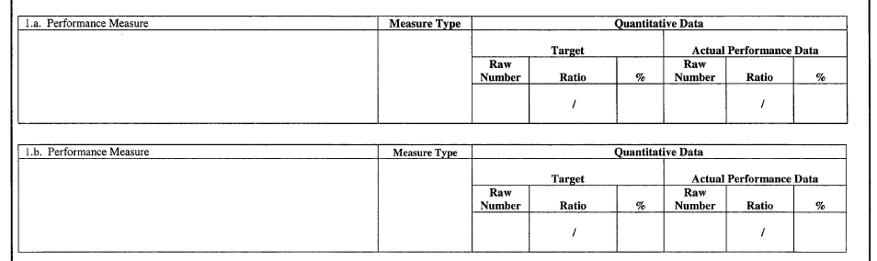
PROJECT STATUS CHART
Enter the PROGRAM performance measure(s) that align with the objective immediately followed by any PROJECT measure(s) developed to address that program measure.
Enter any additional PROJECT performance measures that show you are measuring progress toward meeting the objective (e.g., 1c., 1d.,).

Slide 54
PROJECT STATUS CHART
Here you identify if the performance measure is a PROGRAM measure, “PRGM,” or a PROJECT measure, “PROJ.”
PRGM
PROJ
Note: Program measure refers to one of the SPDG shared performance measures for the Professional Development Program. Project measures are unique to your grant.

Slide 55
PROJECT STATUS CHART
Quantitative data:
Depending on your measure, enter either a raw number or a ratio and percentage. Enter the target number identified in the performance measure and then the actual data for this year. If complete data are not available for the measure, enter actual data for the reporting period and provide an explanation at the bottom of the page.
8
6
10
10
5
10
50

Slide 56
INFORMATION TO INCLUDE IN THE EXPLANATION OF PROGRESS SECTION
Describe the data provided (e.g., what data collection methods were used, when were the data collected, how was a sample drawn, are there missing/incomplete data, what was the response rate, was a reliability measure taken). Your Project Officer should be able to understand and interpret the numbers in the chart from your description in this section.
What changes in the data occurred since last APR (i.e., trend)?
What activities were undertaken to achieve the targets?
If targets were not met, what are possible reasons?
How will activities that failed to meet targets be improved?

Slide 57
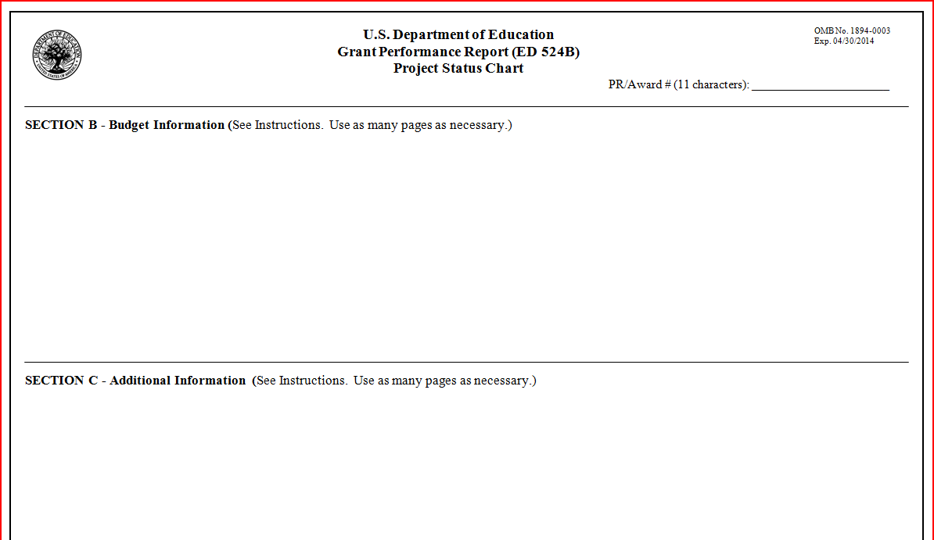
FINAL PAGE OF THE REPORT
H325 - - - - -
Section B & C: Refer to the instructions for Section B & C with the ED 524B

Slide 58
SECTION B – BUDGET INFORMATION
THIS SECTION IS NEVER BLANK!
Actual expenditures for reporting period.
Provide an explanation if you did not expend funds at the expected rate.
Describe any significant changes to your budget resulting from modifications to project activities.
Describe any changes to your budget that affected your ability to achieve your approved project activities and/or project objectives.
Do you expect to have any unexpended funds at the end of the current budget period? (Explain why, provide an estimate, and indicate how you plan to use the unexpended funds [carryover] in the next budget period.)
Describe any anticipated changes in your budget for the next budget period that require prior approval from the Department.

Slide 59
SECTION C – ADDITIONAL INFORMATION
If applicable, please provide a list of current partners on your grant and indicate if any partners changed during the reporting period. Please indicate if you anticipate any change in partners during the next budget period. If any of your partners changed during the reporting period, please describe whether this influenced your ability to achieve your approved project objectives and/or project activities.
Describe any changes that you wish to make in the grant’s activities for the next budget period that are consistent with the scope and objectives of your approved application.

Slide 60
SUBMITTING THE ED 524B
Submit the ED 524B at http://www.g5.gov/ (there are instructions for using G5 in the continuation packet)
A signed ED 524B Cover Sheet must be uploaded in G5.
Refer to the Final Performance Report sections in the Grant Performance Report Instructions if you are submitting your final report.
Contact your project officer for reporting requirements during a no-cost extension period.

Slide 61
Contact your OSEP Project Officer with any questions!

Slide 62
WHY IS THIS IMPORTANT?
HIGH-QUALITY OBJECTIVES & MEASURES:
Make it easier for you to measure your progress
Allow you to report progress easily and quantitatively
Establish targets (both short-term/annual and long-term)
Allow OSEP staff to gather evidence of program effectiveness
Taken from the Center for Evaluation and Education Policy (CEEP) presentation

Slide 63
PERFORMANCE MEASURES ARE:
Measurable indicators used to determine how well objectives are being met.
How will progress be assessed?
How much progress will constitute success?
How will it be known if an objective or part of an objective has been achieved?
Taken from the Center for Evaluation and Education Policy (CEEP) presentation

Slide 64
TYPES OF PERFORMANCE MEASURES
Program
Measures established by OSEP for the Personnel Development program. These include measures established for reporting to Congress under the Government Performance and Results Act of 1993.

Slide 65
TYPES OF PERFORMANCE MEASURES
Project Measures
Measures that the grantee establishes to meet their project objectives
Project performance measures can address both the process of working towards an objective and the outcome related to meeting the objective
Ensure a mix of both process and outcome measures

Slide 66
HIGH-QUALITY PERFORMANCE MEASURES
High-quality performance measures show:
What will change.
How much change you expect.
Who will achieve the change.
When the change will take place.

Slide 67
COMMON PROBLEMS
Activities are NOT performance measures
If the best response is “Yes, we did that,” it is likely an activity (not a performance measure)
Examples of activities:
Training a certain number of sites
Hold an Advisory Board meeting quarterly
Establish a mentoring program
Evaluate the project
Performance measures need to be measurable
Taken from the Center for Evaluation and Education Policy (CEEP) presentation

Slide 68
SUMMARY
Projects should have a few clear objectives that explain what the project is doing to support their overall goal(s)
Each objective should have a few, specific performance measures to demonstrate how progress toward meeting the objective is being measured

