Slide 1
Working Together?
How School Leaders Shape Teachers’ Collaborative Learning Opportunities
Susan Kemper Patrick
Learning Policy Institute
spatrick@learningpolicyinstitute.org
February 8, 2023
This work was supported by the Eugenia Kemble Research Grant from the Albert Shanker Institute and by the Institute of Education Sciences, U.S. Department of Education, through Grant R305B170009 to Vanderbilt University.

Slide 2
Collaboration for Improvement
Growing evidence that engagement in instructionally-focused collaboration is associated with instructional practice and student achievement
(Goddard et al., 2015; Parise & Spillane, 2010;
Ronfeldt et al., 2015; Supovitz, 2002; Wahlstorm & Louis, 2008)

Slide 3
Collaboration for Improvement
Growing evidence that engagement in instructionally-focused collaboration is associated with instructional practice and student achievement
(Goddard et al., 2015; Parise & Spillane, 2010;
Ronfeldt et al., 2015; Supovitz, 2002; Wahlstorm & Louis, 2008)
Collaborating within communities of practice:
Allows for transfer of information
Creates access to expertise and resources
Affords teachers opportunities to discuss, reflect, and take up new ideas about specific problems of practice
(Ball & Cohen, 1999; Horn et al, 2017; Horn, 2005; Little, 2002)

Slide 4
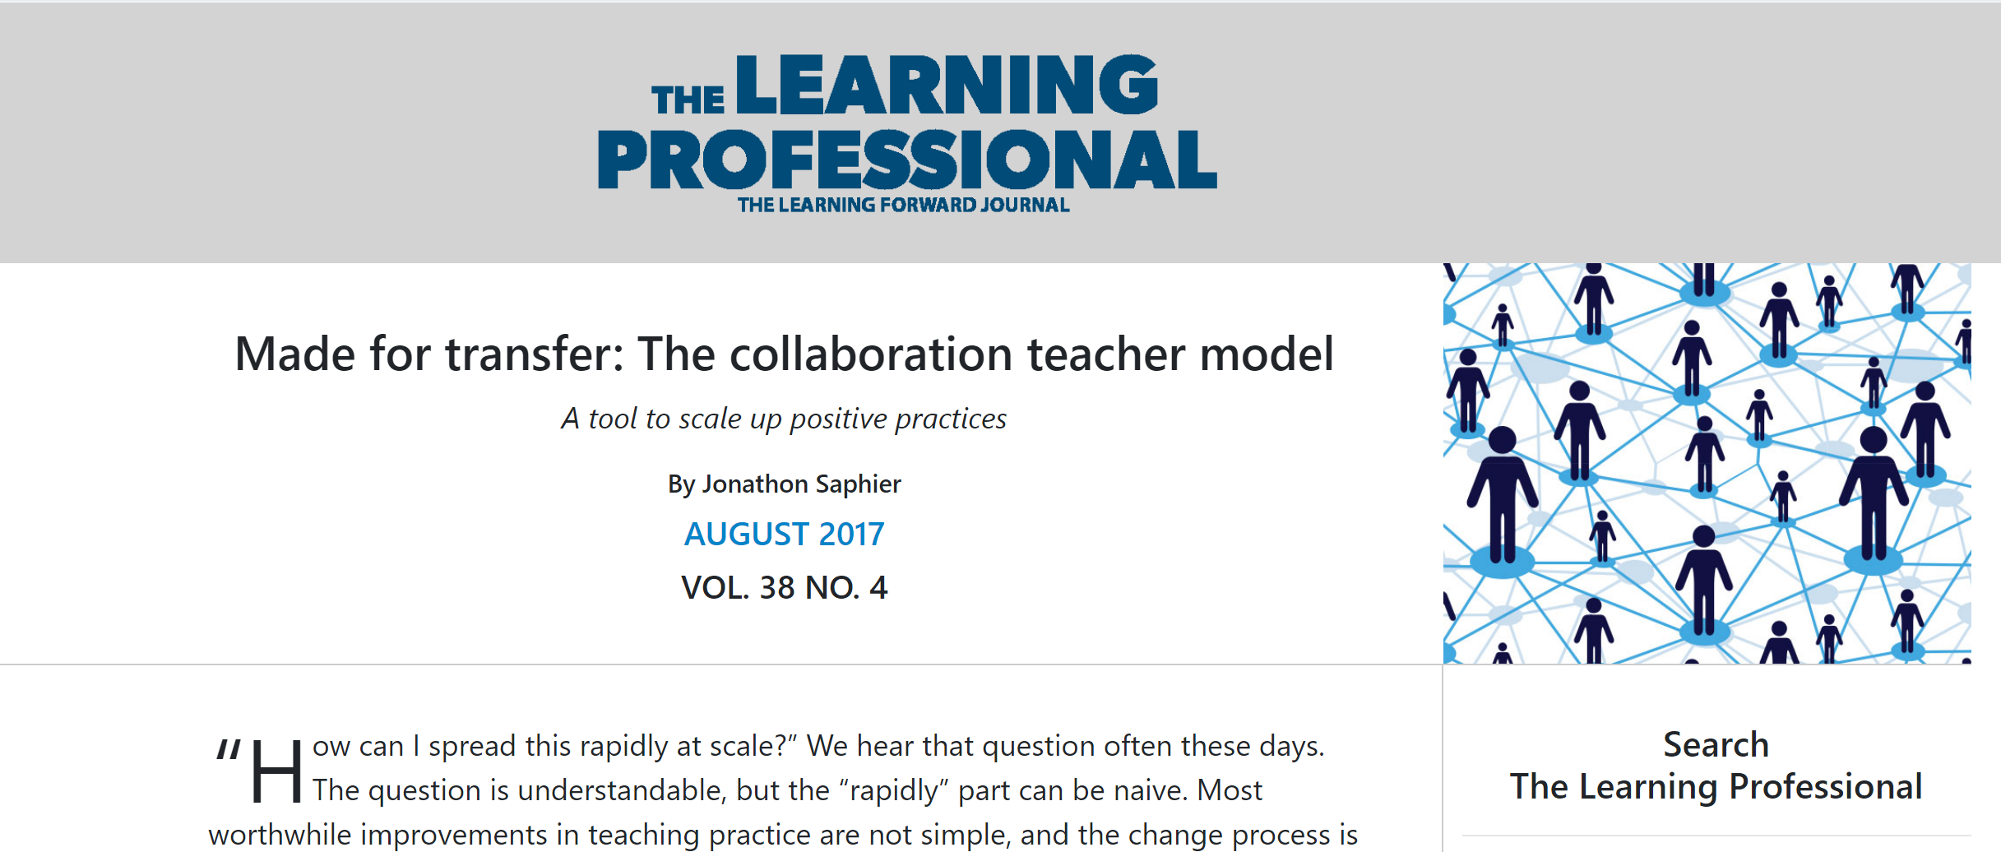
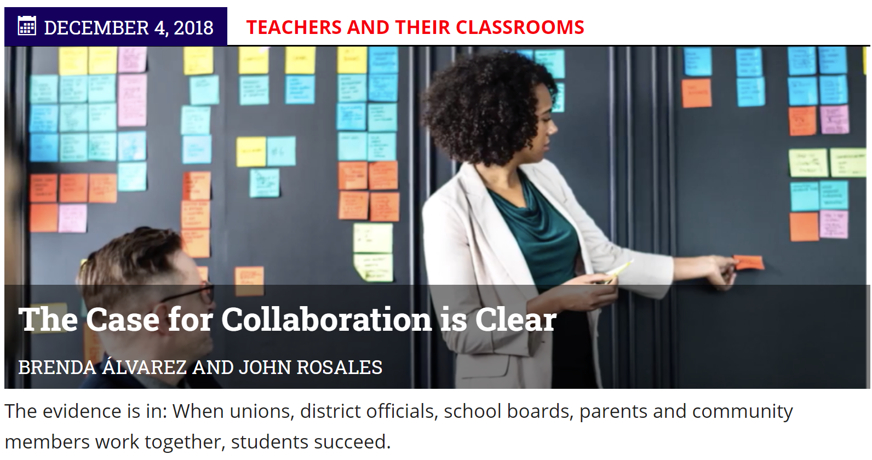
Schools increasingly emphasize collaborative learning for teachers…

Slide 5
… yet in reality collaboration is
Not universally accessible
Only 31% of teachers in national survey reported having enough time for collaboration
(Johnston & Tsai, 2018)
Not equally productive
“Feels like I’m being held hostage.”
“Not another meeting.”
“People might have good knowledge but the pieces don’t fit together.”
(Gates Foundation, 2014)

Slide 6
Reflection
When does collaboration work?
When does collaboration fall flat?

Slide 7
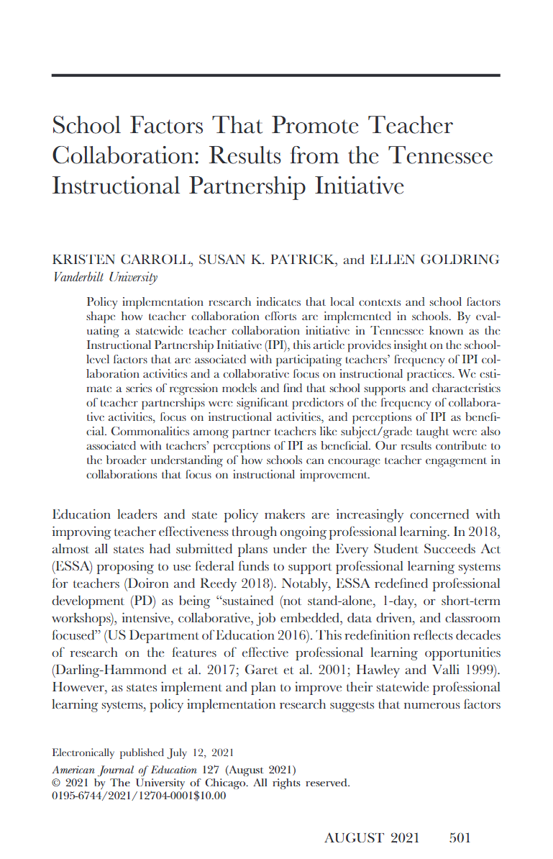
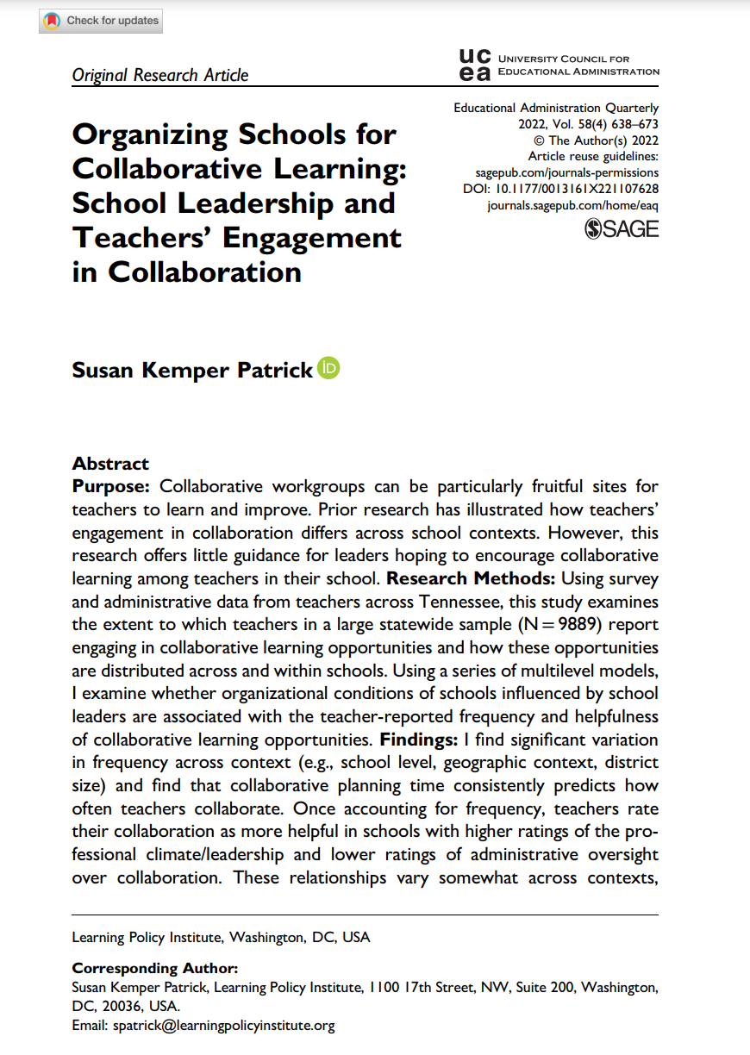
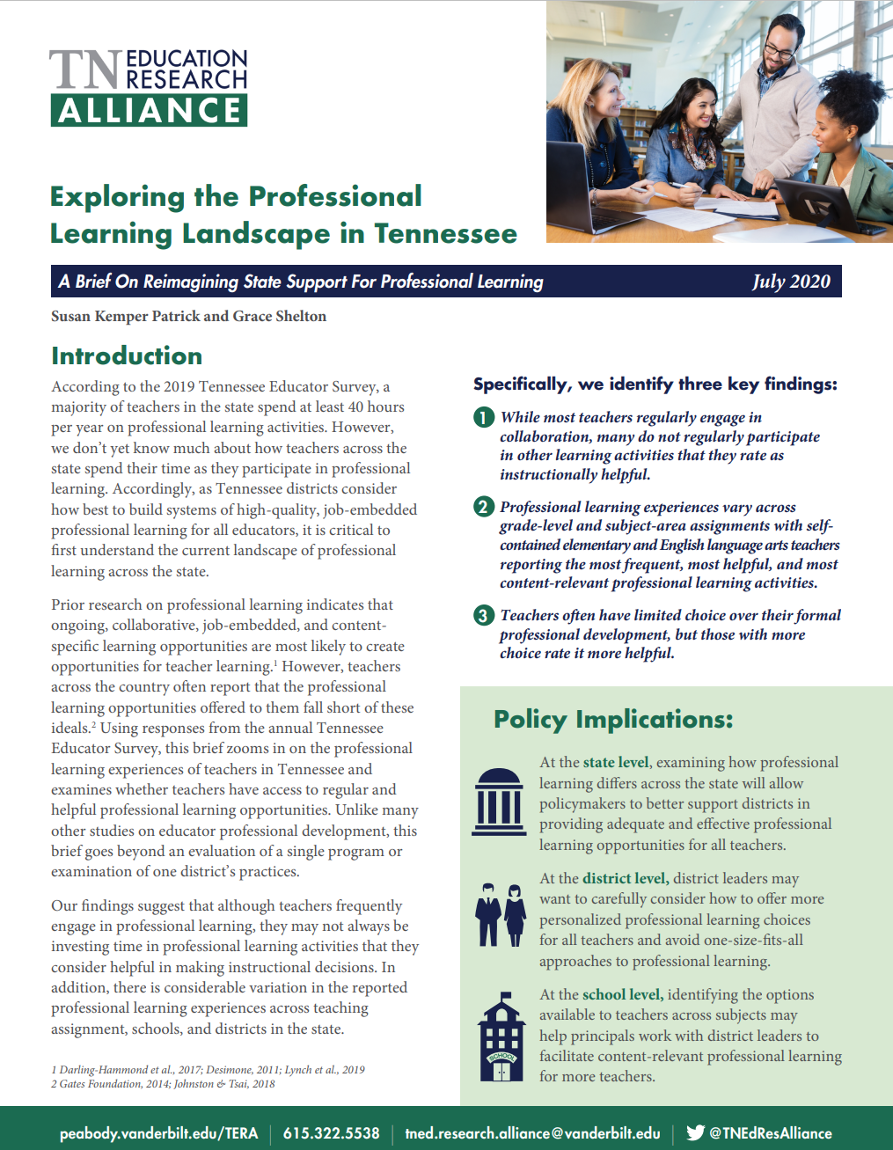
What have I learned about effective collaboration from my own research?
Patrick & Shelton (2020)
Patrick (2022)
Carroll, Patrick, and Goldring (2021)

Slide 8
How and under what conditions can collaboration support teachers?

Slide 9
For effective collaboration, teachers need time built into their working day
Teachers who shared common planning time with their collaborators were more likely to meet frequently and focus on instruction
Teachers who received release time from teaching or professional development credit for collaboration were more likely to engage in peer observations, feedback, and co-teaching
School and district leaders

Slide 10
For effective collaboration, teachers need time built into their working day
What about special education teachers?
School planning schedules often organized around content areas or grade-levels
Additional responsibilities that make it harder to find dedicated, regular time
Share in the chat: What has worked as a way to create time for collaboration?

Slide 11
For effective collaboration, teachers need a chance to share expertise with peers.
Regional or state leaders

Slide 12
For effective collaboration, teachers need a chance to share expertise with peers.
What about special education teachers?
Share in the chat: How can you create spaces for special education teachers to share expertise?

Slide 13
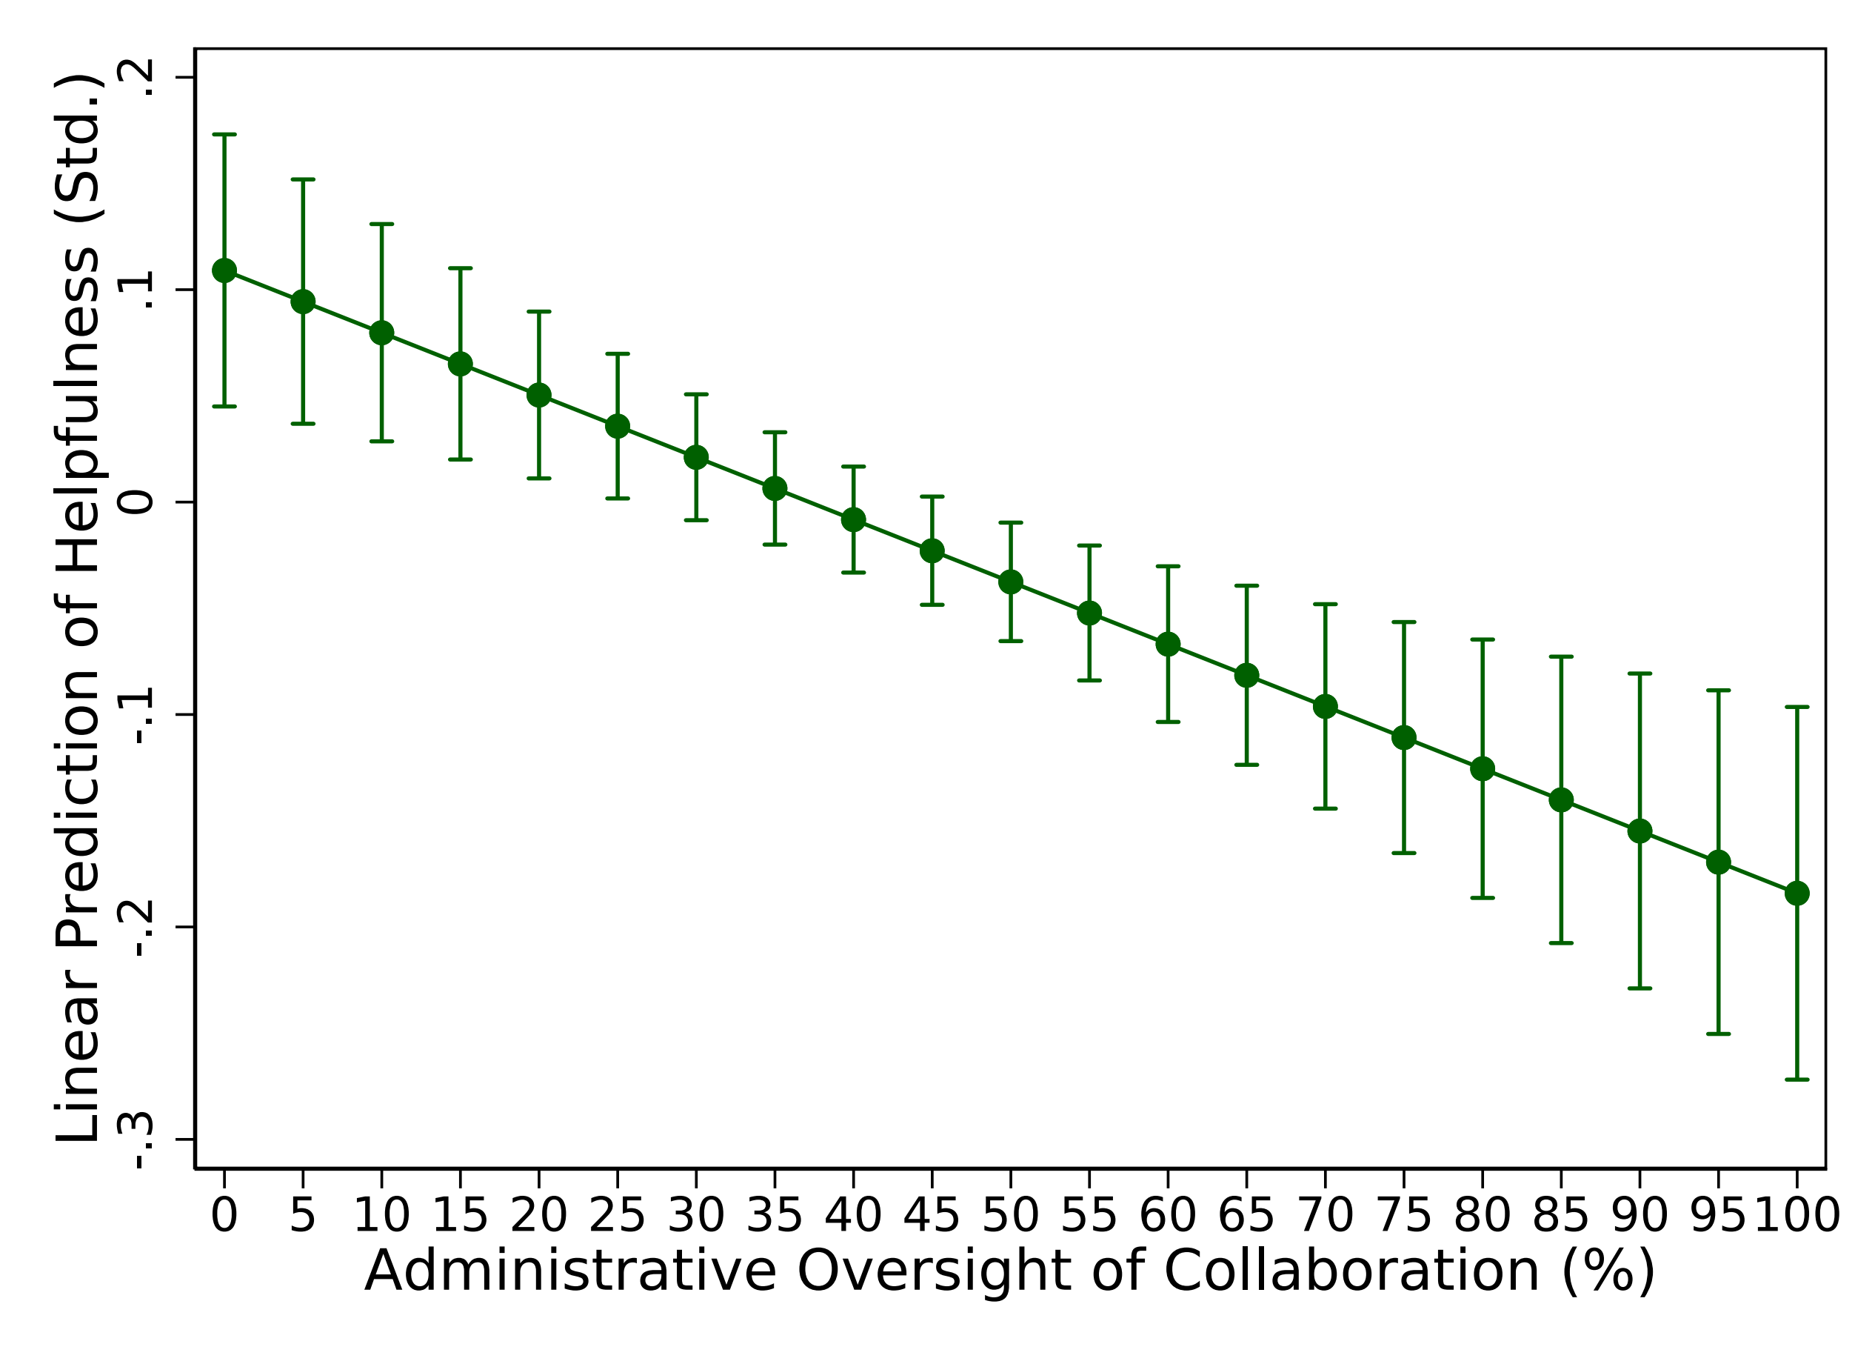
For effective collaboration, teachers need autonomy to determine how to work together
Administrative oversight is not related to frequency of collaboration but is related to whether teachers perceive collaboration to be helpful
Teacher leadership

Slide 14
For effective collaboration, teachers need autonomy to determine how to work together
What about special education teachers?
Ensuring special education teachers have a voice in school-level and team-level decisions
Share in the chat: What have special education teachers wanted from their collaboration?

Slide 15
For effective collaboration, teachers need space to focus on what matters to them.
Calvin and Graham:
Described this collaborative partnership as “the same thing teachers generally do anyway… just with paperwork.”
Explained their peer observations as “show up, and do it, and then keep your eyes open and get something out of it, was basically it.”
Jasmine and Meg:
Described this collaborative partnership as “creating an environment that we could trust each other and draw from each other’s ideas to help us implement things that would make us better.”
Explained their peer observations as “every time I went [to observe], that was what I was watching [how she used groups]”
Teacher relationships and norms

Slide 16
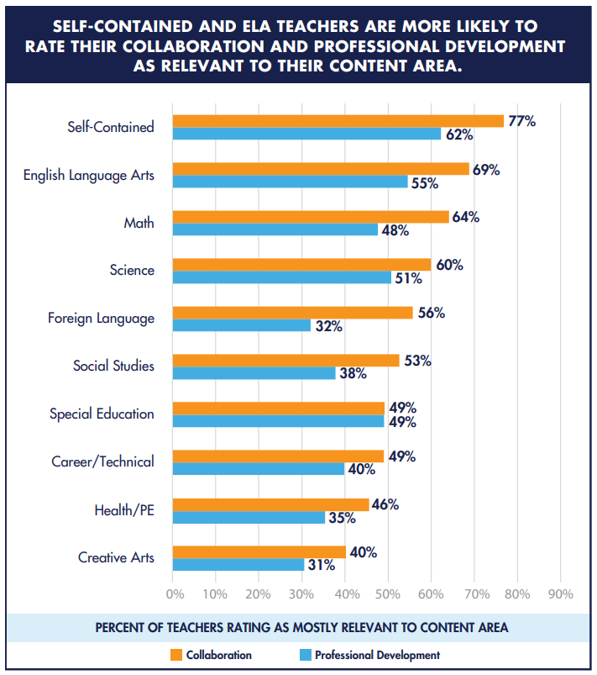
For effective collaboration, teachers need to be able to focus on what matters to them.
What about special education teachers?
Share in the chat: When does collaboration seem most relevant for special education teachers?

Slide 17
For effective collaboration, teachers need…
Time built into their working day to share
Expertise with peers, and
Autonomy to be able to focus on what
Matters to them.

Slide 18
Creating effective collaboration requires TEAMwork from many different partners.
State and regional leaders
Bring together isolated teachers to share expertise
School and district leaders
Create dedicated and regular collaborative time (outside of individual planning)
Teacher leadership
Ensure collaborative time spent on important problems of practice
Teacher relationships and norms
Create meaningful collaborative spaces to share problems of practice, reflect, and offer critical reflection
Build district capacity
A •Distribute leadership

Slide 19
Thanks!
Comments? Questions?
Email: spatrick@learningpolicyinstitute.org

