Slide 1
Indigenous Storytelling
Stephanie Autumn
Co- Director, Tribal Youth Resource Center - Tribal Law and Policy Institute
Consultant, Center for Coordinated Assistance to States - American Institutes for Research

Slide 2
Opening
He said, “In the mist of hate, I found there was, within me, an invincible love.
In the midst of tears, I found there was, within me, an invincible smile.
In the midst of chaos, I found there was, within me an invincible calm.
I realized that through it all that in the midst of winter, I found that there was within me, an invincible summer.
And, that makes me happy
For it says that no matter how hard the world pushes against me,
there’s something stronger-something better, pushing right back
Albert Camus

Slide 3
Our Time Together
The Roots of Story Telling and the Weaving of Restorative Practices:
Building, Strengthening, Honoring, Sustaining Relationships
Promotion & Realization of Inclusion, Racial Equity, Shared Leadership
Lifting Up Student-Parent-Family -Community Voice
Paradigm Shifts – In & Across Systems

Slide 4
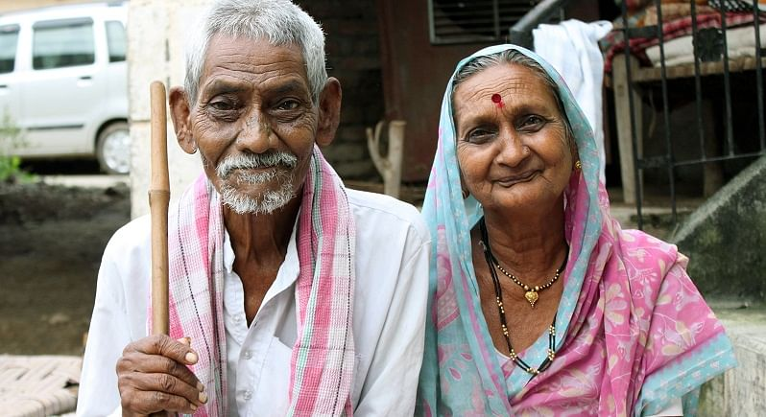
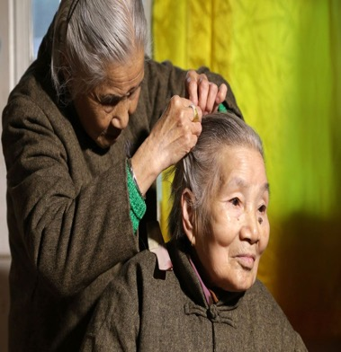
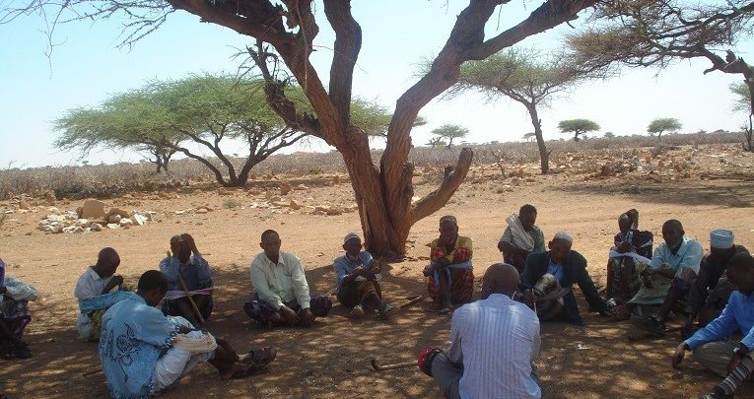
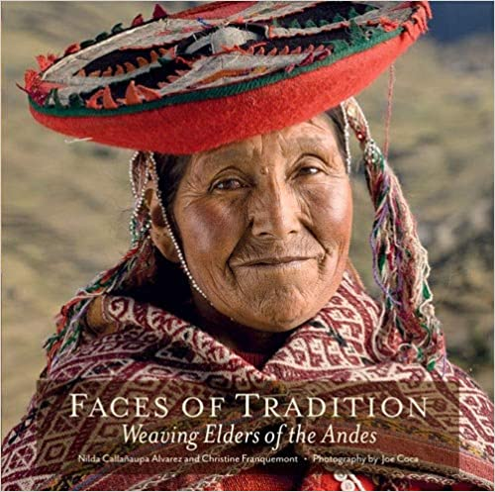
Our Roots Run Deep

Slide 5
Our Stories
Deep in our blood memory,
in the marrow of our DNA,
Impressed within our hearts
lays
our stories …….

Slide 6
Our Stories
Anchor Provide a Foundation
Guide Create a Place and Space
Light a Fire
Remind Us Where We Have Been
Open Us Up Move Us Forward
Provide the Knowing Lift Us Up
Let Go Humble Us
Provide Ease Bring Joy
Cause Pause Reflect Have Faith

Slide 7
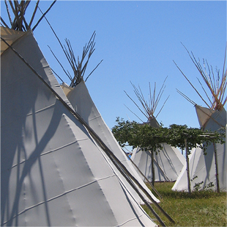
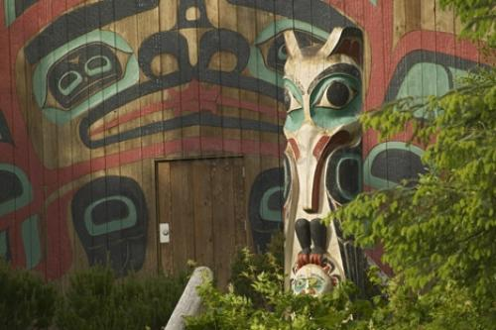
There Are Stories…
Spaces – ancient and modern.
Restorative practices can be traced to ancient Indigenous cultures –
recurring in various forms in many different cultures and nations
around the world.

Slide 8
There Are Stories…
Our Stories served as the philosophical foundation for the Indigenous
model of Restorative Practices….
Our stories today are the embodiment of both ancestral and modern
wisdom about how to keep human relationships alive, free, open, and
constructive, especially when conflict or disharmony is present.

Slide 9
Restorative Values

Slide 10
Creating Place and Space for Everyone’s Story
Vulnerability sounds like truth and feels like courage. Truth and courage aren’t always comfortable, but they’re never weakness. Everyday we experience the uncertainty, risks, and emotional exposure that define what it means to be vulnerable or to dare greatly”
~ Brene Brown
Compassion
Trauma Sensitive
Healing & Restorative

Slide 11
Restorative Practices and Trauma Sensitivity
Ensuring emotional and physical safety
Supporting choice, control, and empowerment
Ensuring cultural awareness
Using a collaborative and strengths-based approach
Viewing relationships as central to health and healing

Slide 12
Relational Worldview
On our globe today, there are two predominant worldviews—linear and relational. The linear worldview is rooted in European and mainstream American thought. It is very temporal, and it is firmly rooted in the logic that says cause has to come before effect.
In contrast, the relational worldview sees life as harmonious relationships where health is achieved by maintaining balance between the many interrelating factors in one’s circle of life.

Slide 13
Linear Worldview
The linear worldview finds its roots in Western European and American thought. It is logical, time oriented, and systematic, and has at it’s core the cause-and-effect relationship.
To understand the world is to understand the linear cause-and-effect relationships between events.

Slide 14
In the relational worldview, helpers and healers are taught to understand problems through the balances and imbalances in the person’s relational world. We are taught to see and accept complex (sometimes illogical) inter-relationships that can be influenced by entering the world of the student/parent and examine and reshaping the balance contextually, cognitively, emotionally, physically, and/or spiritually.

Slide 15
Relational Worldview
Interventions need not be logically targeted to a particular symptom or cause but, rather, focused on bringing the person back into balance. Nothing in a person’s existence can change without all other things changing as well.
Thus, an effective helper is one who gains understanding of the complex interdependent nature of life and learns how to use physical, psychological, contextual, and healing interventions to promote harmony

Slide 16
The “Why” of Relational Approaches
Helps to foster an environment where restorative practices are more likely to be adopted and sustained.
Understanding trauma supports the need to adopt restorative practices.
Supports an emphasis on relationship and connection (vs. isolation and disconnection common with trauma).
Provides an empathic and compassionate space for understanding behavior.

Slide 17
It Starts With Us
What I know about bravery in my community is that I am
not brave by myself…
I am
part of a community….
I am brave because of them
Everyday I wake up and I ask myself
“Am I going to brave enough today to
challenge the system?

Slide 18
Creating Place & Space
Language
Environment
Policy
Relationships
Capacity
Community
Student- Parent- Family Voices
Training

Slide 19
Imagining a New Pathway……
Internal Readiness
External Readiness
Resources Needed
Time
Student, parent/caregiver/community inclusion
Communication plan
Launch Plan

Slide 20
Considerations Moving Forward……
Values
Agreements
Vision
Learning Labs: staff, leadership, student/clients, families, community
Pathways for Support: staff, leadership, students/clients, families, community
Asset Based Problem Solving: practice, celebration, ongoing progress checks
Aligning Relational/Restorative processes with need and intended outcomes
Fidelity reviews (relational/restorative values, philosophy, language, inclusiveness, culturally & linguistically responsiveness )

Slide 21
What choices can we make together to reshape the future of the world that our children’s children will inherit?
Healing & Transformation

