Slide 1
Reconceptualizing MTSS Learning to Maximize Impact
Kim St. Martin, Ph.D.
February 8, 2023
mimtsstac.org
Notes:
Keep formatting of left-justified on the template.

Slide 2
Intended Outcomes
Describe a bidirectional MTSS professional learning model that will demonstrate greater student outcomes in a shorter period than a more traditional MTSS professional learning approach.

Slide 3
Beginning to End-of-Year Progress
64% of students (36 of 56) made above typical progress
Fall scores are a gray dot. Spring scores are blue, green, yellow, or red

Slide 4
1.0 Intensifying Intervention and the Impact

Slide 5
MTSS Bidirectional Model Learning Question
Suppose different school teams are responsible for Tier 1 and the Advanced Tiers (Tiers 2 and 3). Can they implement a quality MTSS framework to accelerate outcomes for all learners, including students with disabilities?
This learning question was initially tested in one district with its three elementary schools.

Slide 6
DBI, a Process for Intensifying Instruction
Data-based Individualization (DBI)
Also referred to as Intensifying Intervention Instruction
DBI Graphic: National Center for Intensive Intervention
An orange box on top is labeled “Validated Intervention Program (e.g., Tier 2, Standard Protocol, Secondary Intervention)” below that is a green oval labeled Progress Monitor. Progress monitoring is administered to determine student response to the selected intervention. If a student is responsive (symbolized by plus sign), an arrow directs the team to continue implementing and progress monitoring without change. When a student is non-responsive, an arrow directs team to the lower section of the graphic where a green oval directs them to gather diagnostic data to formulate an intervention adaptation (orange rectangle) and continue progress-monitoring (green oval). Progress-monitoring data is again used to determine responsiveness, responsive arrow directs the team to continue implementation and progress monitoring with change and the non-responsive arrow points back to the Diagnostic Assessment/Functional Assessment oval.
Notes:
Based on the video, see if the participants can help you review the 5 steps in the DBI process.
The DBI process (as conceptualized initially by Stan Deno and Phyllis Mirkin in the 70’s and studied by many others) has 5 steps. This is the graphic used by the National Center for Intensive Intervention.
The 5 steps are:
Select a validated intervention program
Progress monitor students to determine response to the validated intervention (continue intervention as long as the student is responding and until the goal is met)
If data indicate that the student is not responding, gather additional data sources such as diagnostic academic assessment, functional behavior assessment, and fidelity data.
Use the data you collect to formulate an intervention adaptation
Implement the adaptation and monitor progress
Repeat steps 3-5 until the student responds.
Any student who needs additional support automatically moves into steps 1-2 of the DBI process (whether we call it this or not).
A validated intervention platform is scripted, standard protocol intervention that is based on validated practices: explicit phonics instruction, phonemic awareness instruction (in the early grades), explicit writing instruction, explicit strategy instruction in comprehensnion, vocabulary instruction,

Slide 7
Defining the DBI Process for Intensfiying
Implement a Validated Intervention Program
Monitor Progress
If students don’t respond…
Collect diagnostic academic or functional behavior data
Design and implement an intervention adaptation
Monitor progress in the adapted intervention
Repeat steps 3-5 until student responds (is on track to meet grade level benchmark)
Source: National Center for Intensive Intervention
Notes:
So far we have been focused on steps 1-2 of the process. Last time we discussed evaluating progress monitoring data to determine when to make a change

Slide 8
School Demographics
Grades, Locale and Enrollment are from the MiMTSS Data System & Michigan Educational Entity Master. Students with IEPs and Black, Indigenous and Students of Color are calculated from MiSchoolData

Slide 9
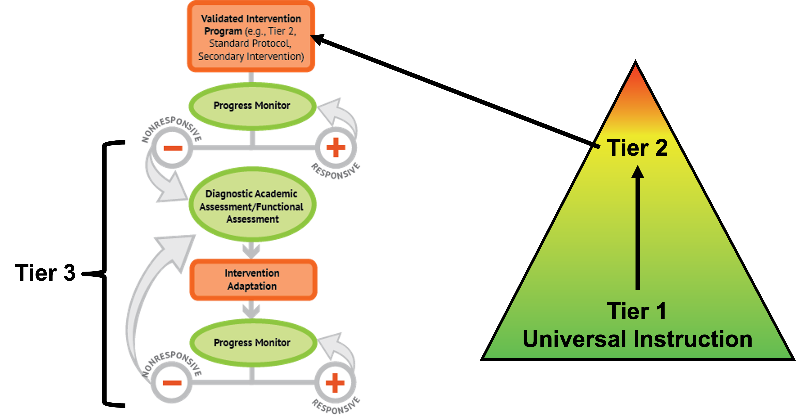
Intervention Access
Intervention Access is Step 1 of the DBI Process: Use a Validated Intervention Program
All students who scored below benchmark were assigned to reading intervention in October 2021 and January 2022 (if not already participating in intervention).
First Grade: 134 of 172 (78%)
Second Grade: 88 of 132 (67%)
This is a high proportion of students needing intervention support.
Notes:
First grade: of 172 students comes from the Acadience data export, all possible 1st graders with scores in fall and/or winter.
Second grade: of 132 students comes from the Acadience data export, all possible 2nd graders with scores in fall and/or winter.

Slide 10
2.0 Traditional versus an Alternate MTSS Approach
Bidirectional Model

Slide 11
A Traditional Approach to MTSS
You must have a strong Tier 1 before you can work on Tier 2 (or 3) – professional learning in how to strengthen Tier 1 happens for teachers, then grade level teams learn to use their data, Tier 1 is supplemented…
Students are not flexibly moving in varying levels of support (e.g., kids begin the year in Tier 2 and remain in Tier 2, nothing noticeably different is happening for Tier 2)
The general education teacher is responsible for Tier 1 and Tier 2 – Tier 2 happens in small groups during Tier 1 reading instruction
Special education (and special education staff) are outside of the MTSS system

Slide 12
Problems with the Traditional Approach
The “Tier 1 Problem” is never solved.
Multiple years of professional learning is focused on Tier 1 and grade level teachers using their data before learning happens for quality intervention supports (Advanced Tiers)
Special Education (staff, students, instruction) is excluded
No team-based leadership in the advanced tiers – School Leadership Team layered on the work as they are still trying to manage Tier 1 implementation
No distinct level of intensity for intervention
Fuchs & Fuchs, 2017
Notes:
What do we mean by a “Tier 1 problem?” Too many students not meeting benchmark standards suggests a problem with Tier 1 implementation. This is very true…and strong Tier 1 is the best way to help all kids…but Pandemics happen, students move, teachers move, curricular changes occur…Schools often become bogged down in the “Tier 1 problem.” Perfection is never achieved. Schools and districts careen from new curriculum to new innovation to new approach looking for the silver bullet. Meanwhile, students don’t access the supports they need because the school is trying to work out the problems with their Tier 1. Students don’t have years to wait while we get our act together. They need additional layers of support when the need arises, not when the school has gotten all of its ducks in a row.
It’s easy to slip into a way of thinking of kids as their tiers. Have you heard this before? ”My tier 2 kiddo” “My tier 3 student” My ”red group.” She’s pretty “yellow.” Why could this be probelematic? Students are not their tiers! Rather students access different tiers of support. Moreover, students may need additional “advanced tiers” support in one area like reading, but not in another area. If our system is working students should not remain in a single tier…instead they should receive flexible support.
In our traditional approach general education teachers are responsible for Tier 1 and Tier 2 (Students are their students and their students only). If they encounter a problem that they can’t solve on their own they may refer the student to the problem solving team… Why could this be a problem? Some students aren’t referred who need to be. Some teachers don’t want to admit when something doesn’t work. Instructional changes aren’t systematic…and biggest problem—the focus on “student provlem solving” means that if students require the most intense layers of support it’s because something is wrong with them…this is deficit based. Deficit-based thinking leads to the status quo, to complaining, to focus on things outside the locus of control of the school or teacher. The problem is the kid—not the teaching.
This includes and is especially true for our students with disabilities. Often the traditional approach to MTSS results in students ”moving” to special education when all else fails even Tier 3. Instead of more support, they receive less—no quality Tier 1, no validated intervention, no systematic intensification. Instead, special education teachers create “individualized” lessons daily (aka. They pull “stuff” out of their closet that is “aligned” to the students generic IEP goals), this “stuff” is delivered with little advance planning, not connected to evidence, and with no accountability. The more severe the disability, often the less intense the support. Thus, students with the most significant and persistent needs opperate outside of our MTSS as do their teachers, their instruction, and even their assessments. This is the opposite of what the initial MTSS/RTI/PBIS models intended.
For Special Education teachers this really problematic. Rather than develop their expertise as interventionists, reading specialists, behavior specialists. They operate in silos. A core component of MTSS is team-based leadership. The Special Education teacher is often a signatory (sitting on many teams) but not part of one. They are included when a special education eligibility is being considered and then as soon as it is confirmed they go back to operating alone. Even the most experienced, well-qualified special education teacher can’t be 100% successful in this setting. And the bar of “success” becomes lower. The special education teacher, just like their students deserves to be a valued part of a team. Their students deserve that too.
RTFI data from hundreds of administrations indicates that by in large nobody ever gets to full implementation of Tier 3, and further more factor and item analysis reveals that Tier 2 is ofen indistinct from Tier 1 and Tier 3. When this happens (as data indicate it often does) we don’t really have MTSS we have Tier 1 and special education.

Slide 13
Activity
Consider the context of your state.
What elements of a traditional MTSS approach are present in your districts/schools?

Slide 14
An alternate approach for…
Students
Teaming
Resources

Slide 15
An alternate approach…students
Students flexibly move within varying levels of instructional support
All students access the supports they need when they need them
Focus on instructional problem solving, not student problem solving
Students with disabilities are fully integrated

Slide 16
An alternate approach…teaming
Schools work to improve both the Advanced and Universal Tiers simultaneously
Grade Level Teams (GLTs)/Teacher-Based Teams (TBTs) focus their energy on the Universal Tier (Tier 1)
A Multidisciplinary team (MDT) is developed to focus on the implementation of the Advanced Tiers (Tiers 2-3)
The teams coordinate supports
Neither team is more important than the other
Notes:
Teams are the “Who” of MTSS Strong teaming structures at all levels of the educational cascade and within the school create the context for strong implementation

Slide 17
An alternate approach…resources
All students receive high-quality Tier 1 (GLTs are focused on this)
All students who need it receive intervention instruction using intervention curriculum resources that have been carefully reviewed and selected to be included in the school’s intervention platform.
Validated assessments screen and monitor student progress
Decision rules are used to guide teams in the process of intensifying selected interventions
Manualizing/documenting decisions and processes is important for sustainability
Notes:
The intervention system outlines the validated intervention platforms, assessments, and decision rules
Intervention System Worked Example:
https://acrobat.adobe.com/link/review?uri=urn:aaid:scds:US:18e3ea29-fae2-3c3a-bc7e-63db64f24b49

Slide 18
Activity.
Consider the traditional versus alternate MTSS approach presented and your state’s context.
What opportunities and potential challenges may exist in supporting an alternate MTSS approach?

Slide 19
3.0 Professional Learning Pacing

Slide 20
Professional Learning Audiences
Teachers
Tier 1 Teams
School Leadership Team oversees the overall MTSS implementation (e.g., aggregated SEB and reading fidelity and outcome data across tiers)
Grade Level Teams are responsible for Tier 1/Universal instruction
Advanced Tier (Tiers 2 and 3) Team
A multidisciplinary team is responsible for the Advanced Tiers:
Tier 2, intervention (evidence-based standard protocol intervention curriculum resource)
Tier 3, Intensifying Support

Slide 21
Professional Learning Audiences (cont.)
Individuals identified by district leadership for implementation support roles:
Instructional coach(es)
School leadership team coach
Multidisciplinary coach

Slide 22
Professional Learning Timing
Year 1:
Fall:
Teachers: Early Childhood and Elementary Teachers (Minimum of PreK-2) begin professional learning in social, emotional, and behavioral supports in the classroom (prevent, teach, respond framework)
School Leadership Team: distributing leadership and maintaining a pulse on SEB, Literacy MTSS impact
Multidisciplinary Team: begin professional learning in the advanced tiers (DBI applied to intensify literacy instruction starting with 1st and 2nd grade) and generalize to intensifying behavioral supports
Winter:
Teachers: Language Essentials for Teachers of Reading and Spelling (LETRS) Volume 1 for K-2 teachers

Slide 23
Professional Learning Timing (cont.)
Year 2:
Fall:
Teachers: Begin accessing professional learning in behavior interventions in the classroom (high frequency, low intensity behaviors)
Grade Level Teams: access professional learning and receive facilitated guidance in grade-level data analysis and implementation planning for the SEB and literacy components of an MTSS framework
School Leadership Team: access professional learning for Tier 1 social, emotional, and behavioral supports in non-classroom settings, engage in data analysis three times per year
Multidisciplinary Team: Fully implement the process designed and tested in year 1 for students to access intervention supports
Winter:
Teachers: Language Essentials for Teachers of Reading and Spelling (LETRS) Volume 2 for K-2 teachers

Slide 24
MTSS Bidirectional Model Learning Questions
Suppose different school teams are responsible for Tier 1 and the Advanced Tiers (Tiers 2 and 3). Can they implement a quality MTSS framework to accelerate outcomes for all learners, including students with disabilities?
+
Suppose we increase teacher access to professional learning in SEB support and evidence-based reading practices and facilitate data analysis at the grade level. Can learner outcomes be accelerated faster than the MTSS traditional approach?
+
Will accelerated outcomes lead to a quality MTSS framework that can be manualized and sustained over time?

Slide 25
Activity..
What thoughts, reactions, or questions do you have about the MTS professional learning presented or about the alternate MTSS approach?

Slide 26
Thank You!
Kim St. Martin, Ph.D.
Director, Michigan’s MTSS Technical Assistance Center
kstmartin@mimtss.org

