Slide 1
SPDG GPRA Performance Reporting: Guidance for Improving Data Quality
October 14, 2021
Shauna Harps, Ph.D.
Laura Johnson, M.A.
Jennifer Schaaf, Ph.D.

Slide 2
Center to Improve Program and Project Performance (CIPP)
Review and report Government Performance and Results Act (GPRA) data
1.1. (Program Measure 1) Percentage of SPDG-funded initiatives that meet benchmarks for use of evidence-based professional development practices to support the attainment of identified competencies.
2.1. (Program Measure 2) The percentage of Special Education State Personnel Grant-funded initiatives that meet benchmarks for improvement in implementation of SPDG-supported practices over time.
2.2. (Program Measure 3) The percentage of Special Education State Personnel Grant-funded initiatives that meet targets for the use of funds to sustain SPDG-supported practices.
3.1. (Program Measure 4) Percent of State Personnel Development Grant-funded projects that meet targets for retention of special education teachers.

Slide 3
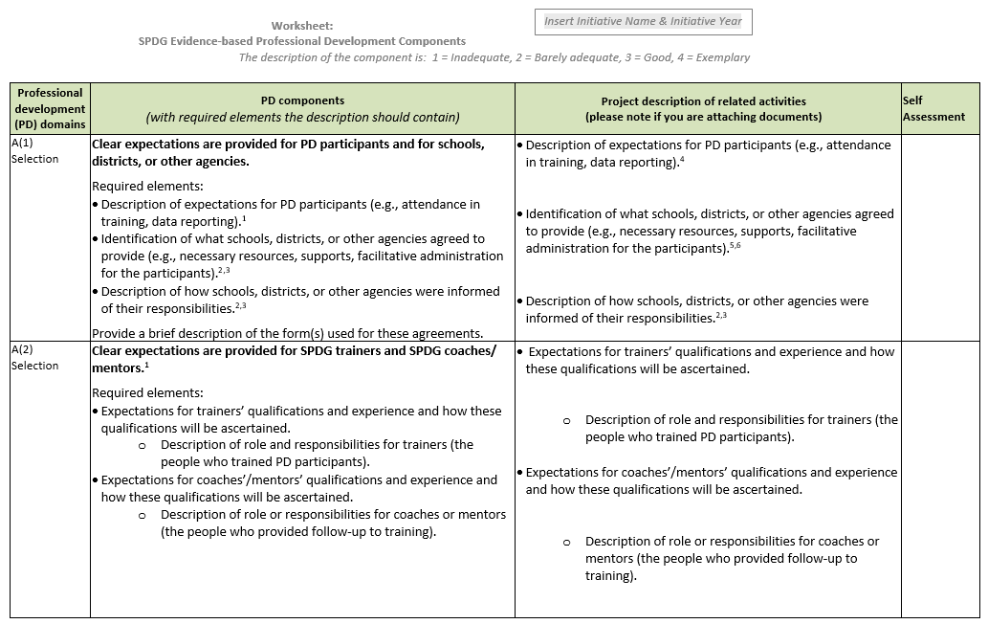
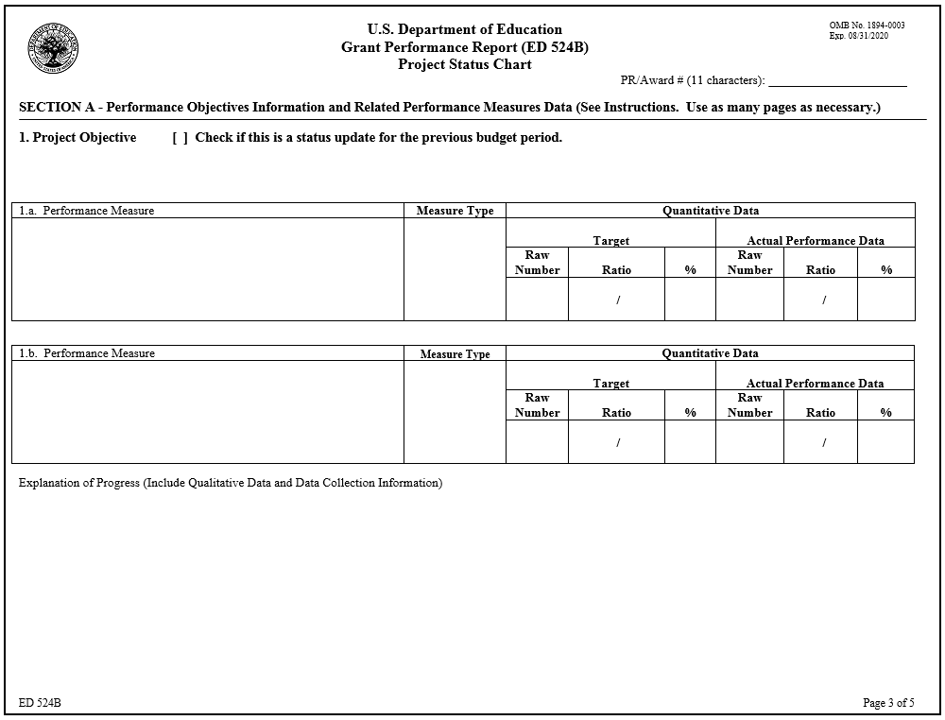
Annual Performance Report Components
SPDG Evidence-based Professional Development Components worksheet
ED 524B project status chart

Slide 4
CIPP’s Process for Reviewing and Reporting GPRA Data
For all measures, two reviewers:
Independently reviewed data reported in annual performance reports.
Examined and rated the quality and completeness of the data.
Aggregated grantee data for annual reporting to OSEP.

Slide 5
Measure 1.1 (Program Measure 1)
Percentage of SPDG-funded initiatives that meet benchmarks for use of evidence-based professional development practices to support the attainment of identified competencies.
Tips for performance reporting
☑ Limit description to information relevant to the professional development component.
☑ Provide thorough descriptions of activities listed in worksheet.
Describe completed activities only.
Use caution when copying and pasting from a prior year (be sure to make all needed updates to the text).

Slide 6
Component Requirements and Sample Description for Measure 1.1 (Program Measure 1)
Rating: 1=Inadequate; 2=Barely adequate; 3=Good; 4=Exemplar
Component and Requirements E(2) Leadership at various education levels (SEA, regional, LEA, school, as appropriate) analyzes feedback regarding barriers and successes and makes the necessary decisions and changes, including revising policies and procedures to alleviate barriers and facilitate implementation. Describe processes for collecting, analyzing, and utilizing input and data from various levels of the education system to recognize barriers to implementation success. Describe processes for revising policies and procedures and making other necessary changes. | Describe processes for collecting, analyzing, and utilizing input and data from various levels of the education system to recognize barriers to implementation success. The SPDG team collects data on project activities and shares them with school and regional coaches. Regional coaches monitor school trends and district data, and the SPDG Implementation Team analyzes the data. The State Team reviews trends. Site Teams complete the Fidelity Tool, and regional coaches share results at leadership meetings to identify implementation strengths, barriers, and support needs. At the district level, the regional coach and District Team monitor implementation using the District Checklist, which outlines expectations for project implementation. Describe processes for revising policies and procedures and making other necessary changes. Site Teams review school policies and identify implementation barriers. Site coaches guide schools on how to modify policies and procedures (e.g., how to select and use literacy assessment materials). District Teams review district-level policies hindering project implementation and determine alternative solutions. Regional coaches provide guidance to District Teams on policy and procedural changes. Also, the State Team meets twice a year to review data from the implementation measures and surveys. The State Team suggests policy and process changes at the district and school levels to increase implementation fidelity and the overall success of the project.

Slide 7
Poll Question 1
What rating would you give this description?
Inadequate
Barely adequate
Good
Exemplar

Slide 8
Component Requirements and Sample Description for Measure 1.1 (Program Measure 1)
Rating: 1=Inadequate; 2=Barely adequate; 3=Good; 4=Exemplar
Component and Requirements E(2) Leadership at various education levels (SEA, regional, LEA, school, as appropriate) analyzes feedback regarding barriers and successes and makes the necessary decisions and changes, including revising policies and procedures to alleviate barriers and facilitate implementation. Describe processes for collecting, analyzing, and utilizing input and data from various levels of the education system to recognize barriers to implementation success. Describe processes for revising policies and procedures and making other necessary changes. | Describe processes for collecting, analyzing, and utilizing input and data from various levels of the education system to recognize barriers to implementation success. The SPDG team collects data on project activities and shares them with school and regional coaches. Regional coaches monitor school trends and district data, and the SPDG Implementation Team analyzes the data. The State Team reviews trends. Site Teams complete the Fidelity Tool, and regional coaches share results at leadership meetings to identify implementation strengths, barriers, and support needs. At the district level, the regional coach and District Team monitor implementation using the District Checklist, which outlines expectations for project implementation. Describe processes for revising policies and procedures and making other necessary changes. Site Teams review school policies and identify implementation barriers. Site coaches guide schools on how to modify policies and procedures (e.g., how to select and use literacy assessment materials). District Teams review district-level policies hindering project implementation and determine alternative solutions. Regional coaches provide guidance to District Teams on policy and procedural changes. Also, the State Team meets twice a year to review data from the implementation measures and surveys. The State Team suggests policy and process changes at the district and school levels to increase implementation fidelity and the overall success of the project.
✓
✓

Slide 9
Component Requirements and Sample Description for Measure 1.1 (Program Measure 1)
Rating: 1=Inadequate; 2=Barely adequate; 3=Good; 4=Exemplar
Component and Requirements E(2) Leadership at various education levels (SEA, regional, LEA, school, as appropriate) analyzes feedback regarding barriers and successes and makes the necessary decisions and changes, including revising policies and procedures to alleviate barriers and facilitate implementation. Describe processes for collecting, analyzing, and utilizing input and data from various levels of the education system to recognize barriers to implementation success. Describe processes for revising policies and procedures and making other necessary changes. | The Implementation Teams review all SPDG project outcome data and recommend improvement goals and activities to the SPDG Coordinators and State-level coaches. SPDG data will also be reviewed with the Board of Education, Advisory Panel, special education administrators, research clearinghouse, and the PTA to ensure there is opportunity to receive broad stakeholder feedback about any need to revise policies and procedures to alleviate barriers and facilitate implementation. The Board of Education website is updated with current projects and resources. Also, coordinators present at several administrator conferences and LEA events and trainings. SPDG Coordinators report to an Assistant Superintendent who has the ability to change Board of Education procedures and also recommend policy changes to the Board of Education. LEA teams use feedback on their PD Checklists, PD planning guides, and post-training surveys to make improvements. LEAs also use their fidelity data to analyze barriers and success and make informed decisions.

Slide 10
Poll Question 2
What rating would you give this description?
Inadequate
Barely adequate
Good
Exemplar

Slide 11
Component Requirements and Sample Description for Measure 1.1 (Program Measure 1)
Rating: 1=Inadequate; 2=Barely adequate; 3=Good; 4=Exemplar
Component and Requirements E(2) Leadership at various education levels (SEA, regional, LEA, school, as appropriate) analyzes feedback regarding barriers and successes and makes the necessary decisions and changes, including revising policies and procedures to alleviate barriers and facilitate implementation. Describe processes for collecting, analyzing, and utilizing input and data from various levels of the education system to recognize barriers to implementation success. Describe processes for revising policies and procedures and making other necessary changes. | The Implementation Teams review all SPDG project outcome data and recommend improvement goals and activities to the SPDG Coordinators and State-level coaches. SPDG data will also be reviewed with the Board of Education, Advisory Panel, special education administrators, research clearinghouse, and the PTA to ensure there is opportunity to receive broad stakeholder feedback about any need to revise policies and procedures to alleviate barriers and facilitate implementation. The Board of Education website is updated with current projects and resources. Also, coordinators present at several administrator conferences and LEA events and trainings. SPDG Coordinators report to an Assistant Superintendent who has the ability to change Board of Education procedures and also recommend policy changes to the Board of Education. LEA teams use feedback on their PD Checklists, PD planning guides, and post-training surveys to make improvements. LEAs also use their fidelity data to analyze barriers and success and make informed decisions.
Missing
Incomplete

Slide 12
New Version of Worksheet for Program Measure 1
Revised formatting
Bullet point in the Project Description column for each required element.
Please enter a brief description under the relevant bullet.
Revisions to professional development components/elements
Minor
Wording changes for clarity or elements removed.
Substantial
New elements within the component or new content within an element.
New components/elements
Elements moved from other components or new elements.

Slide 13
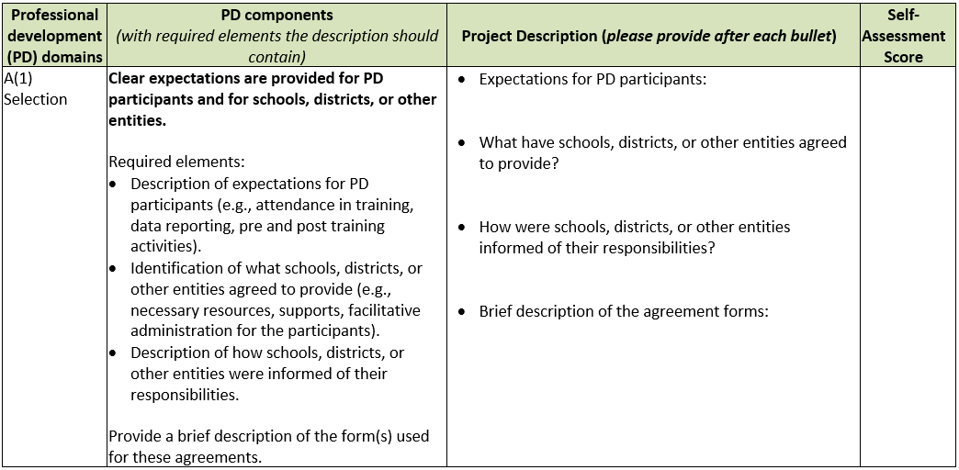
Formatting Changes to Worksheet for Program Measure 1

Slide 14
Minor Revisions to Components for Program Measure 1
Minor Revisions | Substantial Revisions | New Components/Elements
A(1): Clear expectations for participants, schools, districts, other entities A(2): Clear expectations for trainers and coaches/mentors B(1): Accountability for training delivery/quality B(2): Use adult learning strategies B(3): Training is skill-based D(1): Accountability for the measurement/reporting system | B(4): Trainers are trained, coached, and observed B(6): Outcome data are collected and analyzed C(1): Accountability for quality and timeliness of coaching services C(2): Coaches use effective practices D(3): Use fidelity and student outcome data for improvement E(2): Leadership systems build capacity/promote sustainability | B(5): Administrators are trained/coached C(3): Coaching data are collected and analyzed D(2): Data systems in place at all education levels E(1): Accountability for project leadership at the state level

Slide 15
Minor Revisions to Worksheet for Program Measure 1

Slide 16
Substantial Revisions to Components for Program Measure 1
Minor Revisions | Substantial Revisions | New Components/Elements
A(1): Clear expectations for participants, schools, districts, other entities A(2): Clear expectations for trainers and coaches/mentors B(1): Accountability for training delivery/quality B(2): Use adult learning strategies B(3): Training is skill-based D(1): Accountability for the measurement/reporting system | B(4): Trainers are trained, coached, and observed B(6): Outcome data are collected and analyzed C(1): Accountability for quality and timeliness of coaching services C(2): Coaches use effective practices D(3): Use fidelity and student outcome data for improvement E(2): Leadership systems build capacity/promote sustainability | B(5): Administrators are trained/coached C(3): Coaching data are collected and analyzed D(2): Data systems in place at all education levels E(1): Accountability for project leadership at the state level

Slide 17
Substantial Revisions to Worksheet for Program Measure 1
Professional development (PD) domains | PD components (with required elements the description should contain) | Project Description (please provide after each bullet) | Self-Assessment Score
C(2) Coaching OLD VERSION | SPDG coaches use multiple sources of information in order to provide assistive feedback to those being coached and also provide appropriate instruction or modeling. Required elements: Should describe the coaching strategy used and the appropriateness for use with adults (i.e., evidence provided for coaching strategies).⁶ Describe how SPDG coaches monitored implementation progress. Describe how the data from the monitoring are used to provide feedback to implementers.
C(2) Coaching NEW VERSION | Coaches use effective coaching practices to increase innovation fidelity. Required elements: Description of coaching process, including coaching strategies, frequency, how feedback is provided, use of data within the coaching process, and how coaching effectiveness is measured. Note: This description may take the form of a coaching service delivery plan. Description of how coaching process is captured and connected to impact on fidelity of the innovation. Note: These data may be collected in a coaching log. | Coaching process, including coaching strategies, frequency, how feedback is provided, use of data within the coaching process, and how coaching effectiveness is measured: How is your coaching process captured and connected to impact on fidelity of the innovation?

Slide 18
New Components for Program Measure 1
Minor Revisions | Substantial Revisions | New Components/Elements
A(1): Clear expectations for participants, schools, districts, other entities A(2): Clear expectations for trainers and coaches/mentors B(1): Accountability for training delivery/quality B(2): Use adult learning strategies B(3): Training is skill-based D(1): Accountability for the measurement/reporting system | B(4): Trainers are trained, coached, and observed B(6): Outcome data are collected and analyzed C(1): Accountability for quality and timeliness of coaching services C(2): Coaches use effective practices D(3): Use fidelity and student outcome data for improvement E(2): Leadership systems build capacity/promote sustainability | B(5): Administrators are trained/coached C(3): Coaching data are collected and analyzed D(2): Data systems in place at all education levels E(1): Accountability for project leadership at the state level

Slide 19
New Components/Elements for Program Measure 1
Professional development (PD) domains | PD components (with required elements the description should contain) | Project Description (please provide after each bullet) | Self-Assessment Score
E(1) Systemic Leadership Supports | Accountability for the technical and adaptive leadership of the project at the state level. Required elements: Identification of the lead persons responsible for (1) technical leadership and (2) adaptive leadership – include names and position/title. Description of how the lead(s): Engages in regular communication with the leads for training, coaching and data systems, Promotes the effective use of evidence based professional development components, Problem solves challenges to innovation implementation, Recognizes effort and successes, and Develops and/or refines state policies or procedures to support the sustainability of evidenced based professional development components. | ● Lead persons responsible for (1) technical leadership and (2) adaptive leadership – include names and position/title: ● How does this person ensure there is regular communication with the leads for training, coaching and data systems? ● How does this person promote the effective use of evidence based professional development components? ● How does this person problem solve challenges to innovation implementation? ● How does this person recognize effort and successes? ● How does this person lead the work of developing and/or refining state policies or procedures to support the sustainability of evidenced based professional development components?

Slide 20
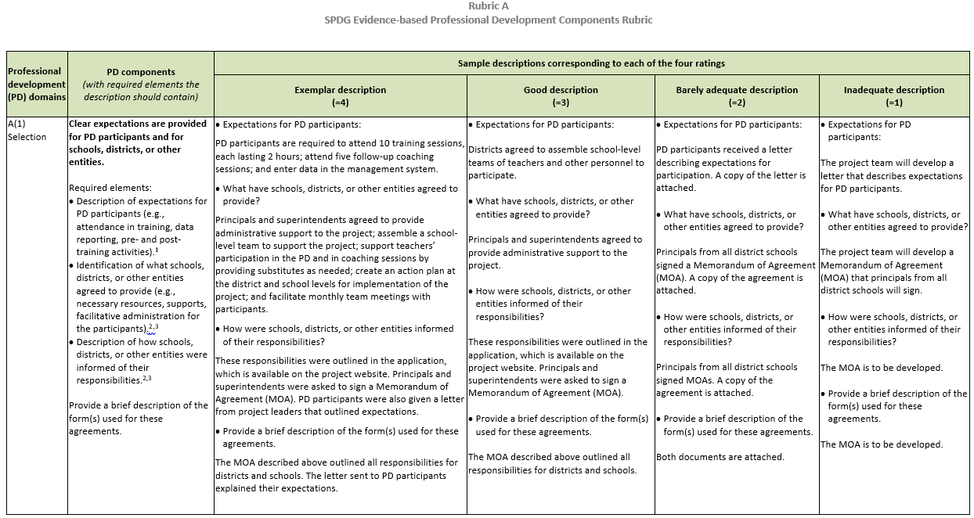
New Version of Rubric A

Slide 21
Measure 2.1 (Program Measure 2)
The percentage of Special Education State Personnel Grant-funded initiatives that meet benchmarks for improvement in implementation of SPDG-supported practices over time.
Tips for performance reporting
Work with your program officer to confirm that targets are appropriate and achievable.
Use the correct equation.
Report complete data.
Enter data in the correct location of the project status chart (e.g., target vs. actual).
Sum benchmarks with multiple components into a single numerator and denominator.
Number of professional development participants meeting the benchmark
÷
Total number of professional development participants

Slide 22
Sample Data for Measure 2.1 (Program Measure 2)
Performance Measure | Measure Type | Target |  |  | Actual
 |  | Raw Number | Ratio | % | Raw Number | Ratio | %
One year after completing the Reading coursework, 80% of teachers in participating sites will implement the program with fidelity as measured by the Reading Fidelity Checklist | Program |  | 61/75 | 81 |  | 65/75 | 87
Performance Measure | Measure Type | Target |  |  | Actual
 |  | Raw Number | Ratio | % | Raw Number | Ratio | %
In Year 3 of MTSS implementation, 90% of schools that received 2 years or more of SPDG support will score 85% or more on the MTSS fidelity rubric. | Program |  |  | 87 |  |  | 90

Slide 23
Poll Question 3 Which sample data fulfill the reporting criteria for Measure 2.1?
1
Performance Measure | Measure Type | Target |  |  | Actual
 |  | Raw Number | Ratio | % | Raw Number | Ratio | %
One year after completing the Reading coursework, 80% of teachers in participating sites will implement the program with fidelity as measured by the Reading Fidelity Checklist | Program |  | 61/75 | 81 |  | 65/75 | 87
2
Performance Measure | Measure Type | Target |  |  | Actual
 |  | Raw Number | Ratio | % | Raw Number | Ratio | %
In Year 3 of MTSS implementation, 90% of schools that received 2 years or more of SPDG support will score 85% or more on the MTSS fidelity rubric. | Program |  |  | 87 |  |  | 90

Slide 24
Sample Data for Measure 2.1 (Program Measure 2)
1
Performance Measure | Measure Type | Target |  |  | Actual
 |  | Raw Number | Ratio | % | Raw Number | Ratio | %
One year after completing the Reading coursework, 80% of teachers in participating sites will implement the program with fidelity as measured by the Reading Fidelity Checklist | Program |  | 61/75 | 81 |  | 65/75 | 87
✓
2
Performance Measure | Measure Type | Target |  |  | Actual
 |  | Raw Number | Ratio | % | Raw Number | Ratio | %
In Year 3 of MTSS implementation, 90% of schools that received 2 years or more of SPDG support will score 85% or more on the MTSS fidelity rubric. | Program |  |  | 87 |  |  | 90
X

Slide 25
Measure 2.2 (Program Measure 3)
The percentage of Special Education State Personnel Grant-funded initiatives that meet targets for the use of funds to sustain SPDG-supported practices.
Tips for performance reporting
Use the correct equation.
Report complete data.
Enter data in correct location of the project status chart (e.g., target vs actual).
Sum multiple costs for an initiative into a single numerator and denominator.
Cost of technical assistance
÷
Cost of all professional development activities

Slide 26
Sample Data for Measure 2.2 (Program Measure 3)
Performance Measure | Measure Type | Target |  |  | Actual
 |  | Raw Number | Ratio | % | Raw Number | Ratio | %
60% of SPDG funds are used for activities designed to sustain the use of PBIS. | Program |  | 6 / 10 | 60 |  | 43 / 100 | 43
Performance Measure | Measure Type | Target |  |  | Actual
 |  | Raw Number | Ratio | % | Raw Number | Ratio | %
In 2020-21, 70% of the SPDG funds will be used for activities designed to sustain the use of practices on which PD/TA are focused | Program |  | 427,350 / 610,500 | 70 |  | 439,560 / 610,500 | 72

Slide 27
Poll Question 4 Which sample data fulfill the reporting criteria for Measure 2.2?
1
Performance Measure | Measure Type | Target |  |  | Actual
 |  | Raw Number | Ratio | % | Raw Number | Ratio | %
60% of SPDG funds are used for activities designed to sustain the use of PBIS. | Program |  | 6 / 10 | 60 |  | 43 / 100 | 43
2
Performance Measure | Measure Type | Target |  |  | Actual
 |  | Raw Number | Ratio | % | Raw Number | Ratio | %
In 2020-21, 70% of the SPDG funds will be used for activities designed to sustain the use of practices on which PD/TA are focused | Program |  | 427,350 / 610,500 | 70 |  | 439,560 / 610,500 | 72

Slide 28
Sample Data for Measure 2.2 (Program Measure 3)
1
Performance Measure | Measure Type | Target |  |  | Actual
 |  | Raw Number | Ratio | % | Raw Number | Ratio | %
60% of SPDG funds are used for activities designed to sustain the use of PBIS. | Program |  | 6 / 10 | 60 |  | 43 / 100 | 43
X
2
Performance Measure | Measure Type | Target |  |  | Actual
 |  | Raw Number | Ratio | % | Raw Number | Ratio | %
In 2020-21, 70% of the SPDG funds will be used for activities designed to sustain the use of practices on which PD/TA are focused | Program |  | 427,350 / 610,500 | 70 |  | 439,560 / 610,500 | 72
✓

Slide 29
Measure 3.1 (Program Measure 4)
Percent of State Personnel Development Grant-funded projects that meet targets for retention of special education teachers.
Tip for performance reporting
Report on this measure only if teacher retention is a project objective.

Slide 30
Recommendations for Reporting Across Measures
Categorize project and program (GPRA) measure data clearly.
Report the numerator, denominator, and resulting percentage for each measure and initiative.
If multiple instruments are used to report on one measure, report aggregated data on unduplicated counts of participants.
Provide relevant information in the Explanation of Progress (EOP).
Ensure that information in the table and EOP are consistent.

Slide 31
Key Takeaways
Set realistic targets
Review report guidance carefully
Report complete data
Check data for accuracy and completeness
Consult with your program officer if necessary

Slide 32
Resources and Support
Visit OSEP’s IDEAs That Work website (https://osepideasthatwork.org/) for useful tools and resources.
CIPP Team
CIPP@westat.com
(888) 843-4101

Slide 33
Questions and Discussion

