Slide 1
Telling Our Stories: Podcasting
Sophia Farmer, Implementation Specialist
10.12.2021

Slide 2
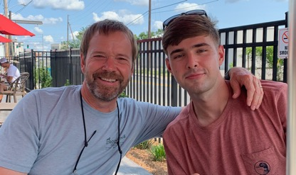
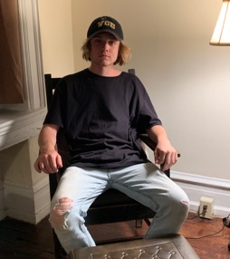
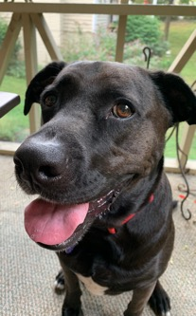
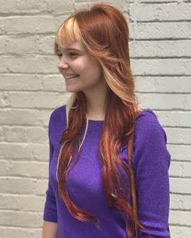
Learning Objectives
My History:
Elementary Special Education Teacher
Ran the MTSS Center in VA! Loved that!
My SHEroes: There are so many!
Brene Brown
My Heartbreak:
Not having the opportunity to travel more – be more of a global citizen – to further advance my equity journey
My Hopes:
Greater body-mind balance - staying fully present

Slide 3
https://sisep.fpg.unc.edu

Slide 4
Why Podcasts?
Make the implementation science more ‘real’ and practical
Connect with our learners on a more personal level
Convenient and easy to consume – we keep it SHORT!
Cheap!
Portable – people love to listen while walking, in the car, exercising
So easy to do – but you must have a love and passion about your subject so that you can communicate in ways that get people excited
Great way to get many voices out there with diverse and interesting stories and perspectives.
Reach! We have listeners in Australia, Canada, Brazil and others

Slide 5
Next Steps…
We are beginners…so we need to GROW!
Advertising – marketing
Moving to a more consistent ‘interview’ format
SISEP hosting families, teachers, students and educators from every level of the system doing the real work of implementation
Keep it practical and short – tips and concrete examples and ideas

Slide 6
Discussion
How could you use this resource or something similar for your work? Have you tried this or something similar before? If yes, what worked and what didn’t work?

Slide 7
Thank you!

Slide 8
Copyright

Slide 9
UNC FPG Logo

