Slide 1
Effective Communication Methods and Practices
Facilitated by: Correy Watkins

Slide 2
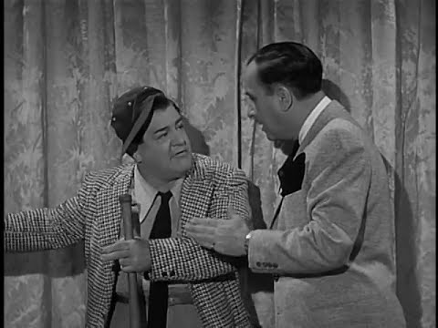
Notes:
Start @:59 seconds

Slide 3
Communication Protocols Making Linked Implementation Teams Effective and Efficient

Slide 4
How to make internal communication flow
Linked Implementation Teams
Building
Implementation Team
District
Implementation Team
Teachers
Students
Regional
Implementation Team
State
Implementation Team

Slide 5
Communication Protocol
What is it?
A written document outlining the frequency, type, format, and content parameters of communication with stakeholders and between teams.

Slide 6
Communication Protocol
Why?
Communicate progress and celebrate success between linked teams or groups
Report systemic barriers preventing or hindering implementation and:
Should be resolved by one of the groups
Need to be moved ‘up the line’ to the group that can best address the barrier
Report on actions taken to resolve or address past issues
Revisit past decisions and agreements to ensure that solutions remain functional

Slide 7
Communication Protocol
Who?
Implementation Teams and Workgroups

Slide 8
Communication Protocol
How?
Develop collaboratively with relevant implementation teams
Evaluate for satisfaction, effectiveness, and functionality
Adjust to meet needs and purpose

Slide 9
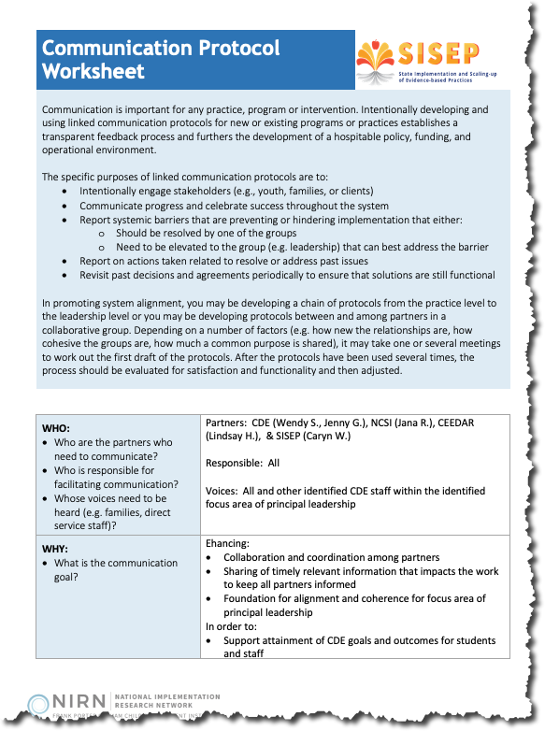
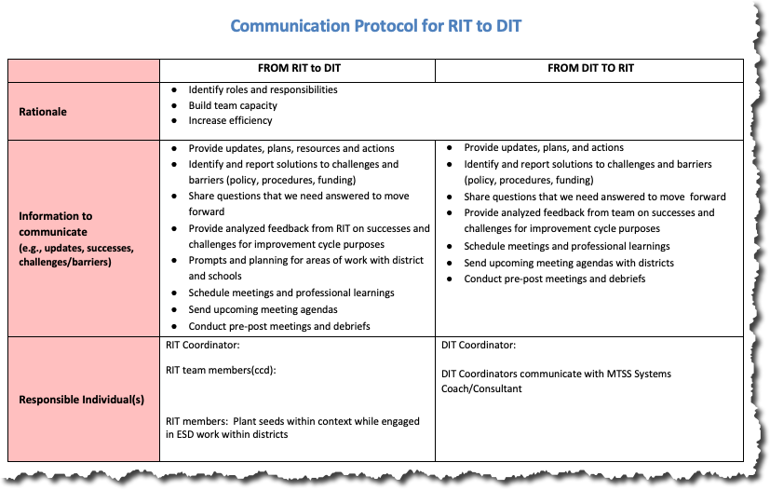
Activity: Reviewing some examples
See
RIT-DIT Communication Protocol Activity in Participant Guide
Notes:
Handout
Example
Dissemination: https://implementation.fpg.unc.edu/resource/dissemination-plan-template/

Slide 10
Follow us!
Twitter/Facebook/LinkedIn
SISEP Center | @sisepcenter
NIRN | @impscience
Websites:
sisep.fpg.unc.edu
nirn.fpg.unc.edu
Email:
correy.watkins@unc.edu

Slide 11
Copyright

Slide 12
UNC FPG Logo

