Slide 1
Reaching Families Where they Are
Created and Presented by:
Mary Ann Shepherd, PhD, Behavior Consultant
And
Kristen Perez-Rickels, Oklahoma
www.everydaybehaviors.com

Slide 2
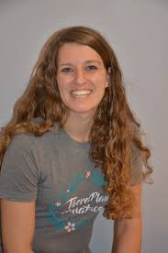
Introduction
Mary Ann Shepherd:
My History - From Oklahoma, multiple licenses, specialty in Autism.
My Hopes - To leave my footprint on the field.
My Heartbreaks - Lack of services, early identification, and resources for parents
My Heroes - My Staff and Co-Workers

Slide 3
Goals and Objectives
At the end of this training:
The learner will become familiar with novel resources/strategies to reach families and educators.
The learner will become familiar with novel ways to create sustainable resources for families and educators.
The learner will become familiar with ways to provide asynchronous training resources.

Slide 4
Meeting People Where They Are
Barriers –
Low attendance at trainings
Scheduling conflicts
High cost of trainings
Geographical limitations
COVID
Solutions –
Provide materials via Social Media
Provide a range of Asynchronous training materials.

Slide 5
Community Partners
Everyday Behavior With Dr. Mary Ann
Three Local Partnerships
Oklahoma SPDG Team – OTISS
Oklahoma Parents Center
Oklahoma Pediatric Therapy Center

Slide 6
Solution
Four Levels of Training
Level One – Social Media Resources
Facebook
Instagram
Level Two – Free Brief Training Videos
Approximately 5 minute tips and tricks
YouTube
Level Three - Asynchronous training options
1 – 3 hour trainings provided asynchronously with a live Q & A Component
Level Four - Intensive Asynchronous Training Options
30-40 hours of intensive ABA Training Videos
Housed on the State Online Training Platform

Slide 7
Resources
Annual Training Calendar
Functions of Behavior
School Refusal and School Truancy
Data Based Decision Making
Effective Consequences
Monthly Training Materials on a Preplanned Topic
Resources, Handouts, Flyers
YouTube Videos
Related Quotes
Linked Resources

Slide 10
YouTube Channel Navigation

Slide 11
Facebook Navigation

Slide 12
Website Navigation

Slide 13
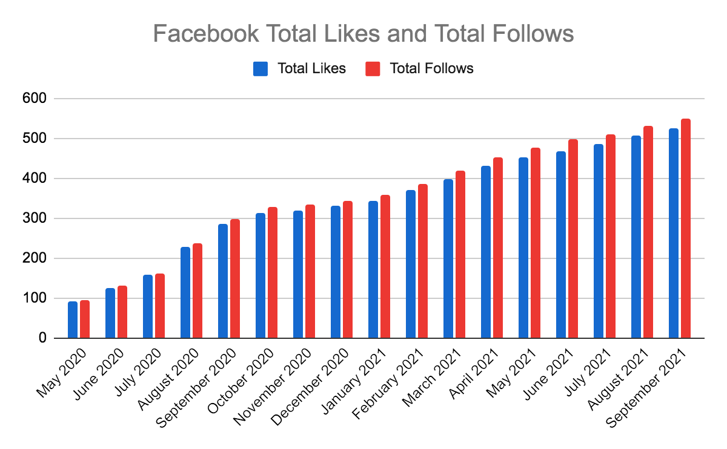
Facebook Data

Slide 14
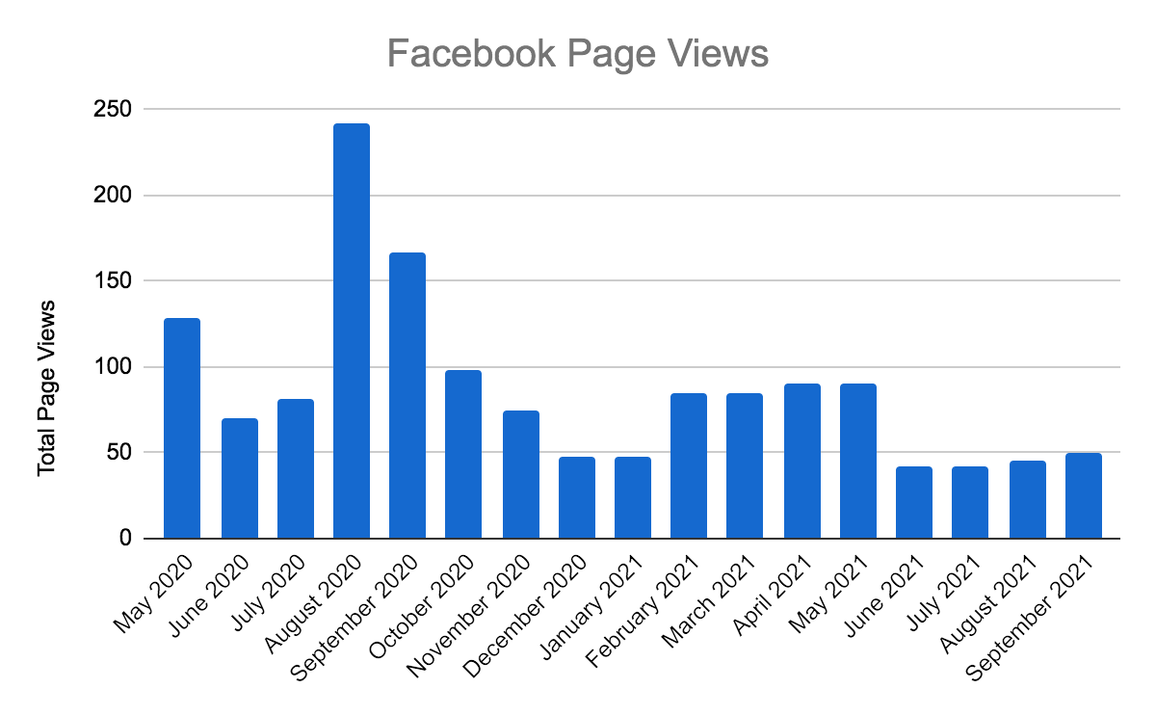
Facebook Data

Slide 15
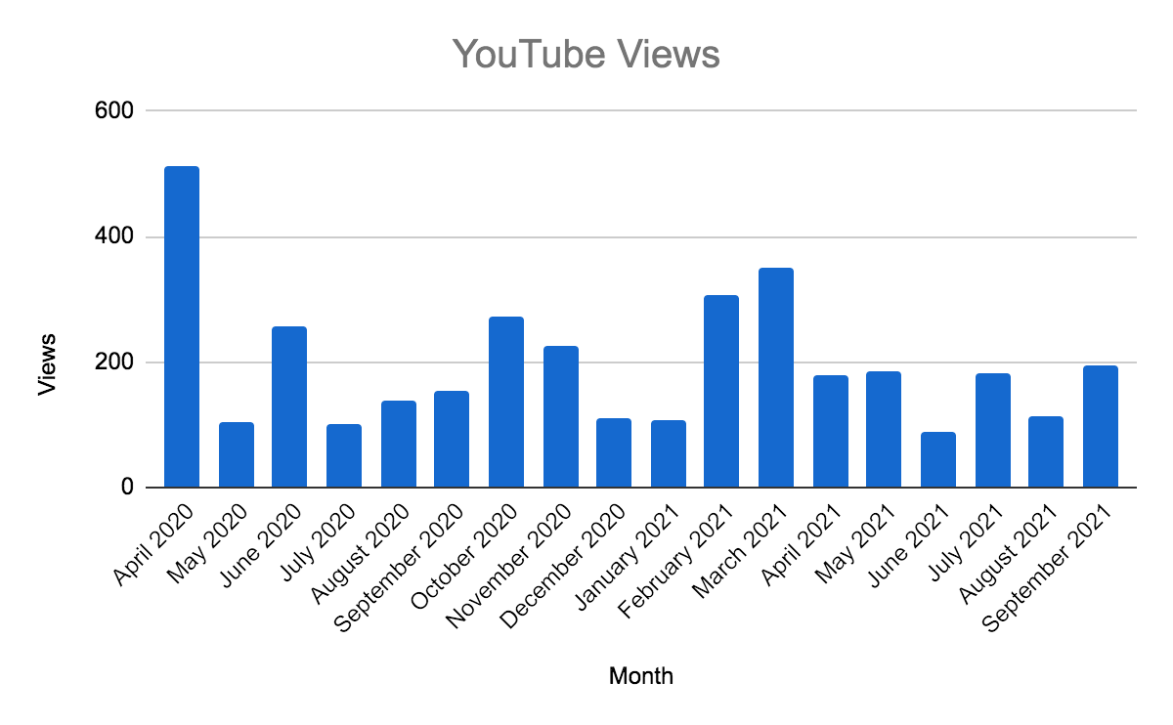
YouTube Data

Slide 16
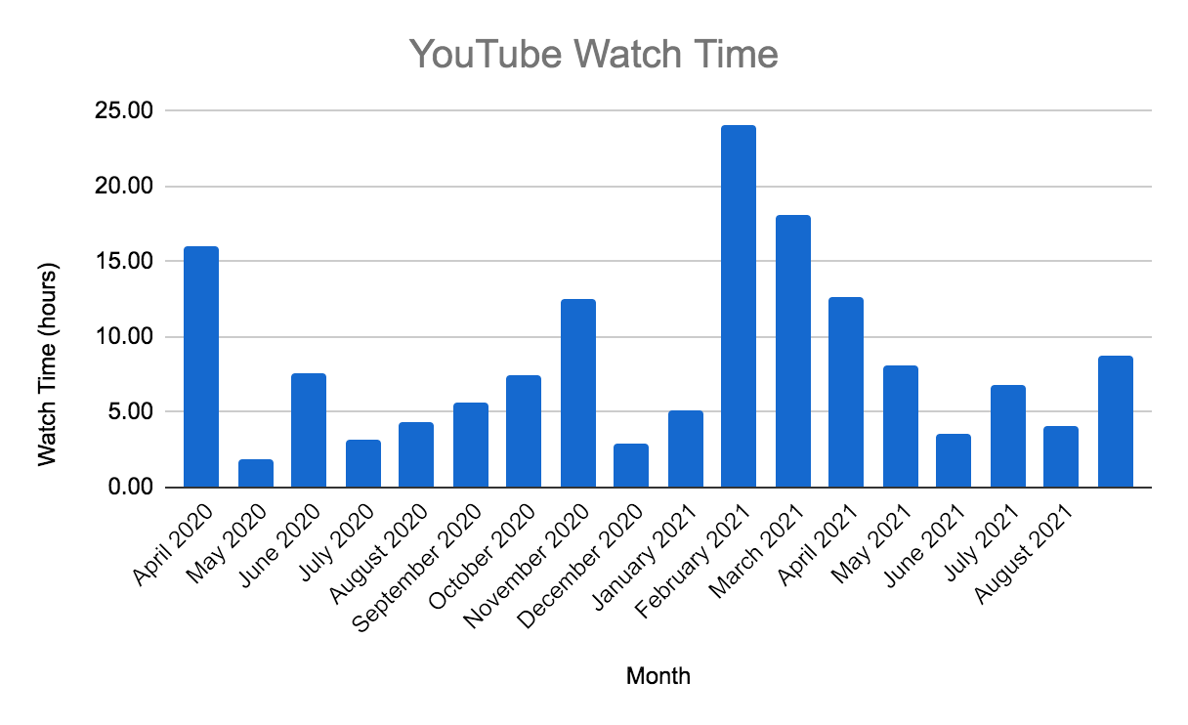
YouTube Data

Slide 17
Thank You!
Mary Ann Shepherd, PhD
Kristen Perez-Rickels, M.Ed.

Slide 18
For more information please visit:
www.everydaybehaviors.com
Facebook @ Everyday Behavior with Dr. Mary Ann
You Tube @ Everyday Behavior with Dr. Mary Ann

