Slide 1



Arizona Professional Learning Series
AZPLS DATA PORTAL
SPDG National Meeting
Fall 2021

Slide 2

SPDG National Meeting Outcomes
Increase
knowledge and skills related to inclusive leadership and virtual professional learning
Increase
knowledge of and ability to use new tools
Build
a stronger program network

Slide 3
Focus of the AZPLS
Arizona Professional Learning Series for creating systems change to increase literacy achievement for all students.

Slide 4

Systems
Professional Learning
Leadership
Data Analysis
Coaching
Team Structure
Action Planning

Slide 5







Content
Module 3: Formative Assessment
Module 4: Literacy Strategies
Module 2: Collaboration
Module 5: Literacy Strategies
Module 1: Introduction
Module 6: Differentiation

Slide 6
Our Story
Where we began…
Where we are now…
Established 2015
In-person
Outside facilitator
Coaching focus
External evaluator
2020–2022
Virtual coaching
Virtual capacity building
Leadership focus
Data portal

Slide 7


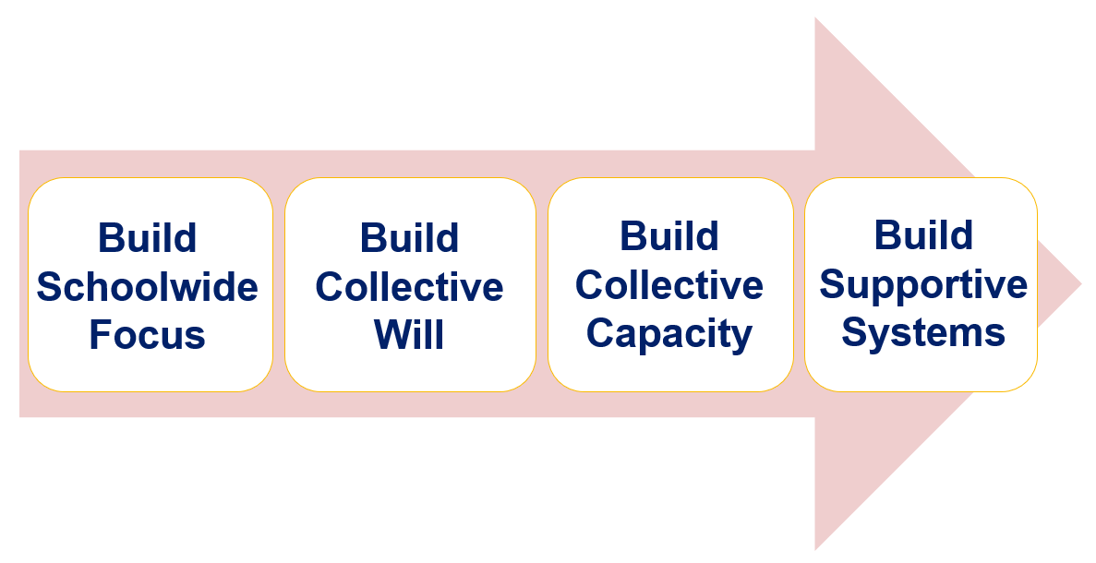
Leading for Impact
School
Students
District
Teacher

Slide 8
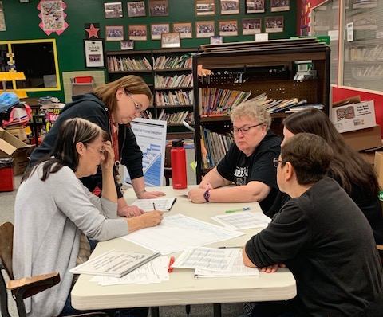
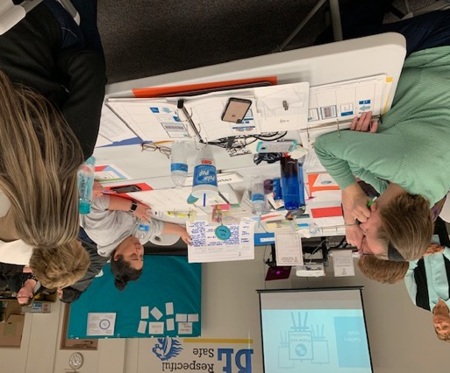
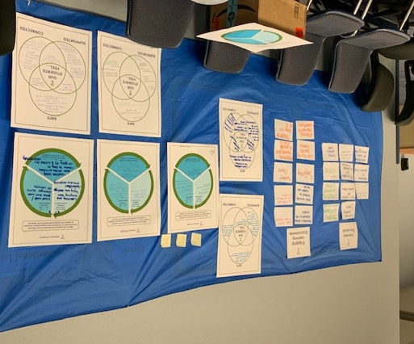
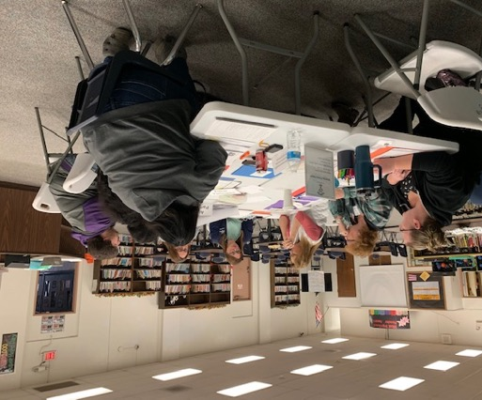
“The teachers hold their students to high expectations. By participating in the AZPLS, it has increased the visible learning that has gone on between our students as well as our teachers. When we take a look at where we started compared to where we ended, as you walk the classrooms you see that in action. You see the students being able to articulate their learning.”
- Principal

Slide 9
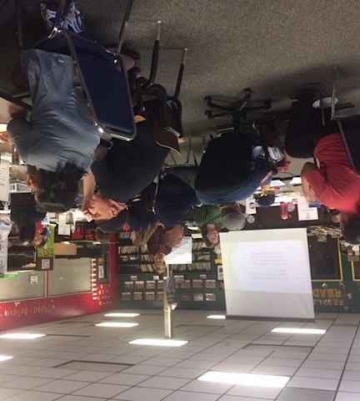
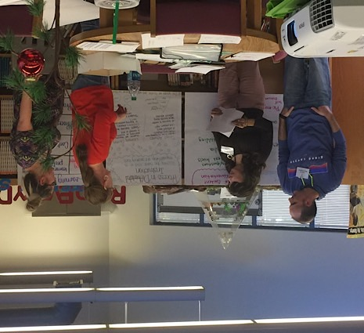
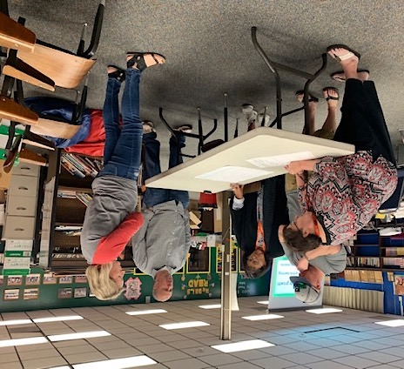
“The AZPLS has had a BIG impact on enhancing systems at our school. We did not just take on another initiative. It supported a collaborative structure that we had, but just wasn’t really working. It has given us a drive, a focus to be more student centered as a school. The AZPLS has brought us together.”
- Coach

Slide 10
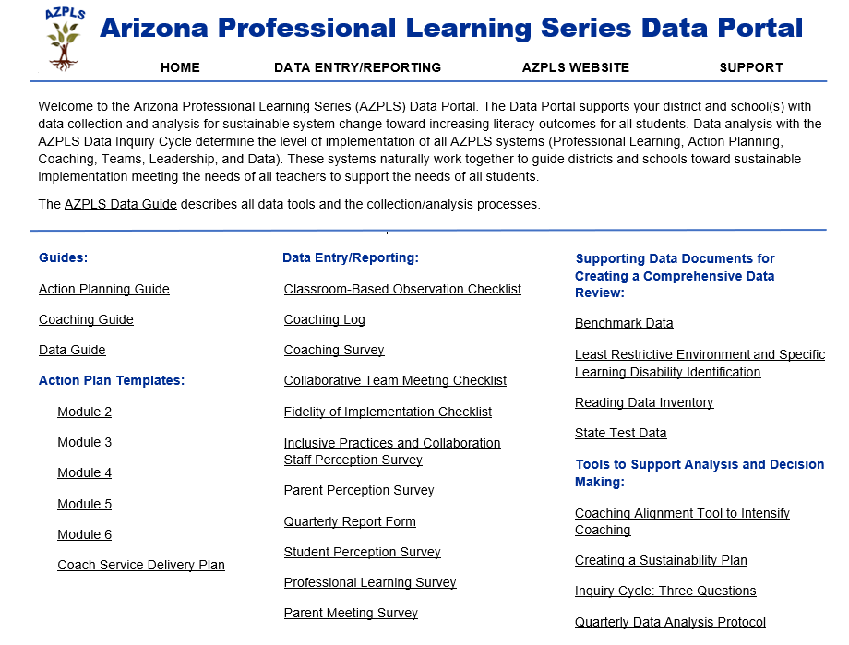

Arizona Professional Learning Series Data Portal
Where are we now?
Where are we headed?
How will we close the gap?

Slide 11
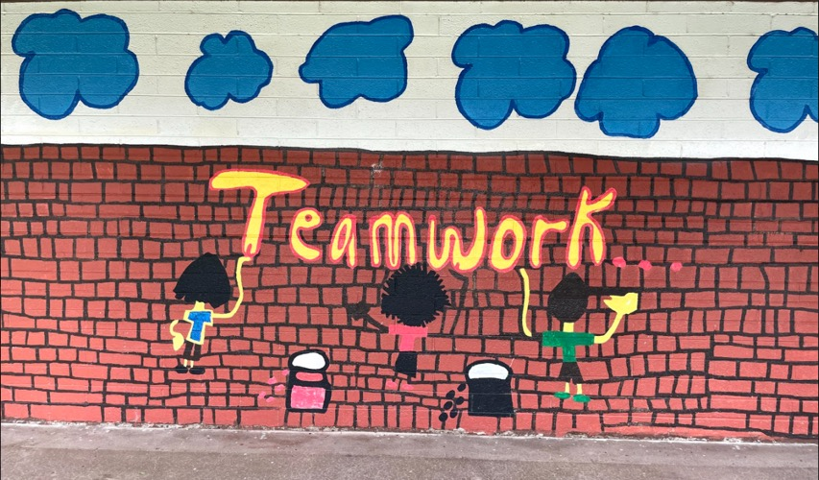
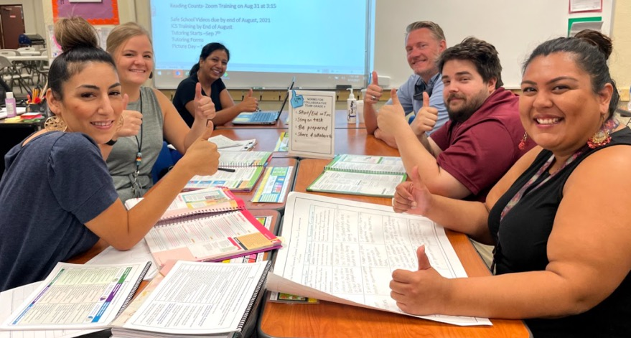
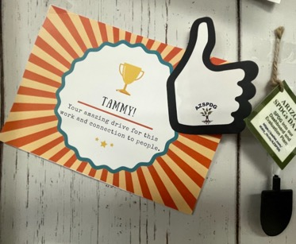

AZPLS Celebration

Slide 12


Questions

Slide 13



Contact
Stacy Riccio
Stacy.Riccio@azed.gov

