Slide 1
Welcome and Day 1
July 19, 2021

Slide 3
My History
Special education teacher for 21+ years
18+ years in low incidence programs
Low Incidence and Autism Coordinator
Work ranges along a continuum from federal level to student level
Facilitator, trainer, and policy-maker

Slide 4
My Hopes
The greatest danger for most of us is not that our aim is too high and we miss it, but that it is too low and we reach it.
Michelangelo

Slide 5
My Heros
I am humbled by the opportunity to teach students with disabilities. But, the truth is, I learned more than I taught. And one thing I now know to be undeniably true. Individuals with significant cognitive disabilities or complex needs are the bravest people I have ever met or could hope to meet.

Slide 6
My Heartbreak

Slide 7
Project Overview

Slide 8
TAS Goal 1
Goal 1: Increase inclusive opportunities for students with complex needs to reduce the achievement gap, resulting in more students participating in the general assessment, thus reducing the statewide alternate assessment participation rate to 1%.

Slide 9
TAS Goal 2
Goal 2: Increase the graduation rate and enrollment in postsecondary education for students with complex needs (e.g., inclusive higher education, technical colleges, and community colleges) and competitive integrated employment, thereby reducing the gap in employment of individuals with complex needs as compared to all other individuals' employment gap by 5%.

Slide 10
School Team Membership
School teams must include:
high school administrator
general education teacher
special education teacher
district special education director
Participation is a three-year commitment.

Slide 11
What Do We Know?

Slide 15
Longitudinal Indicator 14 Data–Specific Learning Disability (SLD) and ID

Slide 16
Project Overview
Teaching All Students Initiative
Training
Coaching
Synchronous School Team
(3 summer sessions)
Synchronous Intensive Teacher
(3 summer sessions)
On-site School Team Implementation Fidelity Checks
(at least 2 per year)
Student Specific Communication System Coaching
(at least 2 per year)
Asynchronous Training
(includes a mix of training for school team members, self-contained teachers, school-wide staff, and optional topic-based trainings)
Evaluation Process
(includes training surveys, implementation data, and student outcomes)
Sustainability and State-wide Implementation

Slide 17
Your Role
School Administrator
IEP team member
School-wide systemic change
Evaluative support
Expert on school improvement plan
Professional development planning
Special Education Director
IEP team member
District-wide policy and systems
Fiscal (purchases, staffing, etc.)
Connect to LEA plan
Professional development planning
General Education Teacher
IEP team member
Model inclusive practices
Content expert
Collaborative partner with special education team
Educator
Special Education Teacher
IEP team member
Transition planning
Partner with families to increase expectations
Collaborative partner with general education
Case manager

Slide 18
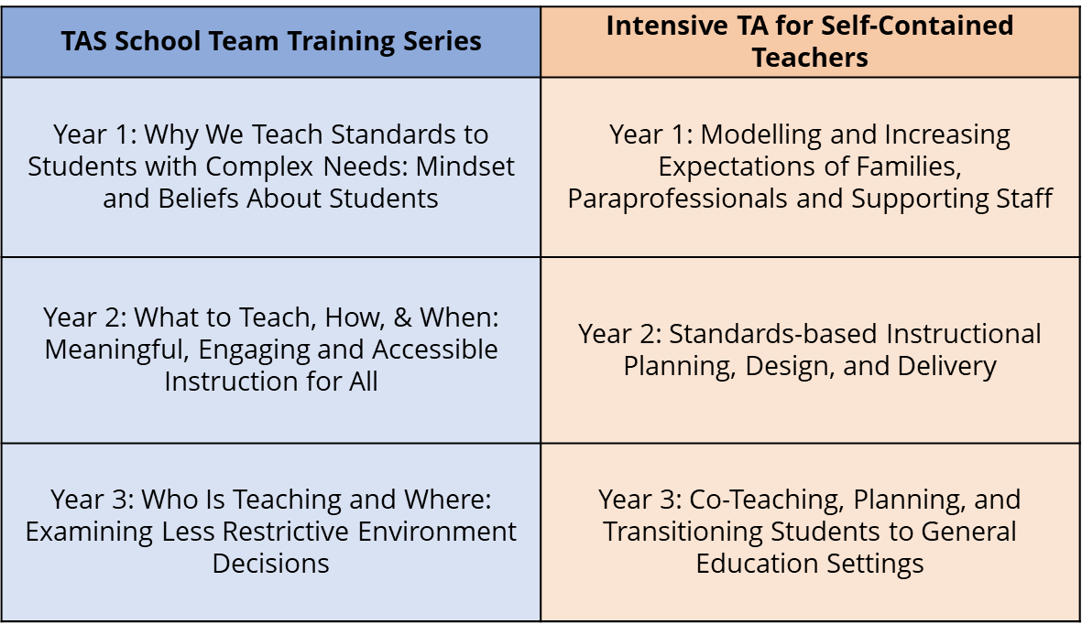
Project Overview

Slide 19
Project Overview – Year 1
Year 1: Why We Teach Standards to Students with Complex Needs: Mindset and Beliefs About Students
School teams will focus on current practices related to equity, access, instruction, and expectations. Clearly defining the reasons for ensuring that high school students with complex needs are challenged, heard, and valued as learners will help to drive future practices. A mini-grant to support all high school students’ communication will be available to each school team. The key learning targets of the first year are: create a shared vision of staff, family, and student mindset about expectations for students with complex needs, develop a systemic plan to ensure all students are afforded equitable access to meaningful instruction, create collaborative partnerships between general education and special education in planning and supporting the learning of students with complex needs, and prepare all students, including students with complex needs, for postsecondary success by providing high-leverage, evidence-based experiences for students with complex needs to achieve such as career and technical education (CTE) and work-based learning (WBL).

Slide 20
Project Overview—Year 2
Year 2: What to Teach, How, & When: Meaningful, Engaging and Accessible Instruction for All
Building on year one, the second year will focus on how to effectively engage high school students with complex needs in grade-level, standards-aligned instruction. Standards-based content is the strongest forum for teaching students both functional skills and how to learn, think, question, decide, hypothesize, plan, observe, adapt, change, debate, and grow. In short, standards-based instruction is how students learn the skills needed to be empowered adults. The key learning targets of the second year are: plan instruction and intervention for students with complex needs with a clear understanding of the difference between mastery versus learning, increase the learning outcomes of students with complex needs through evidence-based strategies for engagement and instruction, use assessment data to inform instruction, and integrate resources and supports into a cohesive single plan.

Slide 21
Project Overview – Year 3
Year 3: Who Is Teaching and Where: Examining Less Restrictive Environment Decisions
The final year of the intensive training will integrate the learning of the prior two years and extend it to decisions of instructional delivery and least restrictive environment (LRE) to increase high school student outcomes. The training will focus on demystifying the complex concept of LRE and the critical need to individually determine the LRE for each student for each portion of their school day at each IEP meeting. The key learning targets of the third year are: implement effective assessment and progress monitoring systems, establish a school culture of TAS mindset, principles, and strategies to ensure fidelity and sustainability of the work, and ensure strong LRE decision-making practices for students with complex needs with school-wide commitment to meet each student’s needs.

Slide 22
A Glimpse of Year 1

Slide 23
State-Wide Teaching All Students (TAS) Map

Slide 24
Where Are the Students?

Slide 26
Notes:
All data metrics will be provided in a paper version for school teams to write up and analyze. Each school will also be given their number.

Slide 27
Norms
We are all professionals and therefore, we will:
value the knowledge, expertise, and perspectives in the room;
embrace challenging learning; and
ensure all voices are heard.

Slide 28
Today’s Agenda

Slide 29
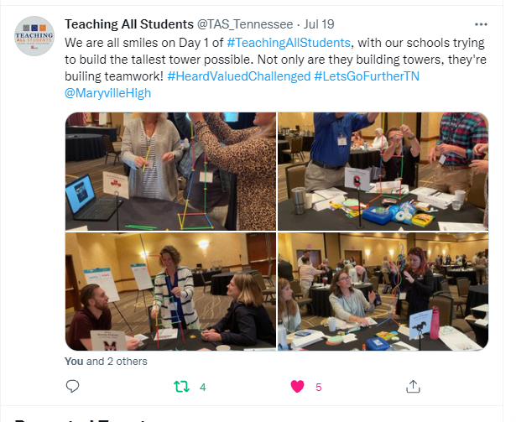

Slide 30
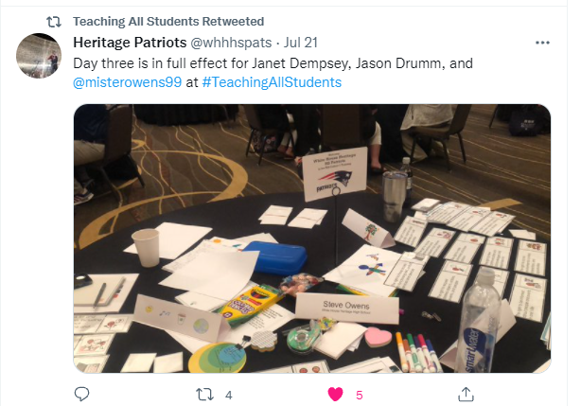

Slide 31
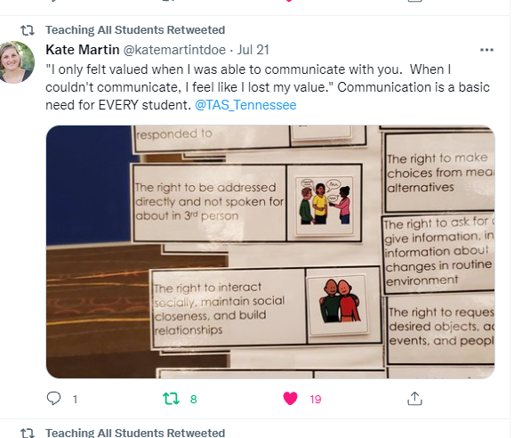

Slide 32
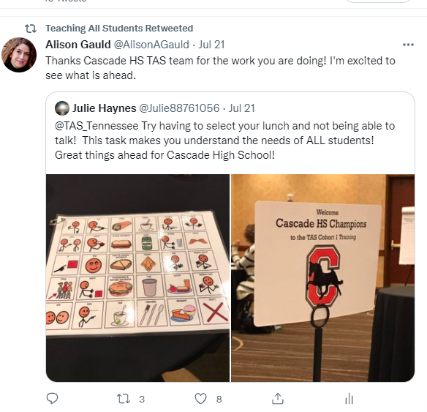

Slide 33
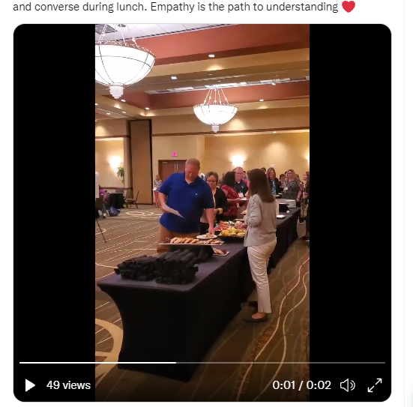
https://twitter.com/i/status/1417891842826326021
@TAS_Tennessee
https://clee.utk.edu/2021/09/10/reflections-on-communication/

Slide 34
Contact Info
Alison Gauld
Alison.Gauld@tn.gov
@TAS_Tennessee
615-854-9520

