Slide 1
April 26, 2022
Getting to Know Standards for Professional Learning
Notes:
Tuesday intro slide

Slide 2
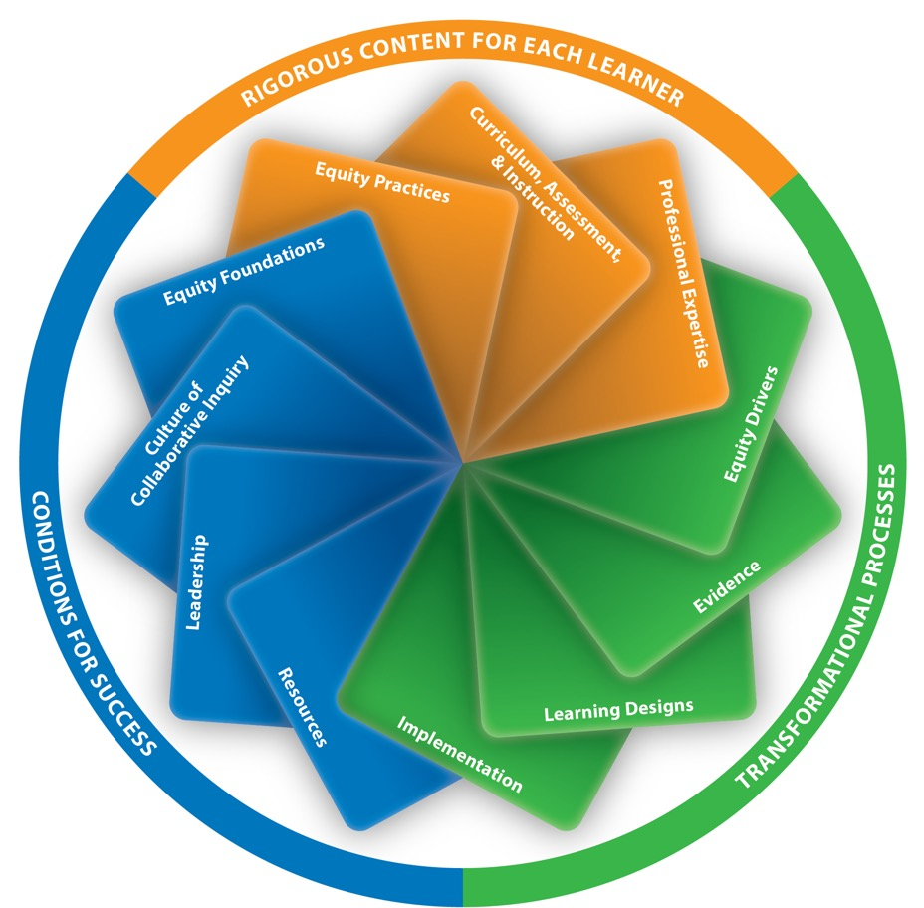
Standards work in concert within a system framework
Notes:
How we got here – review process, two drafts out, districts convened teams. Etc.

Slide 3
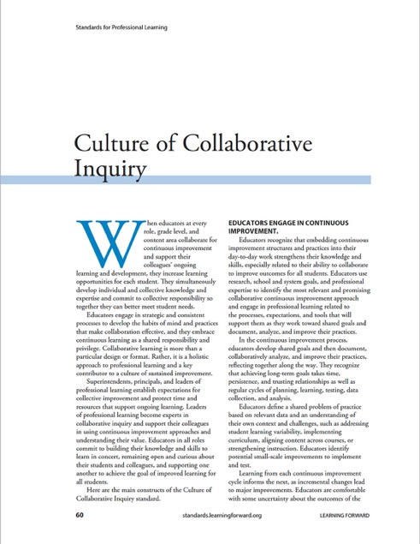
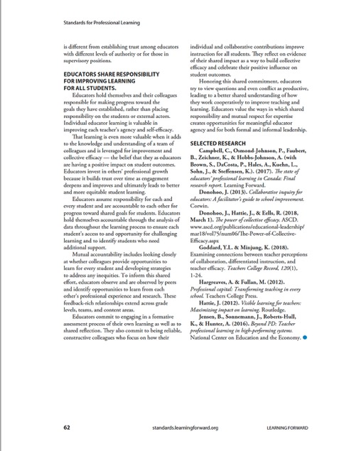
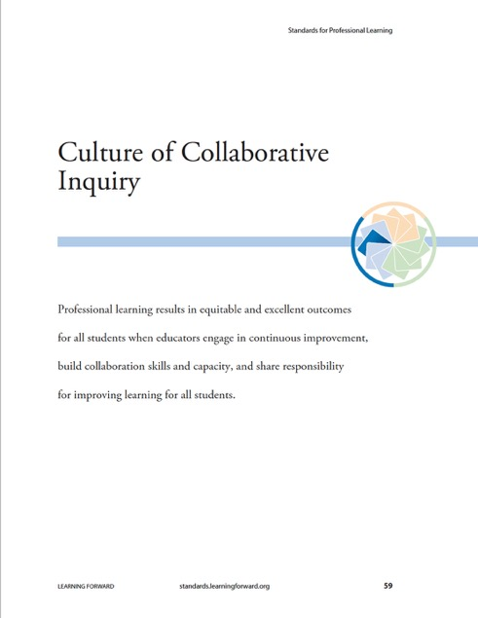
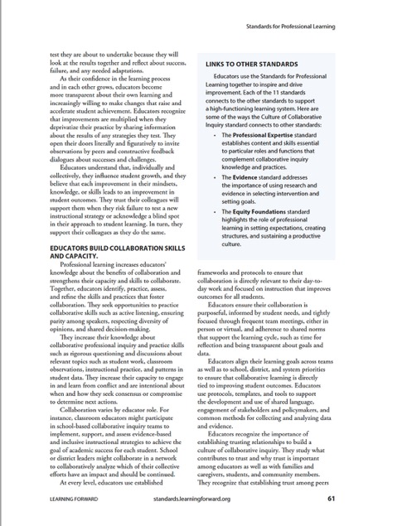
What is included in each standard?
Common stem
Three components or concepts are included in the narrative
Linkages with other standards suggest how these components work together to create a system
Selected research is listed at the end of each standard
Notes:
Culture of Collab Inquiry slide.
Talk about what each standard includes:
The common stem.
The three components or concepts included in the narrative.
The selected research elements.
The connections to other standards emphasizing how these work together to create a system.

Slide 4
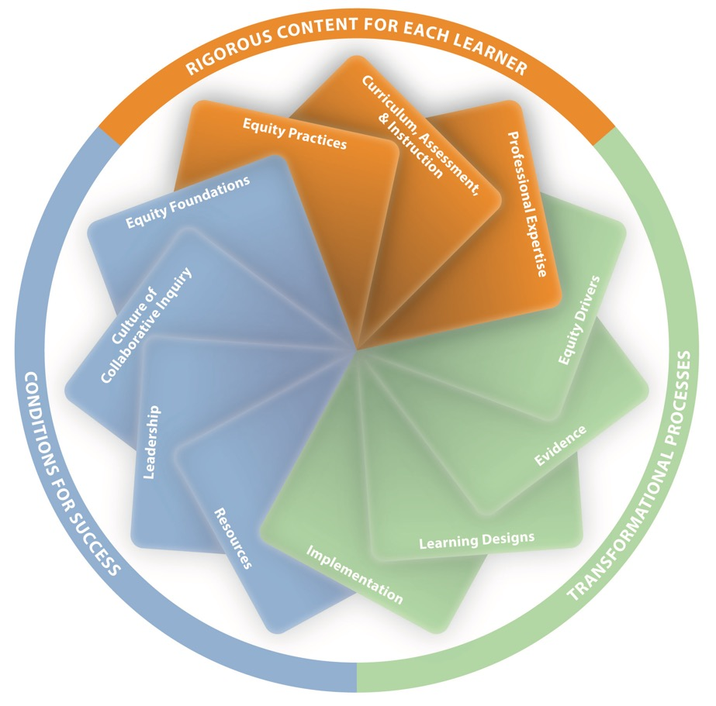
A system framework
Rigorous content for each learner
The essential content of adult learning that leads to improved student outcomes
Notes:
System framework
Talk about the three categories and why they are helpful.
Rigorous content for each learner
Added standard of Professional Expertise as well as CAI and equity practices.

Slide 5
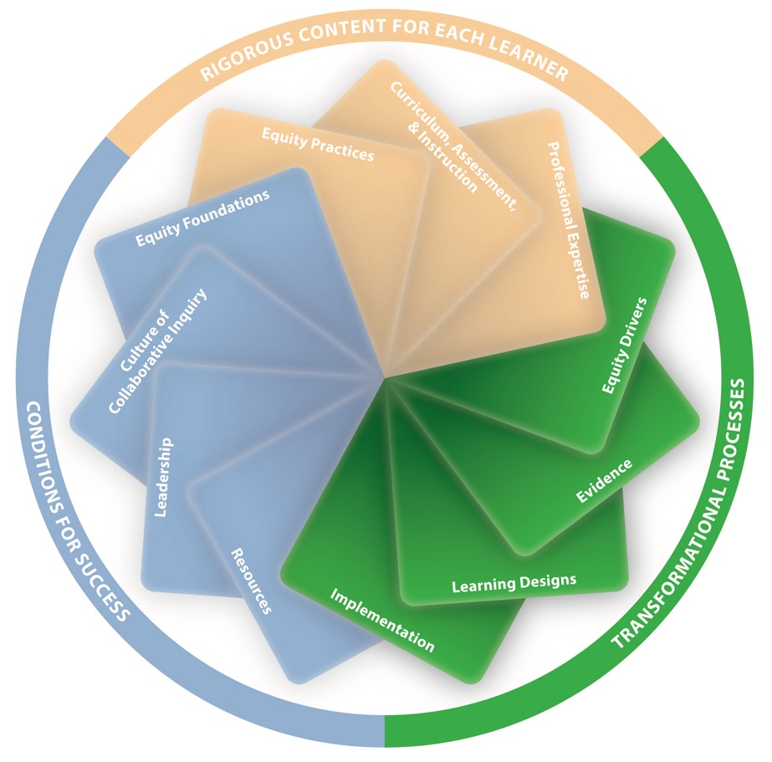
A system framework
Transformational processes
Process elements of professional learning that explain how educators sustain significant changes in their knowledge, skills, practices, and mindsets
Notes:
Transformational processes
This is the how of PL

Slide 6
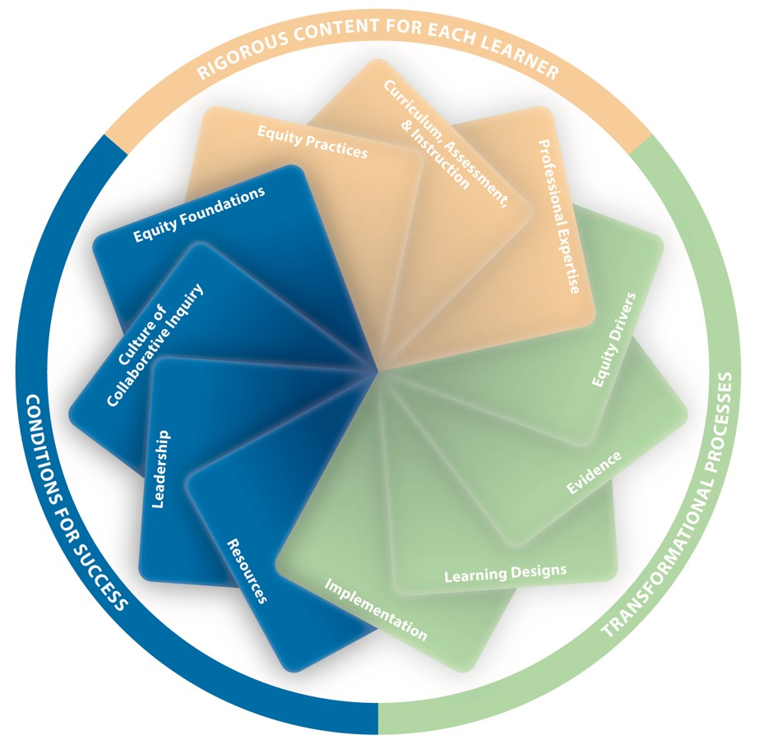
A system framework
Conditions for success
Aspects of the professional learning context, structures, and cultures that undergird high-quality professional learning
Notes:
Conditions for success
The foundation that makes it all possible.
Currently envisioning always using the cycle graphic with all standards even when we talk about one – to show that the entire system is always essential for success.

Slide 7
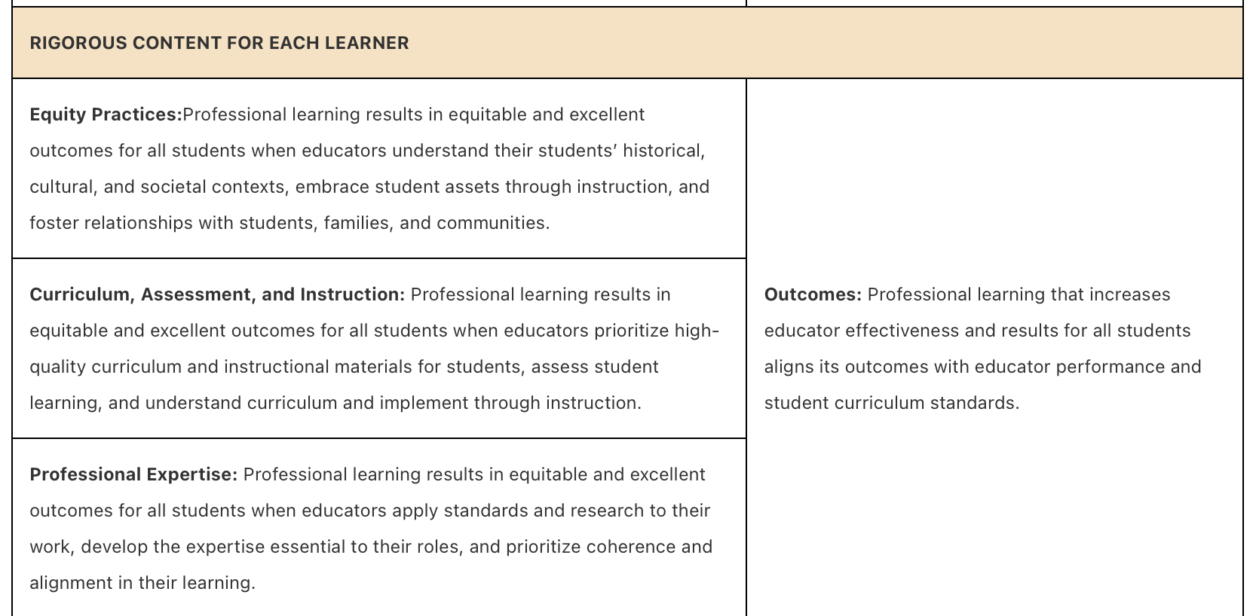
Crosswalk: 2022 and 2011 Standards
Notes:
The meta-analysis gives us encouraging information. It included 48 studies that examined the impacts of 52 teacher professional learning programs. All studies considered program impacts on observational measures of instruction, and 34 of the studies also explored impacts on student achievement. The goal of the meta-analysis was to have an unbiased empirical study of evidence of alignment with the Standards to see how this was associated with outcomes for teachers and students.
While meta-analyses have limitations and we’re committed to more research, we are pleased that overall the study found positive average effects on instruction for most of the 2022 standards.

Slide 8
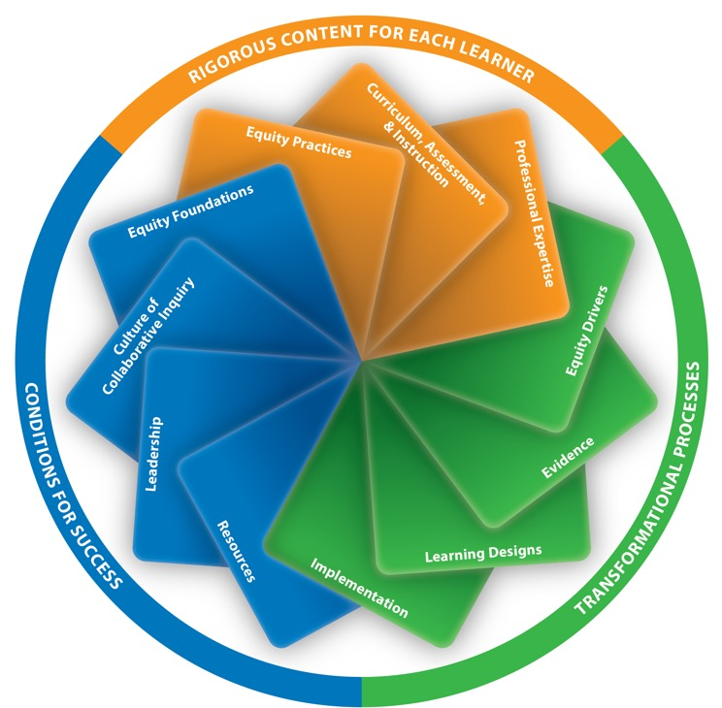
Research overview
Standards for Professional Learning is grounded in evidence from the use of past standards and insights from the field.
AIR (American Institutes for Research) conducted a literature review and meta-analysis.
The research overview and links to meta-analysis is available at standards.learningforward.org
Notes:
Grounding in evidence from use of past standards and insights from field
Worked with AIR on lit review and meta-analysis
Will release research overview and links to meta-analysis in April along with standards.

Slide 9
Research high-level findings
The meta-analysis found “consistent evidence that program alignment with the Learning Forward Standards for Professional Learning is associated with improved teacher instruction and student achievement outcomes.”
The research overview and links to meta-analysis is available at standards.learningforward.org
Notes:
The meta-analysis gives us encouraging information. It included 48 studies that examined the impacts of 52 teacher professional learning programs. All studies considered program impacts on observational measures of instruction, and 34 of the studies also explored impacts on student achievement. The goal of the meta-analysis was to have an unbiased empirical study of evidence of alignment with the Standards to see how this was associated with outcomes for teachers and students.
While meta-analyses have limitations and we’re committed to more research, we are pleased that overall the study found positive average effects on instruction for most of the 2022 standards.

Slide 10
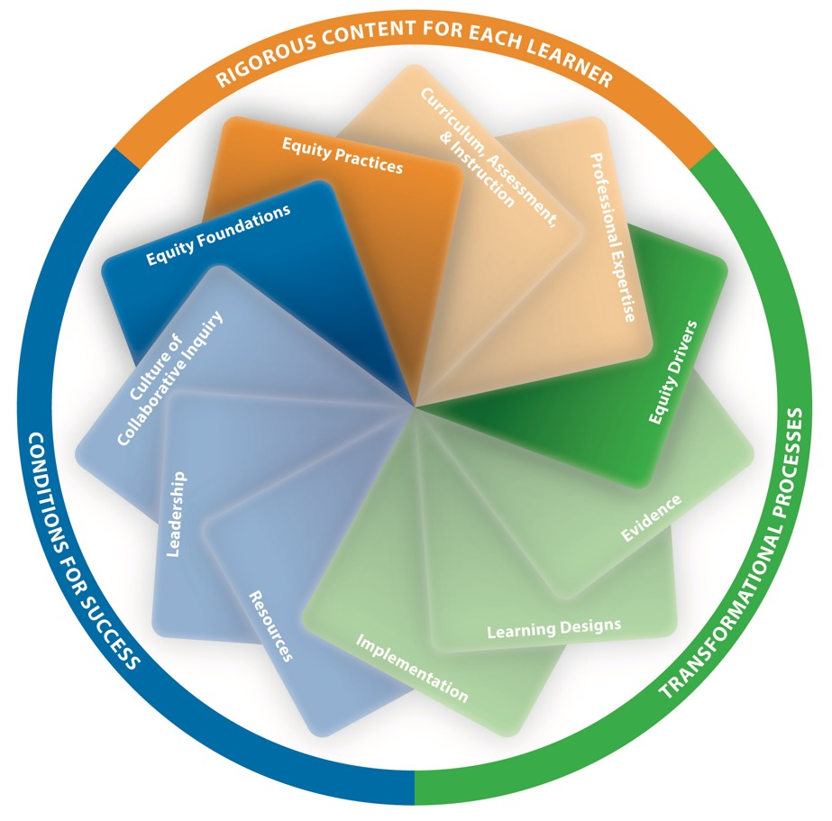
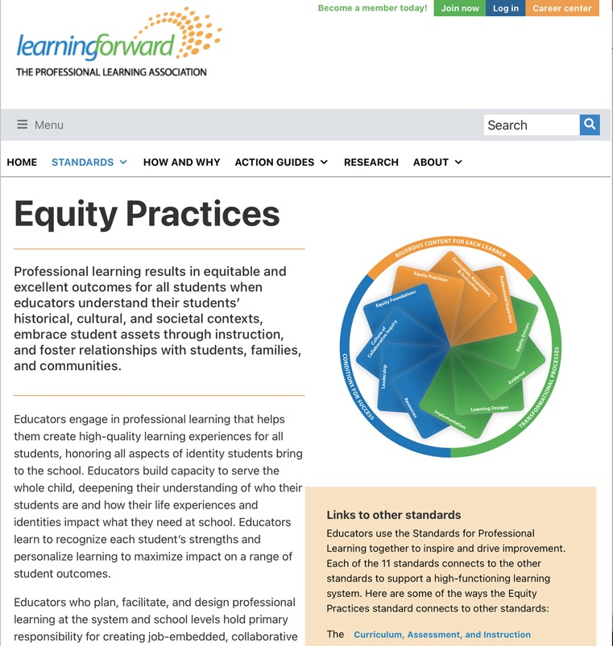
Explicit, inclusive equity standards
Notes:
Importance of emphasizing equity explicitly in each frame and throughout each standard – they can’t be standalone standards– which is why they weren’t addressed as separate standards in the 2011 version.

Slide 11
New equity standards, continued
Equity Practices
Professional learning results in equitable and excellent outcomes for all students when educators understand their students’ historical, cultural, and societal contexts, embrace student assets through instruction, and foster relationships with students, families, and communities.

Slide 12
New equity standards, continued
Equity Drivers
Professional learning results in equitable and excellent outcomes for all students when educators prioritize equity in professional learning practices, identify and address their own biases and beliefs, and collaborate with diverse colleagues.

Slide 13
New equity standards
Equity Foundations
Professional learning results in equitable and excellent outcomes for all students when educators establish expectations for equity, create structures to ensure equitable access to learning, and sustain a culture of support for all staff.

Slide 14
New Curriculum, Assessment, and Instruction standard
Professional learning results in equitable and excellent outcomes for all students when educators prioritize high-quality curriculum and instructional materials for students, assess student learning, and understand curriculum and implement through instruction.

Slide 15
New Professional Expertise standard
Professional learning results in equitable and excellent outcomes for all students when educators apply standards and research to their work, develop the expertise essential to their roles, and prioritize coherence and alignment in their learning.

Slide 16
How do I use Standards?
Innovation configuration map: used to define and measure implementation of a new program or practice
Hall and Hord, (2011). Implementing change: Patterns, principles, and potholes. Boston: Allyn & Bacon.

Slide 17
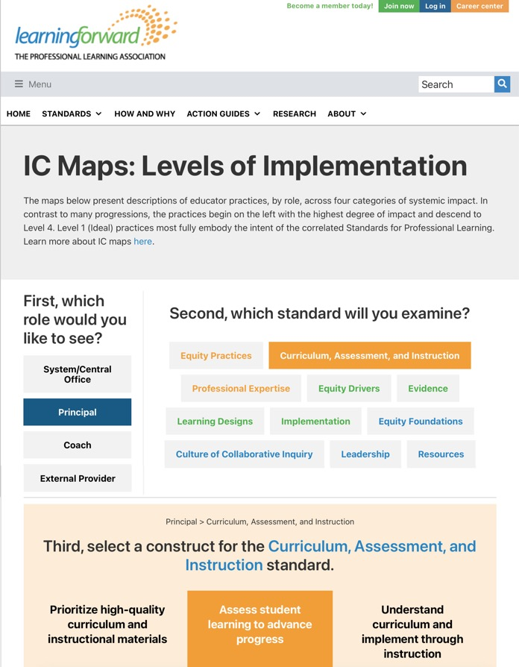
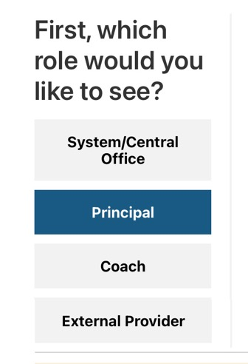
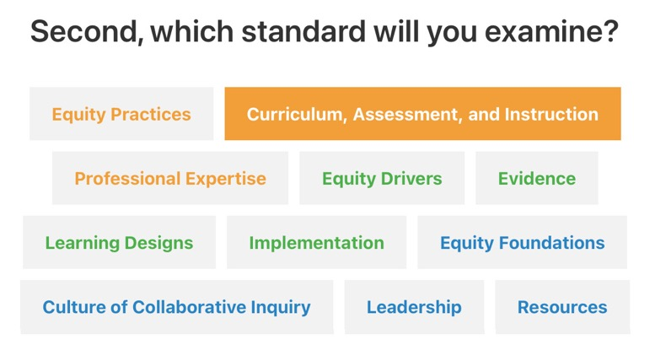
Innovation Configuration maps

Slide 18
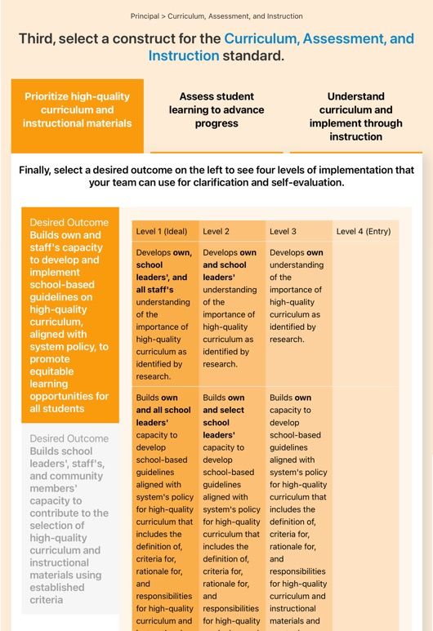
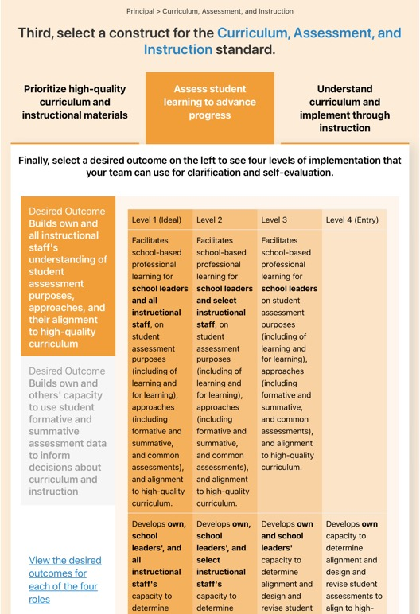
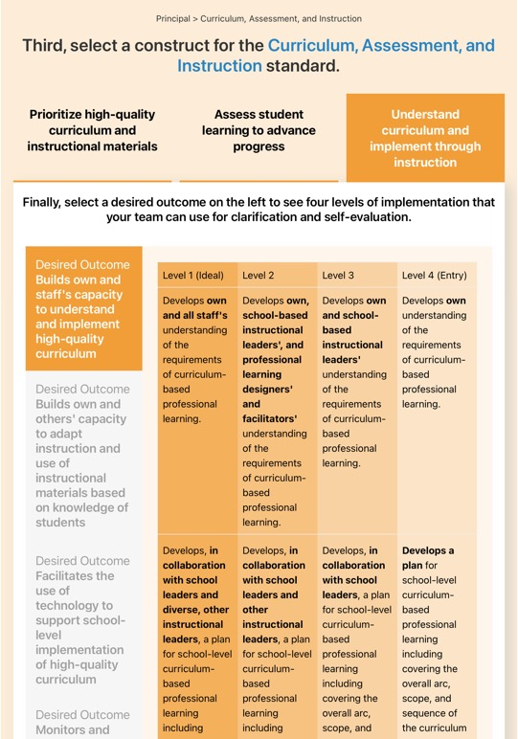
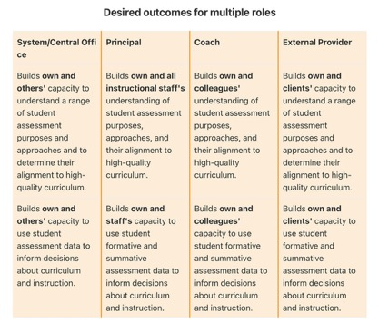
Drilling down into one Innovation Configuration map

Slide 19
Curriculum, Assessment, & Instruction detail

Slide 20
Standards Assessment Inventory
The SAI provides decision-makers with data on 1, the professional learning experienced by educators, and 2, their professional learning system’s alignment to the Standards.
Web-based inventory
Valid and reliable
Administered to classroom teachers and support staff
Confidential and anonymous
No knowledge of Standards required
30-40 minutes
Items aligned to each standard
School and system data collected

Slide 21
How Schools and Systems/States Use SAI
Schools use the SAI:
To introduce staff to the Standards for Professional Learning.
To use results to inform school-wide practices and guide school improvement planning.
To identify clear expectations and specific actions that contribute to high-quality PL.
For benchmark data to get a clear picture of what’s working and where to focus resources.
For dialogue and reflection among staff about professional learning.
For program evaluation.
To identify next steps for Standards implementation.
Districts/States use the SAI:
To group schools/districts with similar needs and priorities.
To identify school/district strengths to share with others.
To assess whether a particular improvement effort has contributed to the quality of professional learning across several schools or systems.
As a source of data to recognize schools for quality professional learning.
To identify next steps for Standards implementation.

Slide 22
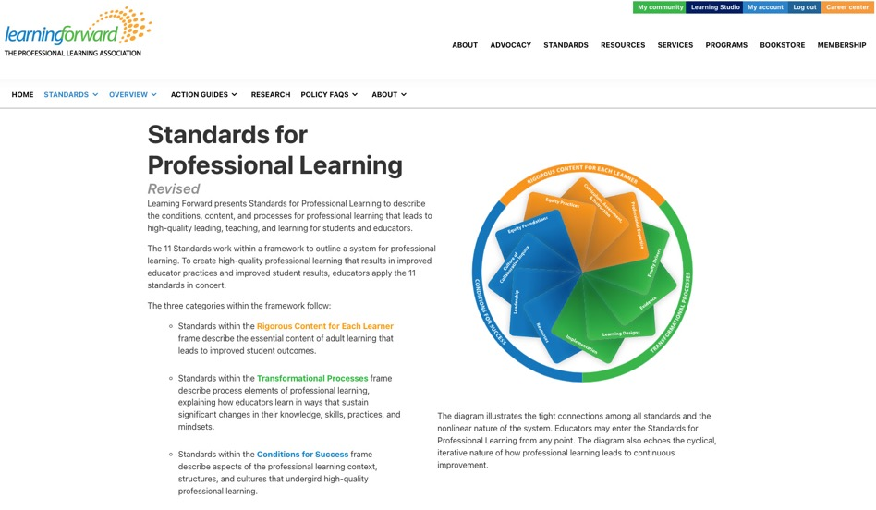
Additional resources
Visit standards.learningforward.org for resources useful for sharing, studying, and implementation of Standards for Professional Learning*
Resources include:
Role-based action guides
Innovation configuration maps
Quick-start guide
Research resources
Policy tools
* Some resources are available in full to anyone who visits standards.learningforward.org, while others require membership in Learning Forward.

Slide 23
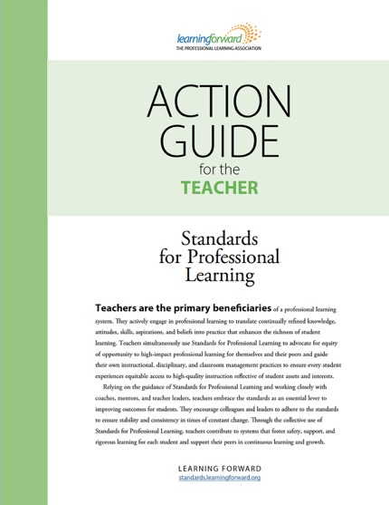
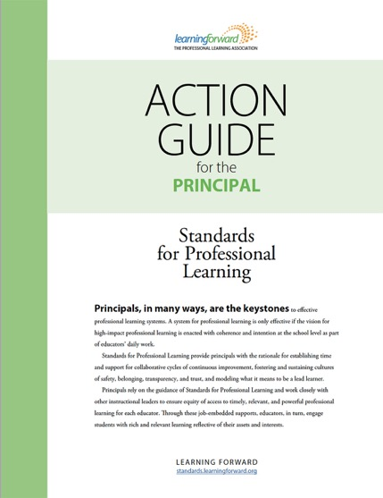
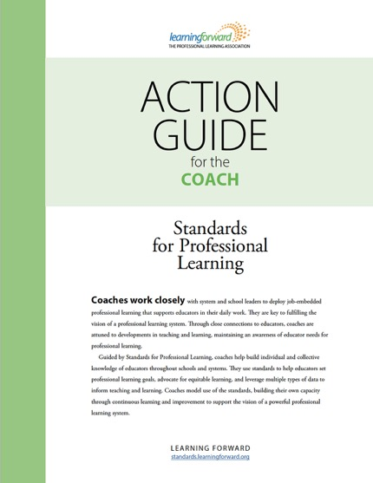
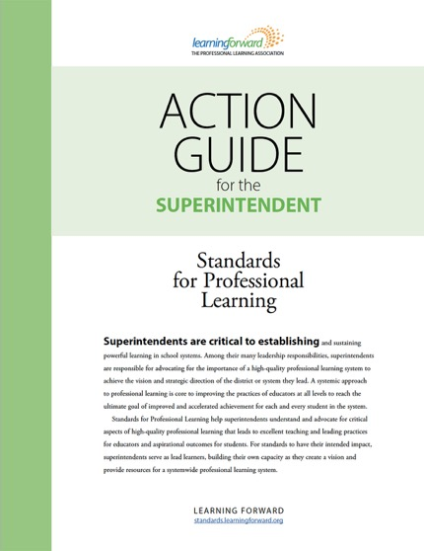
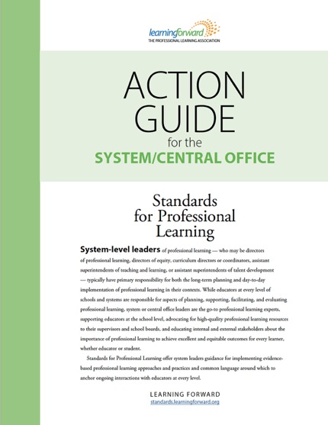
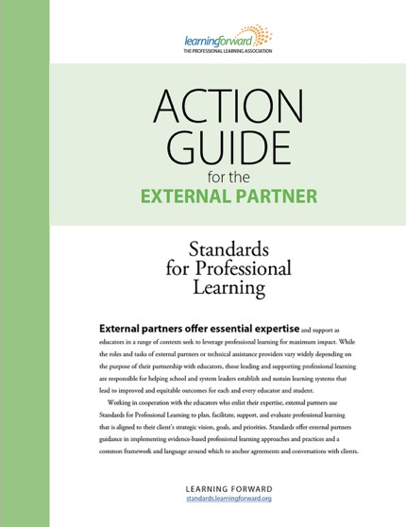
Action Guides

Slide 24
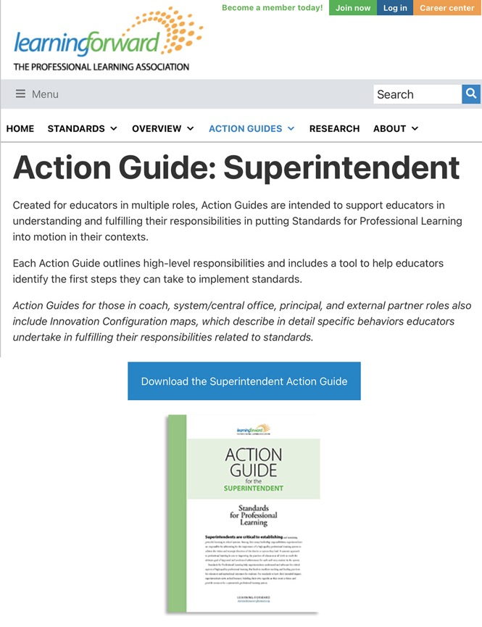
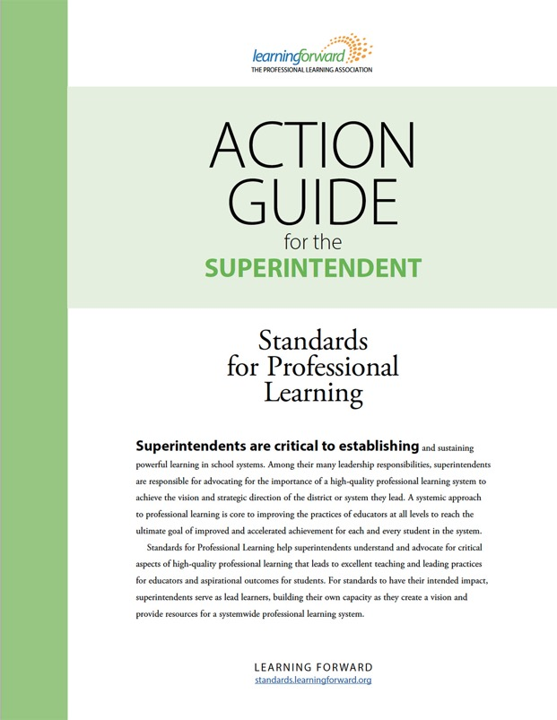
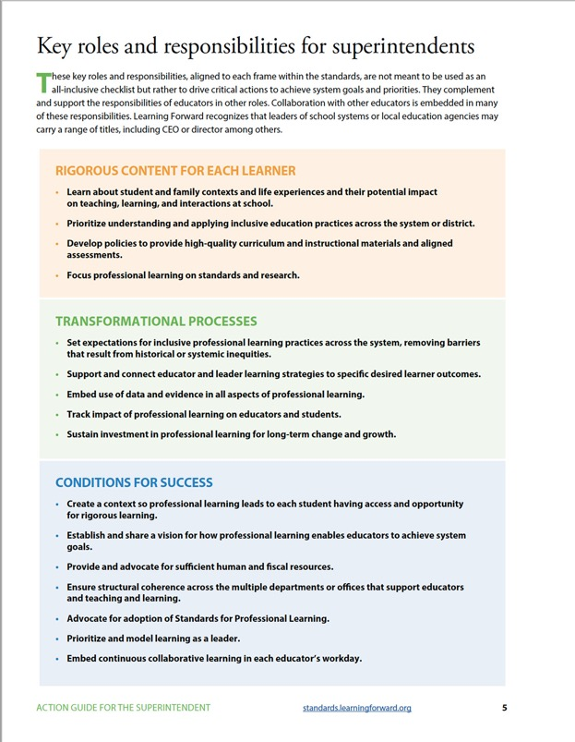
Previewing the Action Guide for the Superintendent

Slide 25
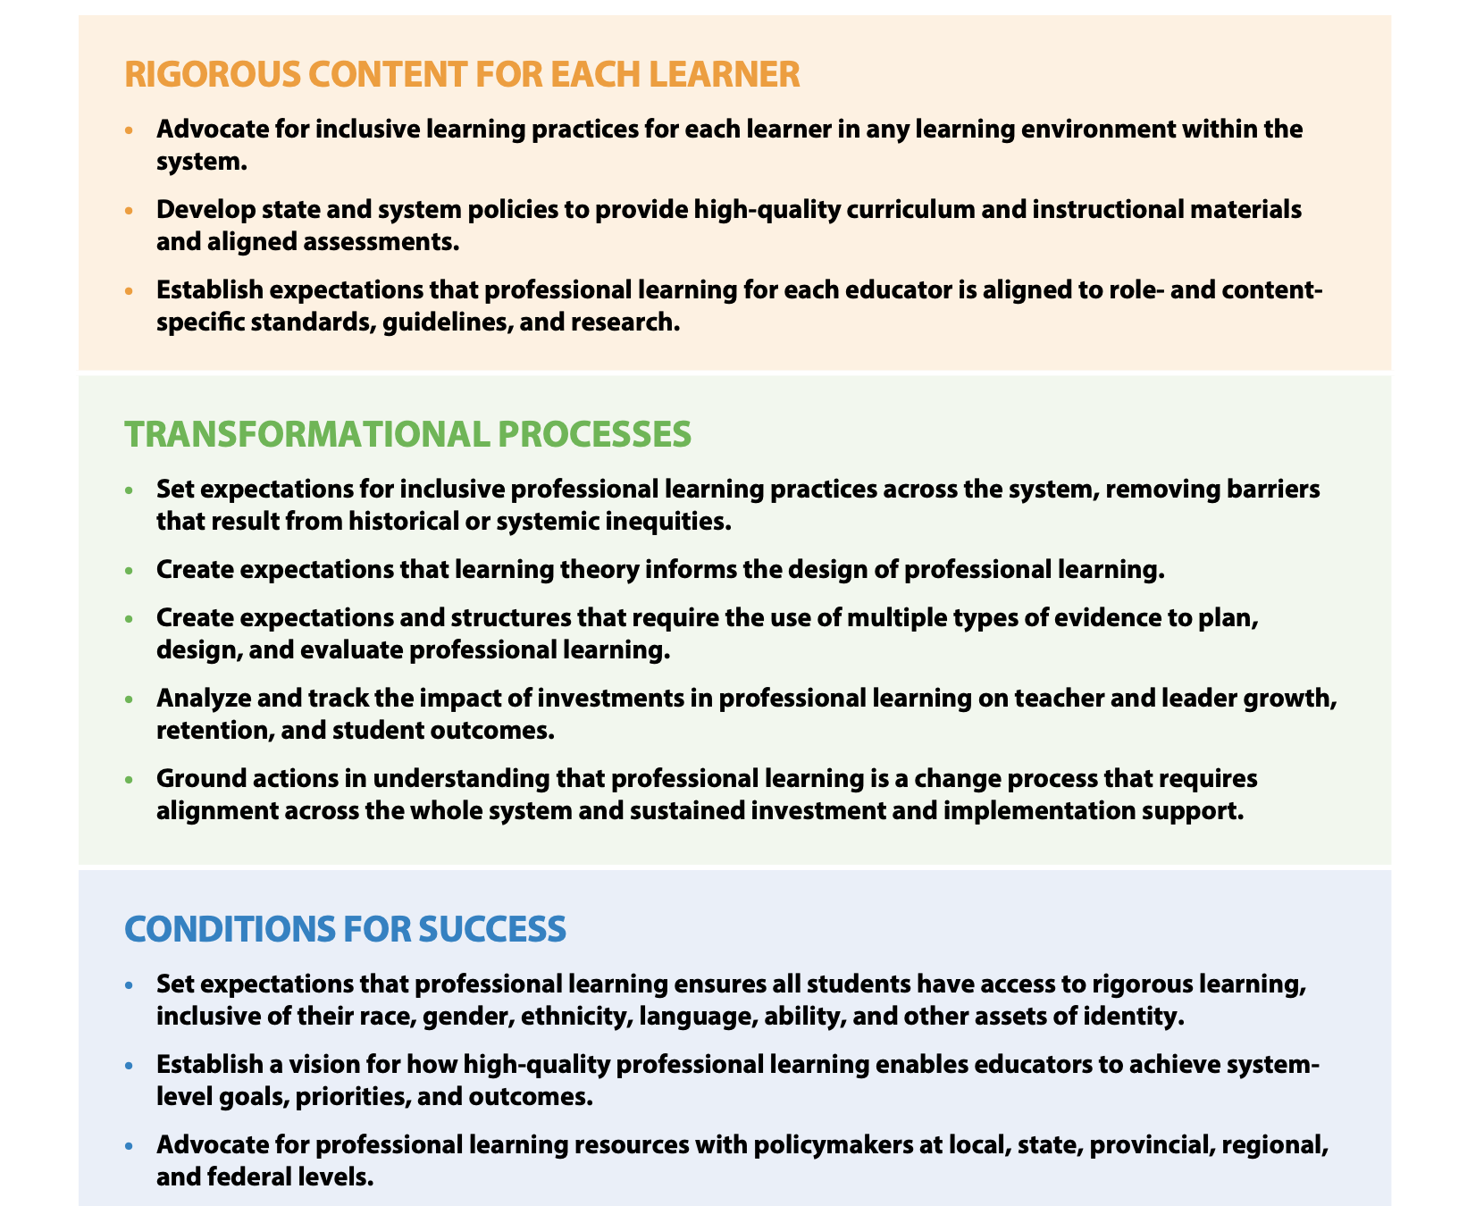
Notes:
This is the state commissioner – list of first actions – can be used to share with others, advocate, choose a step to focus your efforts around
https://standards.learningforward.org/wp-content/uploads/sites/29/2022/04/state-commissioner-action-guide-1.pdf

Slide 26
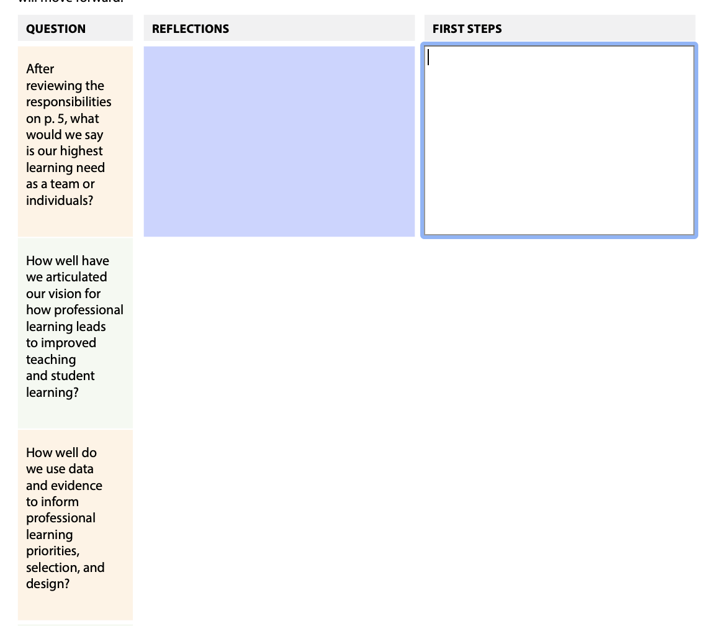
Notes:
From the commissioner action guide – use to facilitate conversations, focus teamwork, etc

Slide 27
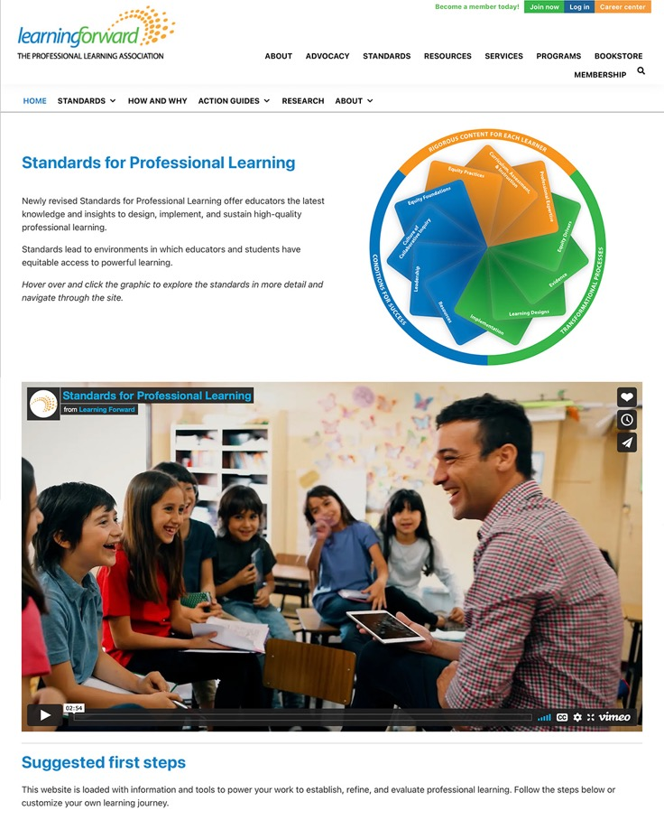
Standards for Professional Learning website
The website is loaded with information and tools to power your work to establish, refine, and evaluate professional learning.
standards.learningforward.org

Slide 28
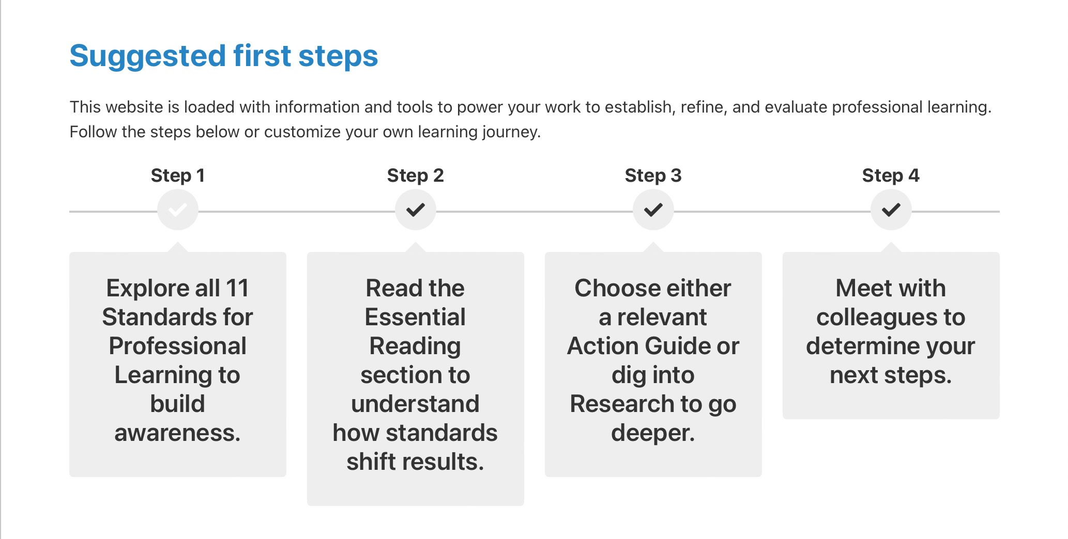
Action steps

