Slide 1
Ohio's P20 Collaborative: Dynamic Growth in Literacy Instruction
David Brobeck, ALEX PAVLIK, & Jennifer Ottley

Slide 2
OUR HISTORY
Improve learning and outcomes for all students
Collective action
Shared under-standing

Slide 3
OUR HISTORY
P20 Literacy Collaborative
2019-20
2012
2018
2021
Higher Education Literacy Steering Committee
LETRS PD
3 state & federal literacy grants

Slide 4
OUR HISTORY

Slide 5
Our Heroes
Louisa
Moats

Slide 6
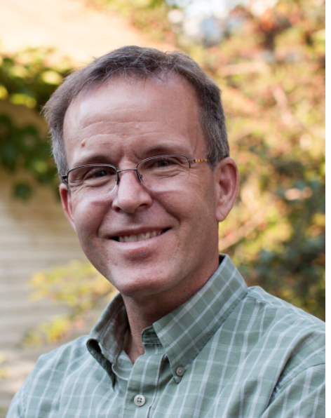
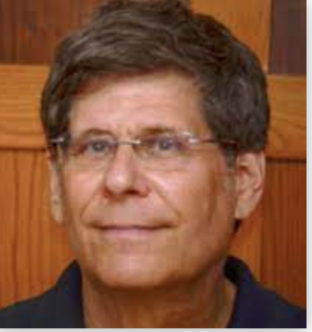
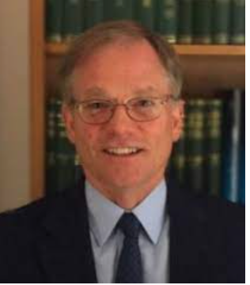
Our Heroes
David
Kilpatrick
Steve
Dykstra
Mark
Seidenberg

Slide 7
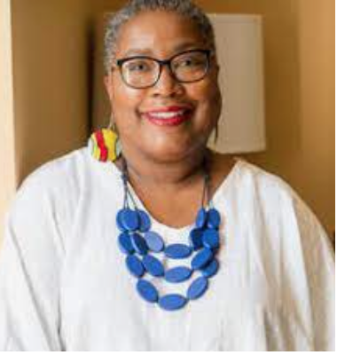
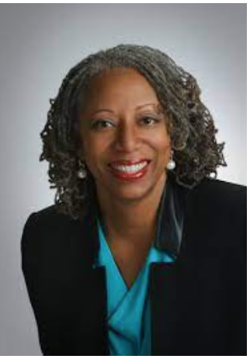
Our Heroes
Julie
Washington
Tracey
Weeden

Slide 8
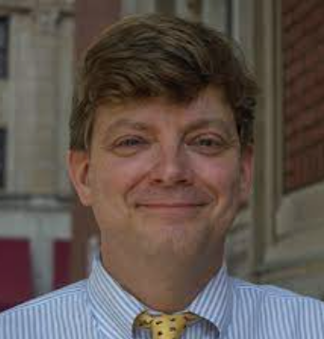
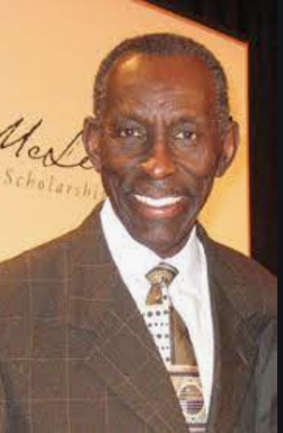
Our Heroes
James Frank
1930-2019
William Van Cleave
1958-2021

Slide 9
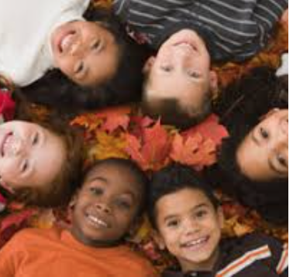
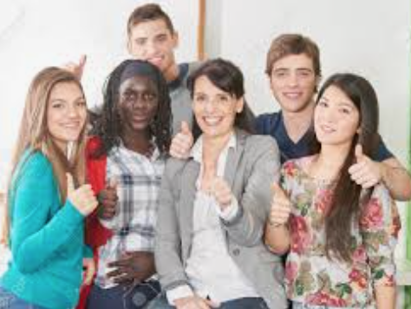
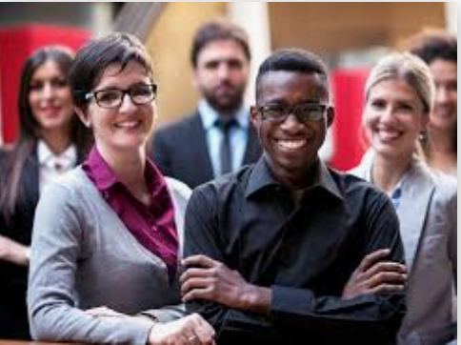
Our Heroes Teachers Professors Advocates
YOU!

Slide 10
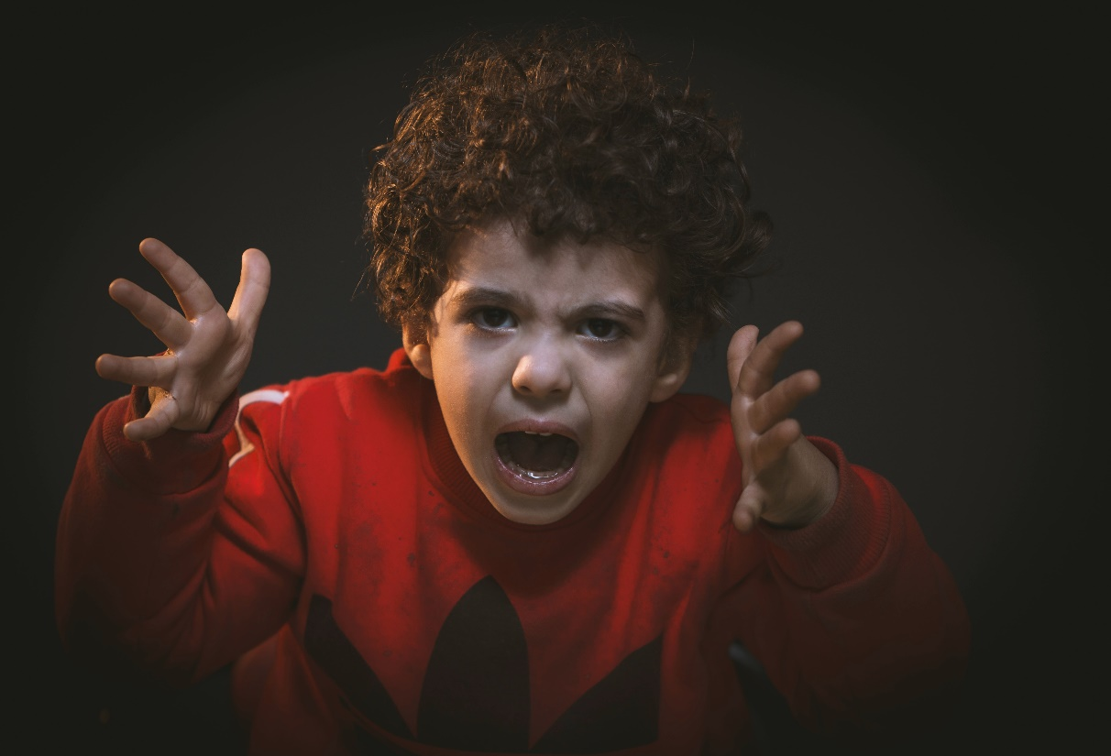
OUR HEARTBREAK
So many students are not reading proficiently
Struggling readers are not receiving the support they need to “close the gap”
Reading problems are preventable
We can do better together if we follow the body of evidence from scientific work

Slide 11
OUR HEARTBREAK

Slide 12
Our Hopes
Imagine…

Slide 13
Our Hopes
You are a visitor!

Slide 14
Our Hopes
3rd Grade Test
87% passage rate
New district record!

Slide 15
Our Hopes
“We can do better!”

Slide 16
Our Hopes
“We want 95%”

Slide 17
Our Hopes
Our participants…
Some come in hot and blazing
Some are curious
Some have had success & question change
Some resist
And it is okay…

Slide 18
Our Hopes
Our participants…
“And now I get what we are doing… with the science of reading…
I see the benefit and important.”

Slide 19
Our Hopes
We will reach 95% of all learners
We accept some will “jump in.”
Others need more time.
Both are important.
Together, we will see 95% become reality.

Slide 21
Ohio Literacy Library

