Slide 1
Developing Trunkey MTSS Infographics and Resources for LEAs
2021 SPDG National Meeting
Utah State Board of Education (USBE)
Emily Berry, MPP

Slide 2
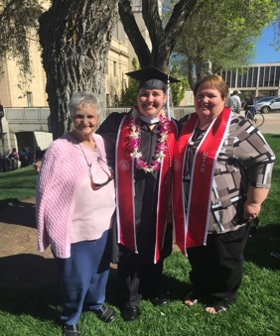
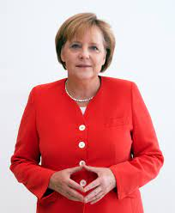
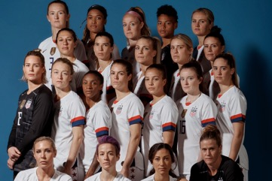
Telling Our Stories
My History
University of Utah, MPP
Assessment, Data Specialist
Student Support/Special Education, Program Evaluator
President of a local non-profit organization
My Heroes
Leadership at

Slide 3
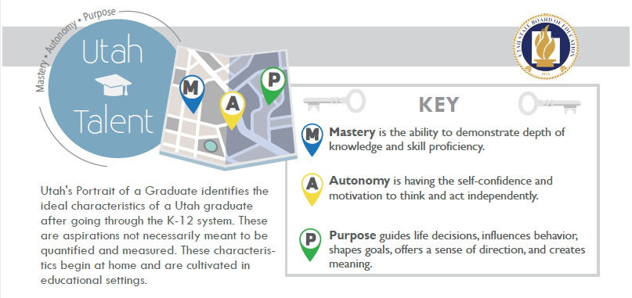
Telling Our Stories
My Hopes
My Heartbreak

Slide 4
UMTSS Monthly Minute Intention
Month | 2021-2022 Proposed Topic Areas
September | Tiered Instruction
October | Family Engagement
November | Screening into Tiered Supports
December | Formative Assessment
January | Deep Dive Tier 1
February | It’s Mid-Year, Now What? (Behavior)
March | Preparing for Summative Assessments with MTSS
April | Deep Dive Tier 2
May | Deep Dive Tier 3
June | Adapt Instruction
July | Teacher Self-Care
August | Inclusion
Topics that address LEA focus areas
Develop reliable resource of information
Offer an “easy to digest” resource with option to pursue a deeper understanding

Slide 5
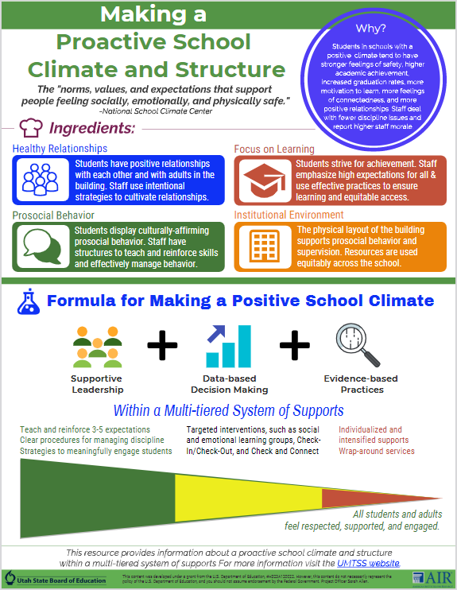
Developing Resources
Content based on LEA focus areas and identified needs
1 page infographic and 1 paragraph write up with links for deeper learning
Created with our grant partners at AIR
All information is vetted for
Evidence-Based Practices
Validity
USBE messaging

Slide 6
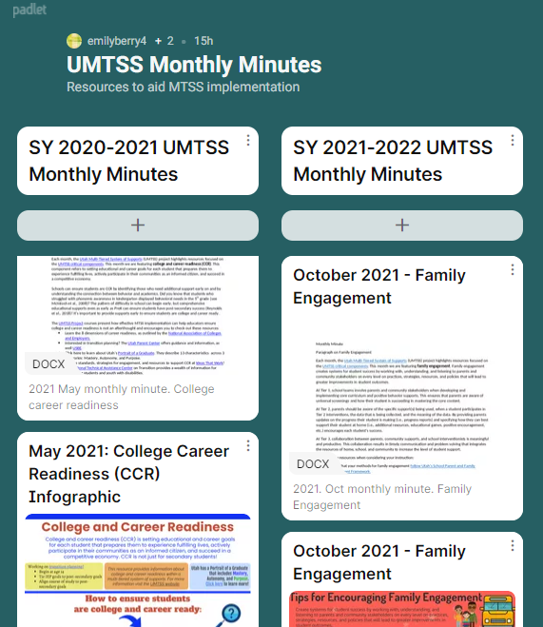
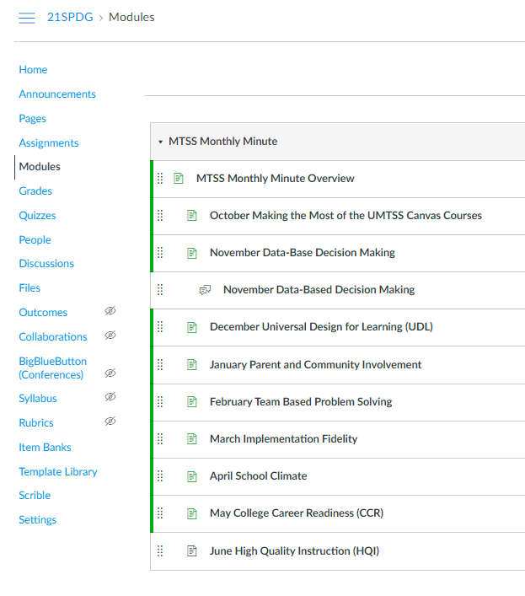
Disseminating UMTSS Monthly Minutes
Padlet | SPDG/UMTSS Canvas Course
https://tinyurl.com/h2kx4wjc | Access given to SPDG grant participants

Slide 7
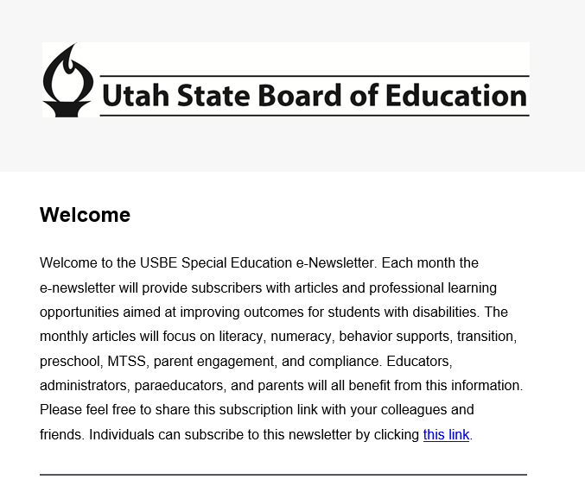
Disseminating UMTSS Monthly Minutes Cont.
Utah Special Education Newsletter | Website
https://tinyurl.com/rvr9h6wb | https://www.schools.utah.gov/curr/umtss?mid=923&tid=5

Slide 8
Overcoming Challenges
Ensuring USBE messaging
LEA messaging that differs from USBE
Sharing the resources
Measuring impact

