Slide 1
SPDG National Meeting
February 8, 2023
Sponsored by the U.S. Department of Education Office of Special Education Programs and developed in collaboration with Rutgers University – New Brunswick.
Notes:
Good afternoon! This webinar will provide an orientation to the New Jersey Tiered Systems of Support-Early reading (or NJTSS-ER) Framework. We are excited to share the work we have been engaged in to support our districts in establishing, scaling, and sustaining their work with NJTSS-ER through the use of the concrete resources we are about to share with you.

Slide 2
Agenda
Who we are
NJTSS-ER Framework Overview
District Leadership Team
Implementation Roadmap
Website Walkthrough
NJTSS-ER Framework Resources
Q&A
Notes:
Our agenda for today begins with a description of who we are and what we do, followed by a brief overview of the NJTSS-ER Framework and the resources available to all districts to support its implementation, a description of district leadership roles and the roadmap districts follow to implement the framework over time, and finally a brief walkthrough of the NJTSS-ER website before our Q&A.

Slide 3
State-Personnel Development Grant
A U.S. Department of Education grant-funded NJDOE-Rutgers University collaboration supports districts in…
improving knowledge and practices pertaining to NJTSS for early reading
building and sustaining multi-tiered, data-based decision making system that increases early reading proficiency for K-3 students
increasing NJTSS-ER implementation fidelity
Notes:
Who are we?
NJTSS-ER is an New Jersey Dept of Education-Rutgers University collaboration supports districts in improving knowledge and practices pertaining to NJTSS for early reading; building and sustaining a multi-tiered, data-based decision making system that increases early reading proficiency for K-3 students; and increasing NJTSS-ER implementation fidelity. The focus of this grant is to help districts build capacity to do this work independent of the support of NJTSS-ER state consultants, sustain the work across years and personnel changes, and allowing for scalability across districts throughout New Jersey.

Slide 4
NJTSS-ER Framework
Overview
Notes:
Let’s begin with an overview of our NJTSS-ER Framework. This framework outlines essential knowledge and implementation components required to effectively integrate NJTSS-ER into schools.

Slide 5
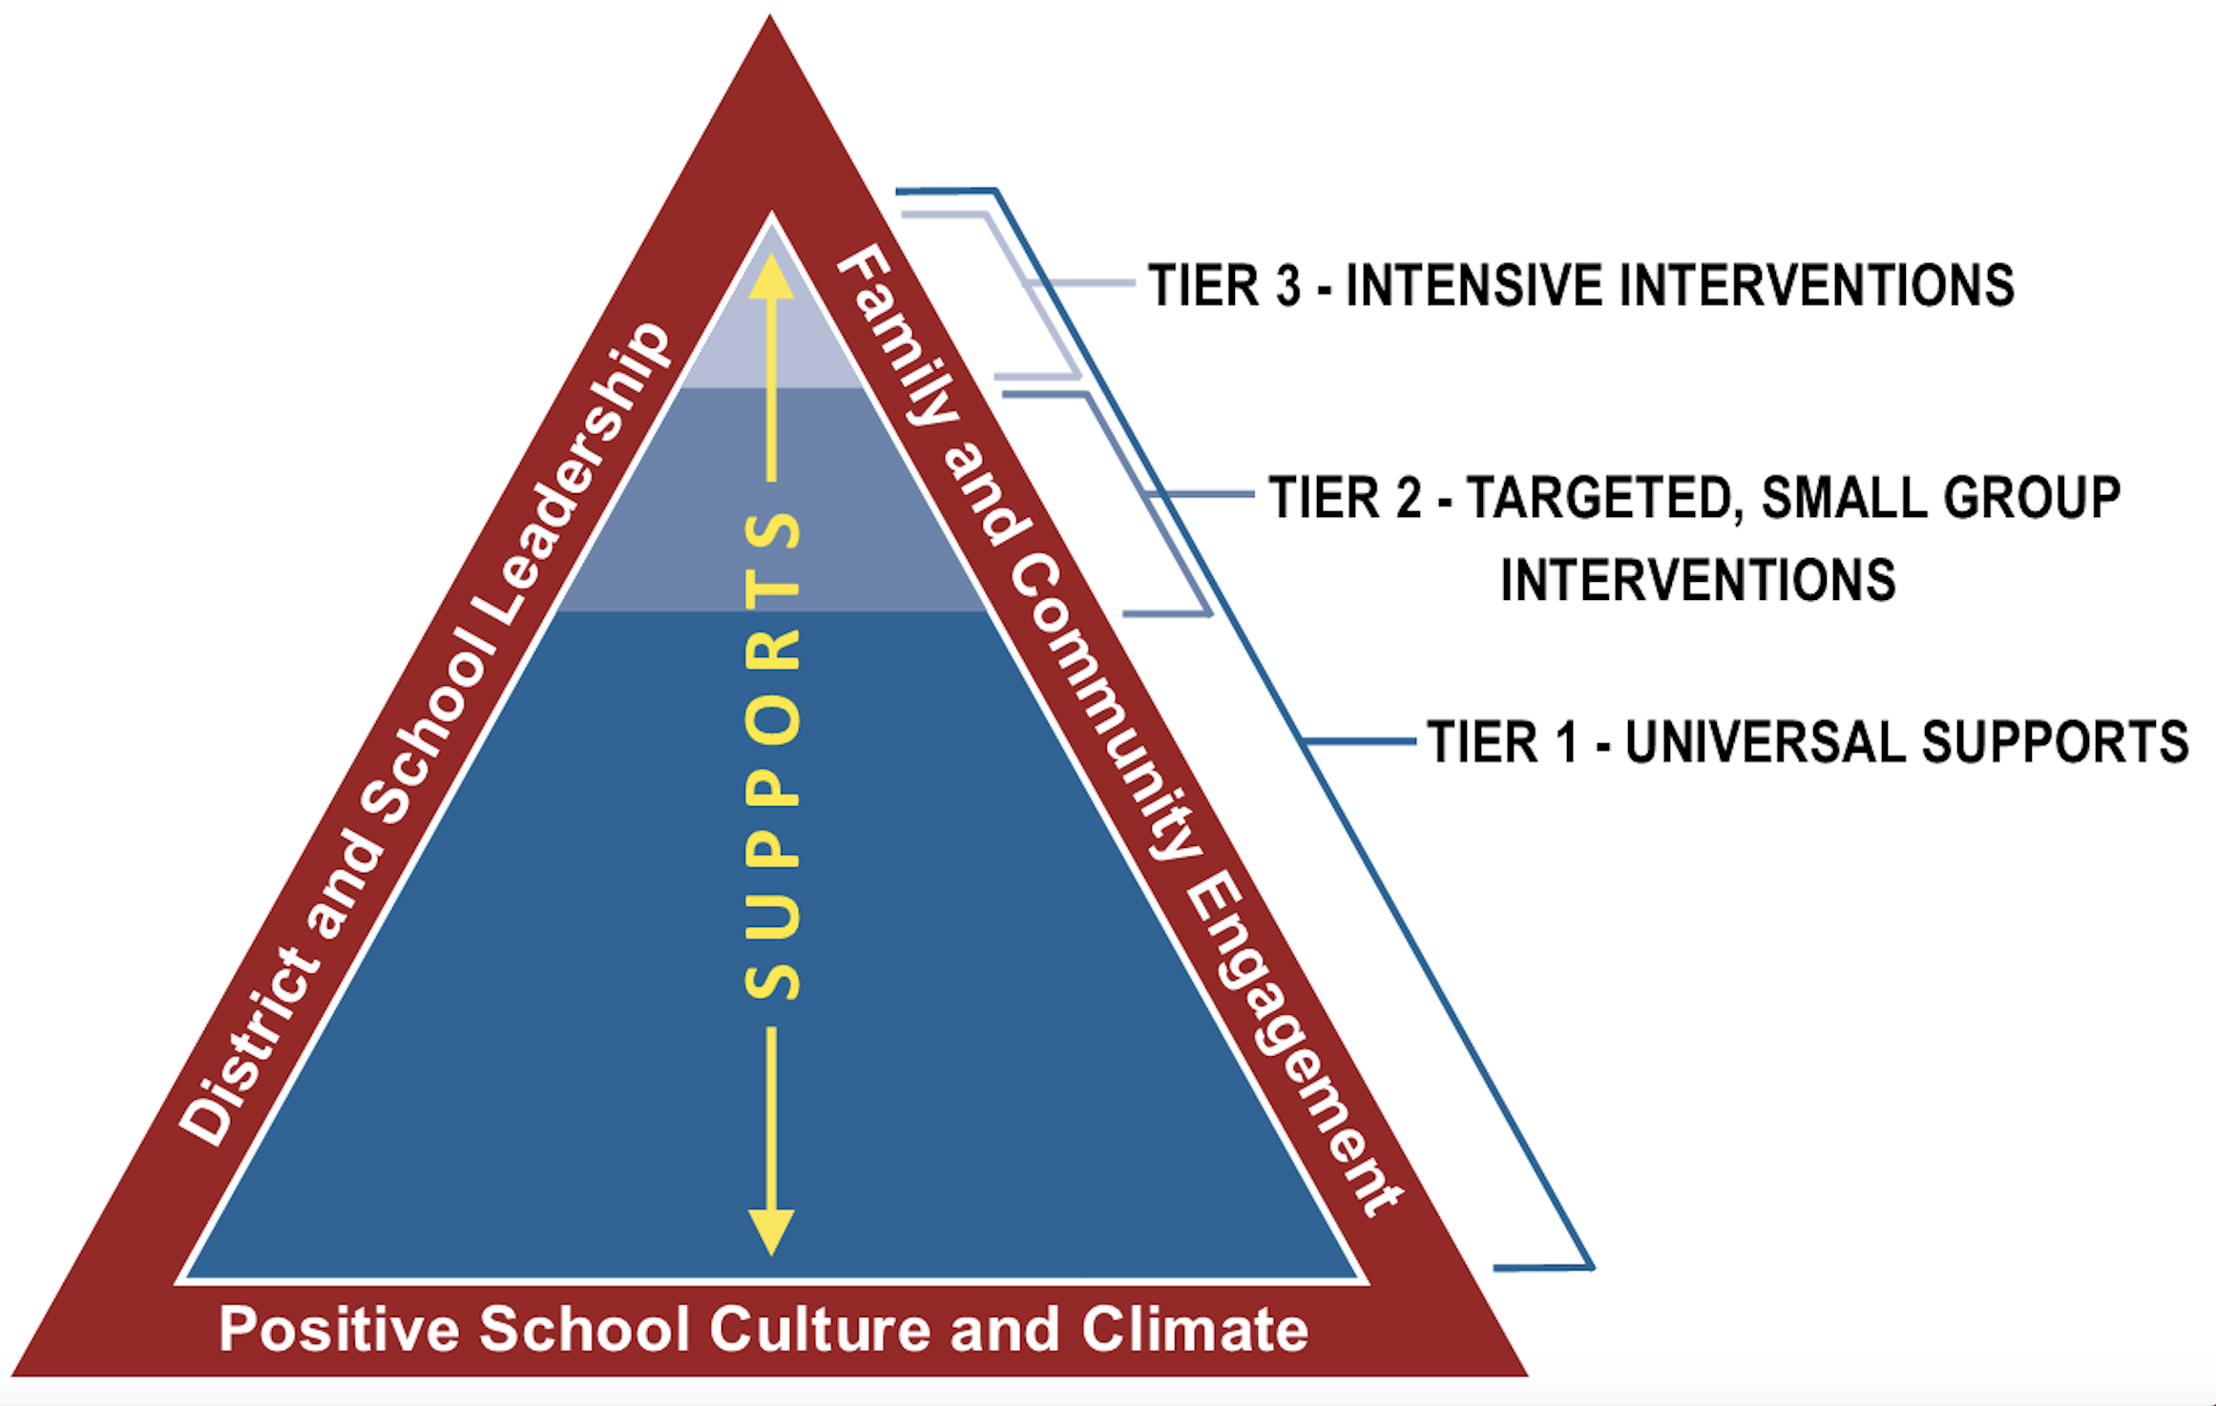
New Jersey Tiered System of Supports (NJTSS)
Notes:
NJTSS builds on current intervention and referral services and calls for the coordination of all supports and interventions across schools and districts to target the educational needs of students.

Slide 6
NJTSS-ER Framework
Foundational Knowledge
Team-Based
Early Prevention Model
Assessment & Data-Based Decision Making
Research-Based Priority
Early Reading Skills
Essential Components of an NJTSS-ER Approach
Assessment of Student Needs
Implementation & Monitoring Fidelity of Instruction
Notes:
This overview of the NJTSS Early Reading Framework is comprised of

Slide 7
NJTSS-ER Framework
Foundational Knowledge
Team-Based
Early Prevention Model
Assessment & Data-Based Decision Making
Research-Based Priority
Early Reading Skills
Essential Components of an NJTSS-ER Approach
Assessment of Student Needs
Implementation & Monitoring Fidelity of Instruction
Notes:
of the key foundational knowledge

Slide 8
NJTSS-ER Framework
Foundational Knowledge
Team-Based
Early Prevention Model
Assessment & Data-Based Decision Making
Research-Based Priority
Early Reading Skills
Essential Components of an NJTSS-ER Approach
Assessment of Student Needs
Implementation & Monitoring Fidelity of Instruction
Notes:
and essential components needed to effectively implement an NJTSS approach focused on improving students’ early reading proficiency.

Slide 9
NJTSS-ER Framework
Foundational Knowledge
Team-Based
Early Prevention Model
Assessment & Data-Based Decision Making
Research-Based Priority
Early Reading Skills
Essential Components of an NJTSS-ER Approach
Assessment of Student Needs
Implementation & Monitoring Fidelity of Instruction
Notes:
To inform decisions, foundational knowledge is required in three areas:
Team-Based Early Prevention Model
Assessment & Data-Based Decision Making; and
Research Based Priority Early Reading Skills

Slide 10
NJTSS-ER Framework
Foundational Knowledge
Team-Based
Early Prevention Model
Assessment & Data-Based Decision Making
Research-Based Priority
Early Reading Skills
Essential Components of an NJTSS-ER Approach
Assessment of Student Needs
Implementation & Monitoring Fidelity of Instruction
Universal
Screening
Diagnostics
Student Progress
Monitoring
Notes:
This foundational knowledge is an important prerequisite to effectively implementing practices and procedures for universal screening, diagnostics, and progress monitoring…

Slide 11
NJTSS-ER Framework
Foundational Knowledge
Team-Based
Early Prevention Model
Assessment & Data-Based Decision Making
Research-Based Priority
Early Reading Skills
Essential Components of an NJTSS-ER Approach
Assessment of Student Needs
Implementation & Monitoring Fidelity of Instruction
Universal
Screening
Diagnostics
Student Progress
Monitoring
Tier 1
Instruction
Tier 2/3
Intervention
Notes:
… as well as implementing and monitoring instructional supports across all tiers of instruction.

Slide 12
NJTSS-ER Framework
Foundational Knowledge
Team-Based
Early Prevention Model
Assessment & Data-Based Decision Making
Research-Based Priority
Early Reading Skills
Essential Components of an NJTSS-ER Approach
Assessment of Student Needs
Implementation & Monitoring Fidelity of Instruction
Universal
Screening
Diagnostics
Student Progress
Monitoring
Tier 1
Instruction
Tier 2/3
Intervention
Notes:
The yellow, green, and blue lozenges outlined here are the main components that comprise the NJTSS-ER Framework.

Slide 13
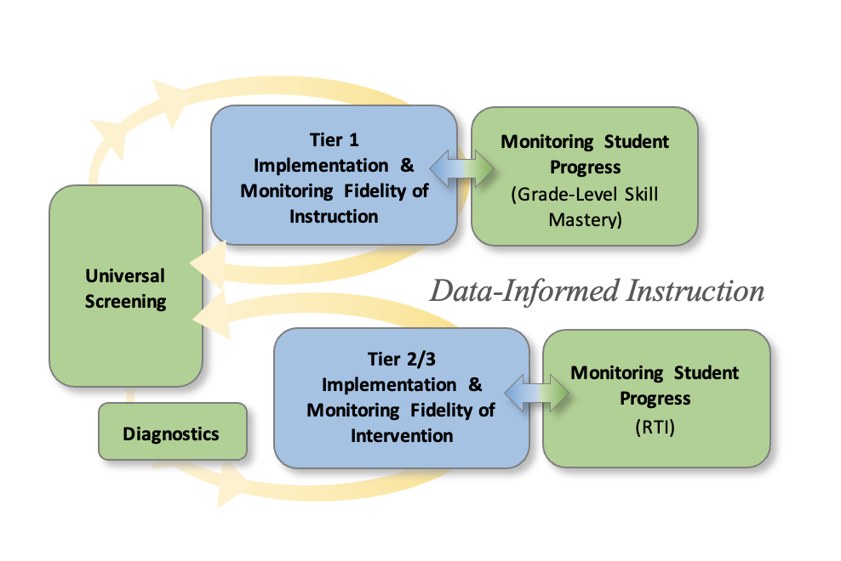
NJTSS-ER Data-Informed Instruction
Notes:
The full integration of all components results in a continuous cycle of data-informed instructional decision-making.

Slide 14
NJTSS-ER Data-Informed Instruction
Notes:
An essential first step is to collect data on the early reading proficiency of all kindergarten through third grade students through the administration of universal screening.

Slide 15
NJTSS-ER Data-Informed Instruction
Notes:
Universal screening data are used to determine the extent to which core reading instruction is enabling students to meet benchmark expectations,

Slide 16
NJTSS-ER Data-Informed Instruction
Notes:
and to identify which students may benefit from additional intervention supports to close skill gaps.

Slide 17
NJTSS-ER Data-Informed Instruction
Notes:
In Tier 1, ongoing curriculum-embedded assessment data are collected and analyzed in order to inform differentiation and adjustment to core needs. Tier 1 implementation is also monitored to ensure instruction is being delivered with fidelity.

Slide 18
NJTSS-ER Data-Informed Instruction
Notes:
For students who did not reach benchmark expectations on universal screening early reading indicators, diagnostic skill inventories are administered to determine which specific skills to target for intervention.

Slide 19
NJTSS-ER Data-Informed Instruction
Notes:
With this data, interventions are planned and implemented. Ongoing progress monitoring assessments are administered to determine student progress towards goals and the effectiveness of the intervention. The implementation of Tiers 2 and 3 is also monitored to ensure instruction is being delivered with fidelity.

Slide 20
NJTSS-ER Stages of Implementation
Stage 1: PREPARE
Stage 2: ESTABLISH
Stage 3: INSTALL
Stage 4: IMPLEMENT
Stage 5: EVALUATE & REFINE
Notes:
So how do we assist NJ school districts in integrating the components that we just reviewed? Districts integrate each component in 5 stages. [Read bullets]. These 5 stages repeat for each component.

Slide 21
NJTSS-ER Stages of Implementation
Stage 1: PREPARE
Stage 2: ESTABLISH
Stage 3: INSTALL
Stage 4: IMPLEMENT
Stage 5: EVALUATE & REFINE
Notes:
Here you see an example of a Universal Screening Action Plan (universal screening being one of our components) that drives the work districts do to integrate Universal Screening. There are full Action Plans organized into these 5 stages for each component, but for demonstration purposes, we will use the Universal Screening component as a model.

Slide 22
NJTSS-ER Stages of Implementation
Stage 1: PREPARE
Stage 2: ESTABLISH
Stage 3: INSTALL
Stage 4: IMPLEMENT
Stage 5: EVALUATE & REFINE
Notes:
In Stage 1, districts PREPARE. They preview the implementation steps for that component as outlined in the Action Plan and build knowledge.

Slide 23
NJTSS-ER Stages of Implementation
Stage 1: PREPARE
Notes:
Districts build this knowledge by taking an interactive online learning course to deepen their understanding of each component.

Slide 24
NJTSS-ER Stages of Implementation
Stage 1: PREPARE
Stage 2: ESTABLISH
Stage 3: INSTALL
Stage 4: IMPLEMENT
Stage 5: EVALUATE & REFINE
Notes:
In Stage 2, districts appraise existing school practices, select resources and tools, and ESTABLISH district guidelines.

Slide 25
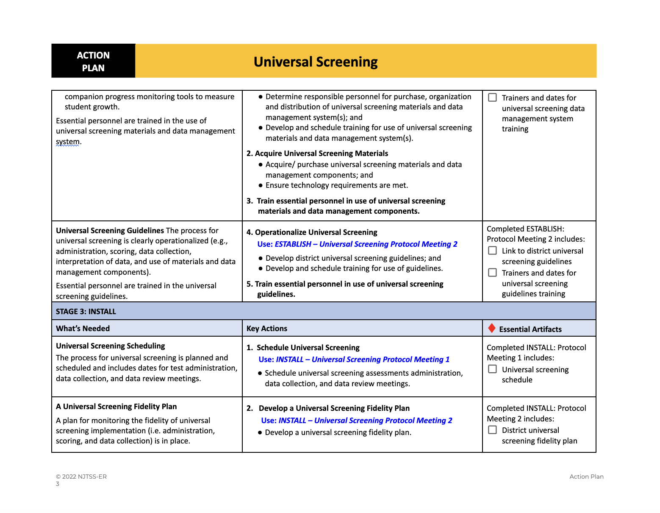
NJTSS-ER Stages of Implementation
Stage 1: PREPARE
Stage 2: ESTABLISH
Stage 3: INSTALL
Stage 4: IMPLEMENT
Stage 5: EVALUATE & REFINE
Notes:
In Stage 3, districts INSTALL the essential component. They schedule implementation and prepare for implementation monitoring.

Slide 26
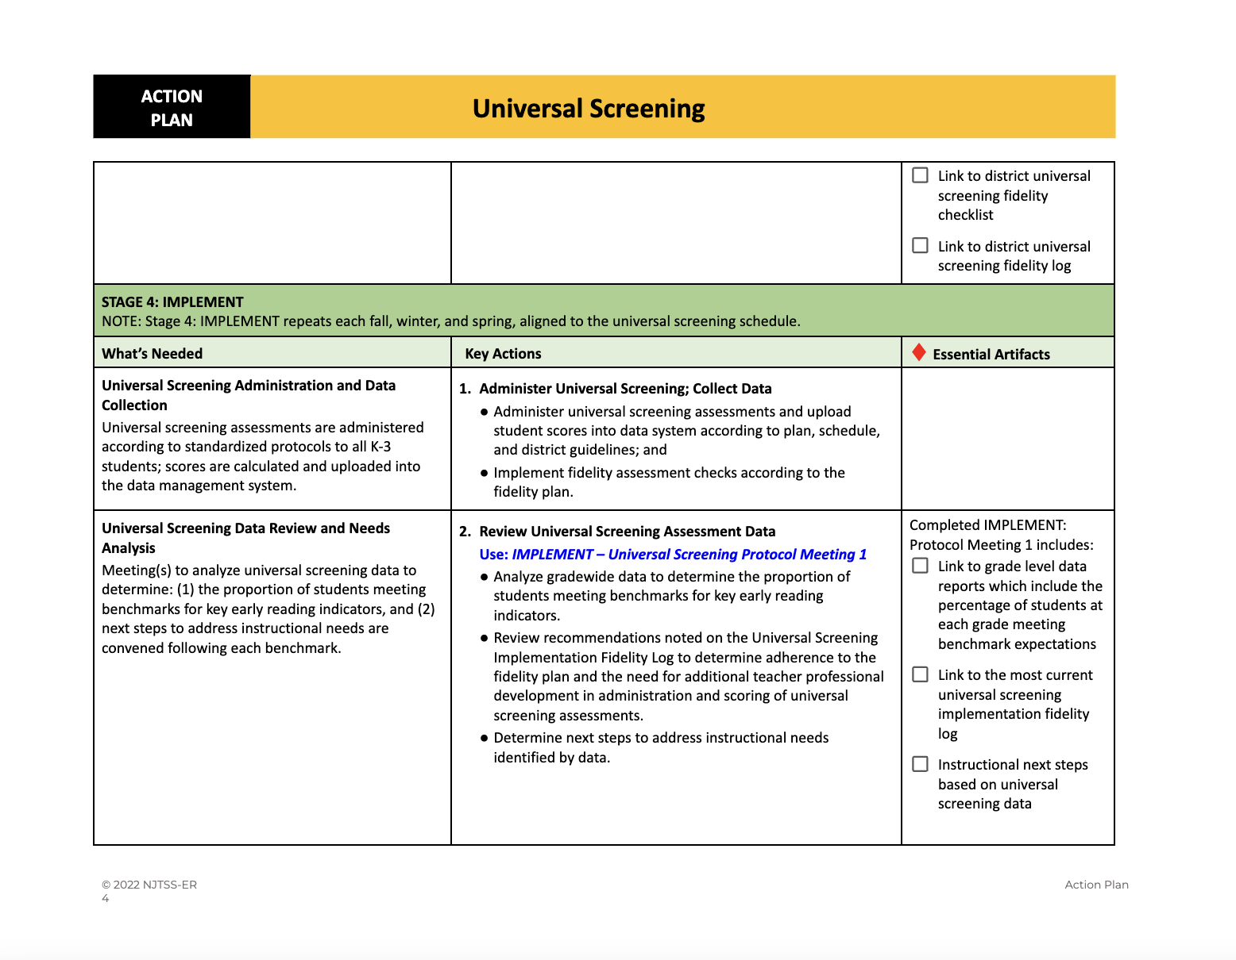
NJTSS-ER Roadmap Stages of Implementation
Stage 1: PREPARE
Stage 2: ESTABLISH
Stage 3: INSTALL
Stage 4: IMPLEMENT
Stage 5: EVALUATE & REFINE
Notes:
In Stage 4, districts IMPLEMENT the essential component, as well as engage in data-based decision-making aligned to district guidelines and plans.

Slide 27
NJTSS-ER Roadmap Stages of Implementation
Stage 1: PREPARE
Stage 2: ESTABLISH
Stage 3: INSTALL
Stage 4: IMPLEMENT
Stage 5: EVALUATE & REFINE
Notes:
and finally in Stage 5, districts evaluate the effectiveness of the implementation and make refinements, as needed.

Slide 28
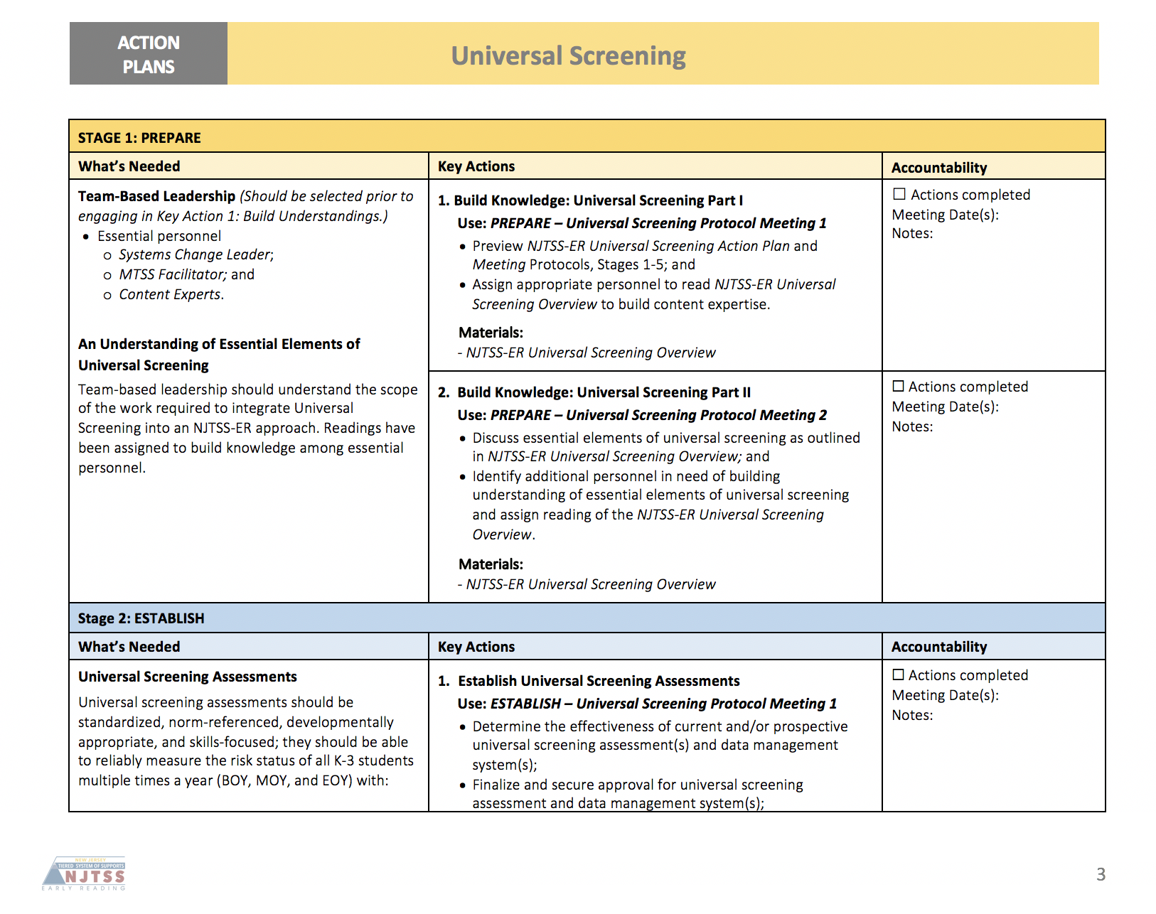
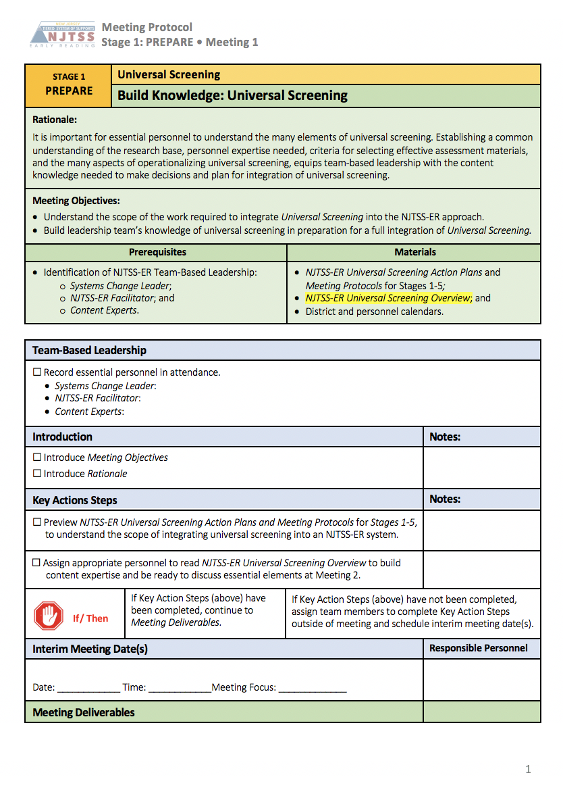
Action Plans and Meeting Protocols
Meeting Protocols
Facilitate meetings
Plan key actions
Memorialize decisions
Notes:
Within each Action Plan are Meeting Protocols, identified at point-of-use. These meeting protocols are a unique feature of our framework that promotes sustainability because these meeting protocols are used by local school district leadership teams to accomplish key actions outlined in each action plan. They provide step-by-step procedures for facilitating meetings and memorializing the work.

Slide 29
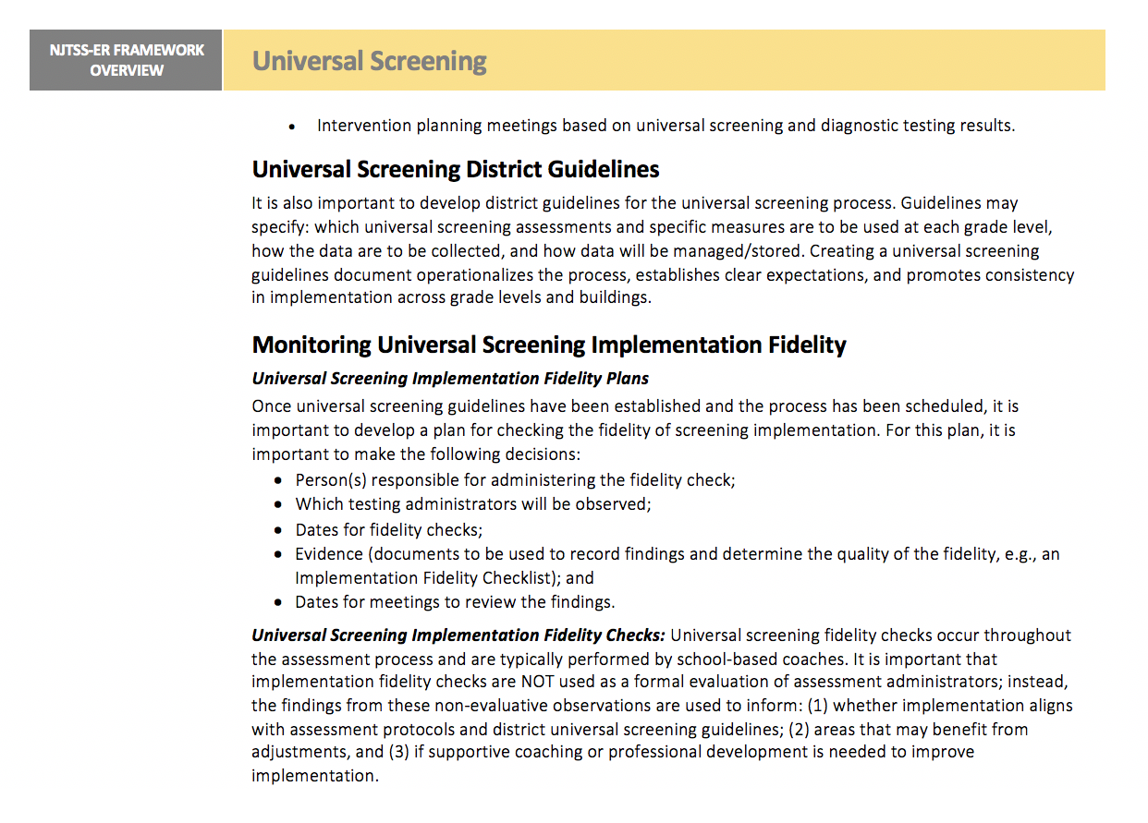
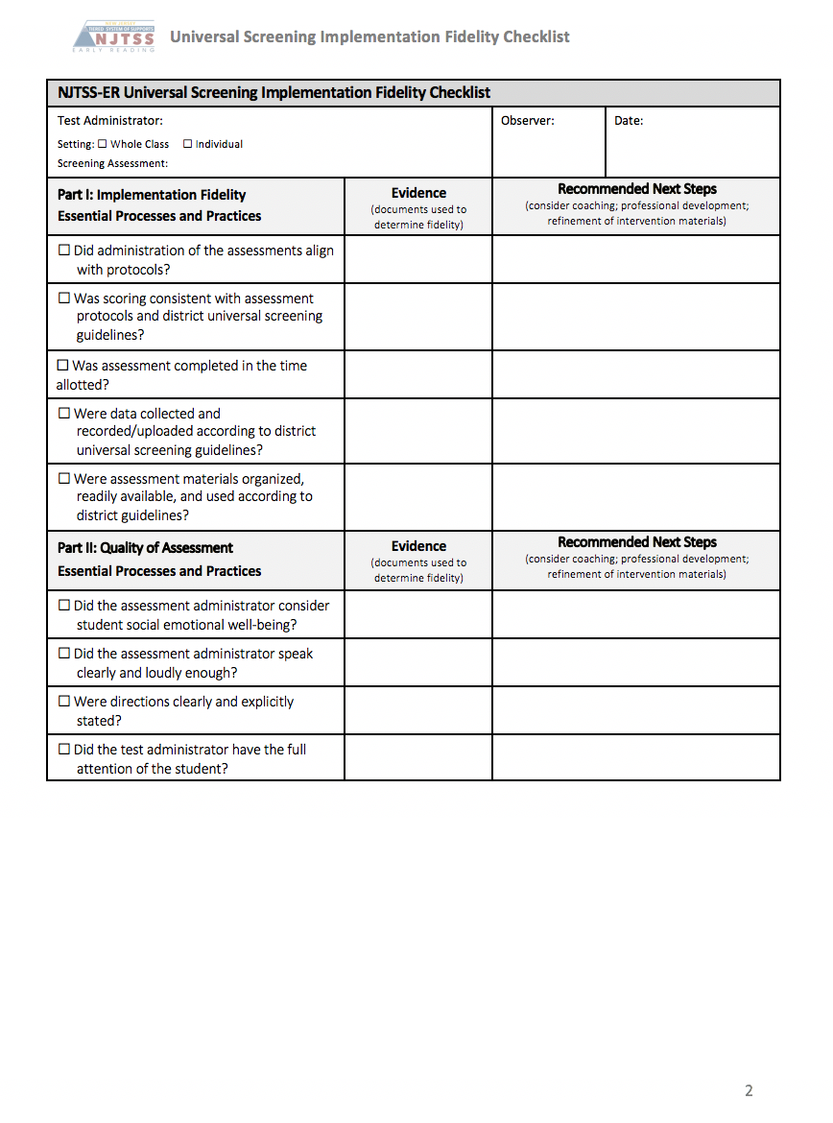
Action Plans and Meeting Protocols
Notes:
The meeting protocols also provide links to protocols, tools, and online learning courses to help districts operationalize implementation of each component.

Slide 30
NJTSS-ER District
Leadership Team
Notes:
Because we know that locally-led implementation of NJTSS-ER promotes long-term sustainability of systems change, district leadership teams play a crucial role in effective NJTSS-ER implementation. In order for districts to implement this work, It’s important that districts identify who in their district team is responsible for facilitating this work.

Slide 31
Selecting Leadership Team Members
Systems Change Leader |  | NJTSS-ER Facilitator |  | Content Experts
Has authority to oversee process for: Reviewing the NJTSS-ER Component Overviews; Evaluating district capacity and receptivity to this work; Problem solving ways for improving district capacity and receptivity to this work; and Training essential personnel for foundational knowledge building |  | Has authority to: Collaborate with the Systems Change Leader to identify Content Experts for implementing key actions; Facilitate NJTSS-ER meetings using NJTSS-ER Meeting Protocols; Monitor completion of the NJTSS-ER Action Plan and coordinate regularly with the Systems Change Leader to manage progress of key actions and deliverables; and Identify training needs for Content Experts to build content expertise |  | Must have expertise in: The function and purpose of early reading assessments; Characteristics of evidence-based skill-focused early-reading instruction; Evidence-based practices for assessing and intervening with students both with and without disabilities; and Implementing instructional supports and addressing barriers
Examples: Assistant Superintendent, Director of Curriculum, English Language Arts Supervisor |  | Examples: English Language Arts Supervisor; Instructional Coach, Reading Specialist |  | Examples: Director of Curriculum, English Language Arts Supervisor, Instructional Coach, Reading Specialist, Classroom Teacher, Interventionist
Notes:
There are three primary early reading leadership team roles that have been established in NJTSS-ER:

Slide 32
Systems Change Leader |  | NJTSS-ER Facilitator |  | Content Experts
Has authority to oversee process for: Reviewing the NJTSS-ER Component Overviews; Evaluating district capacity and receptivity to this work; Problem solving ways for improving district capacity and receptivity to this work; and Training essential personnel for foundational knowledge building |  | Has authority to: Collaborate with the Systems Change Leader to identify Content Experts for implementing key actions; Facilitate NJTSS-ER meetings using NJTSS-ER Meeting Protocols; Monitor completion of the NJTSS-ER Action Plan and coordinate regularly with the Systems Change Leader to manage progress of key actions and deliverables; and Identify training needs for Content Experts to build content expertise |  | Must have expertise in: The function and purpose of early reading assessments; Characteristics of evidence-based skill-focused early-reading instruction; Evidence-based practices for assessing and intervening with students both with and without disabilities; and Implementing instructional supports and addressing barriers
Examples: Assistant Superintendent, Director of Curriculum, English Language Arts Supervisor |  | Examples: English Language Arts Supervisor; Instructional Coach, Reading Specialist |  | Examples: Director of Curriculum, English Language Arts Supervisor, Instructional Coach, Reading Specialist, Classroom Teacher, Interventionist
Notes:
a Systems Change Leader, an NJTSS-ER Facilitator, and Content Experts.

Slide 33
Selecting Leadership Team Members
Systems Change Leader |  | NJTSS-ER Facilitator |  | Content Experts
Has authority to oversee process for: Reviewing the NJTSS-ER Component Overviews; Evaluating district capacity and receptivity to this work; Problem solving ways for improving district capacity and receptivity to this work; and Training essential personnel for foundational knowledge building |  | Has authority to: Collaborate with the Systems Change Leader to identify Content Experts for implementing key actions; Facilitate NJTSS-ER meetings using NJTSS-ER Meeting Protocols; Monitor completion of the NJTSS-ER Action Plan and coordinate regularly with the Systems Change Leader to manage progress of key actions and deliverables; and Identify training needs for Content Experts to build content expertise |  | Must have expertise in: The function and purpose of early reading assessments; Characteristics of evidence-based skill-focused early-reading instruction; Evidence-based practices for assessing and intervening with students both with and without disabilities; and Implementing instructional supports and addressing barriers
Examples: Assistant Superintendent, Director of Curriculum, English Language Arts Supervisor |  | Examples: English Language Arts Supervisor; Instructional Coach, Reading Specialist |  | Examples: Director of Curriculum, English Language Arts Supervisor, Instructional Coach, Reading Specialist, Classroom Teacher, Interventionist
Notes:
It is the function of each of these roles, more so than the titles of the

Slide 34
Selecting Leadership Team Members
Systems Change Leader |  | NJTSS-ER Facilitator |  | Content Experts
Has authority to oversee process for: Reviewing the NJTSS-ER Component Overviews; Evaluating district capacity and receptivity to this work; Problem solving ways for improving district capacity and receptivity to this work; and Training essential personnel for foundational knowledge building |  | Has authority to: Collaborate with the Systems Change Leader to identify Content Experts for implementing key actions; Facilitate NJTSS-ER meetings using NJTSS-ER Meeting Protocols; Monitor completion of the NJTSS-ER Action Plan and coordinate regularly with the Systems Change Leader to manage progress of key actions and deliverables; and Identify training needs for Content Experts to build content expertise |  | Must have expertise in: The function and purpose of early reading assessments; Characteristics of evidence-based skill-focused early-reading instruction; Evidence-based practices for assessing and intervening with students both with and without disabilities; and Implementing instructional supports and addressing barriers
Examples: Assistant Superintendent, Director of Curriculum, English Language Arts Supervisor |  | Examples: English Language Arts Supervisor; Instructional Coach, Reading Specialist |  | Examples: Director of Curriculum, English Language Arts Supervisor, Instructional Coach, Reading Specialist, Classroom Teacher, Interventionist
Notes:
personnel that are essential to the effective action planning, capacity building, and integration of the framework. Individuals may be well positioned to be assigned to different roles at different times depending on their level of authority, capacity and expertise.

Slide 35
Selecting Leadership Team Members
Systems Change Leader |  | NJTSS-ER Facilitator |  | Content Experts
Has authority to oversee process for: Reviewing the NJTSS-ER Component Overviews; Evaluating district capacity and receptivity to this work; Problem solving ways for improving district capacity and receptivity to this work; and Training essential personnel for foundational knowledge building |  | Has authority to: Collaborate with the Systems Change Leader to identify Content Experts for implementing key actions; Facilitate NJTSS-ER meetings using NJTSS-ER Meeting Protocols; Monitor completion of the NJTSS-ER Action Plan and coordinate regularly with the Systems Change Leader to manage progress of key actions and deliverables; and Identify training needs for Content Experts to build content expertise |  | Must have expertise in: The function and purpose of early reading assessments; Characteristics of evidence-based skill-focused early-reading instruction; Evidence-based practices for assessing and intervening with students both with and without disabilities; and Implementing instructional supports and addressing barriers
Examples: Assistant Superintendent, Director of Curriculum, English Language Arts Supervisor |  | Examples: English Language Arts Supervisor; Instructional Coach, Reading Specialist |  | Examples: Director of Curriculum, English Language Arts Supervisor, Instructional Coach, Reading Specialist, Classroom Teacher, Interventionist
Notes:
For example, an English Language Arts supervisor may serve as a Systems Change Leader, a NJTSS-ER Facilitator and/or as a Content Expert. Team building is dependent on district resources, such as personnel and time.

Slide 36
NJTSS-ER Roadmap
Notes:
It takes time to appropriately integrate each essential component of NJTSS-ER into schools. Within multiple phases, district leadership team members engage in a staged approach to integrating NJTSS-ER components into schools.

Slide 37
NJTSS-ER Roadmap
 | Foundational Knowledge | Universal Screening | Tier 1 Instruction | Diagnostics | Tier 2 & 3 Intervention | Progress Monitoring
Phase 1 | • Team-Based Early Prevention Model • Assessment & Data-Based Decision Making • Research-Based Priority Early Reading Skills
Phase 2 |  | Stage 1: PREPARE Stage 2: ESTABLISH Stage 3: INSTALL Stage 4: IMPLEMENT Stage 5: EVALUATE & REFINE | Stage 1: PREPARE Stage 2: ESTABLISH Stage 3: INSTALL
Phase3 |  |  | Stage 4: IMPLEMENT Stage 5: EVALUATE & REFINE | Stage 1: PREPARE Stage 2: ESTABLISH Stage 3: INSTALL Stage 4: IMPLEMENT | Stage 1: PREPARE Stage 2: ESTABLISH
Phase 4 |  |  |  | Stage 5: EVALUATE & REFINE | Stage 3: INSTALL Stage 4: IMPLEMENT Stage 5: EVALUATE & REFINE
Notes:
NJTSS-ER is designed to be integrated in phases,

Slide 38
NJTSS-ER Roadmap
 | Foundational Knowledge | Universal Screening | Tier 1 Instruction | Diagnostics | Tier 2 & 3 Intervention | Progress Monitoring
Phase 1 | • Team-Based Early Prevention Model • Assessment & Data-Based Decision Making • Research-Based Priority Early Reading Skills
Phase 2 |  | Stage 1: PREPARE Stage 2: ESTABLISH Stage 3: INSTALL Stage 4: IMPLEMENT Stage 5: EVALUATE & REFINE | Stage 1: PREPARE Stage 2: ESTABLISH Stage 3: INSTALL
Phase3 |  |  | Stage 4: IMPLEMENT Stage 5: EVALUATE & REFINE | Stage 1: PREPARE Stage 2: ESTABLISH Stage 3: INSTALL Stage 4: IMPLEMENT | Stage 1: PREPARE Stage 2: ESTABLISH
Phase 4 |  |  |  | Stage 5: EVALUATE & REFINE | Stage 3: INSTALL Stage 4: IMPLEMENT Stage 5: EVALUATE & REFINE
Notes:
which prioritizes an order for introducing component stages of NJTSS-ER.

Slide 39
NJTSS-ER Roadmap
 | Foundational Knowledge | Universal Screening | Tier 1 Instruction | Diagnostics | Tier 2 & 3 Intervention | Progress Monitoring
Phase 1 | • Team-Based Early Prevention Model • Assessment & Data-Based Decision Making • Research-Based Priority Early Reading Skills
Phase 2 |  | Stage 1: PREPARE Stage 2: ESTABLISH Stage 3: INSTALL Stage 4: IMPLEMENT Stage 5: EVALUATE & REFINE | Stage 1: PREPARE Stage 2: ESTABLISH Stage 3: INSTALL
Phase3 |  |  | Stage 4: IMPLEMENT Stage 5: EVALUATE & REFINE | Stage 1: PREPARE Stage 2: ESTABLISH Stage 3: INSTALL Stage 4: IMPLEMENT | Stage 1: PREPARE Stage 2: ESTABLISH
Phase 4 |  |  |  | Stage 5: EVALUATE & REFINE | Stage 3: INSTALL Stage 4: IMPLEMENT Stage 5: EVALUATE & REFINE
Notes:
The work in each phase

Slide 40
NJTSS-ER Roadmap
 | Foundational Knowledge | Universal Screening | Tier 1 Instruction | Diagnostics | Tier 2 & 3 Intervention | Progress Monitoring
Phase 1 | • Team-Based Early Prevention Model • Assessment & Data-Based Decision Making • Research-Based Priority Early Reading Skills
Phase 2 |  | Stage 1: PREPARE Stage 2: ESTABLISH Stage 3: INSTALL Stage 4: IMPLEMENT Stage 5: EVALUATE & REFINE | Stage 1: PREPARE Stage 2: ESTABLISH Stage 3: INSTALL
Phase3 |  |  | Stage 4: IMPLEMENT Stage 5: EVALUATE & REFINE | Stage 1: PREPARE Stage 2: ESTABLISH Stage 3: INSTALL Stage 4: IMPLEMENT | Stage 1: PREPARE Stage 2: ESTABLISH
Phase 4 |  |  |  | Stage 5: EVALUATE & REFINE | Stage 3: INSTALL Stage 4: IMPLEMENT Stage 5: EVALUATE & REFINE
Notes:
is completed

Slide 41
NJTSS-ER Roadmap
 | Foundational Knowledge | Universal Screening | Tier 1 Instruction | Diagnostics | Tier 2 & 3 Intervention | Progress Monitoring
Phase 1 | • Team-Based Early Prevention Model • Assessment & Data-Based Decision Making • Research-Based Priority Early Reading Skills
Phase 2 |  | Stage 1: PREPARE Stage 2: ESTABLISH Stage 3: INSTALL Stage 4: IMPLEMENT Stage 5: EVALUATE & REFINE | Stage 1: PREPARE Stage 2: ESTABLISH Stage 3: INSTALL
Phase3 |  |  | Stage 4: IMPLEMENT Stage 5: EVALUATE & REFINE | Stage 1: PREPARE Stage 2: ESTABLISH Stage 3: INSTALL Stage 4: IMPLEMENT | Stage 1: PREPARE Stage 2: ESTABLISH
Phase 4 |  |  |  | Stage 5: EVALUATE & REFINE | Stage 3: INSTALL Stage 4: IMPLEMENT Stage 5: EVALUATE & REFINE
Notes:
before moving on

Slide 42
NJTSS-ER Roadmap
 | Foundational Knowledge | Universal Screening | Tier 1 Instruction | Diagnostics | Tier 2 & 3 Intervention | Progress Monitoring
Phase 1 | • Team-Based Early Prevention Model • Assessment & Data-Based Decision Making • Research-Based Priority Early Reading Skills
Phase 2 |  | Stage 1: PREPARE Stage 2: ESTABLISH Stage 3: INSTALL Stage 4: IMPLEMENT Stage 5: EVALUATE & REFINE | Stage 1: PREPARE Stage 2: ESTABLISH Stage 3: INSTALL
Phase3 |  |  | Stage 4: IMPLEMENT Stage 5: EVALUATE & REFINE | Stage 1: PREPARE Stage 2: ESTABLISH Stage 3: INSTALL Stage 4: IMPLEMENT | Stage 1: PREPARE Stage 2: ESTABLISH
Phase 4 |  |  |  | Stage 5: EVALUATE & REFINE | Stage 3: INSTALL Stage 4: IMPLEMENT Stage 5: EVALUATE & REFINE
Notes:
to the next. Once integrated, stages repeat as part of data-guided implementation.

Slide 43
NJTSS-ER Roadmap
 | Foundational Knowledge | Universal Screening | Tier 1 Instruction | Diagnostics | Tier 2 & 3 Intervention | Progress Monitoring
Phase 1 | • Team-Based Early Prevention Model • Assessment & Data-Based Decision Making • Research-Based Priority Early Reading Skills
Phase 2 |  | Stage 1: PREPARE Stage 2: ESTABLISH Stage 3: INSTALL Stage 4: IMPLEMENT Stage 5: EVALUATE & REFINE | Stage 1: PREPARE Stage 2: ESTABLISH Stage 3: INSTALL
Phase3 |  |  | Stage 4: IMPLEMENT Stage 5: EVALUATE & REFINE | Stage 1: PREPARE Stage 2: ESTABLISH Stage 3: INSTALL Stage 4: IMPLEMENT | Stage 1: PREPARE Stage 2: ESTABLISH
Phase 4 |  |  |  | Stage 5: EVALUATE & REFINE | Stage 3: INSTALL Stage 4: IMPLEMENT Stage 5: EVALUATE & REFINE
Notes:
This roadmap and the accompanying resources and supports provide districts with guidance in building a robust system over time to improve the early reading achievement of all students.

Slide 44
NJTSS-ER Website
Notes:
The NJTSS-ER Website is available to all New Jersey school districts to access framework resources.

Slide 45
Action Plans and Meeting Protocols
Notes:
We provide the framework resources to our cohort districts receiving Level 3, consultative supports. Capacity building resources aligned to the NJTSS-ER framework are available to all New Jersey school districts, through the njtss-er website.

Slide 46
NJTSS-ER Website
https://www.njtss-earlyreading.org/
Notes:
Let’s go to the website now.

Slide 47
Q&A
Notes:
This concludes our NJTSS-ER grant project overview. We will now open the meeting up to any questions you may have.

